Slide 1

Ansible
Introduction in 30 min

Slide 2
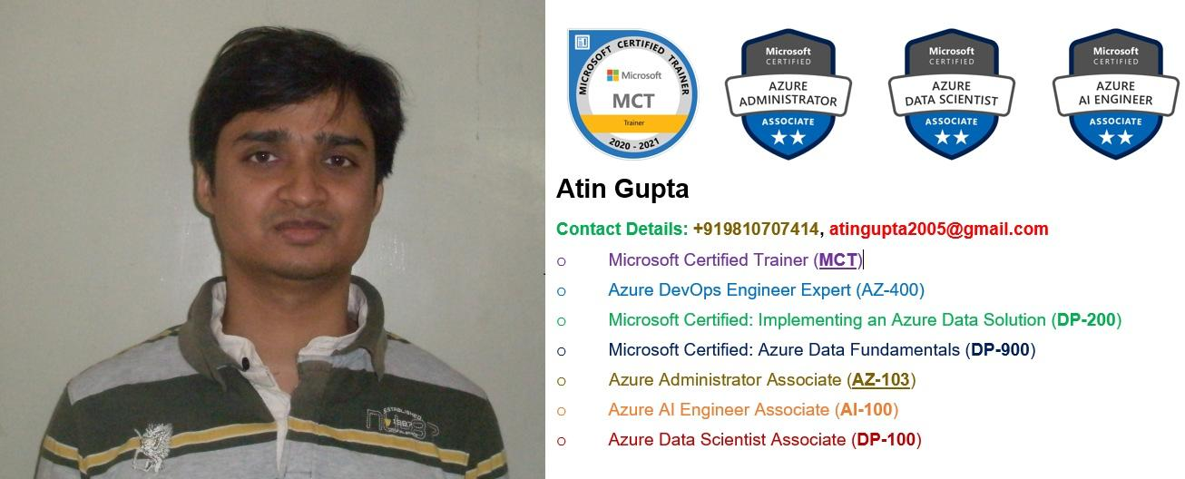
About Trainer
https://www.linkedin.com/in/profileatingupta

Slide 3
References
Join LinkedIn Group for this and future sessions:
https://www.linkedin.com/groups/9020506/
Sessions done till now:
21-Feb-2021: Terraform on AWS
7-Feb-2021: Azure Data Factory

Slide 4




Why tools like Ansible?
Every day the same routine:
Customize OS
Update packages
Apply security patches
Fine tune the configuration
Manually deploy apps
All subject to
Human failures
Time consuming
Repeatable task for multiple machines
Lack of documentation

Slide 5
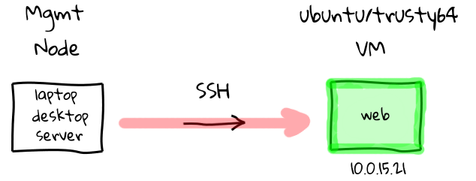
Before Configuration Management

Slide 6
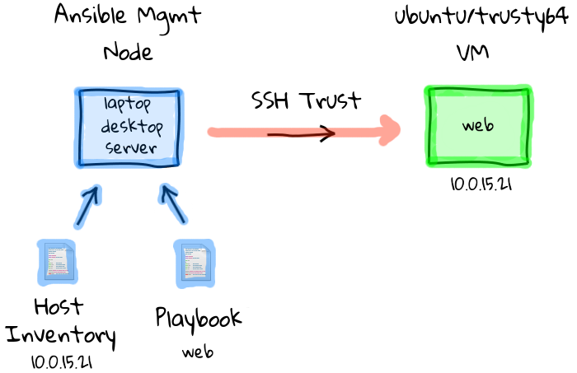
With Configuration Management

Slide 7
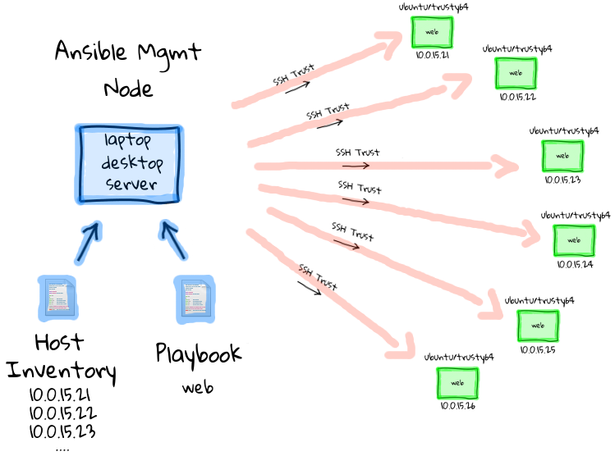
With Configuration Management

Slide 8
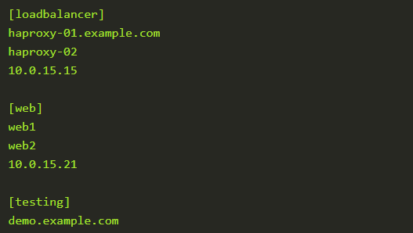
Hosts Inventory

Slide 9
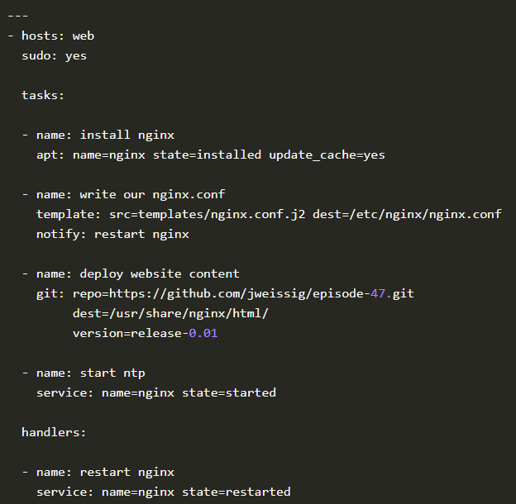
Playbooks
Outline tasks that should be performed against hosts in the hosts inventory

Slide 10

Hands-On

Slide 11
Thanks

