Slide 1

Ansible
Introduction

Slide 2




Why tools like Ansible?
Every day the same routine:
Customize OS
Update packages
Apply security patches
Fine tune the configuration
Manually deploy apps
All subject to
Human failures
Time consuming
Repeatable task for multiple machines
Lack of documentation

Slide 3
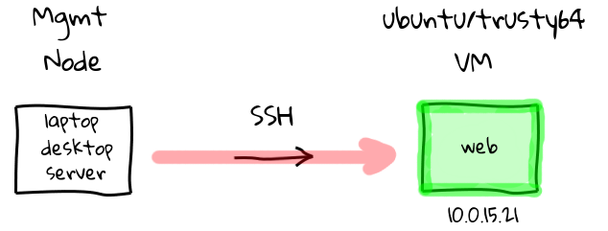
Before Configuration Management

Slide 4
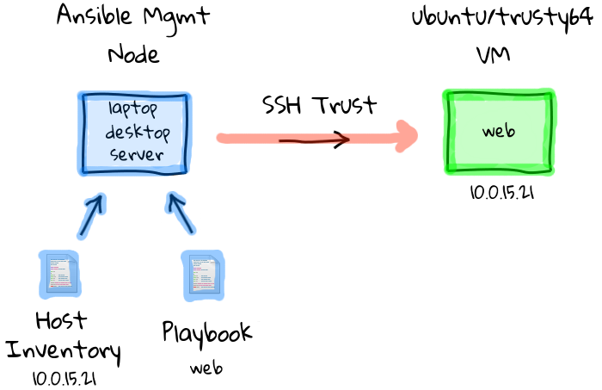
With Configuration Management

Slide 5
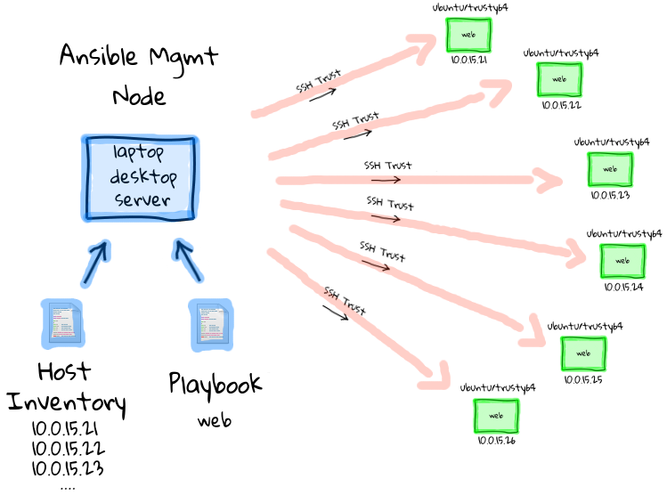
With Configuration Management

Slide 6
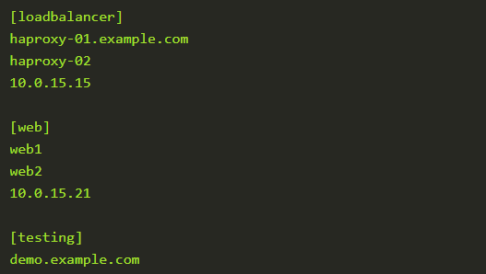
Hosts Inventory

Slide 7
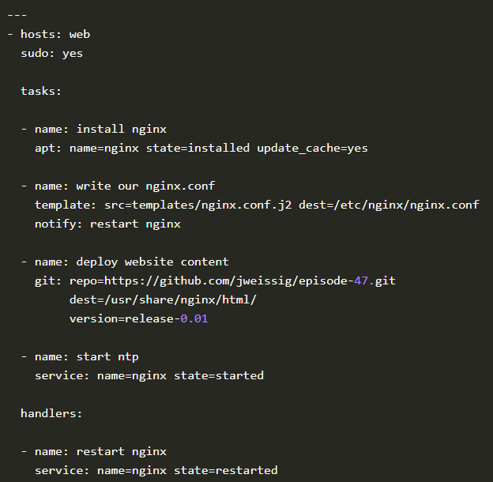
Playbooks
Outline tasks that should be performed against hosts in the hosts inventory

Slide 8

Hands-On

Slide 9
Hands-On
Refer:
https://github.com/atingupta2005/ansible-demo

Slide 10
Thanks

