Slide 1

Cosmos DB - Plan Resource Requirements

Slide 2
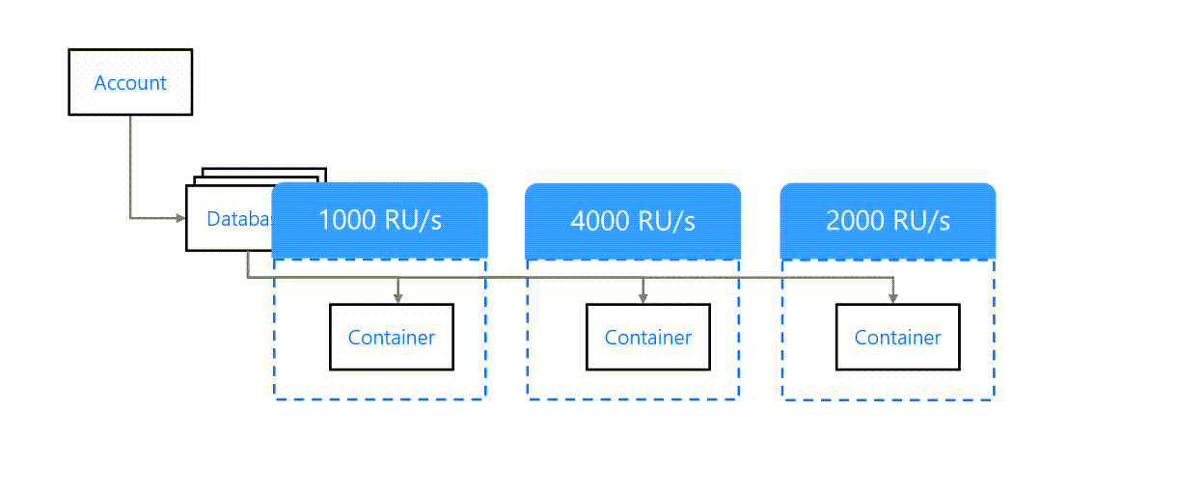
What is throughput
Each container is a unit of scalability for both throughput and storage.
Can provision throughput at
Database levels
Container levels

Slide 3
Container-level throughput provisioning

Slide 4
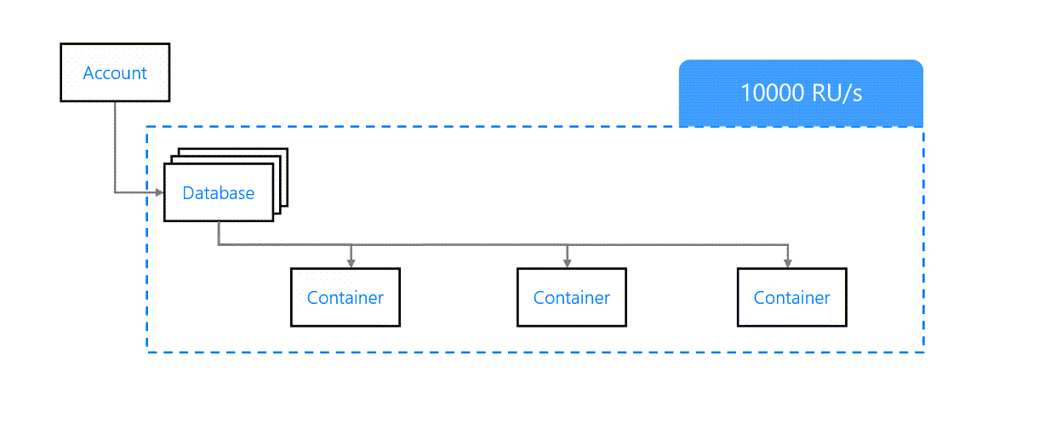
Database-level throughput provisioning

Slide 5
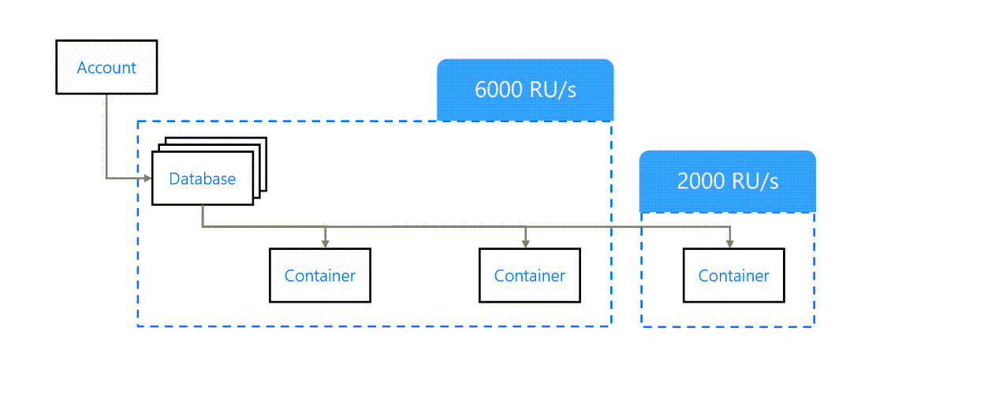
Mixed-throughput provisioning

Slide 6
Evaluate throughput requirements
Request units are a rate-based currency.
Every request consumes a fixed number of request units, including but not limited to:
Reads
Writes
Queries
Stored procedures

Slide 7
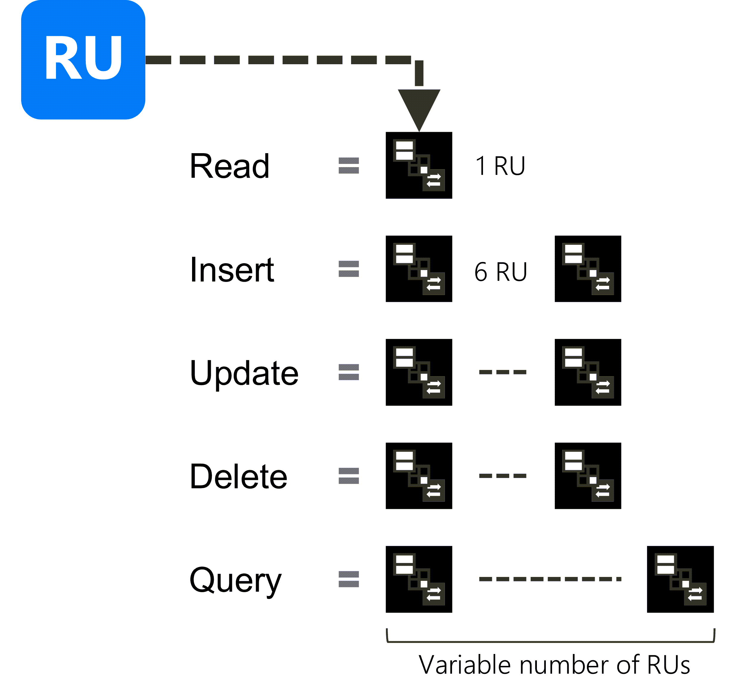
Estimating ad-hoc RU/s consumption

Slide 8
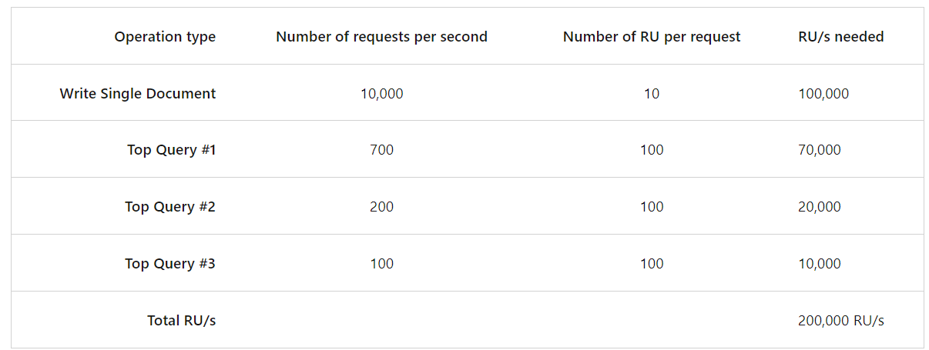
Estimating ad-hoc RU/s consumption
You can use a spreadsheet application to build a quick table to figure out a rough estimate of your needed request unit capacity

Slide 9
Evaluate data storage requirements
Use Azure Cosmos DB Capacity Calculator
https://cosmos.azure.com/capacitycalculator/
The calculator will inquire about details such as:
Total data stored
Whether you expect to perform near real-time analytics
The anticipated size of documents
Point reads per second
Queries per second

Slide 10
TTL
The length of time documents live in the database before being automatically purged.
TTL value is defined as an integer in seconds.

Slide 11
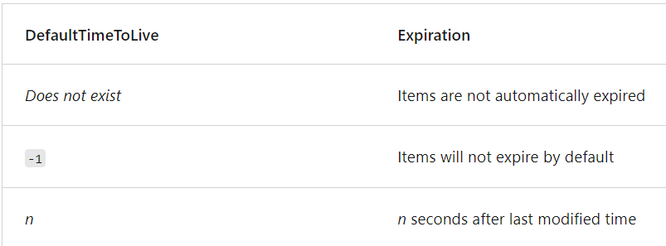
Configuring TTL on a container
Configured using the DefaultTimeToLive property of the container's JSON object.

Slide 12
Configuring TTL on a container
The TTL value for an item is configured by setting the ttl path of the item
The TTL value for an item will only work if the DefaultTimeToLive property is configured for the parent container
If the ttl path is configured for the item, it will override the DefaultTimeToLive property of the parent container.

Slide 13
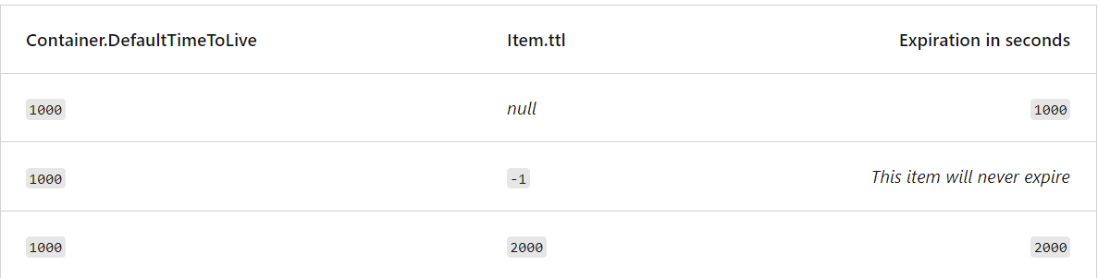
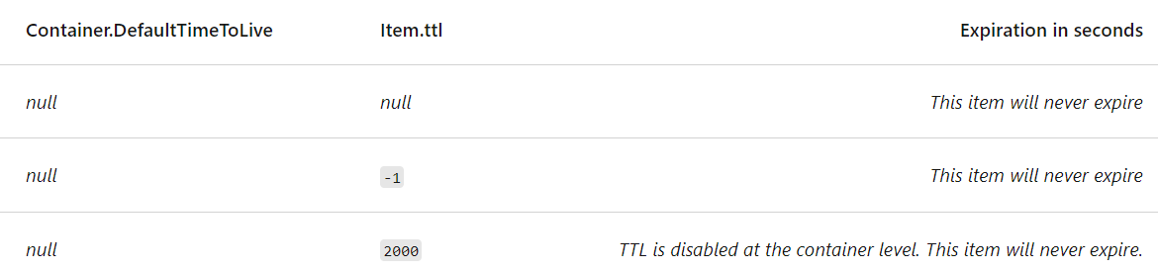
Configuring TTL on a container

Slide 14
Plan for data retention with TTL
Azure Cosmos DB only charges for storage you directly consume in real time
Don't have to pre-reserve storage in advance
In high-write scenarios, TTL values can be used to save on data storage costs in Azure Cosmos DB.
Consider solutions such to aggregate and migrate data such as:
Change feed
Azure Data Warehouse
Azure Blob Storage
When designing your solution, plan how long your data will need to be retained in Azure Cosmos DB before being migrated across your entire Azure solution space to minimize storage costs.

Slide 15
Thank You

