Slide 1

Configure Cosmos DB for NoSQL database & containers

Slide 2
Serverless
Consumption-based model where each request consumes request units
Serverless is great for applications with unpredictable or bursty traffic
You can use serverless with an application such as:
A new application with hard to forecast users loads
A new prototype application within your organization
Serverless compute integration with a service like Azure Functions
Just getting started with Azure Cosmos DB as a new developer
Low traffic application that doesn’t send or receive numerous data

Slide 3
Compare serverless vs. provisioned throughput
 | Provisioned Throughput | Serverless
Workloads | Ideal for workloads with predictable traffic patterns | Can handle workloads that have wildly varying traffic
Request Units | Makes some number of request units available each second to each container for database operations | Doesn’t require any planning or automatic provisioning
Global Distribution | Supports distributing your data to an unlimited number of Azure regions. | Can only run in a single Azure region.
Storage Limits | Allows you to store unlimited data in a container. | Only allows up to 50 GB of data in a container.

Slide 4
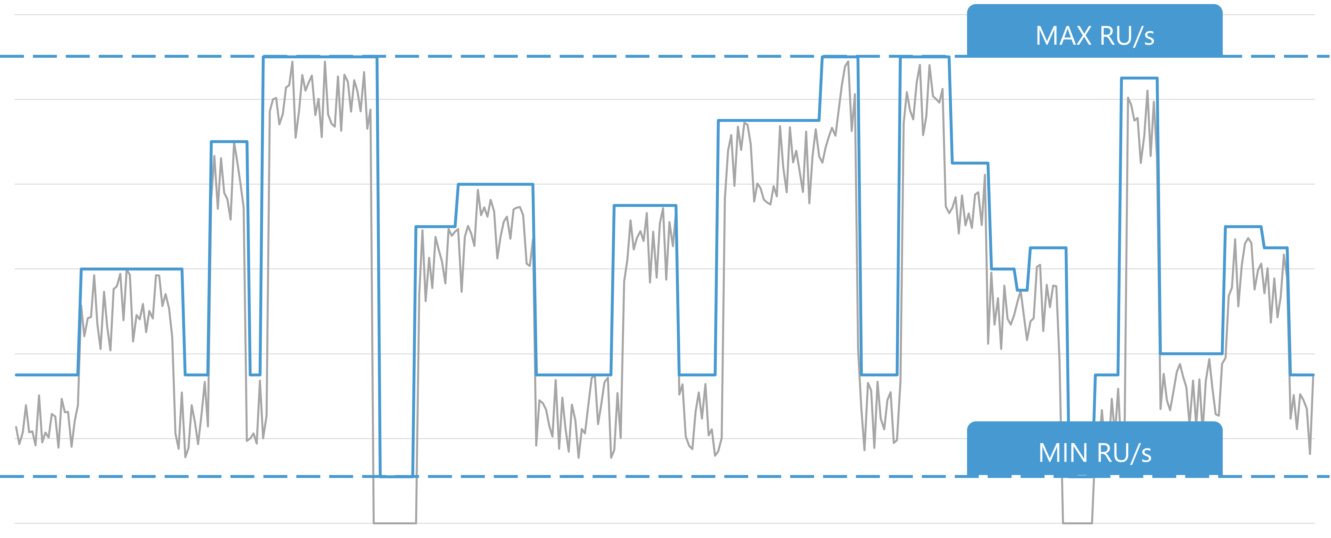
Autoscale throughput
Autoscale is great for workloads with variable or unpredictable traffic patterns and can minimize unused capacity that would typically be pre-provisioned.

Slide 5
Compare autoscale vs. standard (manual) throughput
 | Standard Throughput | Auto scale Throughput
Workloads | Ideal for workloads with predictable traffic patterns | Can handle workloads that have varying traffic
Request Units | Requires a static number of request units to be assigned ahead of time. | With autoscale, you only set the maximum, and the minimum billed will be 10% of the maximum when there are zero requests.
Scenarios | When your team can accurately predict the amount of throughput your application needs, | If your team cannot predict your throughput needs accurately
Rate-limiting | Will always remain static at the set RU/s that is provisioned. Requests beyond this will be rate-limited | Will scale up to the max RU/s before similarly rate-limiting responses

Slide 6
Migrate between standard and autoscale throughput
Existing containers can be migrated to and from autoscale
During the migration process, the system will automatically apply a request unit per second (RU/s) value to the container.

Slide 7
Exercise
Configure throughput for Azure Cosmos DB SQL API with the Azure portal

Slide 8
Thank You

