Slide 1

Perform cross-document transactional operations

Slide 2
Introduction
Create a transactional batch and review results
Implement optimistic concurrency control for an operation

Slide 3
Create a transactional batch with the SDK
Product saddle = new("0120", "Worn Saddle", "accessories-used");
Product handlebar = new("012A", "Rusty Handlebar", "accessories-used");
public record Product(string id, string name, string categoryId);
PartitionKey partitionKey = new ("accessories-used");
TransactionalBatch batch = container.CreateTransactionalBatch(partitionKey)
.CreateItem<Product>(saddle)
.CreateItem<Product>(handlebar);
using TransactionalBatchResponse response = await batch.ExecuteAsync();

Slide 4
Create a transactional batch with the SDK
The transactional batch supports operations with the same logical partition key.
Operations with different logical partition keys will fail. In the example below, the transactional batch will fail with a bad request due to having a different logical partition key.
Product saddle = new("0120", "Worn Saddle", "accessories-used");
Product handlebar = new("012C", "Pristine Handlebar", "accessories-new");
PartitionKey partitionKey = new ("accessories-used");
TransactionalBatch batch = container.CreateTransactionalBatch(partitionKey)
.CreateItem<Product>(saddle)
.CreateItem<Product>(handlebar);

Slide 5
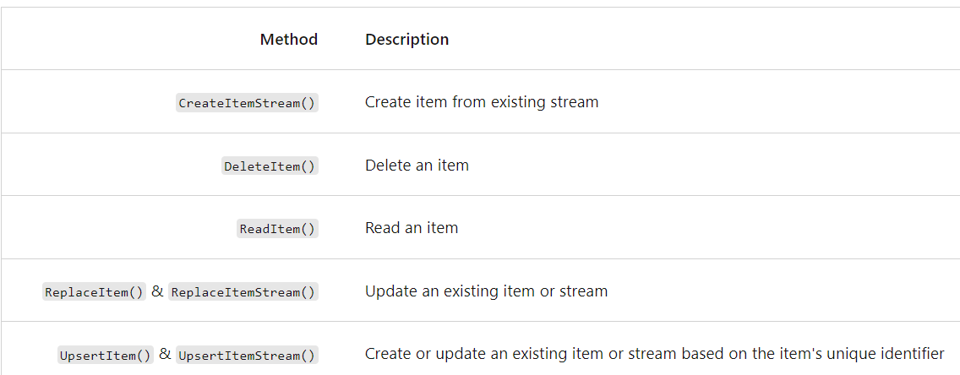
Create a transactional batch with the SDK
Transactional batch also supports a wide variety of operations using the fluent syntax including, but not limited to:

Slide 6
Review batch operation results with the SDK
The TransactionalBatchResponse class contains multiple members to interrogate the results of the batch operation.
response.StatusCode
batchResponse.IsSuccessStatusCode
The GetOperationResultAtIndex<> generic method returns the individual deserialized item at the index you specify.
TransactionalBatchOperationResult<Product> result = response.GetOperationResultAtIndex<Product>(0);
Product firstProductResult = result.Resource;
TransactionalBatchOperationResult<Product> result = response.GetOperationResultAtIndex<Product>(1);
Product secondProductResult = result.Resource;

Slide 7
Exercise
Batch multiple point operations together with the Azure Cosmos DB for NoSQL SDK

Slide 8
Implement optimistic concurrency control
Using the SDK to read an item and then update the same item in a subsequent operation carries some inherent risk.
Another operation could potentially come in from a separate client and change the underlying document before the first client’s update operation is finalized
This conflict could create a “lost update” situation.

Slide 9
Implement optimistic concurrency control
Here is a typical C# code example with a separate read and update operation.
string categoryId = "9603ca6c-9e28-4a02-9194-51cdb7fea816";
PartitionKey partitionKey = new (categoryId);
Product product = await container.ReadItemAsync<Product>("01AC0", partitionKey);
product.price = 50d;
await container.UpsertItemAsync<Product>(product, partitionKey);

Slide 10
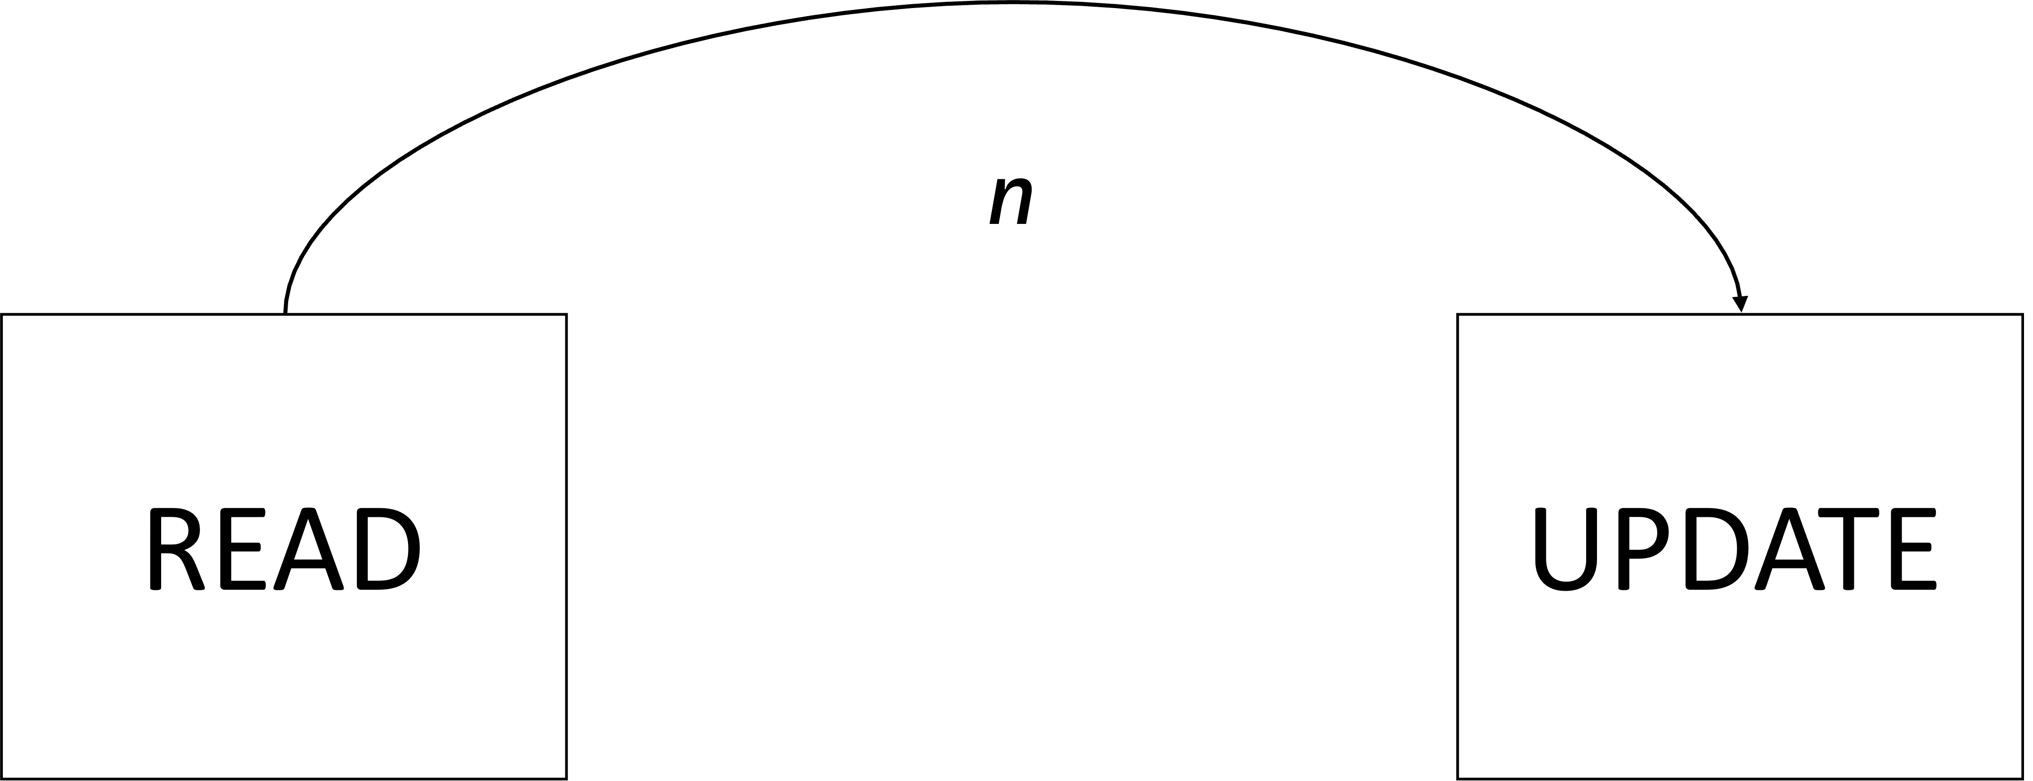
Implement optimistic concurrency control
Since read and write in this example are distinct operations, there is a latency between these operations. This latency is represented in this diagram as n.

Slide 11
Implement optimistic concurrency control
This issue can be resolved by implementing optimistic concurrency control.
Each item has an ETag value. This value is updated when the item is updated.
To prevent lost updates, you can use the if-match rule to see if the ETag still matches the current ETag header of the item server-side as part of your update request.
string categoryId = "9603ca6c-9e28-4a02-9194-51cdb7fea816";
PartitionKey partitionKey = new (categoryId);
ItemResponse<Product> response = await container.ReadItemAsync<Product>("01AC0", partitionKey);
Product product = response.Resource;
string eTag = response.ETag;
product.price = 50d;
ItemRequestOptions options = new ItemRequestOptions { IfMatchEtag = eTag };
await container.UpsertItemAsync<Product>(product, partitionKey, requestOptions: options);

Slide 12
Thank You

