Slide 1
Docker Essentials
Notes:
https://courses.cs.washington.edu/courses/cse403/13au/lectures/git.ppt.pdf
http://enos.itcollege.ee/~jpoial/allalaadimised/git/getting-started-with-git.pdf

Slide 2
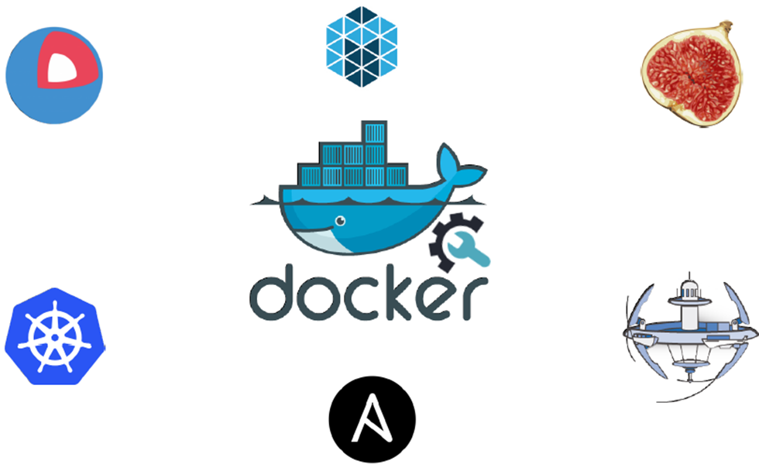
Docker

Slide 3
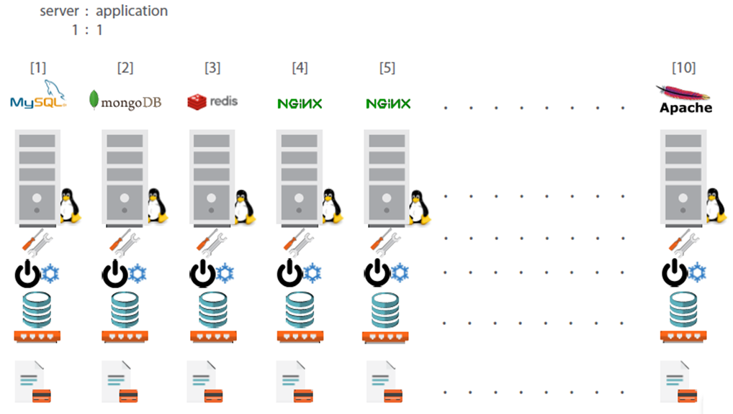
Traditional Deployment Architecture

Slide 4
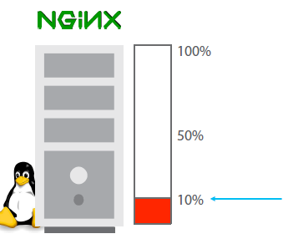
Less Utilization in Traditional Architecture

Slide 5
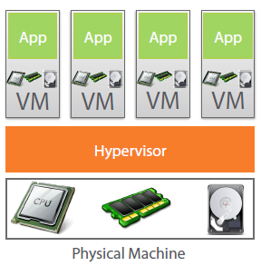
Virtual Machine to the Rescue

Slide 6
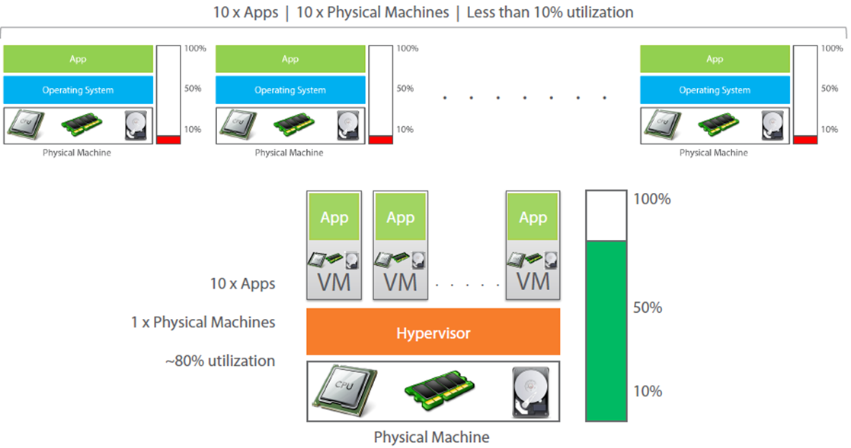
Virtual Machine provides better utilization

Slide 7
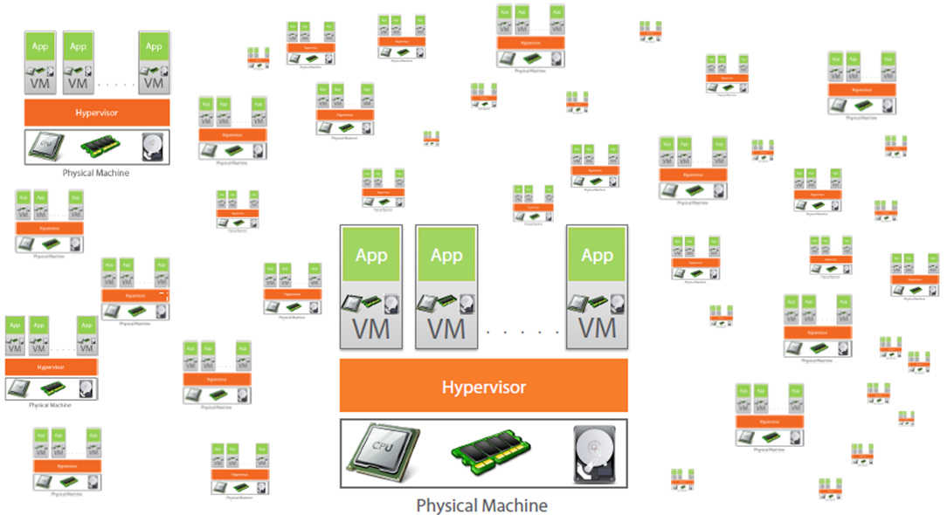
But Virtual Machine increases Licensing Cost

Slide 8
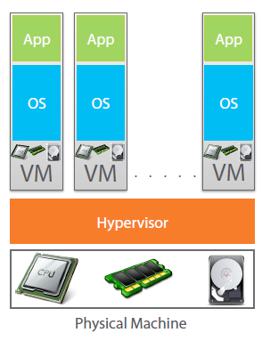
Each VM needs a separate OS

Slide 9
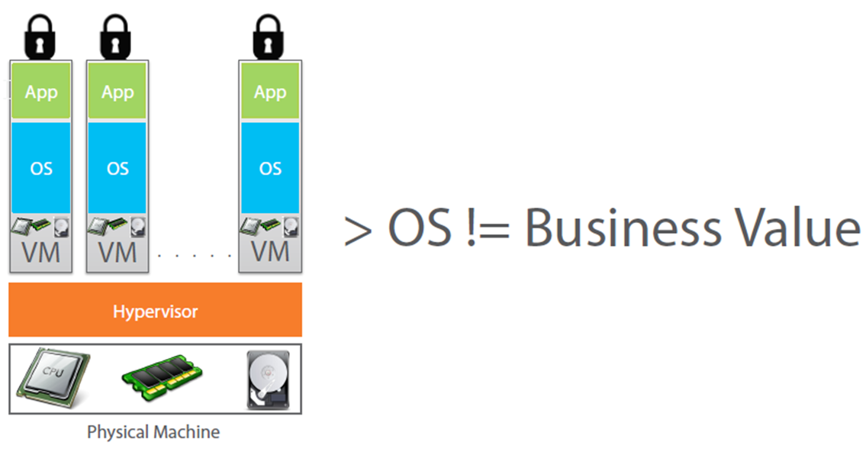
More OSes doesn’t increase Business Value

Slide 10
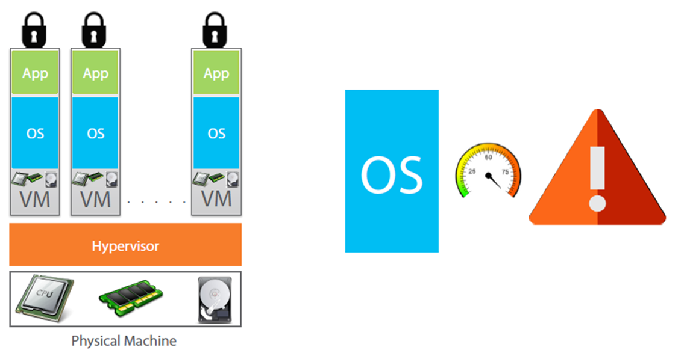
OS takes most of the Resources

Slide 11
Why use separate OS for each App?

Slide 12
Containerization
Encapsulation of an application and its required environment.
The process of packaging an application along with its required libraries, frameworks, and configuration files together so that it can be run in various computing environments efficiently.

Slide 13
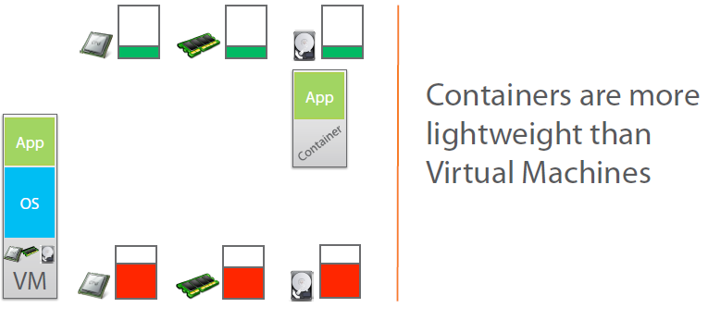
Containers to the Rescue

Slide 14
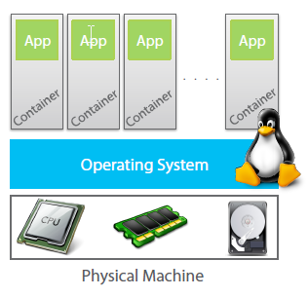
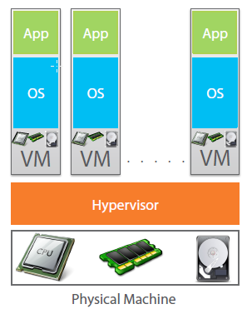
Containers vs VM

Slide 15
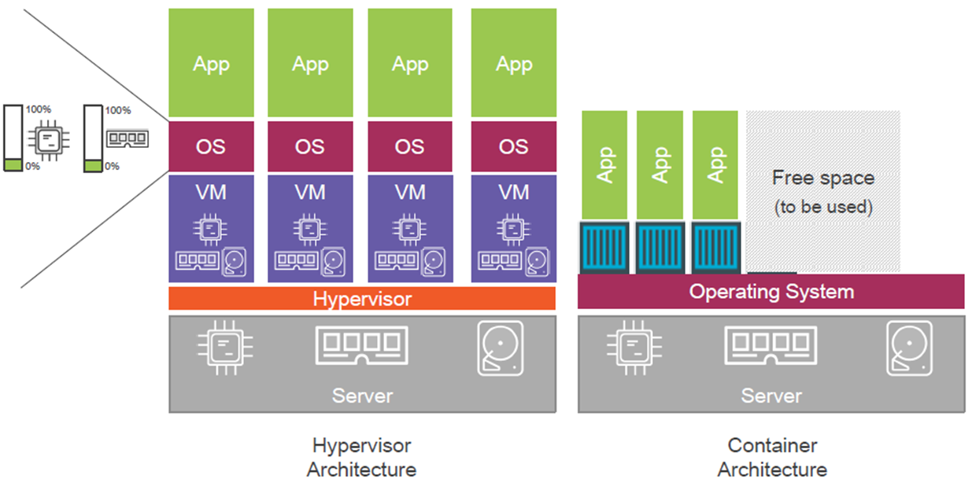
Containers vs VM

Slide 16
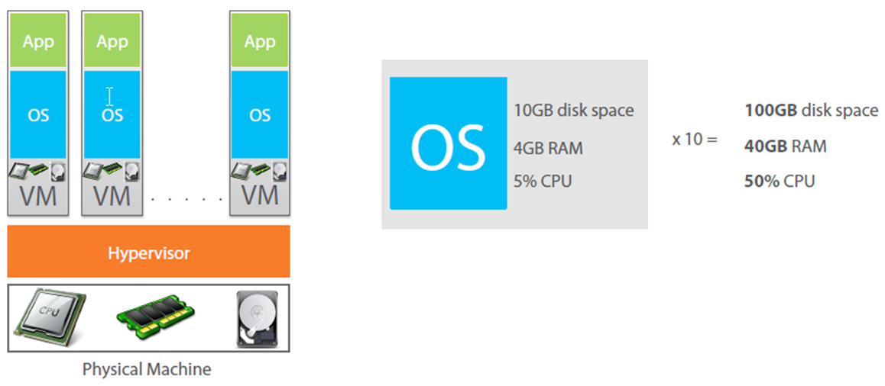
OS takes more resources and Licensing cost

Slide 17
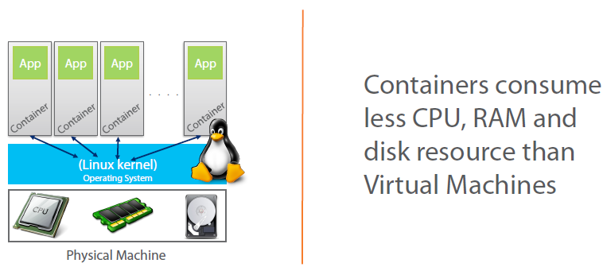
Containers takes less resources

Slide 18
What is Docker?
Docker is an open-source project
that automates the deployment of applications inside software containers,
by providing an additional layer of abstraction and
automation of operating system–level virtualization on Linux.

Slide 19
Practical

Slide 20
Practical Guide

Slide 21
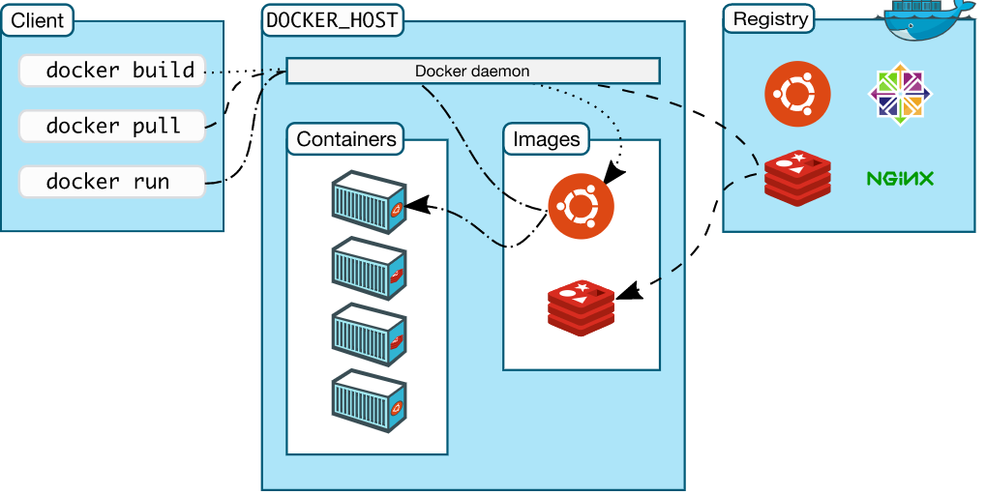
Docker Architecture

Slide 22
Image
Persisted snapshot that can be run
Common Docker Commands:
images: List all local images
run: Create a container from an image and execute a command in it
tag: Tag an image
pull: Download image from repository
rmi: Delete a local image

Slide 23
Container
Runnable instance of an image
Common Docker Commands
ps: List all running containers
ps –a: List all containers (incl. stopped)
top: Display processes of a container
start: Start a stopped container
stop: Stop a running container
pause: Pause all processes within a container
rm: Delete a container
commit: Create an image from a container

Slide 24
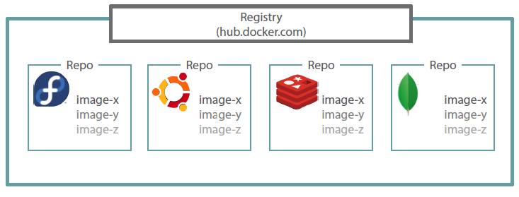
Docker Registry

Slide 25
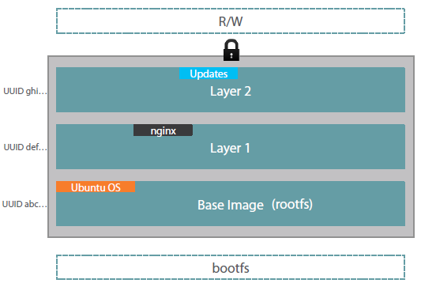
Layers in Images

Slide 26
Hands-On
We need to do the below hands-on:
ssh to Ubuntu server
Install Docker on Ubuntu 18.04
Validate docker engine is successfully installed
Launch a docker container
Login to container
Work in a container
List containers
Pause a container
Un-pause a container
Delete container
Refer to the command guide for instructions

Slide 27
Create Dockerized Application
We can dockerize our application using dockerfile
Dockerfile Create images automatically using a build script: «Dockerfile»
It Can be versioned in a version control system like Git
Docker Hub can automatically build images based on dockerfiles on Github
This is a basic Dockerfile we need to dockerize a node application
FROM node:4-onbuild
RUN mkdir /app
COPY . /app/
WORKDIR /app
RUN npm install
EXPOSE 8234
CMD [ "npm", "start" ]

Slide 28
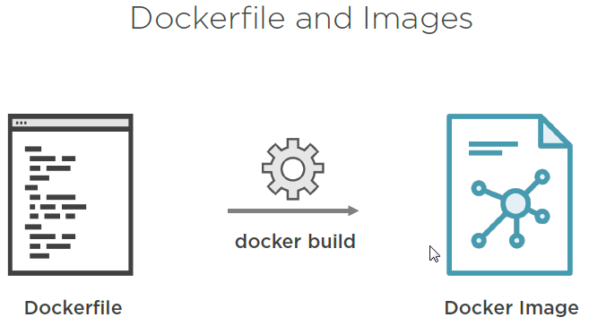
Dockerfile

Slide 29
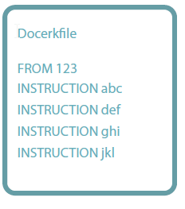
Dockerfile Template

Slide 30
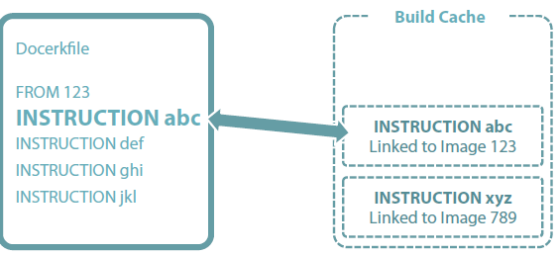
Dockerfile Build Cache

Slide 31
FROM node:4-onbuild
Pulls/downloads a base image from docker hub which is a public hub for docker images.
For running a node appication you need to install node in your system

Slide 32
RUN mkdir /app
In this command we make create an empty directory which will be our working directory with the code files.

Slide 33
COPY . /app/
Copies all files in current directory to the newly created app directory.
Your Dockerfile should be in the parent directory of your project.

Slide 34
WORKDIR /app
To switch from current directory to the app directory where we will run our application.

Slide 35
RUN npm install
This npm command is related to node application.
When we copied all dependencies, our main file - package.json would have been copied.
So running above command installs all dependencies from the file and creates a node_modules folder with mentioned node packages.

Slide 36
EXPOSE 8234
This command is to expose a port we want our docker image to run on.

Slide 37
CMD [ "npm", "start" ]
This is a command line operation to run a node application.
It may differ based on projects.

Slide 38
Build Image
Now once we have our Dockerfile ready lets build an image out of it.
Assuming you all have docker installed on your system lets follow some simple steps:-
Navigate to directory containing Dockerfile.
Run the following command on your terminal:-
docker build -t myimage .
docker images
docker run -p 8234:8234 'your image name'

Slide 39
Publish Port
docker run –t –p 8080:80 ubuntu
Map container port 80 to host port 8080
Notes:
https://docs.docker.com/network/links/

Slide 40
Docker Hub
Public repository of Docker images
https://hub.docker.com/
docker search [term]
Use my own registry
To pull from your own registry, substitute the host and port to your own:
docker login localhost:8080
docker pull 164.52.197.86 :5000/test-image

Slide 41
Clean Up
docker stop $(docker ps -a -q) #stop ALL containers
docker rm -f $(docker ps -a -q) # remove ALL containers

Slide 42


