Slide 1
Introduction to Kubernetes
Notes:
https://courses.cs.washington.edu/courses/cse403/13au/lectures/git.ppt.pdf
http://enos.itcollege.ee/~jpoial/allalaadimised/git/getting-started-with-git.pdf

Slide 2
Features

Slide 3
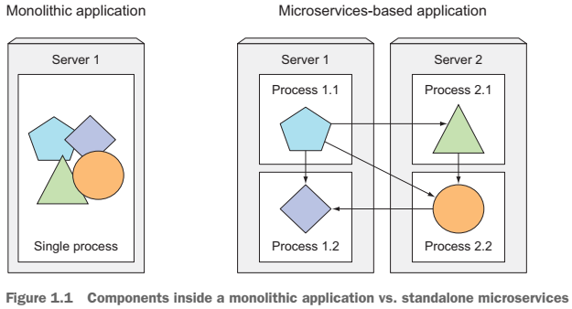

Slide 4
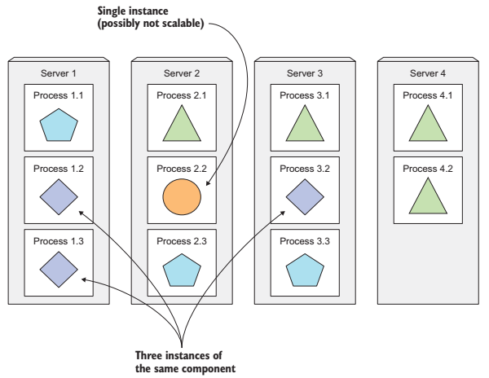

Slide 5
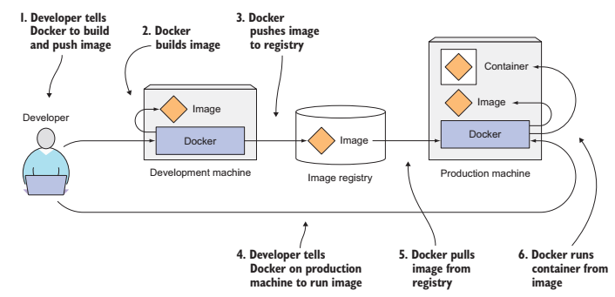

Slide 6
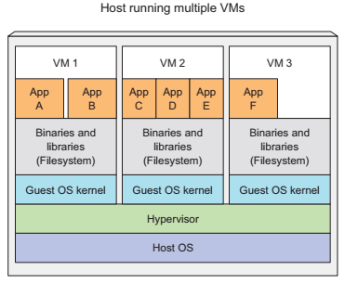
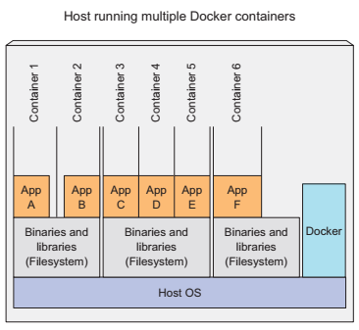

Slide 7
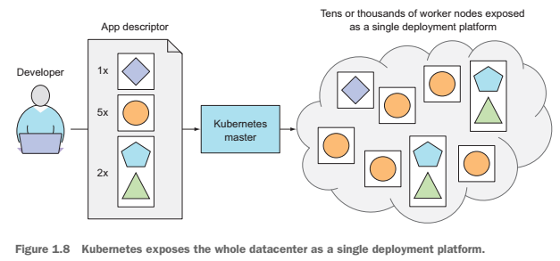

Slide 8
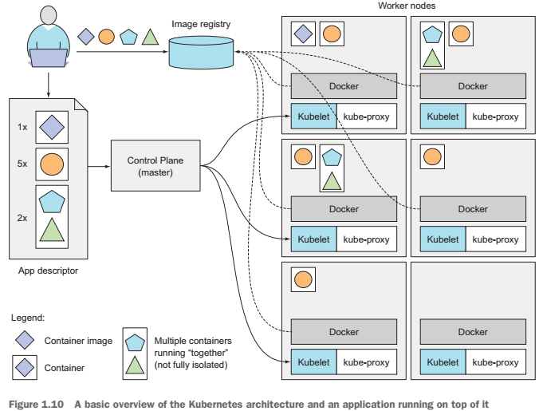

Slide 9
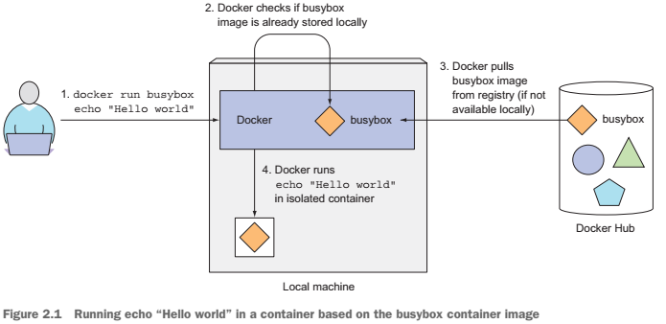

Slide 10
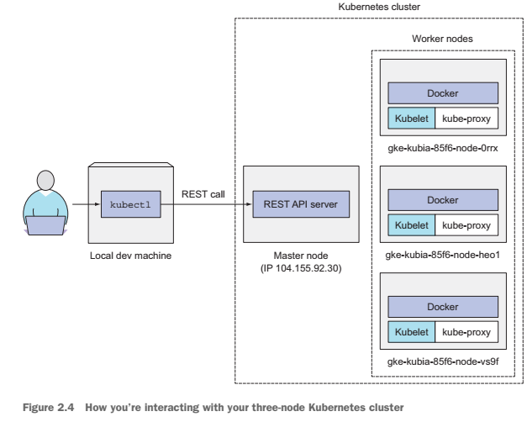

Slide 11
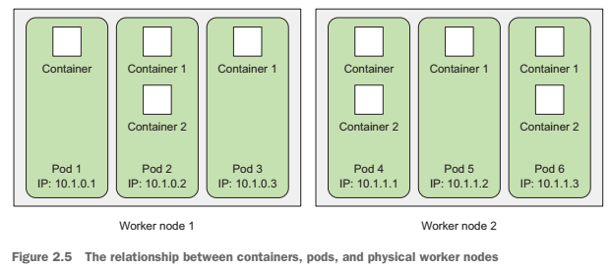

Slide 12
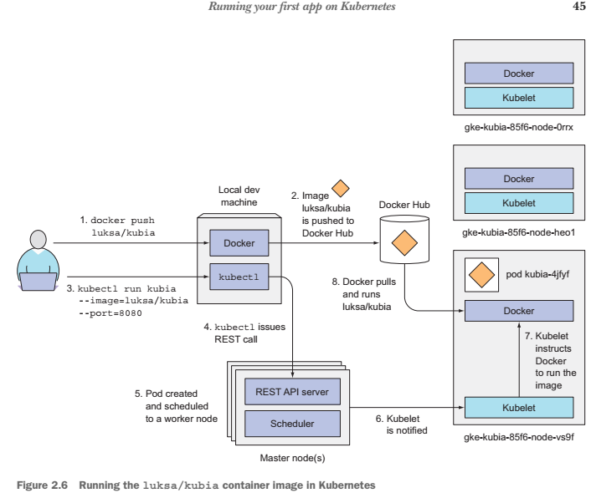

Slide 13
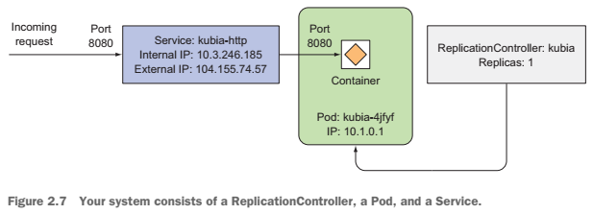

Slide 14
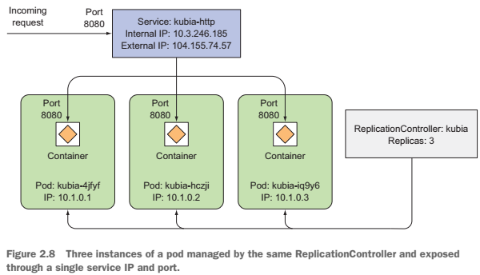

Slide 15
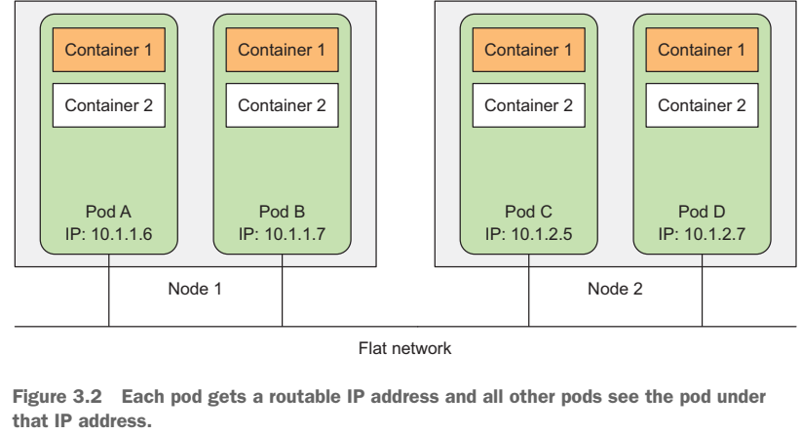

Slide 16
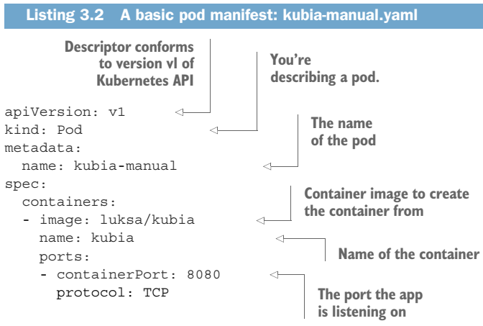

Slide 17
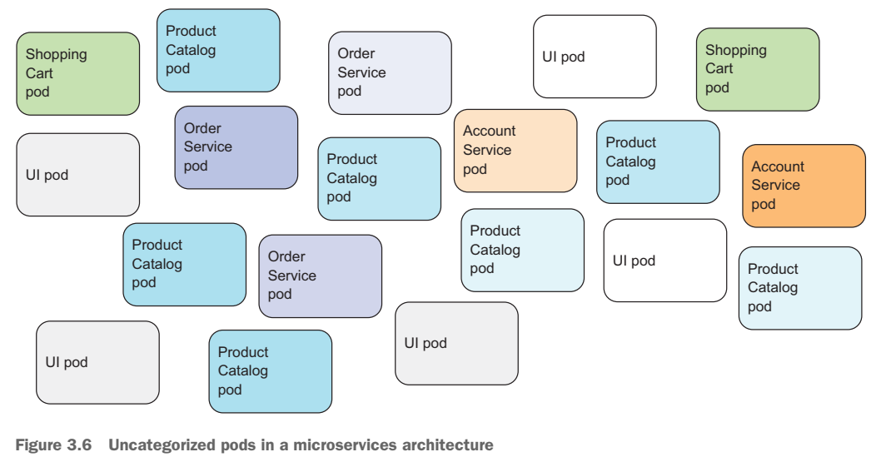

Slide 18
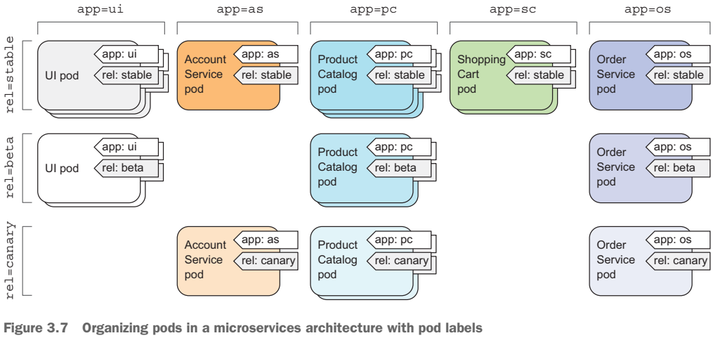

Slide 19
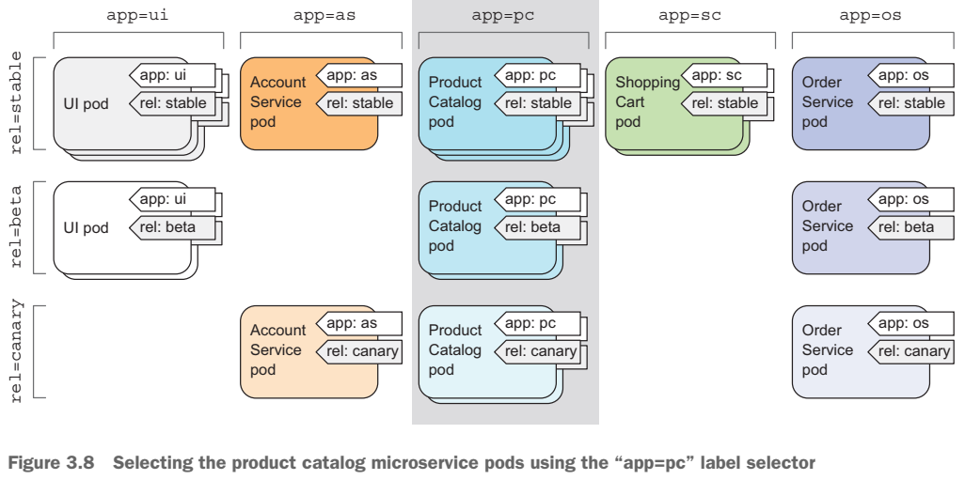

Slide 20
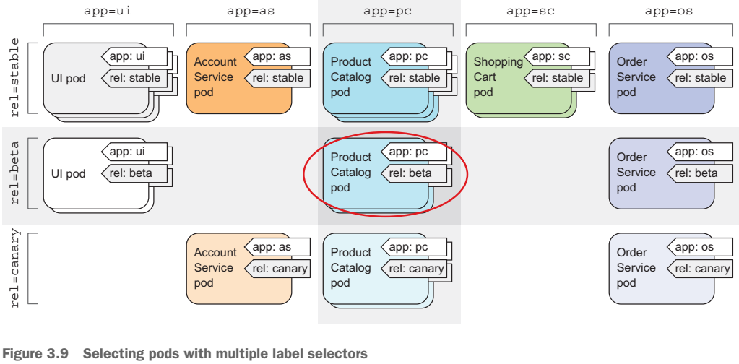

Slide 21
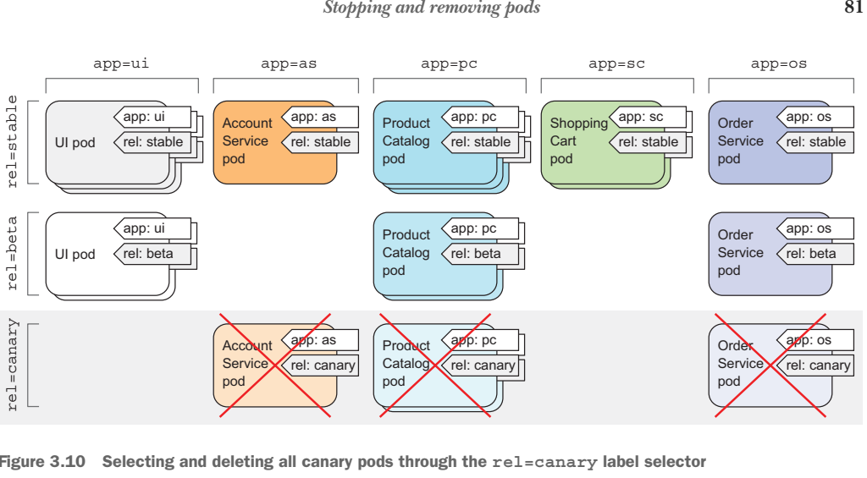

Slide 22
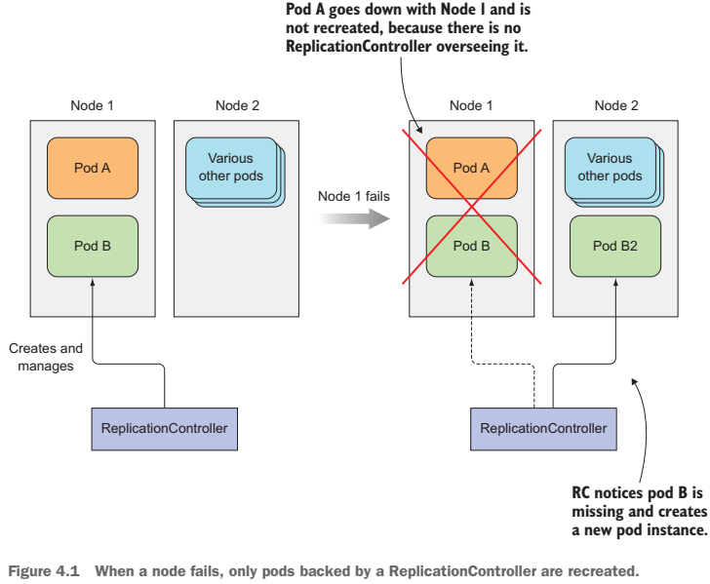

Slide 23
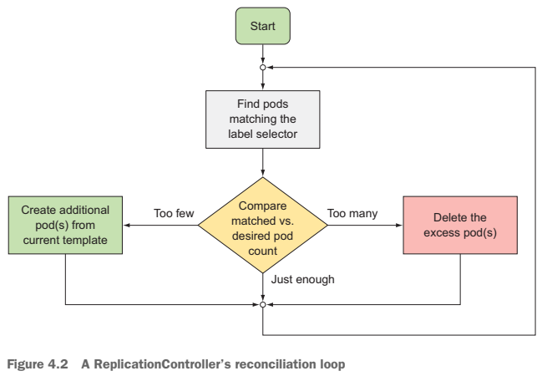

Slide 24
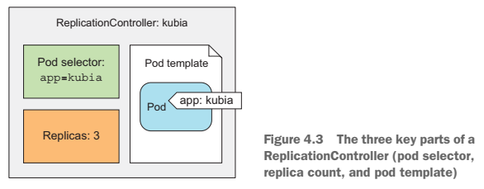

Slide 25
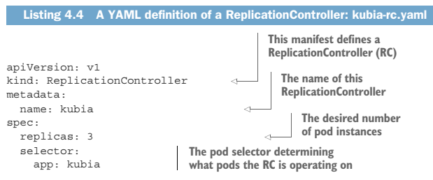
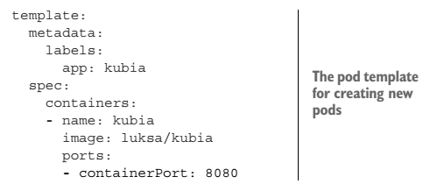

Slide 26
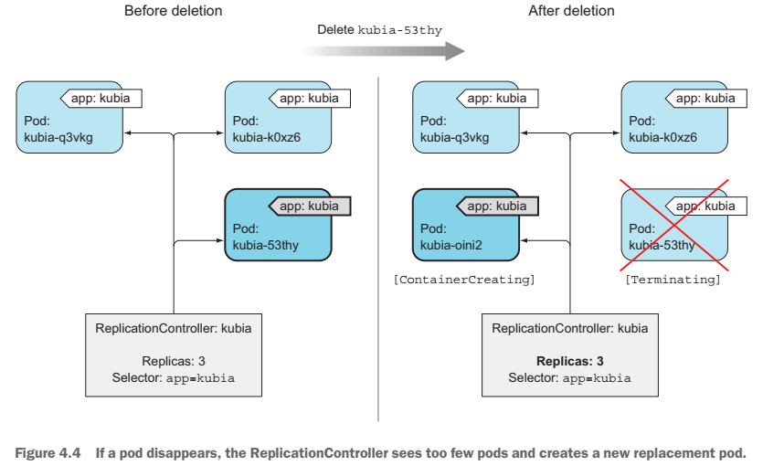

Slide 27
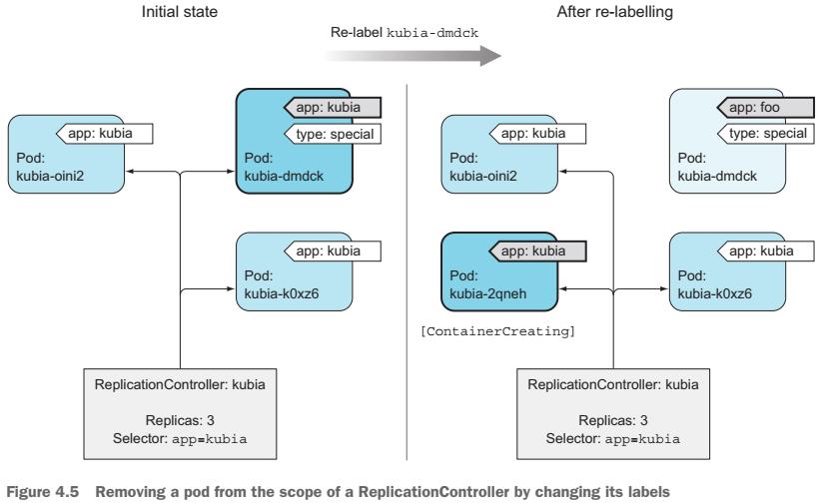

Slide 28
Services

Slide 29
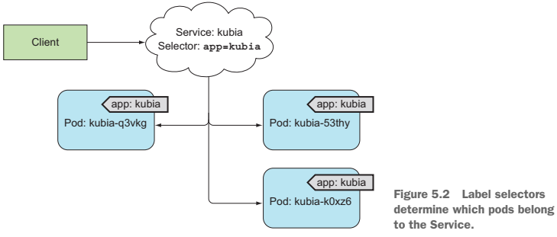

Slide 30
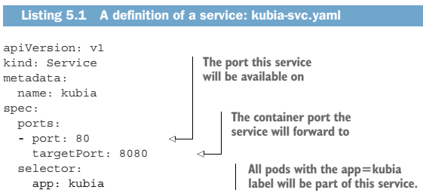

Slide 31
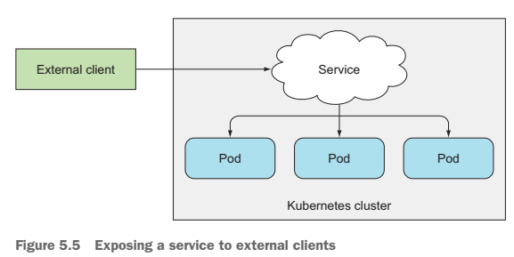

Slide 32
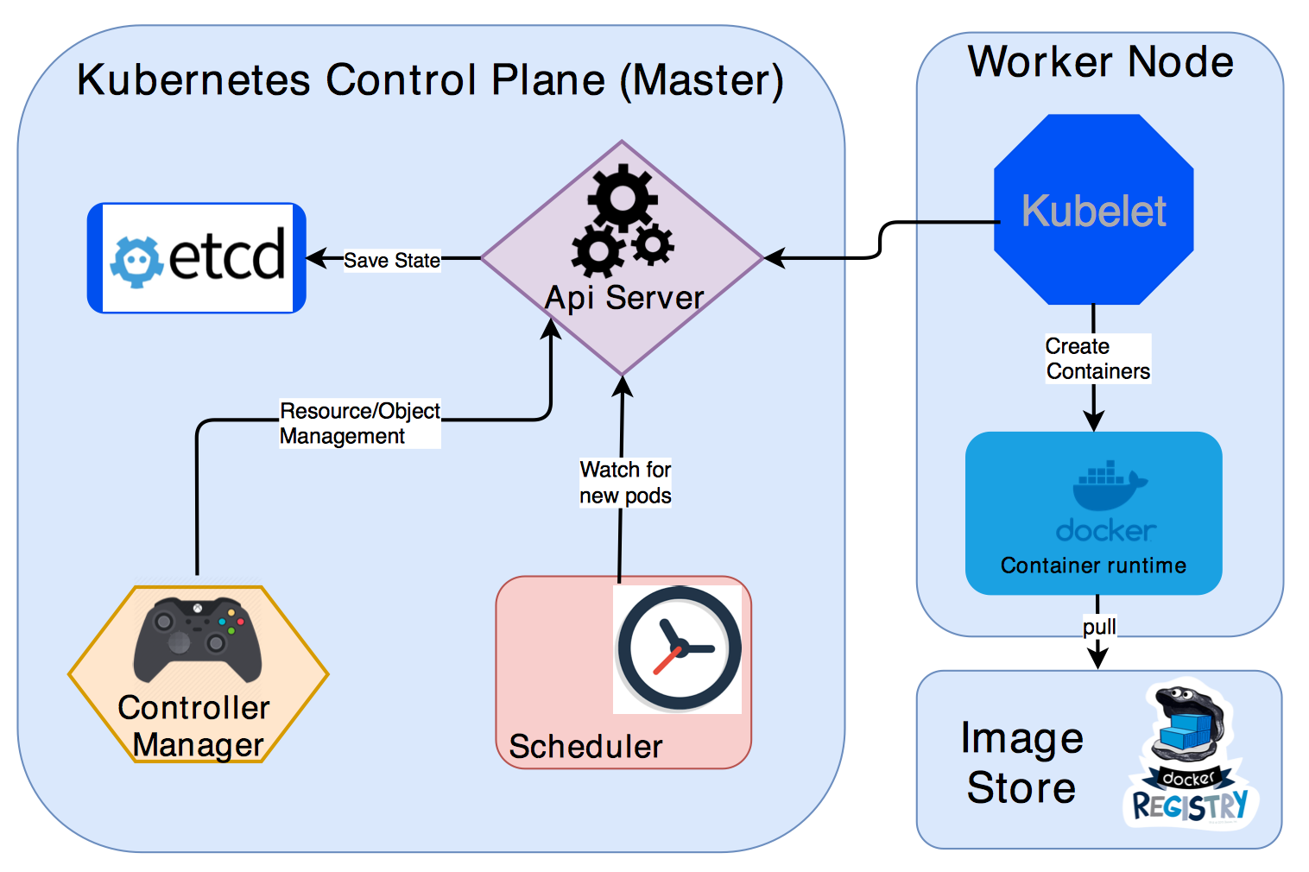
Kubernetes Architecture

Slide 33
Kubernetes Architecture
A Kubernetes cluster consists of two main components:
Master (Control Plane)
Worker Nodes.
Master has following components. These components are responsible for maintaining the state of the cluster:
etcd distributed key value store.
API Server.
Controller Manager
Scheduler
Every worker node consists of the following components.
These components are responsible for deploying and running the application containers.
Kubelet
Container Runtime (Docker)

Slide 34
Master Components
etcd:
Stores the cluster status and metadata.
A distributed key value store
Provides reliable way of storing data across a cluster of machines.
API Server directly talk to etcd store.
K8s stores all its data under /registry directory in etcd.
Api Server:
The central place for all other components.
Api Server will take care about validating the object before saving the information to etcd.
The client for the Api Server can be either kubectl (command line tool) or a Rest Api client.

Slide 35
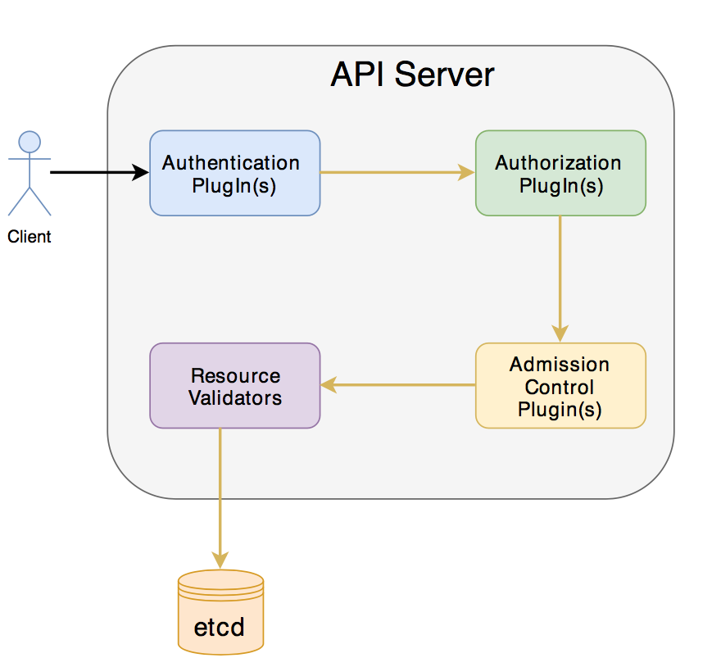
Master Components
Api Server:
Several plugin’s are invoked by Api Server before
creating/deleting/updating the object in etcd.
Scheduler:
Allocate what node the pods needs to be created
Controller Manager:
Make sure the actual state of the system converges towards the desired state.
Watch the API Server for changes to resources/objects and perform necessary actions like create/update/delete of the resource.

Slide 36
Worker Node components
Kubelet
The agent that runs on each node in the cluster.
Monitors the Api Server for Pods
Start the pod’s containers by instructing to docker runtime.
Monitors the status of running containers and reports to api server
Also do health checks for the container and restart if needed.
Docker
Container runtime used by Kubelet for spinning up Containers

Slide 37
Other components
Nodes:
Machine on which Kubernetes is installed.
This is where containers inside the pods will be launched by Kubernetes.
Master Node:
Responsible for managing the cluster
A Kubernetes cluster also contains one or more master nodes that run the Kubernetes control plane
Pod
Smallest deployable unit that can be managed by Kubernetes.
A logical group of one or more containers that share the same IP address

Slide 38
Kubernetes namespaces
Provide for a scope of Kubernetes resource, carving up your cluster in smaller units
$ kubectl get ns
$ kubectl describe ns default
$kubectl create namespace test

Slide 39
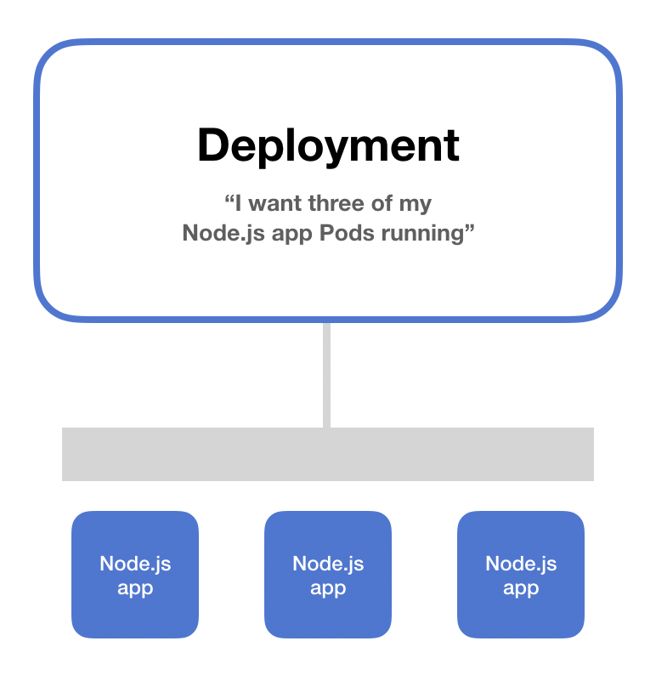
Kubernetes deployment
Everyone running applications on Kubernetes cluster uses a deployment.
It’s what you use to scale, roll out, and roll back versions of your applications.
With a deployment, you tell Kubernetes how many copies of a Pod you want running. The deployment takes care of everything else.

Slide 40
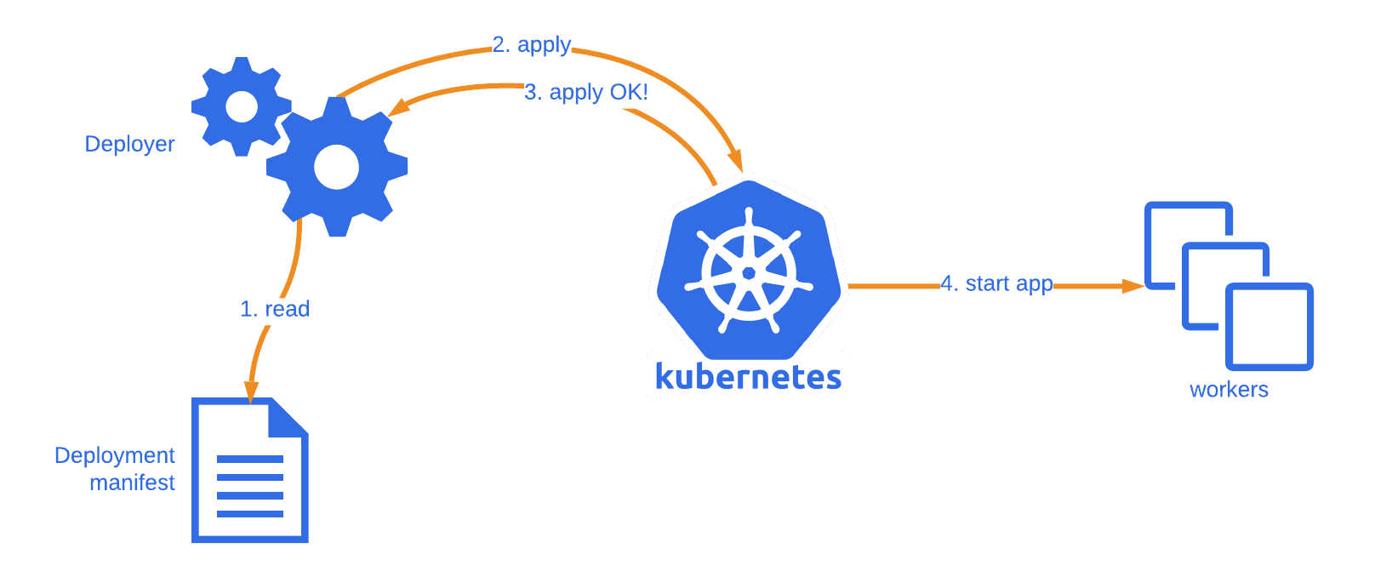
Kubernetes deployment

Slide 41
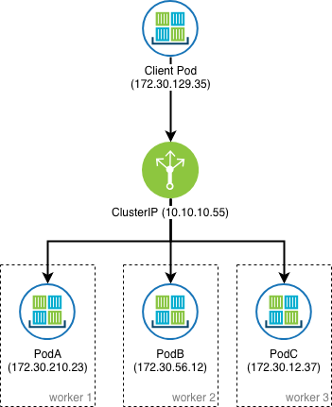
Service

Slide 42
Config Map

Slide 43
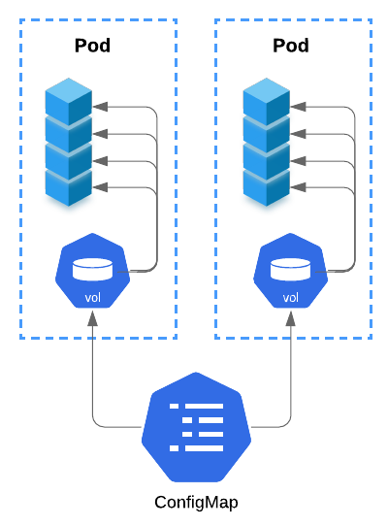
Config Map

Slide 44
Thanks

