Slide 1
Apache Hadoop and NoSQL
Info@stepupanalytics.com

Slide 2
Apache Hadoop
Collection
Of open-source software utilities
Facilitates using a network of many computers
To solve problems involving massive amounts of data and computation
Provides a software framework
For distributed storage and processing of big data using the MapReduce programming model

Slide 3
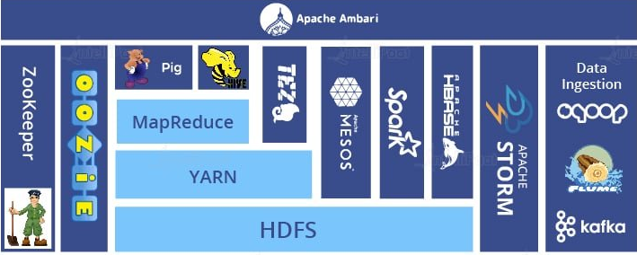
Hadoop ecosystem

Slide 4
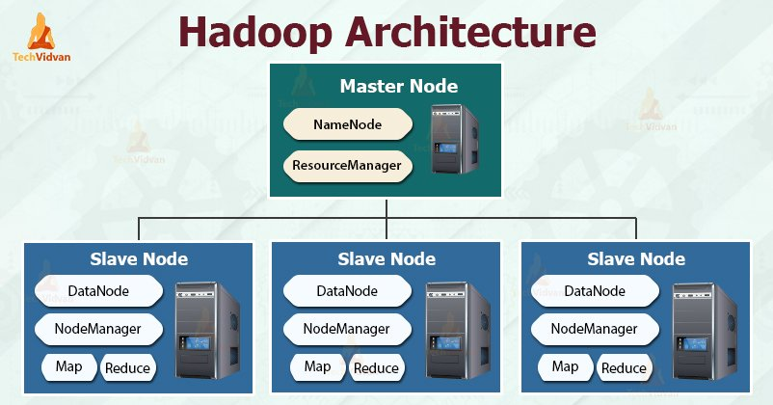
Hadoop Architecture

Slide 5
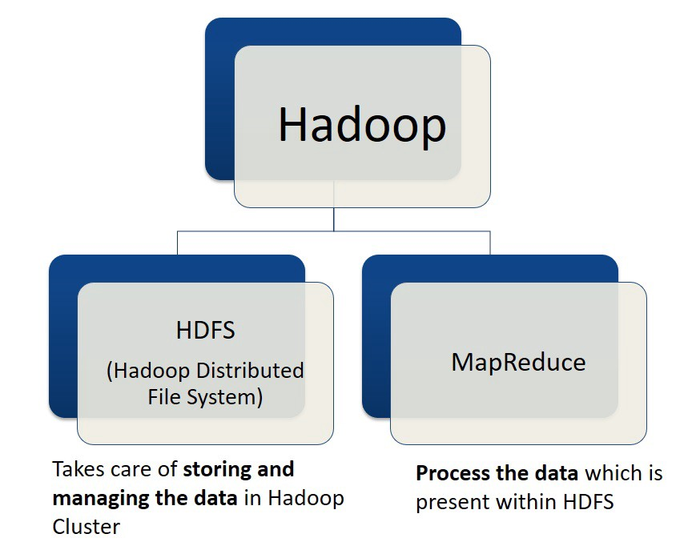
HDFS and MapReduce

Slide 6
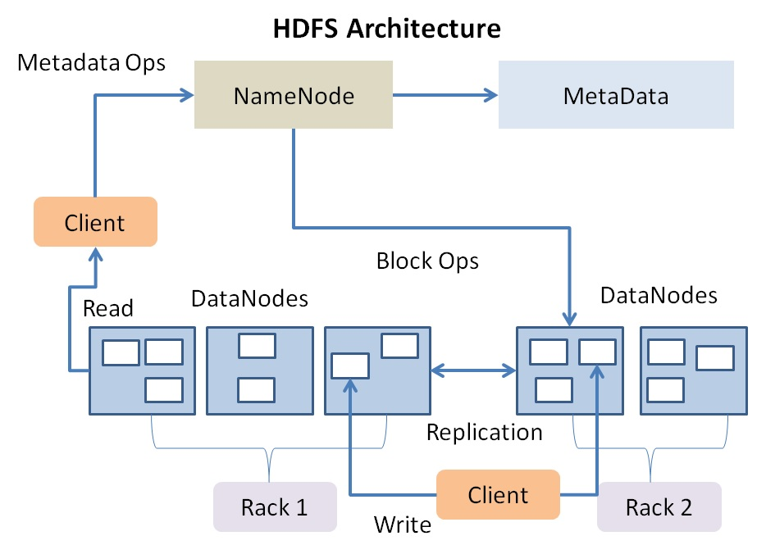
HDFS Architecture

Slide 7
NoSQL

Slide 8
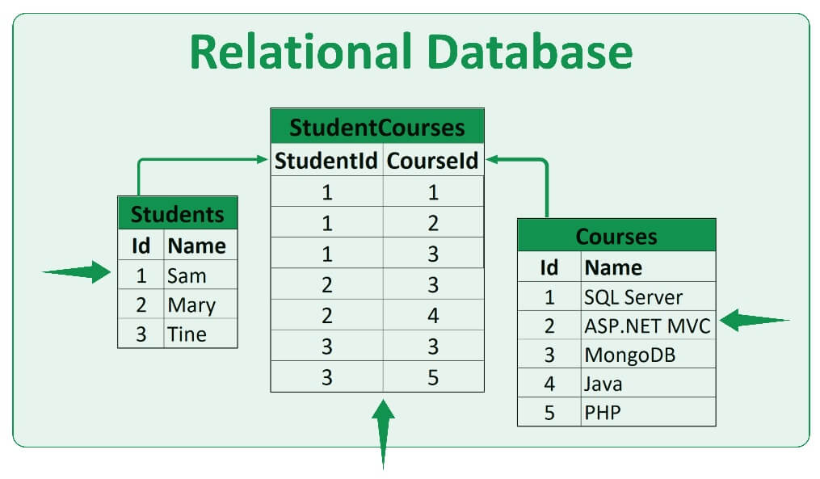
Relational Database

Slide 9
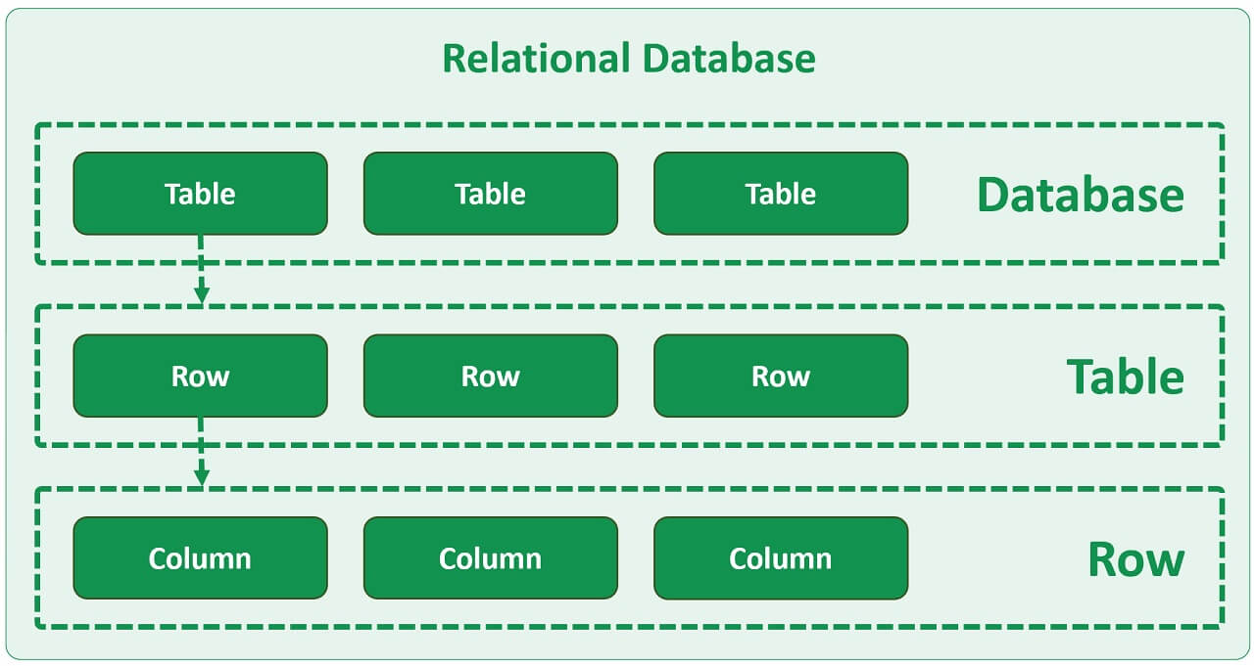
Relational Database

Slide 10
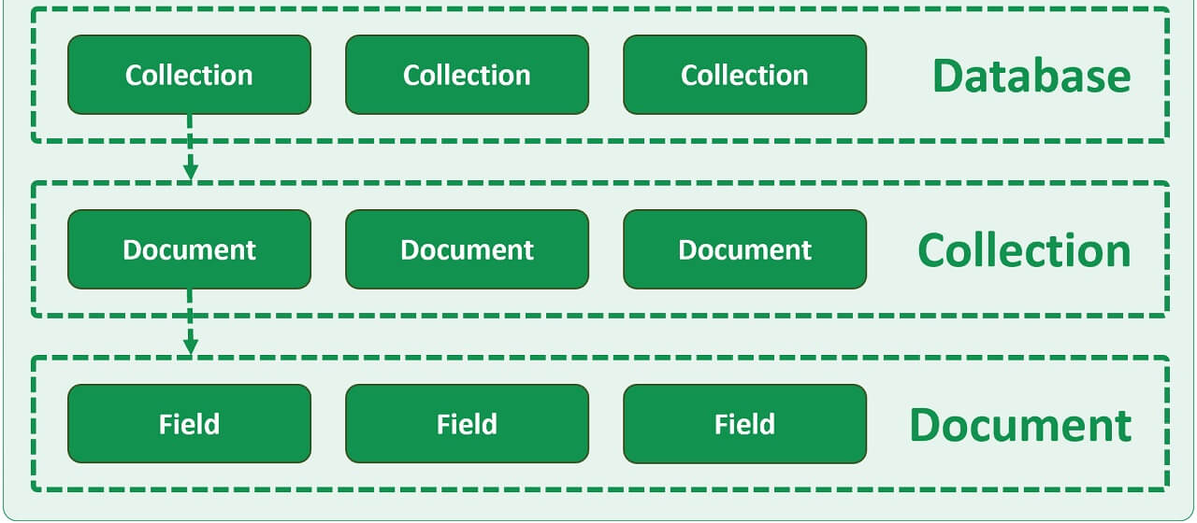
NoSQL Database

Slide 11
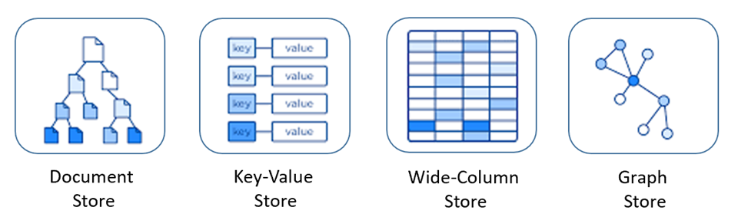
NoSQL

Slide 12
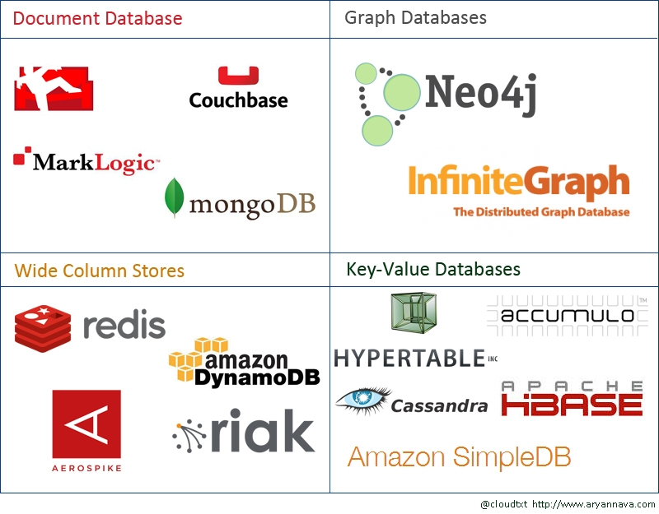
Types of NoSQL Databases

Slide 13
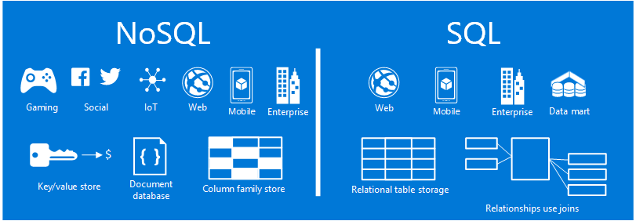
Applications on NoSQL databases

Slide 14
Schema-on-Read vs Schema-on-Write
Schema-on-Write | Schema-on-Read
Feast Reads | Slower Reads
Slower Loads | Fast Loads
Structured | Structured/Semi structured
Fewer Errors | More Errors
SQL | NoSQL

Slide 15
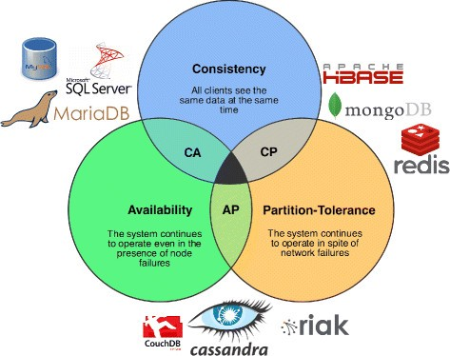
CAP Principal

Slide 16
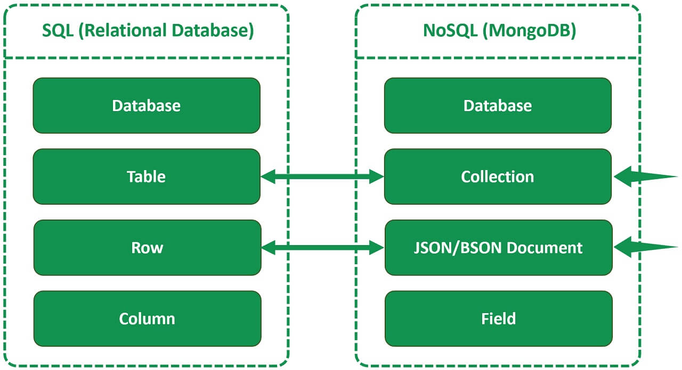
Relational vs non-relational databases

Slide 17
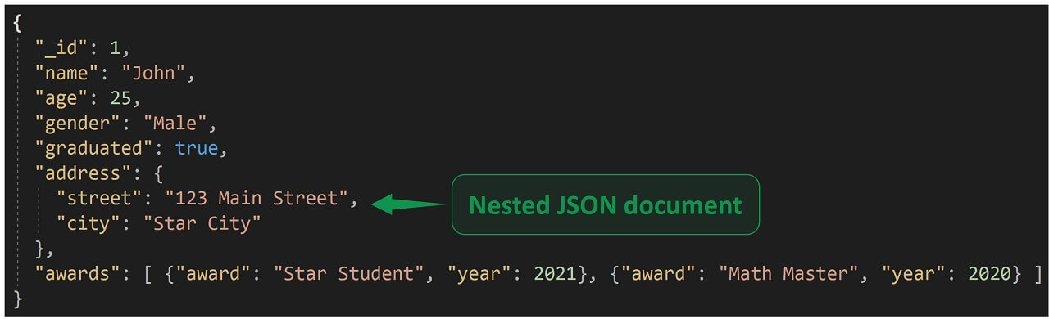
Nested JSON document

Slide 18
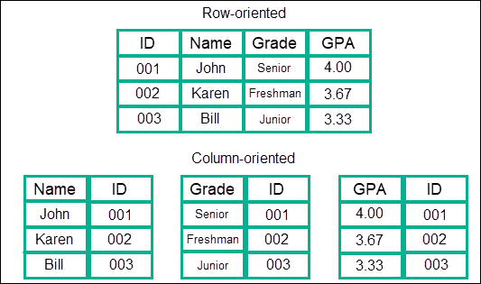
Column-oriented DBMS
Stores data tables by column rather than by row
Benefits
More efficient access to data when only querying a subset of columns (by eliminating the need to read columns that are not relevant)
More options for data compression
Cons:
Typically less efficient for inserting new data
Column oriented databases will have significant benefits when stored on separate disks

Slide 19
Column-oriented DBMS
A column store database can also be referred to as a:
Column database
Column family database
Column oriented database
Wide column store database
Wide column store
Columnar database
Columnar store
Use a concept called a keyspace

Slide 20
Column-oriented DBMS

Slide 21
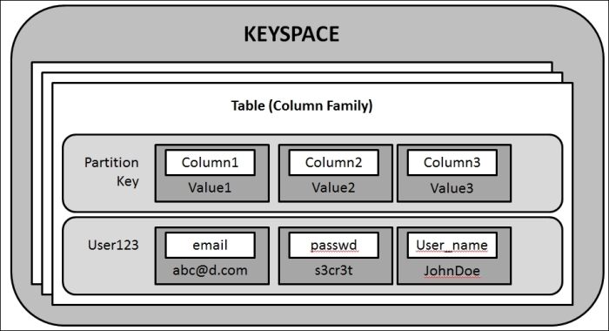
Keyspace
Kind of like a schema in the relational model.
Contains all the column families which contain rows, which contain columns.
From a user perspective, the metadata of a columnar database looks exactly the same as a RDBMS
You perform schema management in much the same way as Oracle
In most cases, it’s 100% SQL compliant and 100 ACID compliant (unlike many NoSQL)
NoSQL databases tend to be either Key Value stores or Document Stores. Columnar is neither

Slide 22
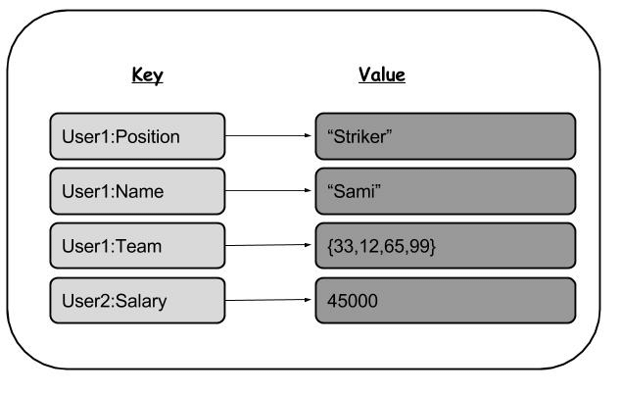
key-value database

Slide 23
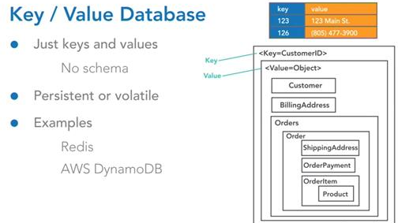
key-value database

Slide 24
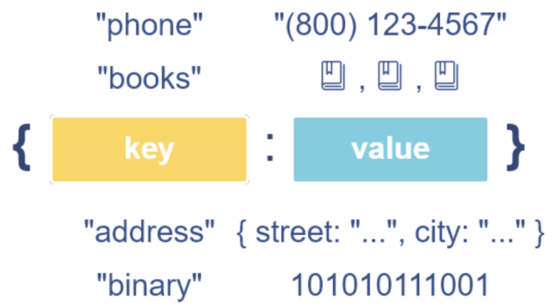
key-value database

Slide 25
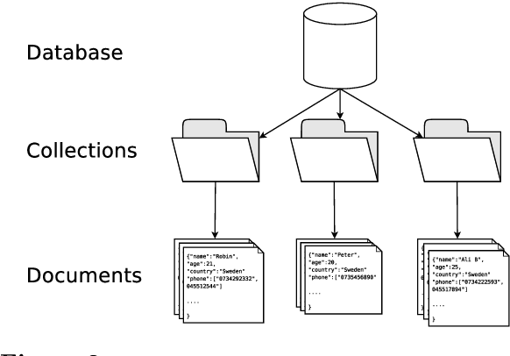
Document database

Slide 26
Document database vs key-value database
An extension of the key-value database model
Support more advanced querying capabilities
Key-value databases typically have more limited querying capabilities and may not support advanced search or indexing features.
In Key value database we can only query by key but in document store, not limited to query by key
Have built-in support for indexing and searching.
The term document in NoSQL databases refers to a set of key-value pairs, typically represented in
JSON
XML or
BSON

Slide 27

AWS DynamoDB
Based upon open-source MongoDB
Fully managed NoSQL database
Supports both
Key-value and
Document data models
Schemaless
Does not have a query optimizer
Secondary index is only used when querying or scanning

Slide 28

AWS Keyspaces
Can have predefined structure but flexible as well
Column-family data model

Slide 29

Azure Cosmos DB
NoSQL document
Supports the APIs:
MongoDB: document
PostgreSQL:document
Cassandra: Columnar
Gremlin: Graph API and
Table: Key Value

Slide 30
JSON and BSON
BSON is the binary encoding of JSON-like documents that MongoDB uses when storing documents in collections
It adds support for data types like Date and binary that aren't supported in JSON.
Pros of BSON:
Compact
In most cases, storing a BSON structure requires less space than its JSON equivalent
Data Types
BSON provides additional data types not found in regular JSON, such as Date and BinData

Slide 31
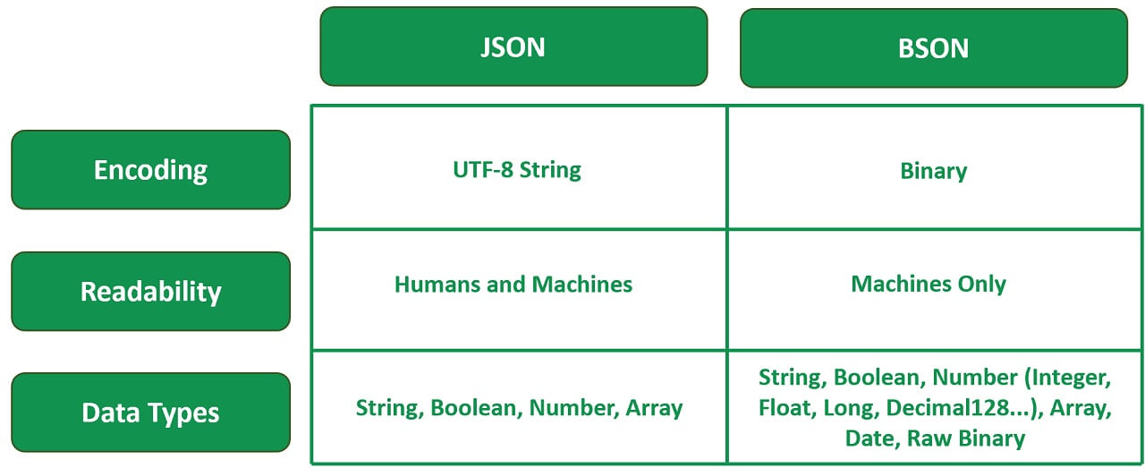
JSON and BSON

Slide 32
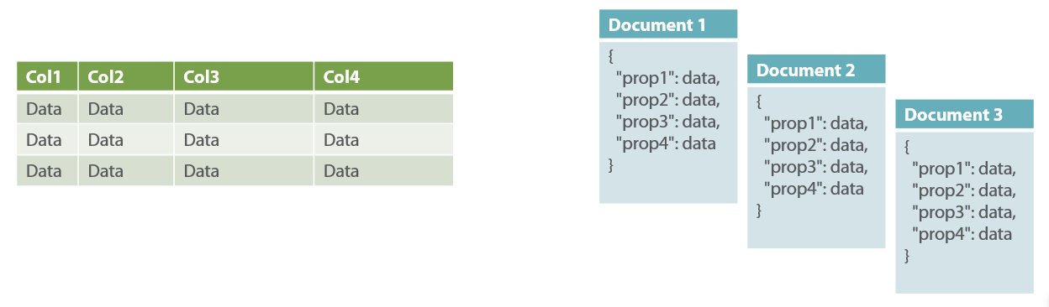
Relational vs NoSQL

Slide 33
Relational Database

Slide 34
SQL vs NoSQL

Slide 35
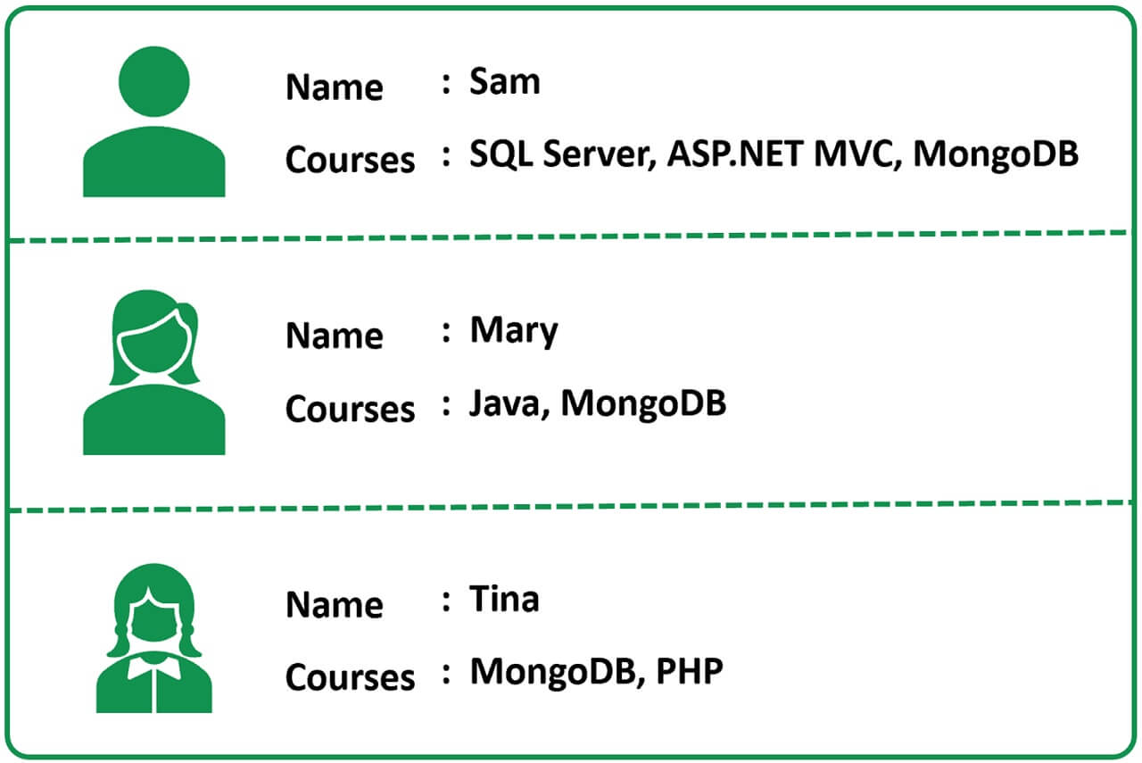
Simple use case
Notes:
Let's say we are developing an application for a training institute and we have a page that displays student names and the courses that they have enrolled in, on a web page as you can see right here.

Slide 36
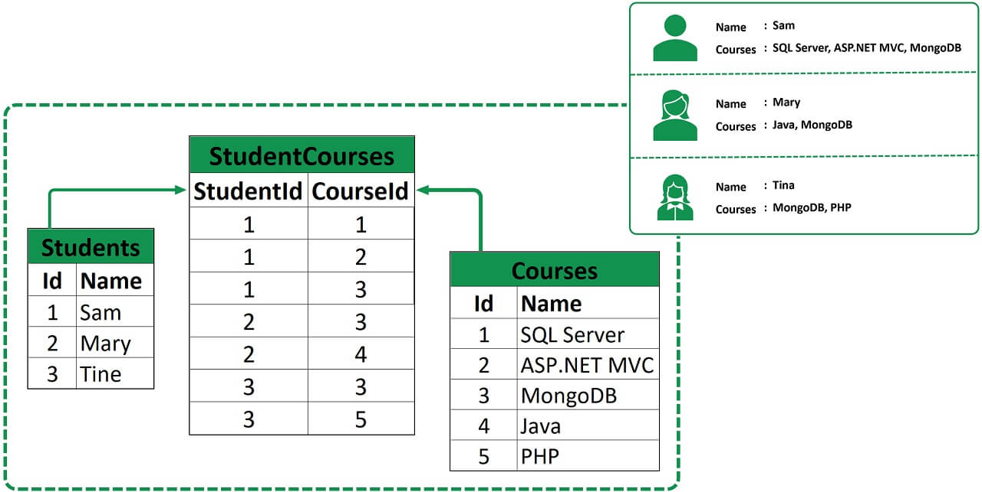
Data Modelling
Notes:
To model something like this, in a relational database world like SQL Server or Oracle, we typically create 3 tables.
Students - Stores the details of students like Id and Name.
Courses - Stores the course details like course Id and Name.
StudentCourses - There is a many to many relationship between Students and Courses tables, meaning, a student can enrol in multiple i.e many courses, similarly a given course can have multiple students enrolled, so this is the table that links students and courses, basically the bridge table for many-to-many relationship between Students and Courses.

Slide 37
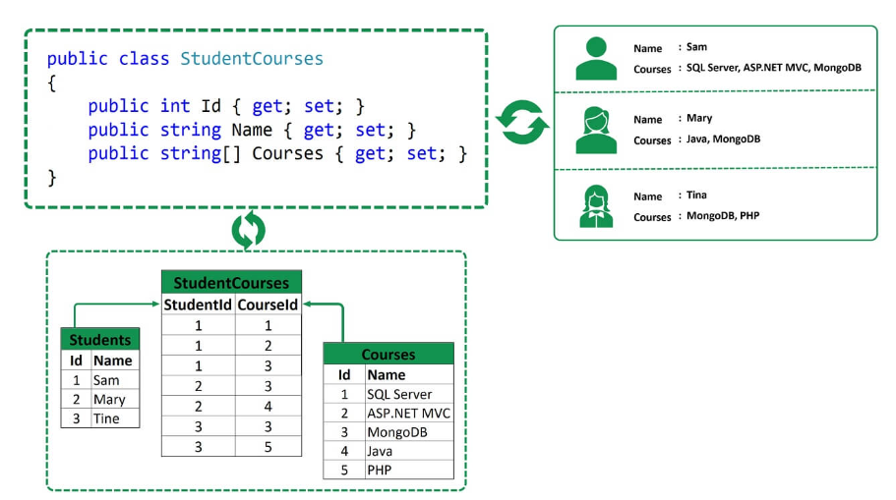
Application Side
Notes:
On the application side to be able to display this database data we may have a class that looks like the following.

Slide 38
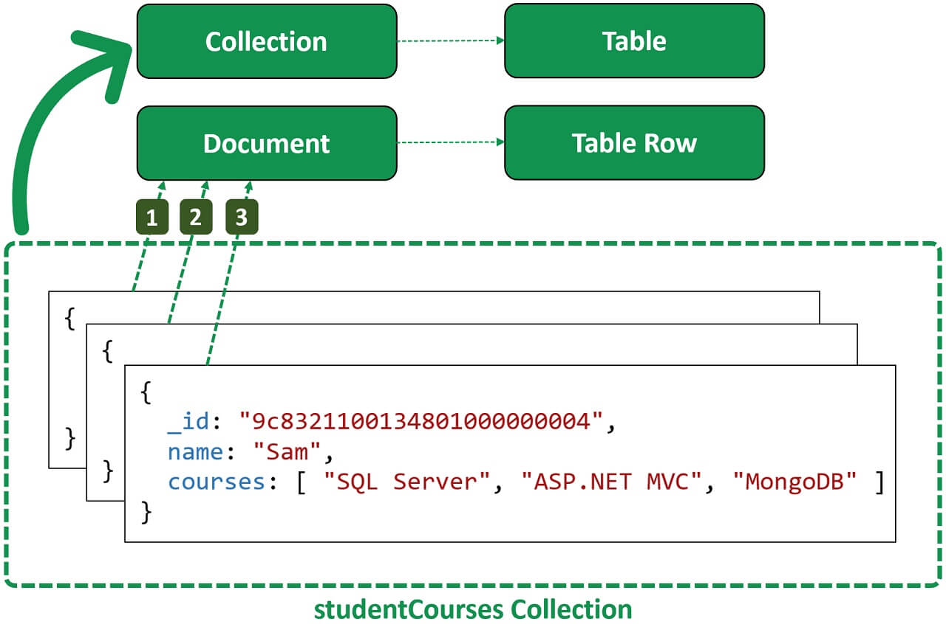
Non-relational Databases
Notes:
Now, let's see how this same data may be stored in a non-relational database like MongoDB. As we have already discussed, in Mongo we do not have tables and rows, instead we have collections and dYou can think of a collection in MongoDB as a table in a relational database and a document as a table row.
In this example, we have 1 collection. The name of the collection is studentCourses. In this collection we have 3 documents.
So, just like how a table is a container for rows, a collection is a container for documents. It is the document that physically stores data.
The data is in BSON format so the documents are also called BSON documents. If you are wondering what is BSON? Well, it's binary JSON, MongoDB stores data on the disk in BSON format,
The same students and courses data that we have across 3 tables in a relational database can be stored in a single collection in Mongo.
For an application this data is very easy to work with. No complex joins and mapping layers are required. Our application code will be much cleaner, simpler and easier to maintain.
ocuments.

Slide 39
When to use SQL database over non-relational database
If you want a flexible schema for the data i.e in terms of shape or size, or if it needs to be open to change in the future, then a non-relational database is the answer
non-relational databases have been designed from the groundup for the cloud, which makes them naturally good for horizontal scaling where lots of smaller servers can be spun up to handle increased load.

Slide 40
Partitions and data distribution

Slide 41
Partitions
Refers to breaking the data in database into separate partitions.
An allocation of storage for a table, backed by solid state drives (SSDs) and automatically replicated across multiple Availability Zones
Partition management occurs automatically in the background and is transparent to your applications.
Improve scalability
Improve availability
Improve performance

Slide 42
Types of database partitioning
Vertical partitioning
Horizontal partitioning and sharding

Slide 43
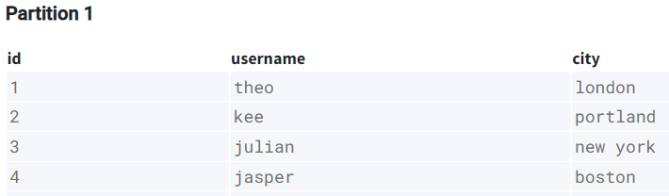
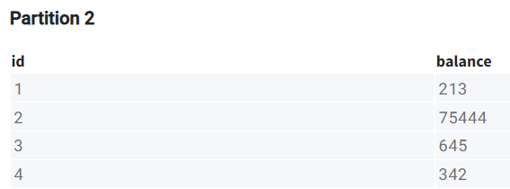
Vertical partitioning
Table is split by columns
Different columns stored on different partitions

Slide 44
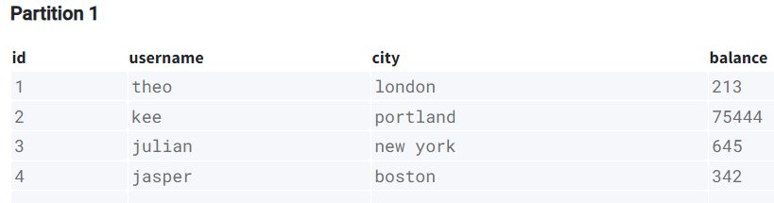
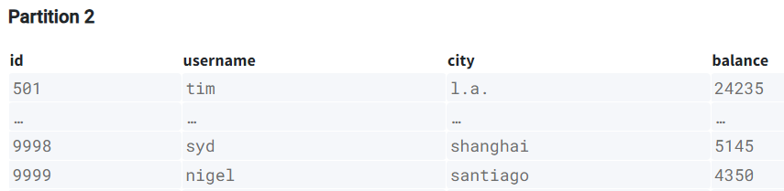
Horizontal partitioning

Slide 45
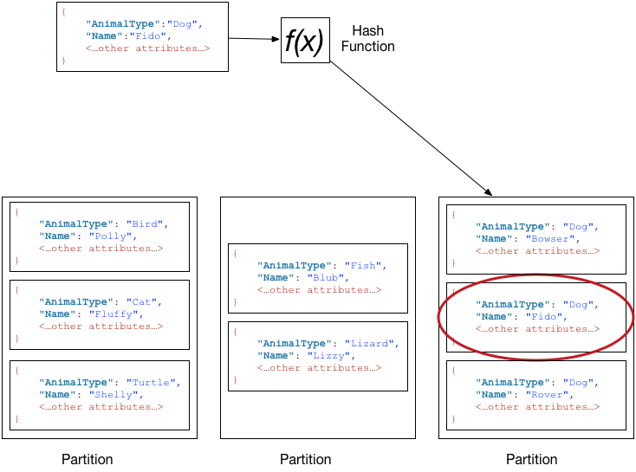
Data distribution: Partition key and sort key

Slide 46
Thanks

