Slide 1
R Programming
A LANGUAGE AND ENVIRONMENT FOR STATISTICAL COMPUTING AND GRAPHICS.

Slide 2
Agenda
Importing data
Reading Tabular Data files
Reading CSV files
Importing data from excel
Loading and storing data with clipboard
Loading R data objects
Writing data to file
Writing text and output from analyses to file

Slide 3
Agenda
Manipulating Data
Selecting rows/observations
Rounding Number
Creating string from variable
R Programming
While loop
If Statement
For loop
Arithmetic operations

Slide 4
Reading Tabular Data files
If you have a .txt or a tab-delimited text file, you can easily import it with the basic R function read.table(). In other words, the contents of your file will look similar to this
1 6 a
2 7 b
3 8 c
4 9 d
5 10 e
and can be imported as follows:
# To Locate the Current Working Directory
getwd()
Company.employees <- read.table("EmployeeSales.txt", TRUE, sep = " ", quote="\"")
Company.employees
write.table(Company.employees,"EmployeeSales2.txt")
Notes:
What is the function to read table from a tab-delimited file?
Which command is used for getting the path to current working directory?
What is the use of specifying quote parameter in read.table function?
Give an example of writing data to the tab delimited .txt file.

Slide 5
Reading Tabular Data files
R Read table Function – testing arguments
employees <- read.table("EmployeeSales.txt", TRUE, quote="\"",
na.strings = c(“NA”,””), strip.white = TRUE,
blank.lines.skip = TRUE)
print(employees)
# Below is the example for using strip.white
employees <- read.table("empdata.csv", TRUE, quote="\'",
na.strings = c("NA",""), sep=",", strip.white = T,
blank.lines.skip = TRUE)
strip.white: If the sep argument is not equal to “” then you may use this Boolean value to trim the extra leading & tailing white spaces from the character field.
blank.lines.skip: A Boolean value that specifies whether you want to skip/ignore the blank lines or not.
na.strings: A character vector specifying values that should be read as NA
Notes:
What is the use of strip.white argument?
If the .txt file has blank line then how we can ignore / skip those blank lines?
Which parameter is used to specify that the table being imported has the header?

Slide 6
Reading Tabular Data files
Testing R Read table arguments
In this example we will show you, How to rename the column names, skip the number of rows, changing the default factors.
employeeNames <- c("Employee_ID", "First Name", "Last Name", "Education", "Profession","Salary","Sales")
employees <- read.table("EmployeeSales.txt", TRUE, quote="\"",
strip.white = TRUE, skip = 3,
as.is = c(TRUE, TRUE, FALSE, FALSE, TRUE),
col.names = employeeNames,
blank.lines.skip = TRUE)
print(employees)
print(str(employees))

Slide 7
Reading Tabular Data files
col.names: A Character vector that contains the column names for the returned data frame
as.is: Please specify the Boolean vector of same length as the number of column. This argument will convert the character values to factors based on the Boolean value. For example, we have two columns (FirstName, Occupation) and we uses as.is = c(TRUE, FALSE). This will keep the FirstName as character (not an implicit factor), and Occupation as Factors
skip: Please specify the number of rows you want to skip from text file before beginning the data read. For example, if you want to skip top 3 records, use skip = 3
Notes:
Which parameter is used to skip the first n rows from the text file?
Can we change the column names while reading from the text file?

Slide 8
Reading and writing CSV files
Example of importing CSV data are provided below.
Read from a Comma Delimited Text File
# first row contains variable names
# “row.names” assigns the variable id to row names
# If we do not specify row.names then it would create another running serial number to it
mydata <- read.csv("empdata.csv", header=TRUE, row.names="Employee_ID")
mydata
Write to Comma Delimited Text File
write.csv(mydata, "MyEmpData.csv")
Notes:
Which parameter is used to assign the ID variable to Row Names?
What will be behavior if we do not specify the ID variable while importing from the CSV file?
What is the function to write the data frame to CSV file?

Slide 9
Importing data from excel
From Excel
You can use the xlsx package to access Excel files. The first row should contain variable/column names.
write.xlsx(mydata, "EmployeeSales.xlsx", row.names= F)
setwd("C:/Users/Atin/Desktop/RProgramming/WorkingD")
install.packages("xlsx")
library(xlsx)
mydata <- read.xlsx("EmployeeSales.xlsx", 1)
mydata
# read in the worksheet named mysheet
mydata <- read.xlsx("EmployeeSales.xlsx", sheetName = "Sheet 1")
mydata
Notes:
Which package we need to install before reading data from the excel file?
How to install and import the package?
What is the function to set the current working directory?
An excel file has multiple sheets, when we import from an excel file, how it will figure out from which sheet the data is to be imported? Specify both the ways.

Slide 10
Loading and storing data with clipboard
You can actually copy the contents to your clipboard and import them quickly into R.
To do this, you can either use the readClipboard() or read.table() functions:
readClipboard() #Only on Windows
read.table(file="clipboard“, sep=“\t”)
writeClipboard
R has a function writeClipboard that does what the name implies. However, the argument to writeClipboard may need to be cast to a character type. For example the code
> x <- "hello world"
> writeClipboard(x)
copies the string “hello world” to the clipboard as expected. However the code
> x <- 3.14
> writeClipboard(x)
produces the error message
Notes:
What are the 2 functions to read data from Clipboard?
Which function only works on windows?
Can we write numeric data to clipboard?
Which type of data can be written to clipboard?
What is the command to write data to clipboard?

Slide 11
Loading and storing data with clipboard
Here we will use a package for reading data from Clipboard
install.packages("psych")
library(psych)
My_data= read.clipboard.csv(header=TRUE,sep=',')
My_data
print(read.clipboard.tab(header=TRUE,sep='\t'))
Notes:
Which package we can use to provide more flexibility for reading/writing data to/from the clipboard?

Slide 12
Loading R data objects
Writing data, in csv or Excel file formats, is the best solution if you want to open these files with other analysis software, such as Excel.
However this solution doesn’t preserve data structures, such as column data types (numeric, character or factor).
In order to do that, the data should be written out in R data format.
Save one object to a file
It’s possible to use the function saveRDS() to write a single R object to a specified file (in rds file format).
The object can be restored back using the function readRDS().
The simplified syntax for saving and restoring is as follow:
my_data= read.clipboard.csv(header=TRUE,sep=',')
saveRDS(my_data, file = "my_data.rds")
rm(my_data)
my_data
my_data = readRDS(file = "my_data.rds")
my_data
Notes:
What is the drawback to read/write data in the text files?
What is the solution to preserve the data structure of the data while writing it to the files?
What is the function to save data to the RDS file format?

Slide 13
Loading R data objects
In the R code below, we’ll save the mtcars data set and restore it under different name:
# Save a single object to a file
saveRDS(mtcars, "mtcars.rds")
# Restore it under a different name
my_data <- readRDS("mtcars.rds")
Save multiple objects to a file
The function save() can be used to save one or more R objects to a specified file.
The function can be read back from the file using the function load().
a=1;b=2;c=3;d="Sumit";e=T
a;b;c;d;e
save(a, file = "data.RData") # Saving on object in RData format
# Save multiple objects
save(b,c,d,e, file = "data.RData")
load("data.RData") # To load the data again
a;b;c;d;e
Notes:
Can we save multiple objects to the R data file?
What is the file extension which stores multiple objects?
Which function is used to save multiple objects to the R data file?

Slide 14
Writing text and output from analyses to file
Sometime we require to redirect our output to some physical file for later analysis.
The sink() function will redirect output to a file instead of to the R terminal.
To return output to the terminal. , call sink() without any arguments
# Start writing to an output file
sink('analysis-output.txt')
a=1;b=2;c=3;d="Sumit";e=T
a;b;c;d;e
sink() # return out back to termincal
a;b;c;d;e
Notes:
Why we need to redirect the output from terminal to a physical file?
Which function is used to redirect the output?
Which function is used to return the output back to the terminal?

Slide 15
Writing text and output from analyses to file
# Append to the file
sink('analysis-output.txt', append=TRUE)
cat("Some more stuff here...\n")
sink()
Notes:
Which parameter of the sink function allows to append the output to existing data?

Slide 16
Manipulating Data
The dplyr package is one of the most powerful and popular package in R.
This package was written by the most popular R programmer Hadley Wickham.
The dplyr is a powerful R-package to
manipulate,
clean and
summarize unstructured data.
The package "dplyr" comprises many functions that perform mostly used data manipulation operations such as
applying filter,
selecting specific columns,
sorting data,
adding or deleting columns and
aggregating data.
Another most important advantage of this package is that it's very easy to learn and use dplyr functions.
Notes:
Which package which can use for data manipulation?
Specify 4 functions which are provided by dplyr for data manipulation?
To use dplyr package is very difficult. True/ False?

Slide 17
Manipulating Data
To install the dplyr package, type the following command.
install.packages("dplyr")
To load dplyr package, type the command below
library(dplyr)
Important dplyr Functions to remember
dplyr Function | Description | Equivalent SQL
select() | Selecting columns (variables) | SELECT
filter() | Filter (subset) rows. | WHERE
group_by() | Group the data | GROUP BY
summarise() | Summarise (or aggregate) data | -
arrange() | Sort the data | ORDER BY
join() | Joining data frames (tables) | JOIN
mutate() | Creating New Variables | COLUMN ALIAS
Notes:
Which function we can use to select columns from Data Frame?
Which function we can use to group data?
Which function we can use to sort the data?

Slide 18
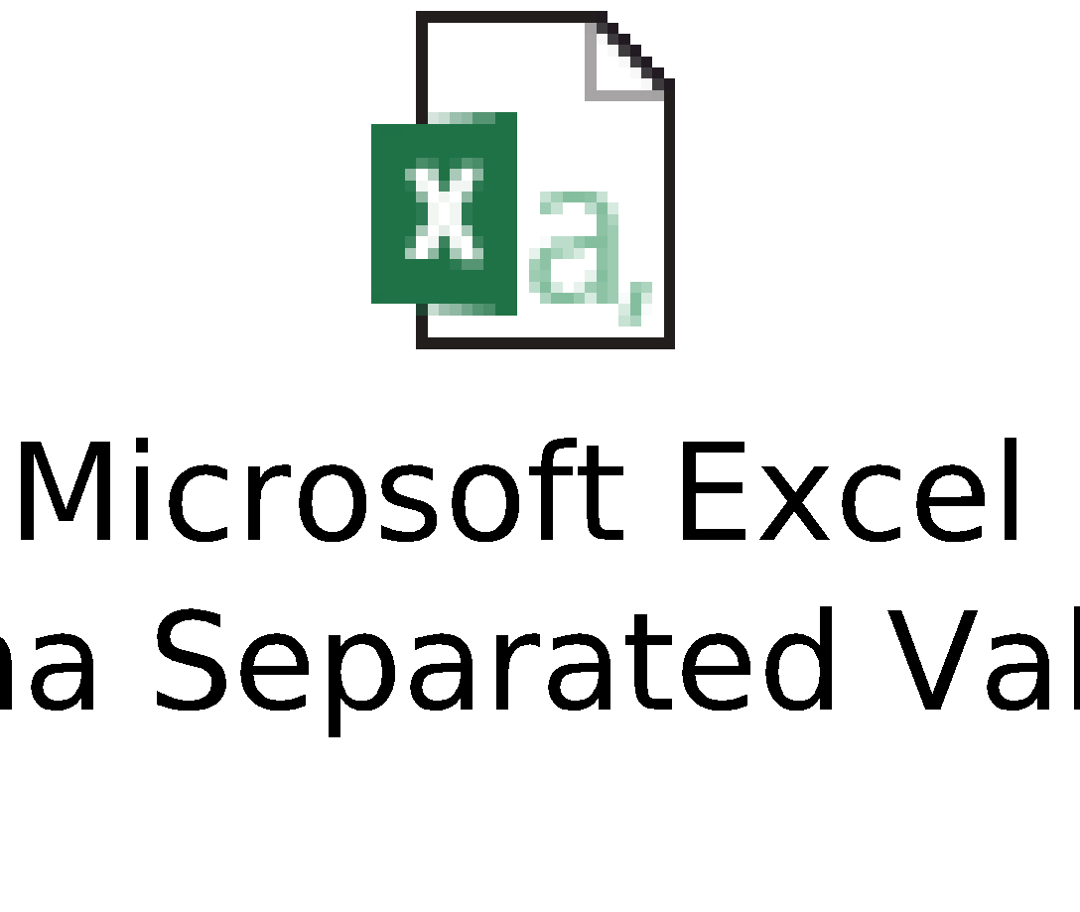
Manipulating Data
Sample Data:
How to load data:
mydata = read.csv("sampledata.csv")
The sample_n function selects random rows from a data frame. The second parameter of the function tells R the number of rows to select.
sample_n(mydata,3)
The sample_frac function returns randomly N% of rows. In the example below, it returns randomly 10% of rows.
sample_frac(mydata,0.1)
Notes:
Which 2 functions are used to get random data for sampling from the data frame?

Slide 19
Manipulating Data
The distinct function is used to eliminate duplicates.
Remove Duplicate Rows based on all the variables (Complete Row)
x1 = distinct(mydata)
Remove Duplicate Rows based on a variable
The .keep_all function is used to retain all other variables in the output data frame.
distinct(mydata, Index, .keep_all= TRUE)
Suppose you are asked to select only a few variables. The code below selects variables "Index", columns from "State" to "Y2008".
select(mydata, Index, State:Y2008)

Slide 20
Manipulating Data
The minus sign before a variable tells R to drop the variable.
select(mydata, -Index, -State)
The starts_with() function is used to select variables starts with an alphabet.
select(mydata, starts_with("Y"))
Selecting Variables contain 'I' in their names
select(mydata, contains("I"))
The code below keeps variable 'State' in the front and the remaining variables follow that.
select(mydata, State, everything())
Notes:
What is the use of specifying minus sign before a variable?

Slide 21
Manipulating Data
In the following code, we are renaming 'Index' variable to 'Index1'.
rename(mydata, Index1=Index)
Suppose you need to subset data. You want to filter rows and retain only those values in which Index is equal to A.
filter(mydata, Index == "A")
Suppose you need to apply 'AND' condition. In this case, we are picking data for 'A' and 'C' in the column 'Index' and income greater than 1.3 million in Year 2002.
filter(mydata, Index %in% c("A", "C") & Y2002 >= 1300000 )
The 'I' denotes OR in the logical condition. It means any of the two conditions.
filter(mydata, Index %in% c("A", "C") | Y2002 >= 1300000)
The "!" sign is used to reverse the logical condition.
filter(mydata, !Index %in% c("A", "C"))
Notes:
Which function we can use to rename the variable in the data frame?

Slide 22
Manipulating Data
Calculating mean and median for the variable Y2015.
summarise(mydata, Y2015_mean = mean(Y2015), Y2015_med=median(Y2015))
sorting data by multiple variables.
arrange(mydata, Index, Y2011)

Slide 23
Selecting rows/observations
Suppose you have a data frame, df - consisting of three vectors that consist of information such as height, weight, age.
df <- data.frame( c( 183, 85, 40), c( 175, 76, 35), c( 178, 79, 38 ))
names(df) <- c("Height", "Weight", "Age")
# All Rows and All Columns
df[,]
# First row and all columns
df[1,]
# First two rows and all columns
df[1:2,]
Notes:
Which 2 functions can be used to specify the column names of the data frame?
Which function can be used to specify the row names of the data frame?

Slide 24
Selecting rows/observations
# First and third row and all columns
df[ c(1,3), ]
# First Row and 2nd and third column
df[1, 2:3]
# First, Second Row and Second and Third Column
df[1:2, 2:3]
Notes:
How to get first and second row and all columns
How to get second Row and 2nd and third column

Slide 25
Rounding Number
Although R can calculate accurately to up to 20 digits, you don’t always want to use that many digits.
format(22/7,nsmall=20)
In this case, you can use a couple functions in R to round numbers.
To round a number to two digits after the decimal point, use the round() function as follows:
> round(22/7,digits=2)
[1] 123.46
Notes:
Up to how many digits R can calculate accurately?
In Round function which parameter is used to specify the number of digits needed after decimal places?

Slide 26
Rounding Number
You also can use the round() function to round numbers to multiples of 10, 100, and so on. For that, you just add a negative number as the digits argument:
> round(-123.456,digits=-2)
[1] -100
If the first digit that is dropped is exactly 5, it rounds to the nearest even number. round(1.5) and round(2.5) both return 2, for example, and round(-4.5) returns -4.

Slide 27
Creating string from variable
The two common ways of creating strings from variables are
the paste function and
the sprintf function.
paste is more useful for vectors, and
sprintf is more useful for precise control of the output.

Slide 28
Creating string from variable
a <- "apple"
b <- "banana"
# Put a and b together, with a space in between:
paste(a, b)
#> [1] "apple banana"
Notes:
What default separator is used while using paste function?

Slide 29
Creating string from variable
# With no space, use sep="", or use paste0():
paste(a, b, sep="")
#> [1] "applebanana"
# With a comma and space:
paste(a, b, sep=", ")
#> [1] "apple, banana"

Slide 30
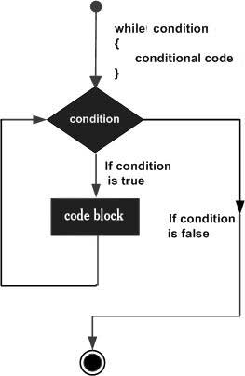
R Programming - While loop
The While loop executes the same code again and again until a stop condition is met.
The basic syntax for creating a while loop in R is −
while (test_expression) {
statement
}

Slide 31
R Programming - While loop
Example
v <- c("Hello","while loop")
cnt <- 2
while (cnt < 7) {
print(v)
cnt = cnt + 1
}
When the above code is compiled and executed, it produces the following result −
[1] "Hello" "while loop"
[1] "Hello" "while loop"
[1] "Hello" "while loop"
[1] "Hello" "while loop"
[1] "Hello" "while loop"

Slide 32
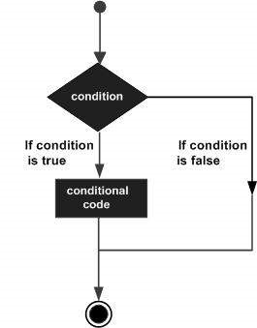
R Programming - If Statement
Following is the general form of a typical decision making structure found in most of the programming languages

Slide 33
R Programming - If Statement
The basic syntax for creating an if statement in R is −
if(boolean_expression) {
// statement(s) will execute if the boolean expression is true.
}
Example
x <- 30L
if(is.integer(x)) {
print("X is an Integer")
}

Slide 34
R Programming - If Statement
The basic syntax for creating an if...else statement in R is −
if(boolean_expression) {
// statement(s) will execute if the boolean expression is true.
} else {
// statement(s) will execute if the boolean expression is false.
}
Example
x <- c("what","is","truth")
if("Truth" %in% x) {
print("Truth is found")
} else {
print("Truth is not found")
}

Slide 35
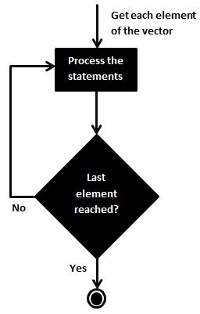
R Programming - For loop
A For loop is a repetition control structure that allows you to efficiently write a loop that needs to execute a specific number of times.
The basic syntax for creating a for loop statement in R is −
for (value in vector) {
statements
}

Slide 36
R Programming - For loop
R’s for loops are particularly flexible in that they are not limited to integers, or even numbers in the input. We can pass character vectors, logical vectors, lists or expressions.
Example
v <- LETTERS[1:4]
for ( i in v) {
print(i)
}
When the above code is compiled and executed, it produces the following result −
[1] "A"
[1] "B"
[1] "C"
[1] "D"

Slide 37
Arithmetic operations
The R Arithmetic operators includes operators like
Arithmetic Addition,
Subtraction,
Division,
Multiplication,
Exponent,
Integer Division and
Modulus.
All these operators are binary operators, which means they operate on two operands.

Slide 38
R Programming - Arithmetic operations
Below table shows all the Arithmetic Operators in R Programming language with examples.
R ARITHMETIC OPERATORS | OPERATION | EXAMPLE
+ | Addition | 15 + 5 = 20
– | Subtraction | 15 – 5 = 10
* | Multiplication | 15 * 5 = 75
/ | Division | 15 / 5 = 3
%/% | Integer Division – Same as Division but it will return the integer value by flooring the extra decimals | 16 %/% 3 = 5. If you divide 16 with 3 you get 5.333 but the Integer division operator will trim the decimal values and outputs the integer
^ | Exponent – It returns the Power of One variable against the other | 15 ^ 3 = 3375 (It means 15 Power 3 or 10³).
%% | Modulus – It returns the remainder after the division | 15 %% 5 = 0 (Here remainder is zero). If it is 17 %% 4 then it will be 1.
Notes:
Which arithmetic operator we can use to get only the integer value by flooring the extra decimals?

Slide 39
Thanks

