Slide 1
Agenda and Training Details

Slide 2
Course Content – Day 1 & 2 Terraform Fundamentals & AWS Provisioning Basics
🧠 Concepts
Introduction to DevOps & IaC
What is Terraform and how it works?
Declarative vs Imperative IaC tools
Terraform CLI, workflow, providers, and state

Slide 3
Course Content – Day 1 & 2 Terraform Fundamentals & AWS Provisioning Basics
🔨 Hands-On
Install Terraform CLI
Setup AWS CLI & credentials
Create first Terraform project (S3 Bucket or EC2 instance)
Use AWS provider
Write and apply basic .tf files
Understand Terraform plan/apply/destroy
Understand resource blocks and meta arguments (count, depends_on)
Cleanup with destroy

Slide 4
Course Content – Day 3 & 4 Variables, Outputs, Modules, and State Management
🧠 Concepts
Input variables, local variables, outputs
Data sources (e.g., AMI lookup, EC2 tags)
Remote state overview and state file best practices
Terraform backends (S3 + DynamoDB for locking)
Reusability with modules

Slide 5
Course Content – Day 3 & 4 Variables, Outputs, Modules, and State Management
🔨 Hands-On
Use variables with tfvars
Output key resource values (e.g., public IP of EC2)
Use terraform_remote_state
Configure S3 as a remote backend (with DynamoDB locking)
Break project into modules (VPC, EC2, security group)
Reference output from modules
Simple module registry usage

Slide 6
Course Content – Day 5 & 6 AWS Resource Management, Monitoring & Update Automation
🧠 Concepts
Infrastructure updates (patches, package upgrades)
Basic monitoring with CloudWatch via Terraform
AWS EC2 lifecycle (stop, update, reboot, terminate)
Terraform provisioners (basic usage)
Templating with templatefile function
Managing dependencies

Slide 7
Course Content – Day 5 & 6 AWS Resource Management, Monitoring & Update Automation
🔨 Hands-On
Create a complete 3-tier architecture (VPC + EC2 + RDS)
Install and update packages via remote-exec provisioner
Use user_data to automate package updates (Amazon Linux)
Enable CloudWatch monitoring using aws_cloudwatch_log_group, metric_alarm
Write alert for high CPU on EC2
Use depends_on and ignore_changes effectively

Slide 8
Course Content – Day 7 & 8 Best Practices, Collaboration, Testing & Final Project
🧠 Concepts
Best practices for production-like Terraform code
Using Terraform with Git (version control, remote modules)
Secure variables using environment variables
Team collaboration tips: workspaces, state isolation
Testing basics: validate, terraform fmt, plan check
Overview of CI/CD integration

Slide 9
Course Content – Day 7 & 8 Best Practices, Collaboration, Testing & Final Project
🔨 Hands-On
Use terraform fmt, validate, and plan in Git workflow
Create separate workspaces (dev, stage, prod)
Final project:
Provision a VPC + public/private subnets
Launch EC2 instance with updates enabled
Configure monitoring & alarms
Reuse modules
Use terraform.tfvars and output key values

Slide 10

Attendance
Notes:
Daily Group Photo for POE

Slide 11
During the training
At any time during the training, please interrupt if:
My speed is slow or fast
Any topic is to be repeated again
You feel a need of a break

Slide 12
Tea Break Time
?

Slide 13

Lab Environment
AWS Cloud Access
Refer in Chat
In Browser Console
http://ec2-35-159-175-24.eu-central-1.compute.amazonaws.com:8787/

Slide 14
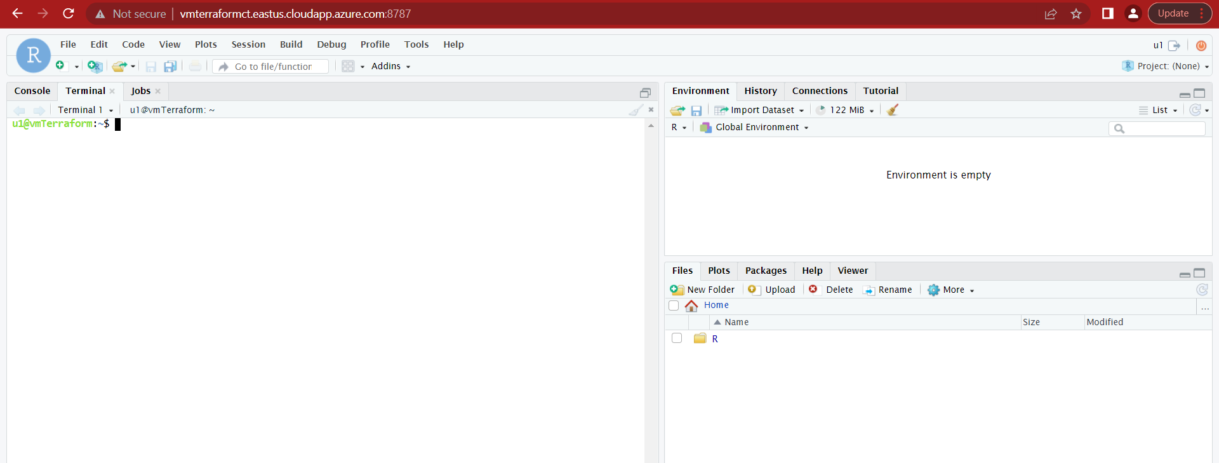
Lab Environment

Slide 15
Thank You

