Slide 1
DevOps

Slide 2
Configuration management
Process of maintaining systems, such as computer hardware and software, in a desired state
Configuration Management (CM) is also a method of ensuring that systems perform in a manner consistent with expectations over time.

Slide 3
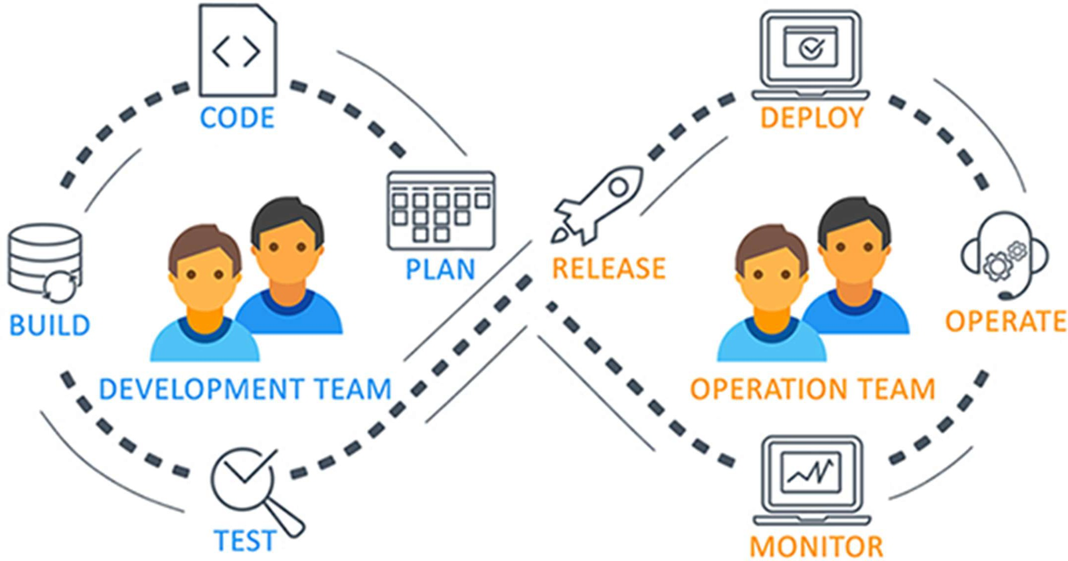
What and why of DevOps?

Slide 4
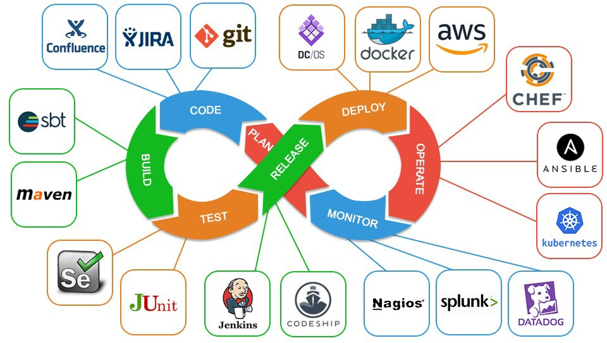
What and why of DevOps?

Slide 5
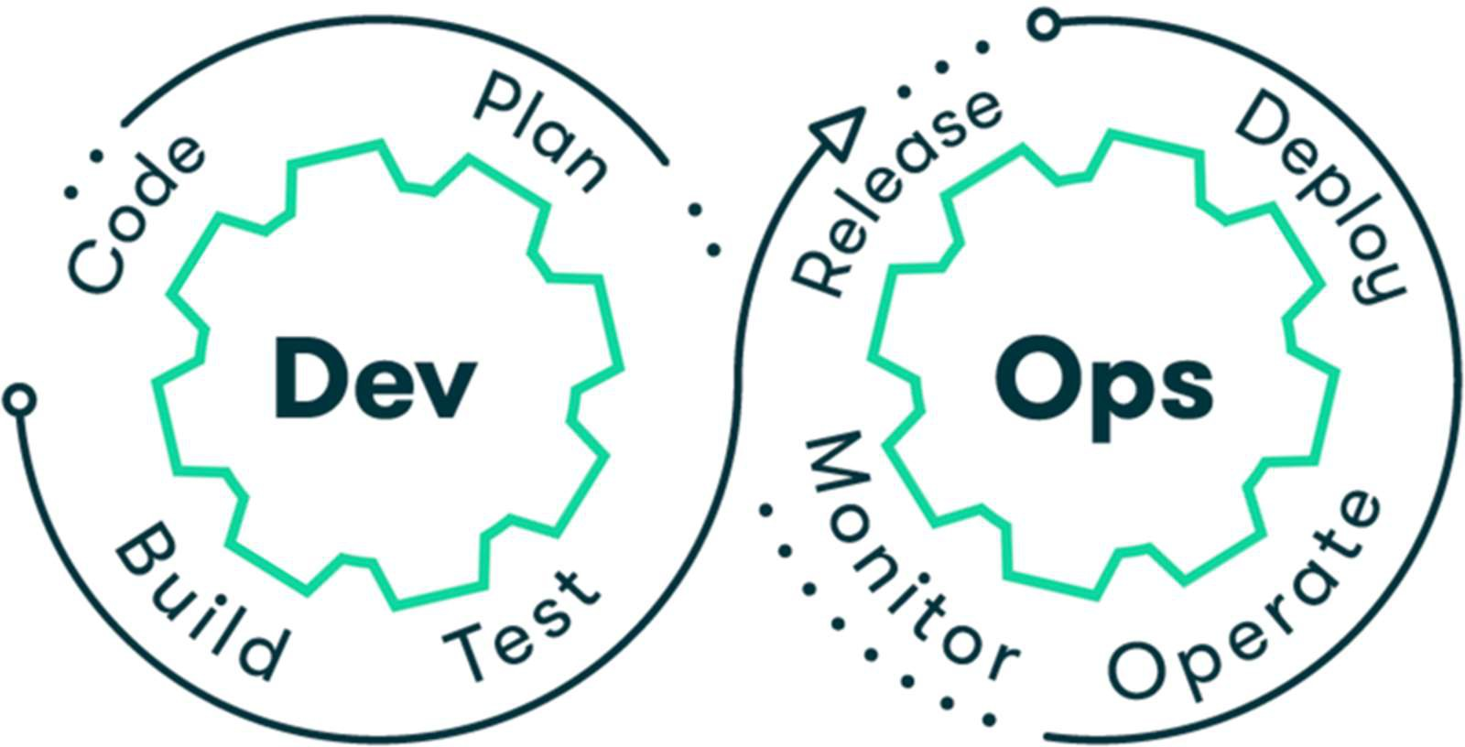
What and why of DevOps?

Slide 6
DevOps Tools – Overview and Use case

Slide 7
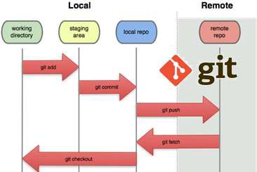
Source control
To ensures for working on the right version
Important for maintaining a single source of truth

Slide 8
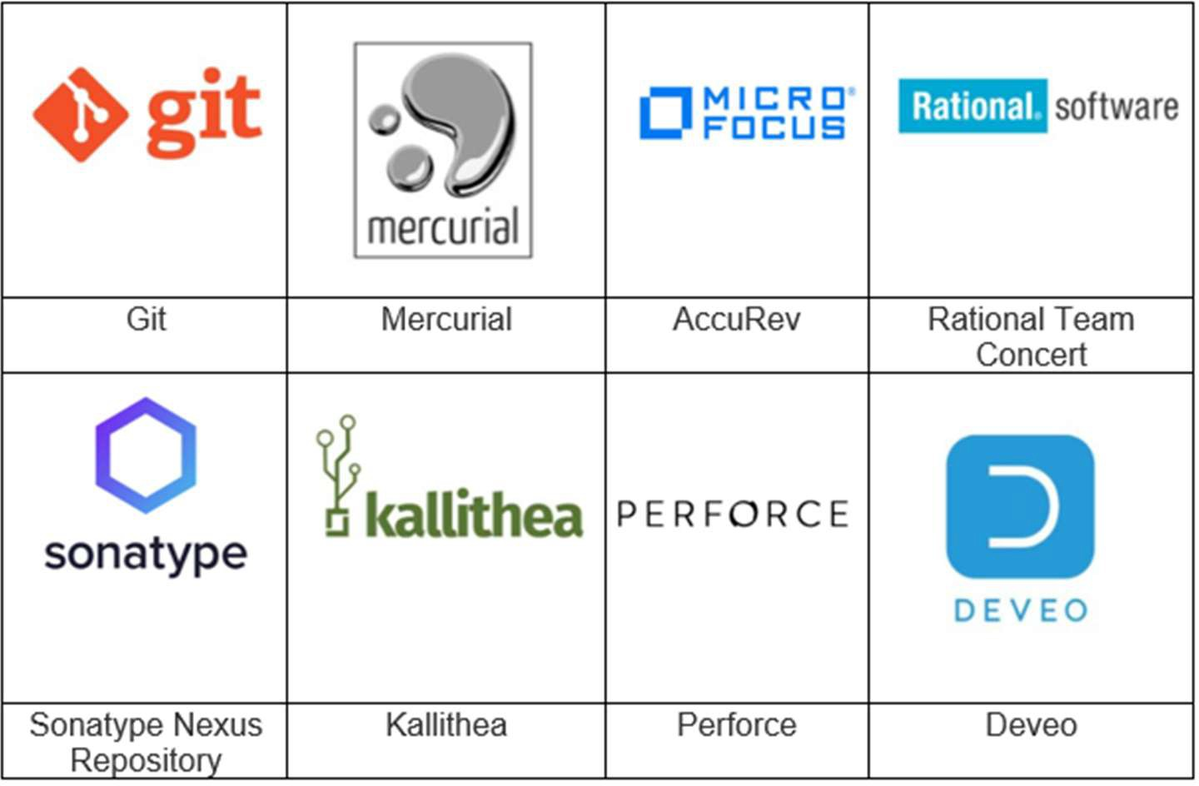
Source Control Management (SCM Tools)
Help to keep track of code
Complete history of changes.

Slide 9
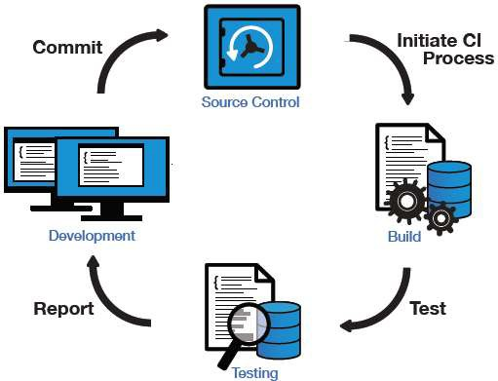
Continuous Integration

Slide 10
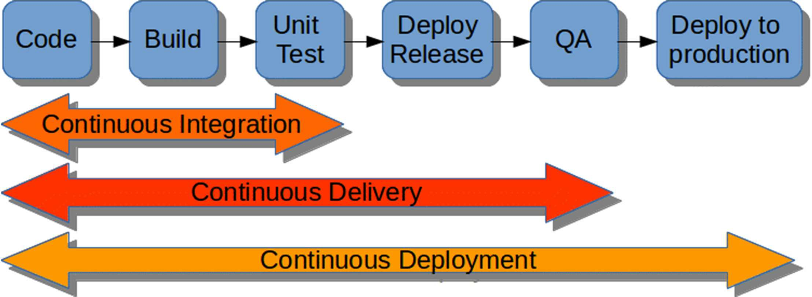
Continuous Delivery and Deployment

Slide 11
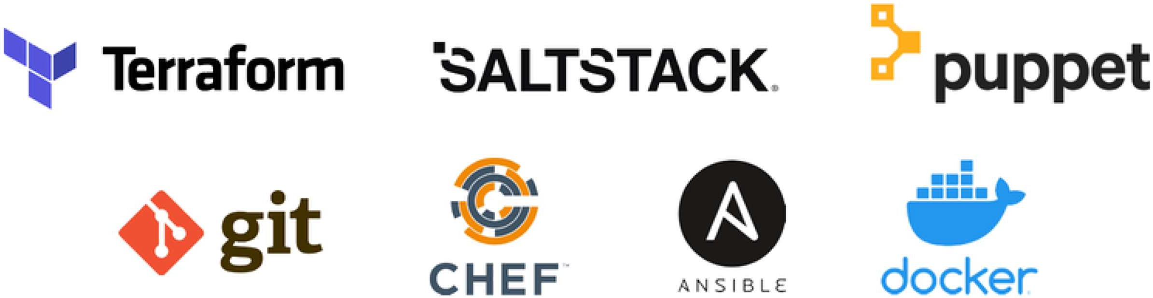
Configuration Management Tools

Slide 12
Thank You

