Slide 1

Terraform
1

Slide 2
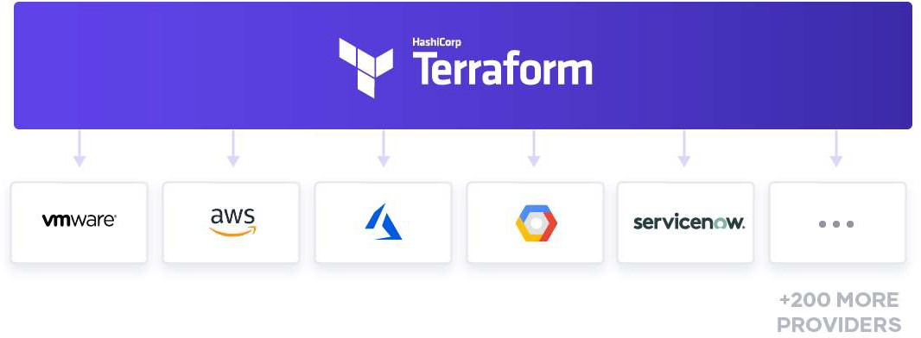
Introduction

Slide 3
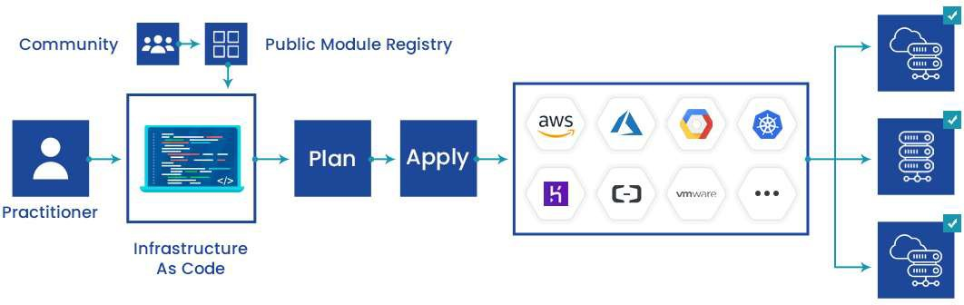
Introduction

Slide 4
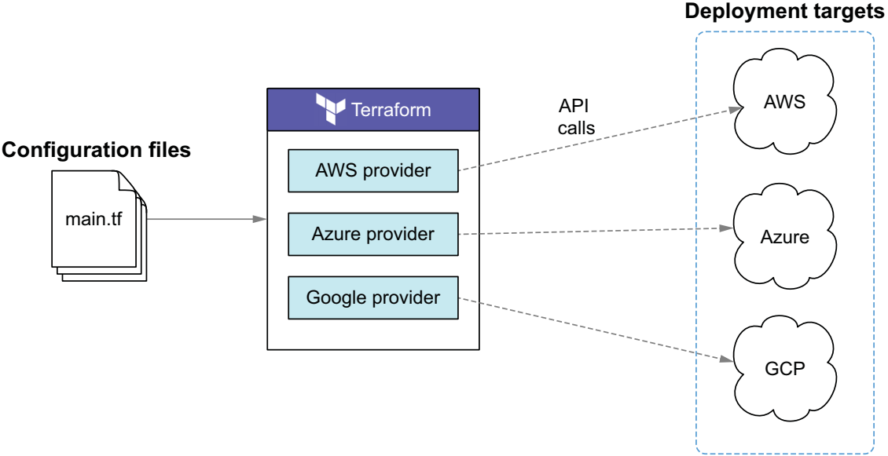
Deploy to multiple cloud using Terraform

Slide 5
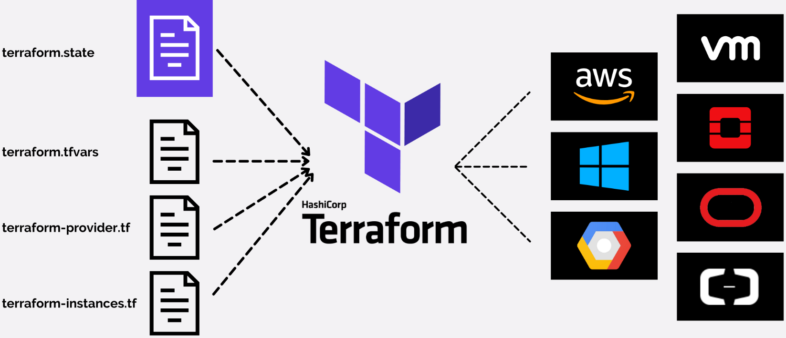
What is Terraform?
Notes:
Tool for
Building,
Changing, and
Versioning infrastructure safely and efficiently
Can manage
Existing and popular service providers as well as
Custom in-house solutions.

Slide 6
The key features of Terraform
Infrastructure as Code
Execution Plans
Resource Graph
Change Automation

Slide 7
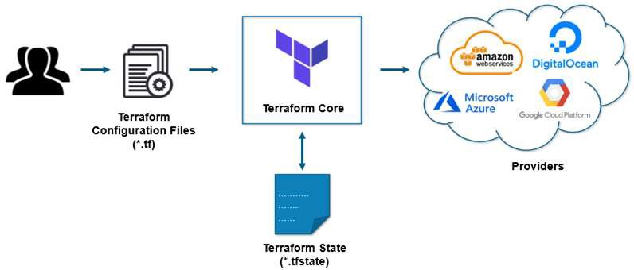
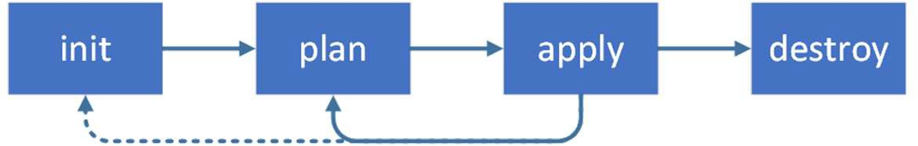
How Terraform works?

Slide 8
Install Azure CLI and Terraform
Azure CLI:
curl -L https://aka.ms/InstallAzureCli | bash
For Terraform, refer:
https://learn.hashicorp.com/tutorials/terraform/install-cli
Notes:
Steps
sudo apt-get update && sudo apt-get install -y gnupg software-properties-common curl
curl -fsSL https://apt.releases.hashicorp.com/gpg | sudo apt-key add –
sudo apt-add-repository "deb [arch=amd64] https://apt.releases.hashicorp.com $(lsb_release -cs) main“
sudo apt-get update && sudo apt-get install terraform
terraform -help

Slide 9
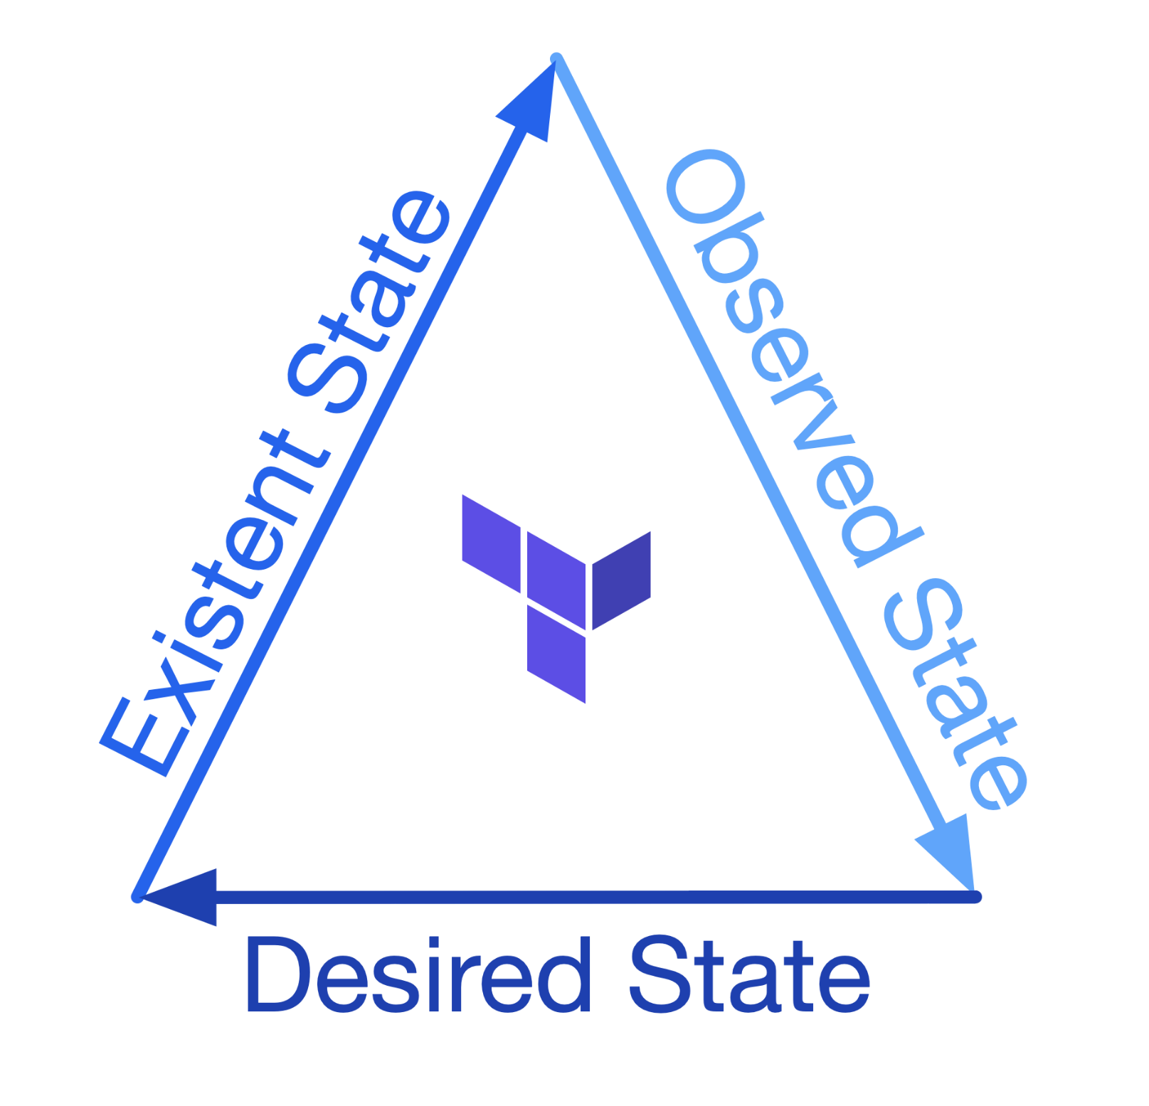
Terraform State
Notes:
Desired State
We wish for our resources to be in - *.tf
Existent/Actual State
Our resources are according to where they are deployed
Observed State
That Terraform has observed the resources to be in at its last run
This representation is held inside state files within our backend

Slide 10
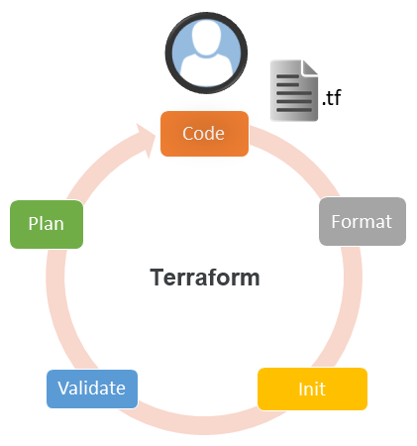
Steps
Notes:
Code development
Code formatting with terraform fmt
Initialization with terraform init
Code validation with terraform validate
Planning with terraform plan
Manual verification of Terraform changes on infrastructure

Slide 11
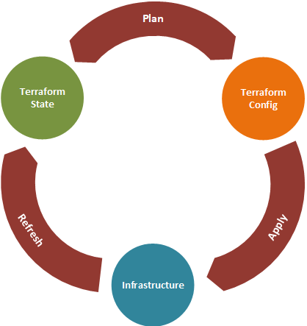
The Terraform Resource Lifecycle
Notes:
When applying a Terraform configuration,
Terraform starts with a refresh of its state-file, reading the information about its resources from the infrastructure, and updating its state-file.
It will look for differences between its state-file and its configuration-files, to make a plan.
It will apply the plan by creating, updating or deleting resources,
Finally, it will refresh its state-file with the information from the updated infrastructure.

Slide 12

Getting Started & Setting Up Labs
Install Terraform
Choosing Right IDE for Terraform
- VSCode
Use Azure and AWS account

Slide 13
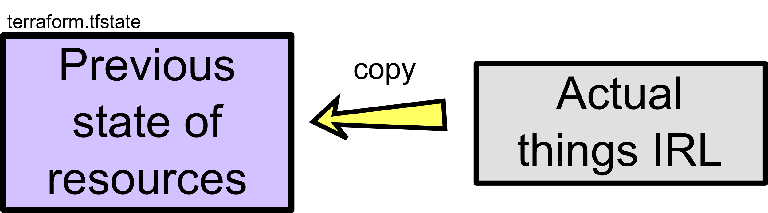
What terraform refresh does?

Slide 14
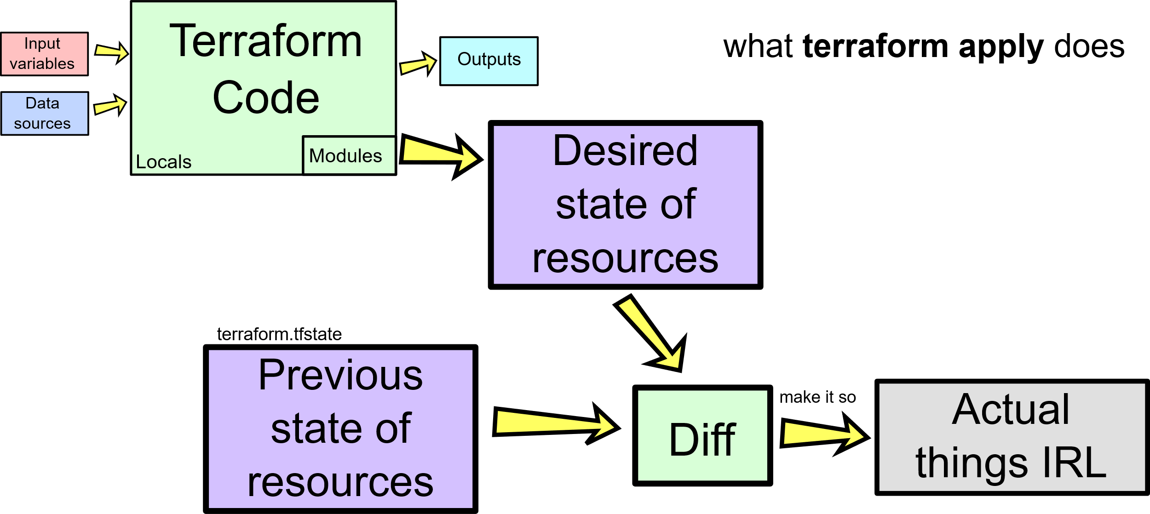
What Terraform apply does?

Slide 15
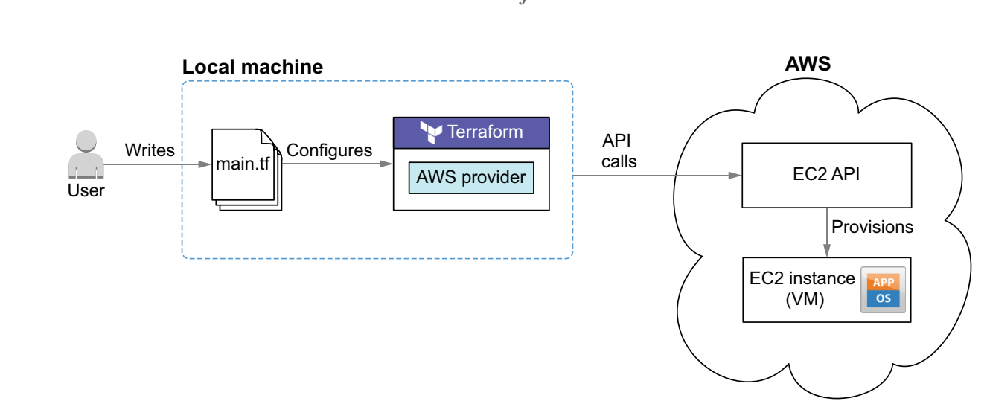
Using Terraform to Deploy EC2 instance to AWS

Slide 16
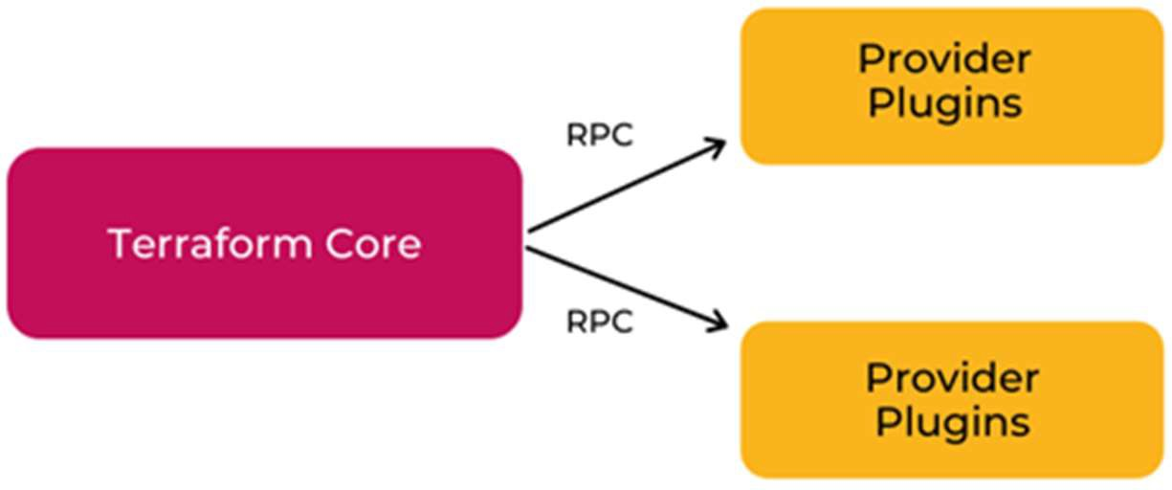
Terraform Core
Written in the Go programming language
The entry-point for anyone using Terraform
Primary responsibilities
Reading configuration files
Resource state management
Construction of the Resource Graph
Plan execution
Communication with plugins

Slide 17
Terraform Plugins
Each plugin exposes an implementation for a specific service
such as AWS, Azure
Plugin Locations
~/.terraform.d/plugins

Slide 18
An Introduction to Terraform Syntax
Called HashiCorp Configuration Language (HCL)
Human readable as well as machine-friendly
# An AMI
variable "ami" {
description = "the AMI to use“
}
resource "aws_instance" "web" {
ami = "${var.ami}"
count = 2
connection {
user = "root"
}
}

Slide 19
How to create reusable infrastructure

Slide 20
How to create reusable infrastructure
Module basics
Module inputs
Module outputs Versioned modules

Slide 21
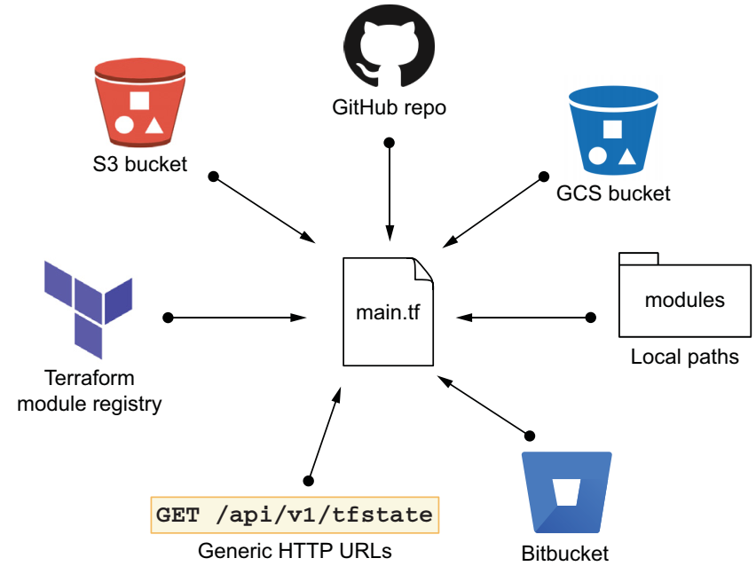
Module basics
Any set of Terraform configuration files in a folder is a module.
$ tree minimal-module/
.
├── README.md
├── main.tf
├── variables.tf
├── outputs.tf
A module can call other modules

Slide 22
Calling a Child Module
module "servers" {
source = "./app-cluster"
servers = 5
}

Slide 23
Module inputs
Parameters for a Terraform module
Like function arguments
variable "image_id" {
type = string
}
variable "availability_zone_names" {
type = list(string)
default = ["us-west-1a"]
}

Slide 24
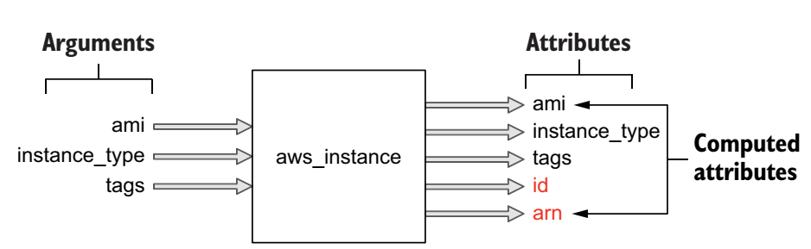
Using Input Variable Values
var.<NAME>
resource "aws_instance" "example" {
instance_type = "t2.micro"
ami = var.image_id
}

Slide 25
Variable Definitions (.tfvars) Files
To set lots of variables, it is more convenient to specify their values in a variable definitions file
And then specify that file on the command line with -var-file
terraform apply -var-file="testing.tfvars"

Slide 26
Module outputs
Like the return values of a Terraform module
output "instance_ip_addr" {
value = aws_instance.server.private_ip
}

Slide 27
Loops
resource "aws_lam_user" "example" {
count = 3
name = "neo.${count.Index}"
}
20

Slide 28
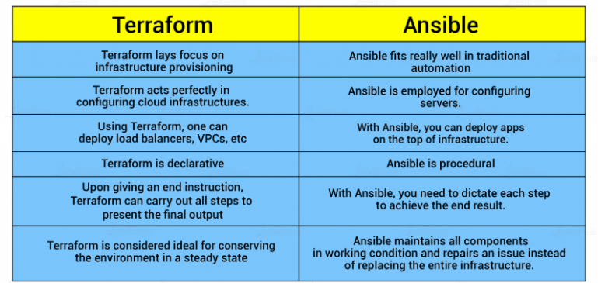
Terraform vs Ansible

Slide 29
Thank You

