Slide 1
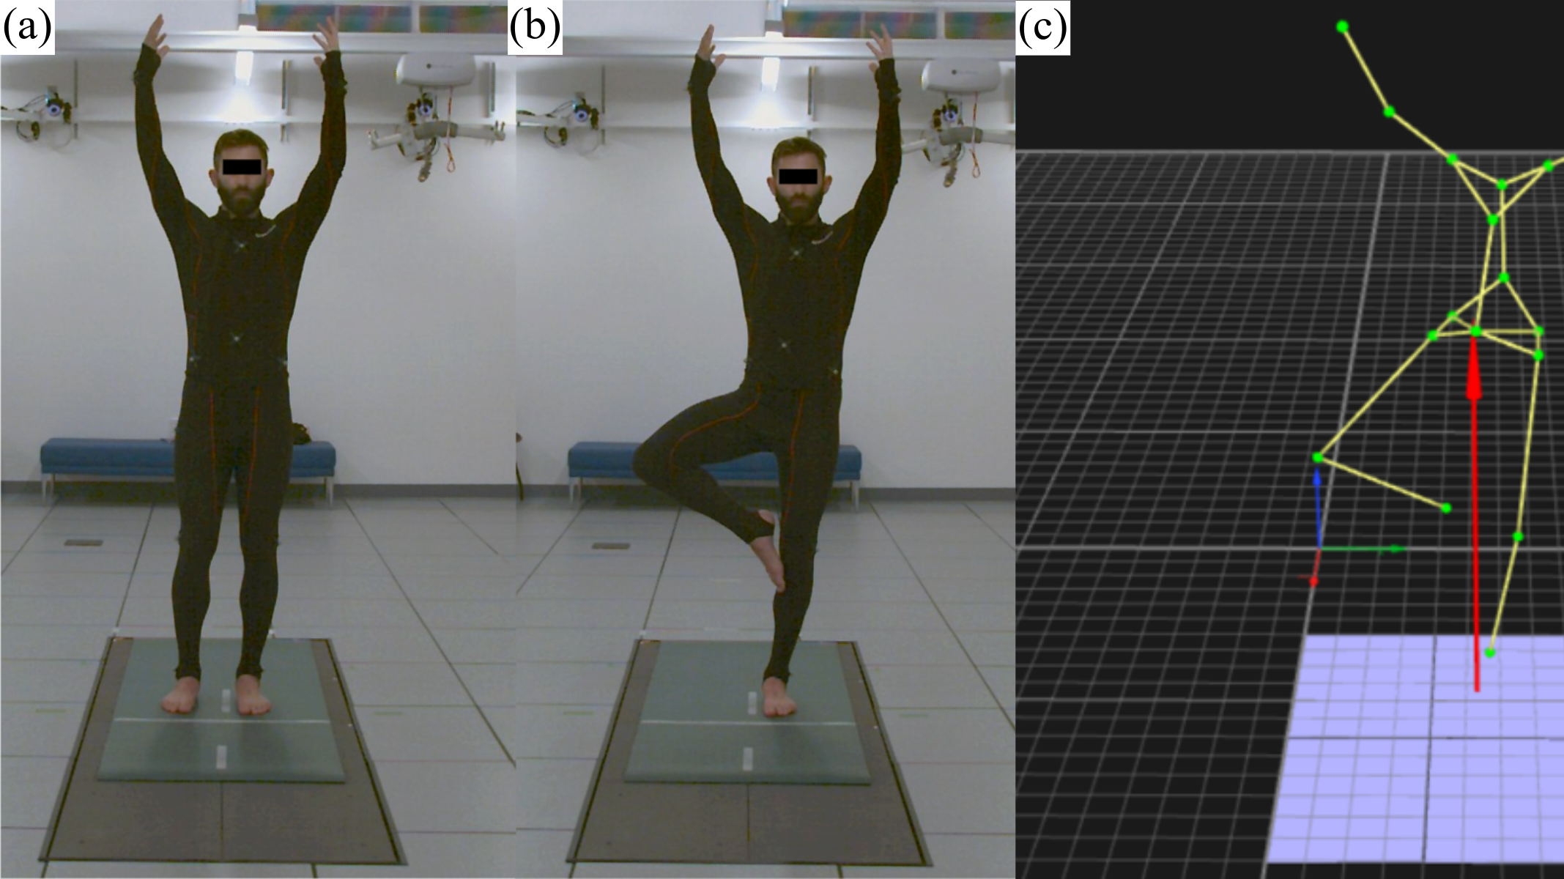
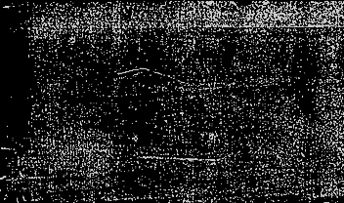
Multimodal Sensor Fusion for Balance Instability Assessment
INFO I-501 Group 4
Akanksha Tipparti, Srilakshmi Maddipati, Vishnu Sudarsanan, Volga Yerukola

Slide 2
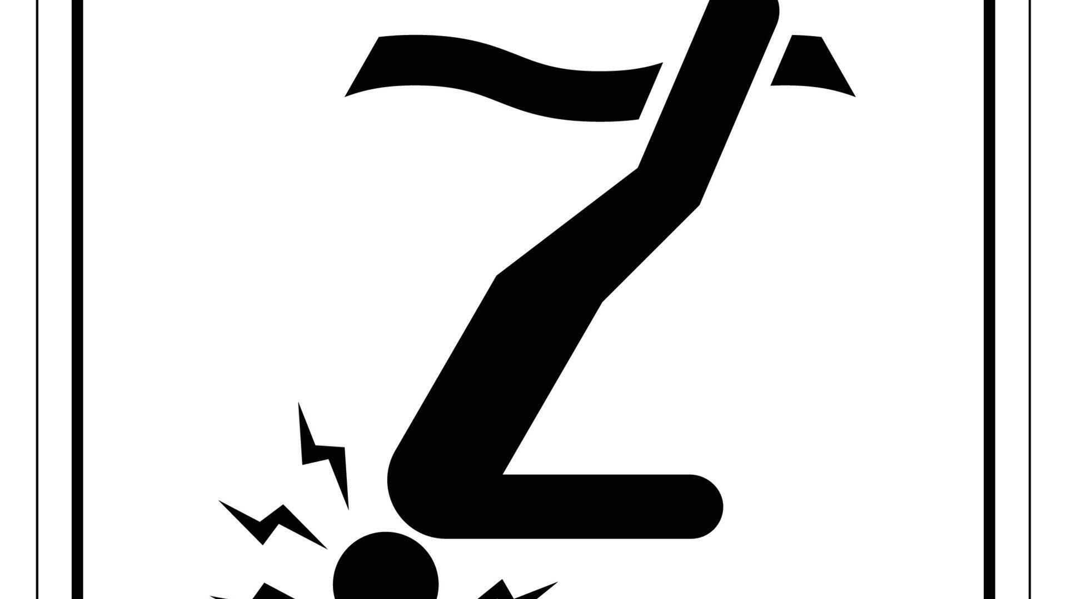

Introduction
Falls are a major global health issue, causing injury, disability, and death.
~37.3 million falls each year require medical attention.
Balance instability is a key predictor of fall risk; early detection of balance instability can help prevent serious injuries.
The One-Legged Stand Test (OLST) is commonly used to assess balance, often relies on manual observation or single measurements.
Traditional methods rely on single sensors → limited accuracy and fail to capture the full complexity of balance.
Balance is influenced by multiple factors and new technologies allow multimodal sensing:
Body movement → Motion capture
Force distribution → Force plates
Subtle micro-motions → Radar sensors
Missing this complexity → reduced accuracy in fall-risk prediction
Balance is complex, but current tools are too simple → need more accurate, objective, and data-driven methods for assessing balance instability
Improving assessment can lead to better prevention, monitoring, and patient outcomes.

Slide 3

Aim
Evaluate whether multimodal sensor fusion improves the detection of balance instability during the One-Legged Stand Test.
Purpose
To compare multiple machine learning models and identify the best-performing model, and to evaluate whether integrating multimodal data improves prediction accuracy.
Goal
Test whether combining multiple sensors improves prediction accuracy compared to single-sensor approaches.
Hypothesis
H0 (Null): Multimodal sensor fusion does not improve classification performance.
H1 (Alternative): Multimodal sensor fusion improves classification performance.

Slide 4

Dataset Overview
Dataset Selection
Publicly available multimodal synchronized OLST dataset
Includes labelled balance events
Supports comparison between:
Single-sensor vs multimodal approaches
32 participants (young and older adults)
1,241 One-Legged Stand Test (OLST) trials
Sensors Used:
Motion Capture (100 Hz): joint movement and posture (kinematics)
Force Plate (1200 Hz): ground reaction force & center of pressure (kinetics)
Radar (~27 Hz): non-contact detection of subtle body sway

Slide 5

Raw Data Acquisition
1
Multimodal sensor recordings from PhysioNet
Data Preprocessing & Feature extraction
2
SQL Data Cleaning
4
Removed trials with missing values
Ensured complete multimodal feature vectors
Feature Engineering
5
Performed EDA, & statistics
Machine Learning Modeling
6
Logistic Regression, Random Forest, Gradient Boosting.
Evaluation
7
Accuracy, ROC-AUC, confusion matrix.
Extracted statistical features (mean, std, RMS, etc.) for each attempt
Multimodal Fusion
3
Combined all sensor features into a single dataset
Dimensionality reduction using PCA and feature importance calculation
Project Workflow

Slide 6
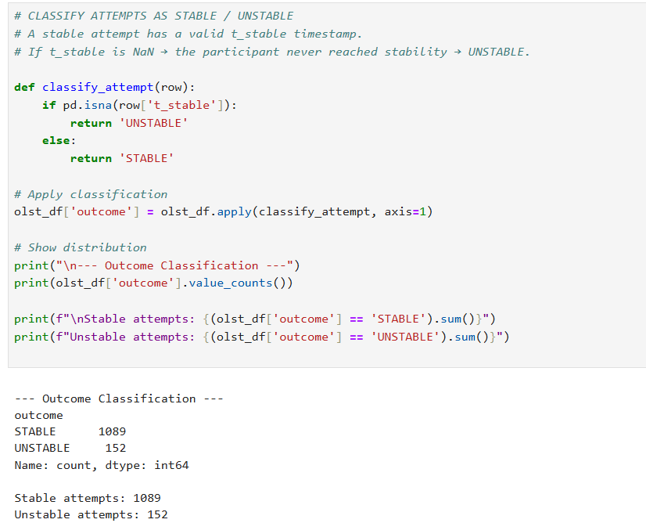
Classifying OLST Attempts
Why This Matters
Labeling logic:
t_stable = NaN → participant never reached stable posture → UNSTABLE
Class imbalance:
7:1 ratio (STABLE:UNSTABLE). All models use class_weight='balanced' to handle this.
1,241 labeled trial segments across 32 subjects.
~87.7%
~12.3%
STABLE
UNSTABLE

Slide 7
Features extracted across three modalities
MOCAP
Radar
Force Plate
25 features
19 features
16 features
Knee velocity (mean, std, max) — stance & lifted
Doppler centroid (mean, std, max, range)
COP Anterior-Posterior (range, mean, sd)
Knee acceleration (mean, std, max) — stance & lifted
Micro-velocity (mean, std, max, energy)
COP Medial-Lateral (range, mean, sd)
CoM displacement (mean, std, max, range X/Y)
Micro-acceleration (mean, std, max)
COP speed (mean, sd, max, computed mean)
CoM velocity (mean, std)
Amplitude total power (mean, std, range)
GRF-Z (mean, sd, cv%, range)
Trunk sway (std, range, velocity) — X & Y axes
Amplitude peak power (mean, std)
Sway path length (total, per second)
Amplitude variation (mean, std, max)
Total: 60 features merged on OLST_attempt_id → OLST_Final_Merged.csv (1,224 rows)

Slide 8
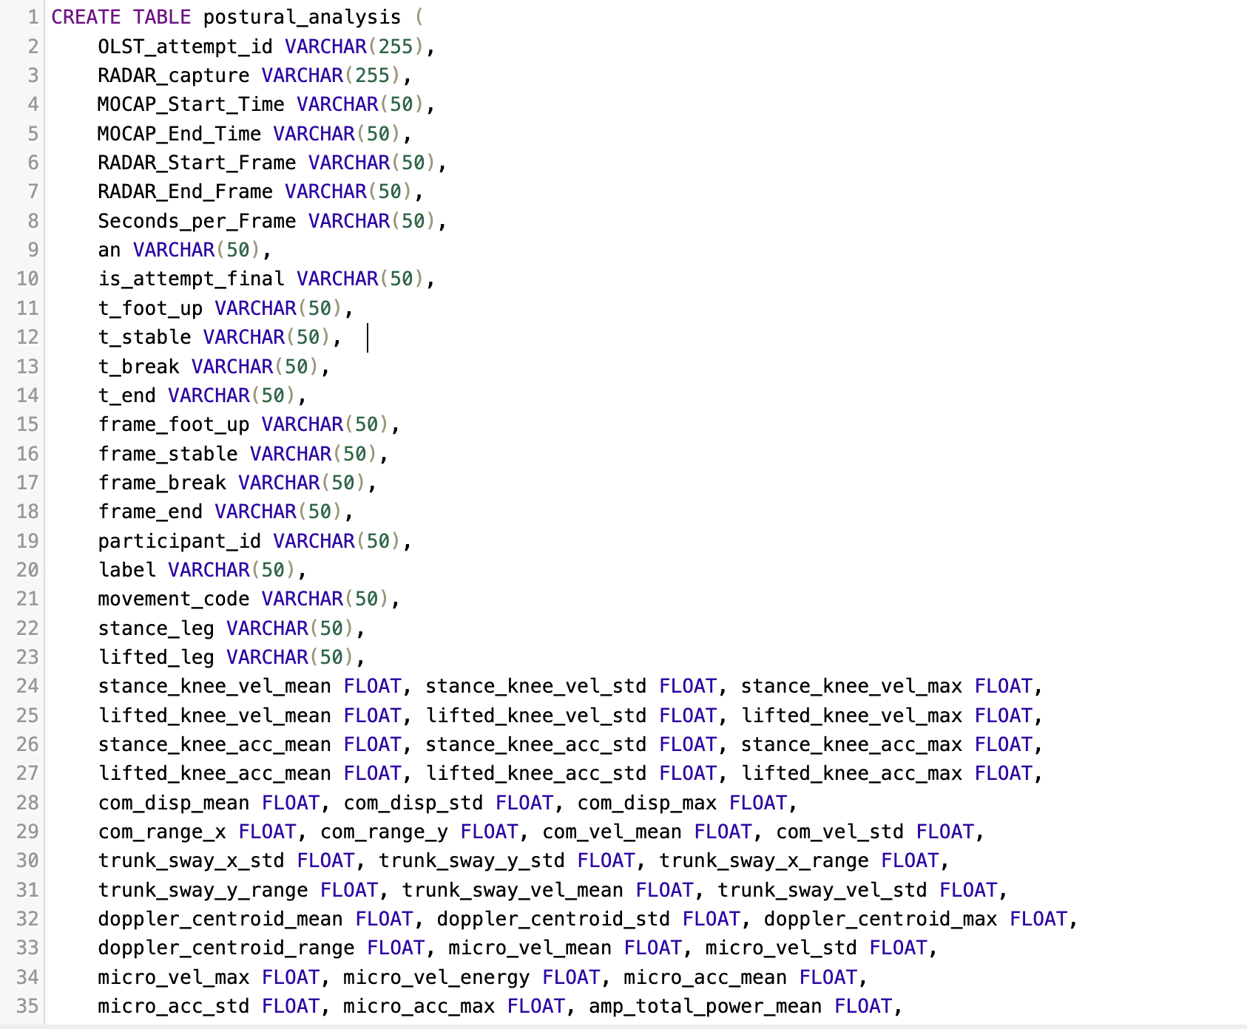
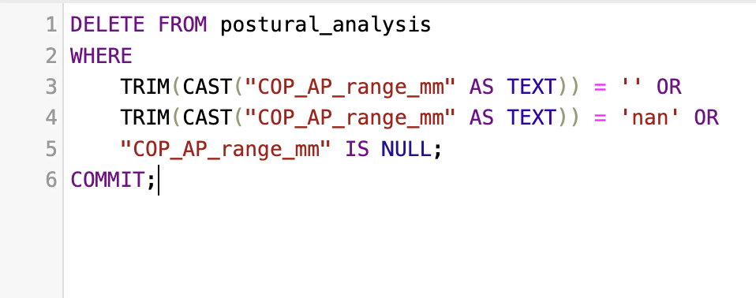
SQL Data Cleaning
Removal of incomplete trials: Deleted attempts with missing sensor values to ensure each observation had a full multimodal feature set (MOCAP, Radar, Force Plate).

Slide 9
EXPLORATORY DATA ANALYSIS
Statistical Testing: Mann-Whitney U + FDR Correction
60
41/60
15
Non-
normal
Total ML features
Significant (FDR p<0.05)
Large effect size features
Shapiro-Wilk → Mann-Whitney
Effect Size Distribution
Key Statistical Findings
Large (|r| ≥ 0.5) (n=15)
Force Plate features showed the strongest effect sizes - COP displacement and sway path had the largest rank-biserial correlations between STABLE/UNSTABLE groups.
MOCAP knee velocity features ranked 2nd strongest, especially lifted leg dynamics.
Radar features contributed smaller but statistically significant effects via Doppler frequency shift.
Medium (|r| ≥ 0.3) (n=10)
Small (|r| ≥ 0.1) (n=17)
Negligible (n=18)
Normality test: Shapiro-Wilk → most features non-normal → Mann-Whitney U selected over t-test; FDR corrected via Benjamini-Hochberg

Slide 10
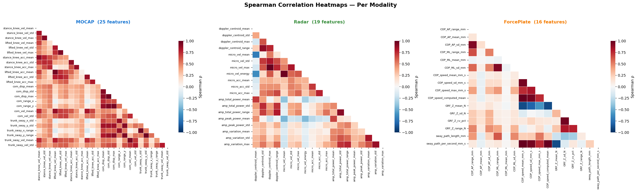
Spearman Correlation Heatmaps
corr = df[feat_cols].corr(method="spearman")
sns.heatmap(corr_matrix, mask=mask, cmap='RdBu_r', center=0, vmin=-1, vmax=1, linewidths=0.2, linecolor='white', annot=False, ax=ax, cbar_kws={'label': 'Spearman ρ', 'shrink': 0.6})

Slide 11
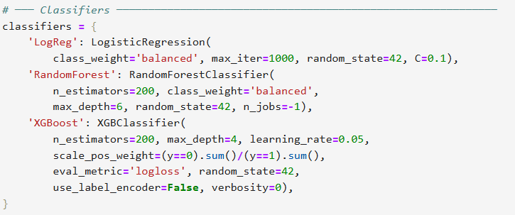
MACHINE LEARNING
Three Classifiers × Four Modalities × LOSO Cross-Validation
Logistic
Regression
Random
Forest
XGBoost
Modalities Evaluated:
MOCAP only
Radar only
Force Plate only
ALL (fused)
3 approaches: All features, PCA (95% var), Top-5 important features
LOSO Cross-Validation: Leave-One-Subject-Out — trained on 31 subjects, tested on 1. Repeated for all 32. Prevents subject-level data leakage since multiple trials per person exist.

Slide 12
Feature Importance
Top Features Across Modalities
Feature (RandomForest Gini Importance)
Importance Score
FP: COP sway path length
0.085
FP: COP displacement AP
0.078
MOCAP: lifted_knee_vel_mean
0.071
FP: GRF variability RMS
0.067
MOCAP: com_vel_std
0.063
MOCAP: lifted_knee_acc_max
0.058
FP: COP velocity mean
0.055
RADAR: Doppler freq shift mean
0.049
MOCAP: trunk_sway_amplitude
0.047
RADAR: Signal amplitude std
0.041
MOCAP
Force Plate
Radar
Note: Feature importance reflects RF Gini importance trained on full data (all 1,224 trials).

Slide 13
Leave-One-Subject-Out Evaluation Function
def loso_evaluate(X, y, participants, clf):
unique_pids = np.unique(participants)
all_y_true, all_y_prob = [], []
for pid in unique_pids: # 32 folds
test_idx = (participants == pid)
train_idx = (participants != pid)
# Scale inside fold (no leakage)
scaler = StandardScaler()
X_tr = scaler.fit_transform(X[train_idx])
X_te = scaler.transform(X[test_idx])
clf.fit(X_tr, y[train_idx])
probs = clf.predict_proba(X_te)[:,1]
all_y_prob.extend(probs)
return roc_auc_score(all_y_true, all_y_prob)
Why LOSO?
Multiple trials per subject → random split would leak identity signal across train/test. Scaler fit on train only → prevents mean/variance leakage. Metrics pooled across all 32 folds → reported as mean ± std.
Same function used for all feature strategies (all, PCA, top-N).

Slide 14
FINAL SUMMARY
Modality
Approach
Classifier
AUC (mean±std)
F1
BAC
All
All features
XGBoost
0.961 ± 0.050
0.745
0.868
All
Top-5
LogReg
0.960 ± 0.054
0.769
0.895
All
PCA
RandomForest
0.952 ± 0.068
0.710
0.832
ForcePlate
All features
LogReg
0.916 ± 0.099
0.596
0.835
ForcePlate
PCA
LogReg
0.914 ± 0.094
0.558
0.827
ForcePlate
Top-5
XGBoost
0.909 ± 0.097
0.579
0.793
MOCAP
All features
XGBoost
0.966 ± 0.051
0.795
0.888
MOCAP
Top-5
RandomForest
0.961 ± 0.052
0.768
0.883
MOCAP
PCA
LogReg
0.946 ± 0.083
0.679
0.874
Radar
All features
LogReg
0.885 ± 0.127
0.504
0.800
Radar
PCA
LogReg
0.881 ± 0.126
0.501
0.799
Radar
Top-5
RandomForest
0.821 ± 0.082
0.337
0.610
MOCAP+XGBoost (all features) leads with AUC=0.966. Multimodal fusion (All+XGBoost) reaches AUC=0.961 with lower F1=0.745 — H₀ retained: fusion did not outperform the best single modality. All+LogReg+Top-5 achieves best BAC=0.895 for screening use.

Slide 15
Results
Hypothesis Evaluation & Key Findings
H₀ RETAINED : Multimodal fusion did NOT significantly outperform the best single-modality model.
MOCAP+XGBoost (AUC=0.966) > All sensors fused (AUC=0.961). Fusion improves over weak modalities but not over the strongest single sensor.
1
MOCAP is the strongest feature
2
Fusion did not outperform MOCAP
MOCAP+XGBoost (all feat): AUC=0.966, F1=0.795, BAC=0.888 the single best combination across all 12 tested.
All sensors + XGBoost: AUC=0.961, F1=0.745
lower AUC and F1 than MOCAP alone. Fusion adds noise, not signal.
3
Fusion helps weak modalities
4
Kinematics provide more information than balance
ForcePlate (0.916) and Radar (0.885) both benefit from fusion context. Fusion rescues weak sensors, not strong ones.
MOCAP knee velocity and CoM features capture most of the balance signal - COP and Doppler add limited value.

Slide 16
Conclusions
H₀ retained: MOCAP alone (AUC=0.966) outperforms multimodal fusion (AUC=0.961) - fusion did not significantly improve over the best single sensor
MOCAP knee kinematics dominate balance classification - lifted knee velocity and CoM features carry the most discriminative signal
Fusion helps weak modalities: ForcePlate (0.916→0.961) and Radar (0.885→0.961) benefit, but MOCAP is already near-ceiling
Top-5 features lose <0.006 AUC vs. all 60 features - highly efficient feature sets are viable

Slide 17

Appendix

Slide 18
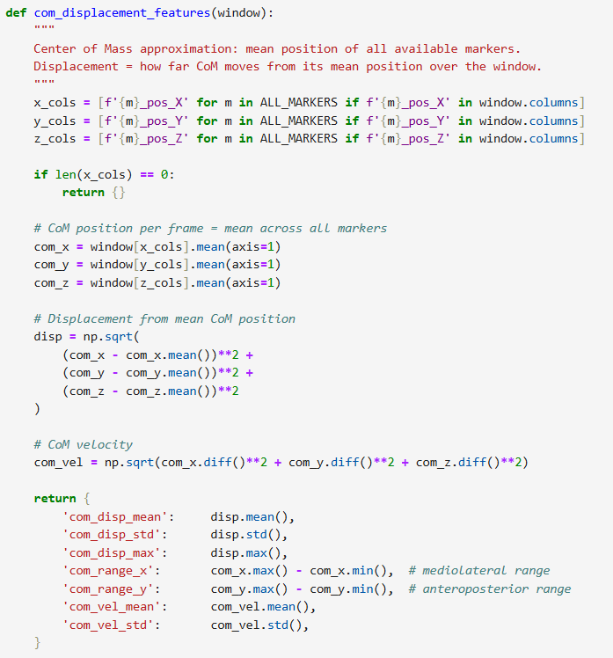
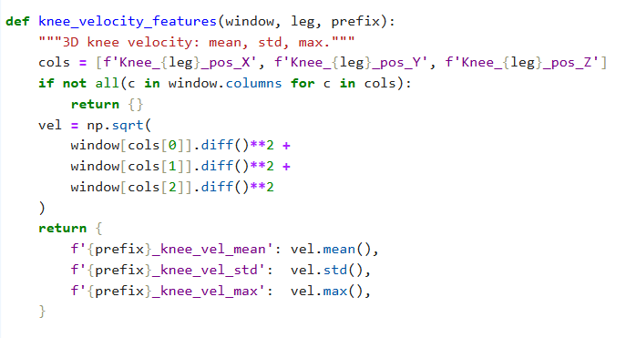
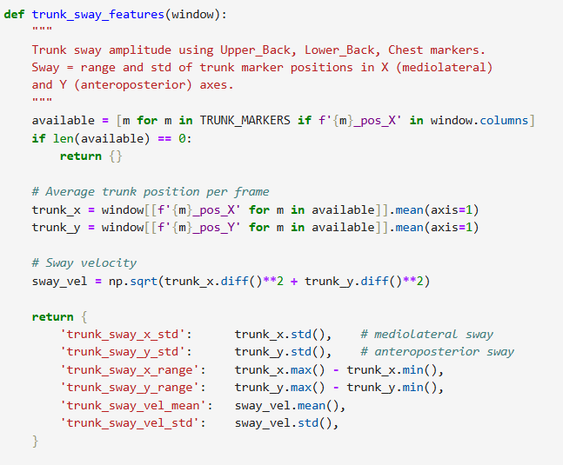
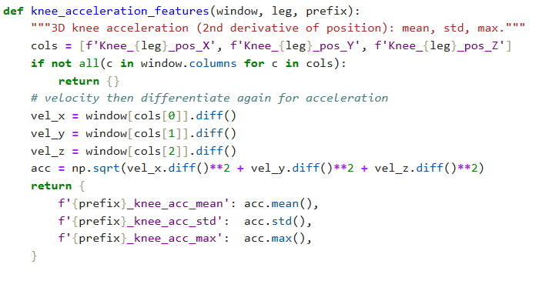
MOCAP Feature extraction code

Slide 19
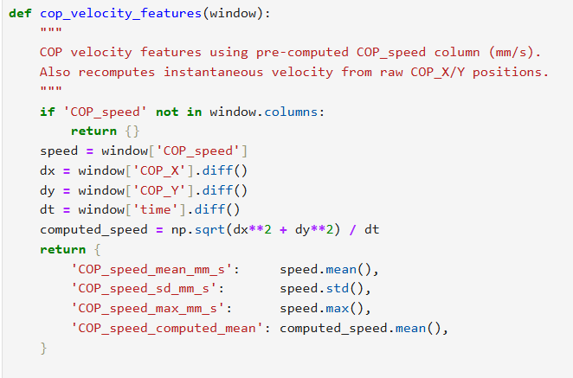
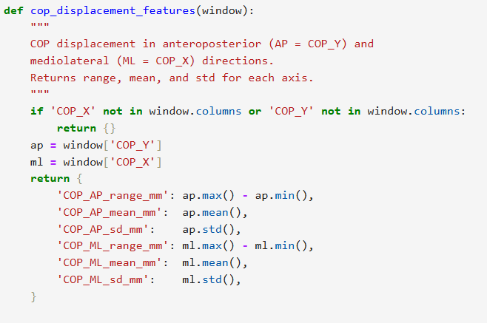
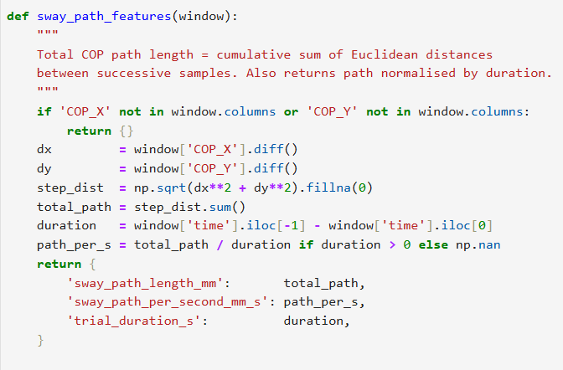
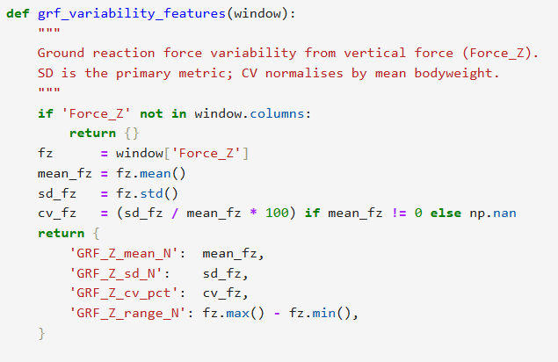
Forceplate Feature extraction code

Slide 20
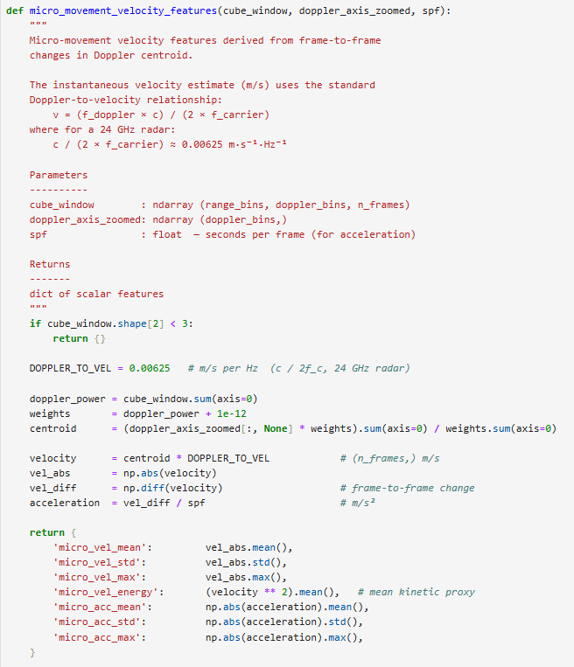
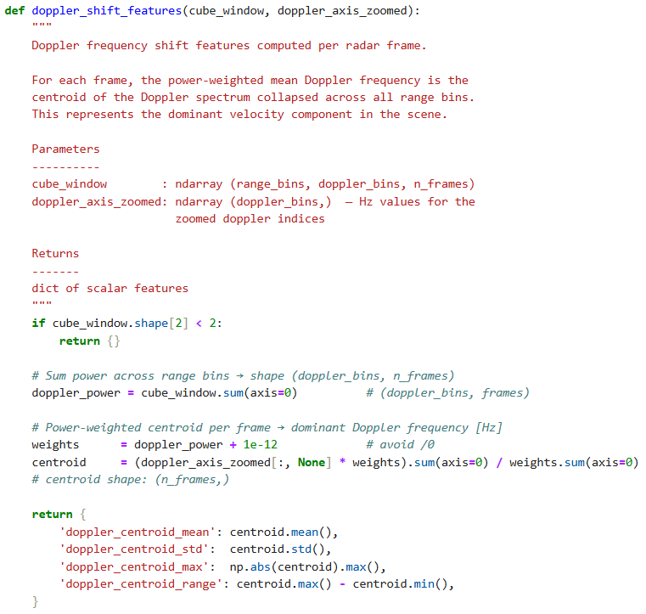
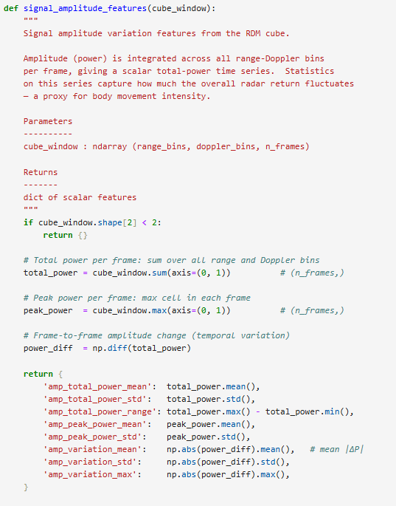
Radar Feature extraction code

Slide 21
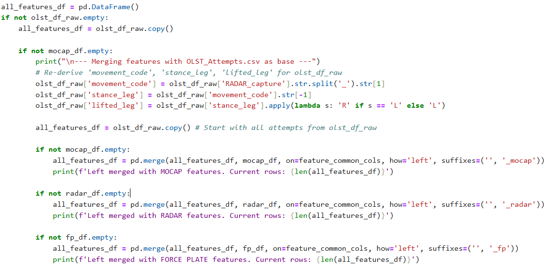
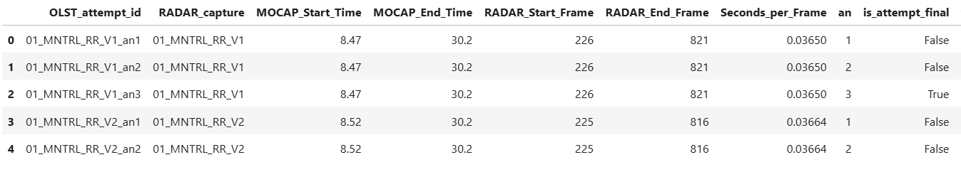
Merging all the features into one CSV and the final Merged Dataframe

Slide 22
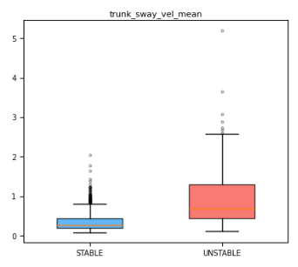
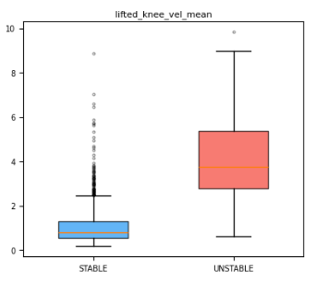
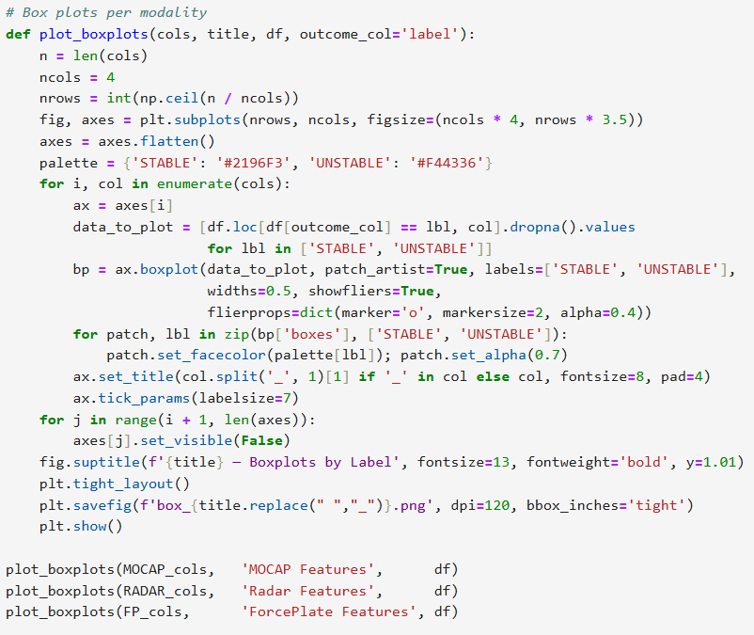
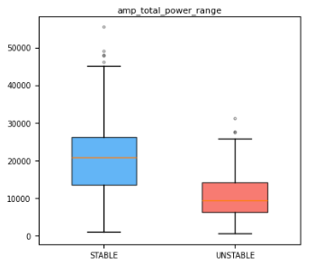
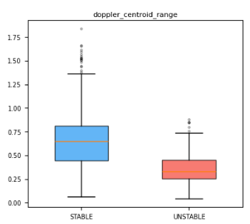
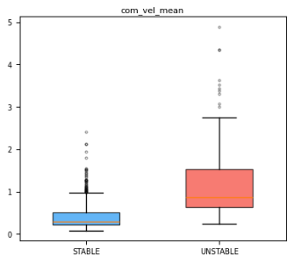
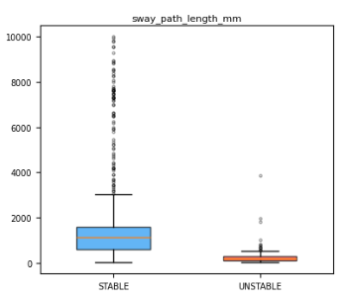
Distribution between two groups – Box-whisker plots

Slide 23
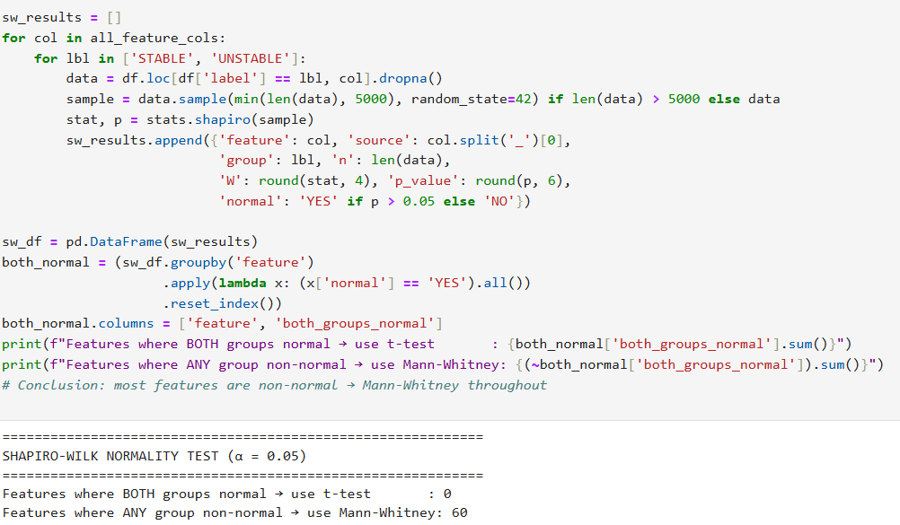
Shapiro-Wilk Normality test

Slide 24
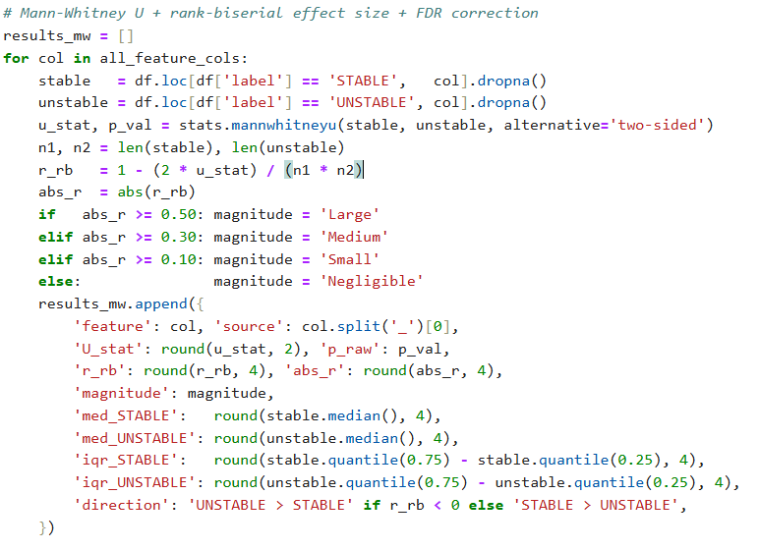
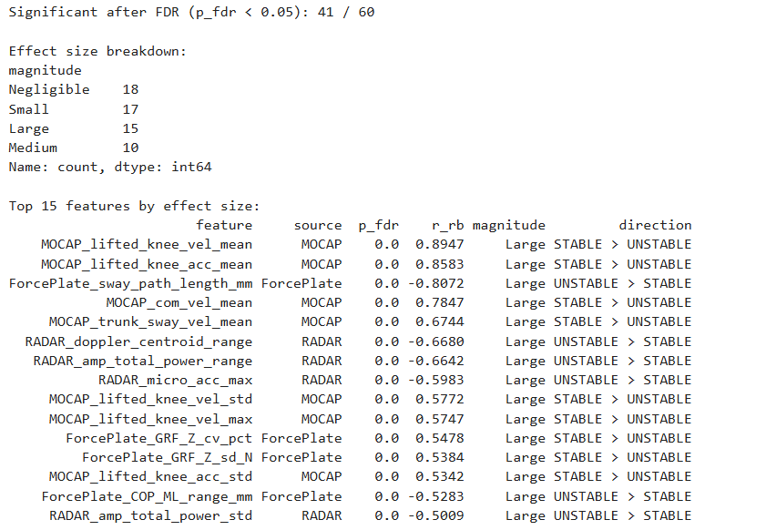
Mann-Whitney U Test

Slide 25
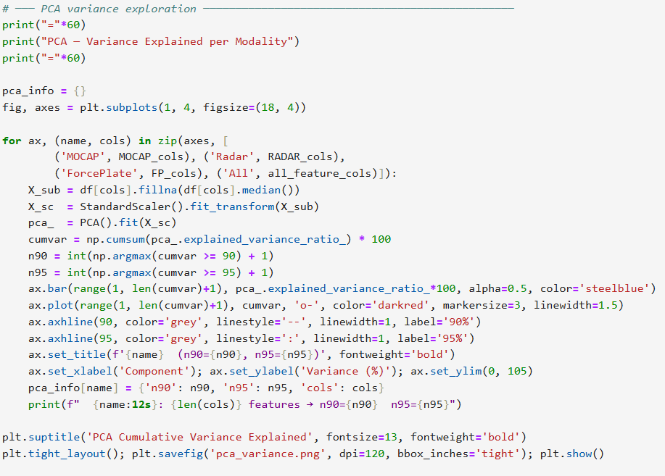
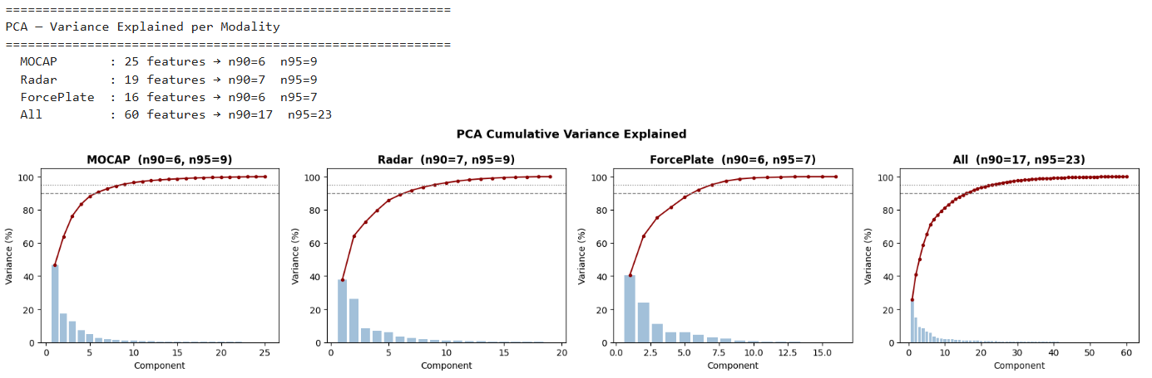
PCA

Slide 26
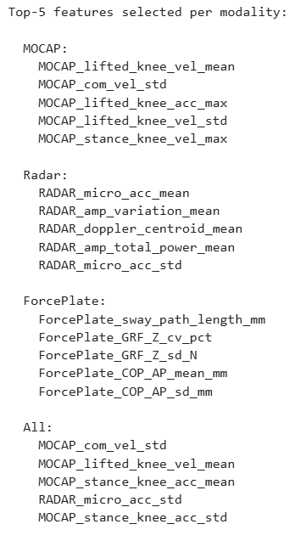
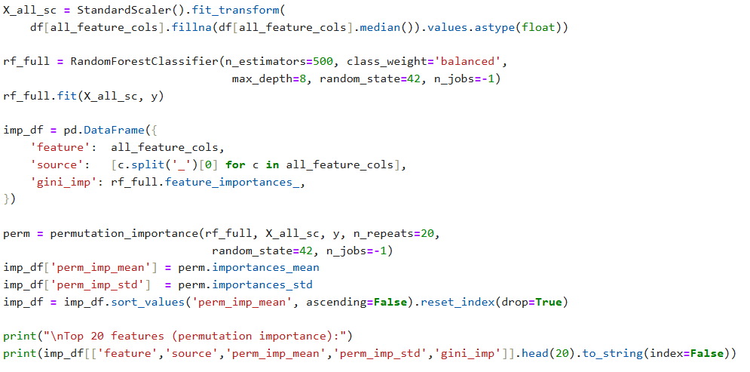
Feature Importance

Slide 27
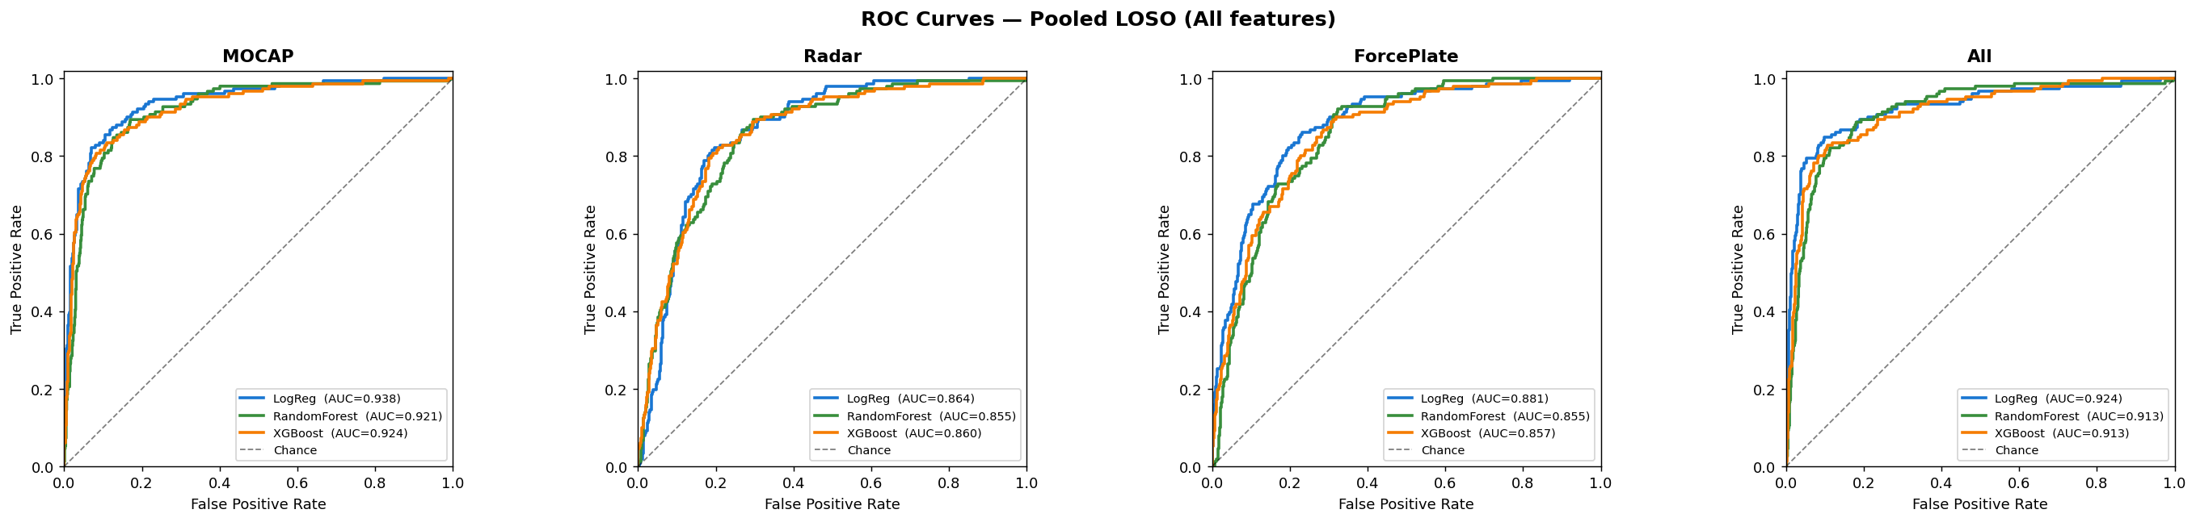
ROC curves

