Slide 1
ICT Education in Bangladesh: Secondary and Higher Secondary Level
BUS 503: Business Communication

Slide 2
Presented To
Mr. Md. Iftekharul Amin
Assistant Professor
Institute of Business Administration
University Of Dhaka

Slide 3
Presented by
Group-3
5th Semester, BSSE 07 Batch
Institute of Information Technology
University of Dhaka
Members | Roll
Md. Shihab Shahriar Khan | 703
Shuvo Saha | 705
Md. Eusha Kadir | 708
Maliha Nawshin Rahman | 713
Md. Aquib Azmain | 718

Slide 4
Presentation Outline
Background
Objectives
Scope
Limitations
Methodology
Challenges
Findings
Recommendations

Slide 5
Background
Computer science was introduced as an optional subject for secondary level students from 1994
About 150 schools were permitted to teach the subject
ICT has been introduced in National Education Policy 2010
ICT has been made compulsory in SSC since 2015
ICT has been made compulsory in HSC since 2015

Slide 6
Objectives
Broad Objective:
Analyze the overall state of ICT Education of Secondary and Higher Secondary level in Bangladesh.

Slide 7
Objectives
Specific Objectives:
Analyze the existing status of ICTs education in the mainstream educational institutions of Bangladesh
Explore the prospects of ICT education in the said field
Identify the problems of ICTs in education sector

Slide 8
Objectives
In particular, this project hopes to answer:
Is the current ICT syllabus a perfect fit for the stated goals of ICT education?
Is our material and human resources both qualitatively and quantitatively capable of handling country’s huge number of students?
Are students capable of coping up with the material?
What are the biggest problems currently faced by our educators and students?
How should the government’s policy and its execution change to reflect the realities on the ground and address those problems?

Slide 9
Objectives
Our objective is to find some way to meet up the following challenges:
Slow decision-making process in the government level
Uninterrupted electricity and internet connectivity
Lack of multimedia contents
Lack of trained and potential teachers

Slide 10
Scope
Interview students and teachers
Gather opinion about the current state of ICT Education
Interview policy makers to know their vision for ICT Education
Inform the interviewee about currently faced problems and ask for solutions
Interview domain experts on the effectiveness of the curriculum and changes recommended

Slide 11
Limitations
Interview limitations
Small sample size
Lack of prior research studies on this topic
Lack of expertise in the domain
Interviewee Bias

Slide 12
Methodology
Population and unit of analysis –
Some schools and colleges of Dhaka city were selected as the unit of analysis. We have collected informed opinion from all stakeholders (teachers, professors and government) on the current state of ICT education. Finally we tried to draw a conclusion over the population. We have collected information from Ministry of Education, Ramna, Dhaka, Bangladesh. We have discussed with professors on this topic.

Slide 13
Methodology
Data collection techniques - Interview.
Interviews are particularly useful for getting the story behind a participant’s experiences. We decided to use the interview as data collection techniques for this project.

Slide 14
Methodology
Data Analysis –
Finally we have analyzed the information. By this we have concluded a summary of our project in chapter 3. We hope we have found answers of our questions and found some ways to solve the problems of ICT education in Bangladesh.

Slide 15
Challenges
Slow decision-making process in the government level
Uninterrupted electricity and internet connectivity
Lack of multimedia contents
Lack of trained and potential teachers

Slide 16
Interviewee
Dr. Aruna Biswas, Additional Secretary, Ministry Of Education
Dr. Umme Salema Begum, Principal, Udayan School & College, Dhaka
Rubina Tasneem, Assistant Professor, Head of ICT department, Viqarunnisa Noon School and College.
Sheikh Mohammad Arif, Senior Lecturer, Notre Dame College, Dhaka
Dr. Zerina Begum, Professor, Institute of Information Technology, University of Dhaka

Slide 17
Question
What is the existing status of ICTs education in the mainstream educational institutions of Bangladesh?
ICT is being taught by qualified teachers but teacher to student ratio is very poor
ICT is a heavy burden for most students and a nuisance for some
Although some are getting poor grades in School exams almost all students are getting their desired grades in their SSC and HSC exams

Slide 18
Question
Problems of ICT education sector
Poor teacher to student ratio
Inadequate Facilities
Ambiguous Syllabus
Unnecessary complicated content
Fear of failure

Slide 19
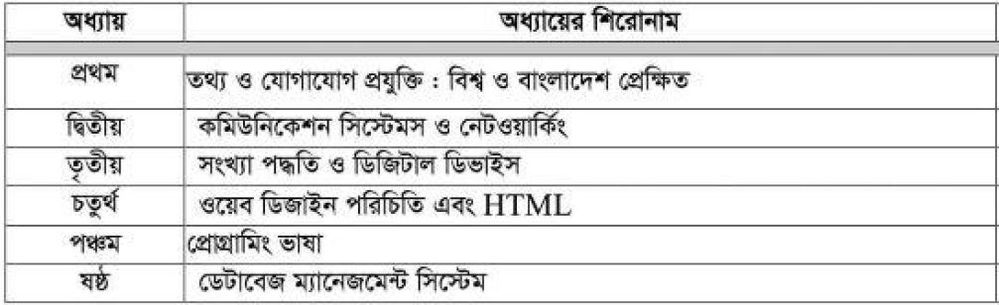
Syllabus Appropriateness
Current HSC ICT Syllabus:

Slide 20
Question
Is the current ICT syllabus a perfect fit for the stated goals of ICT education?
Government goal: Teaching students how to use ICT
Discrepancy between government goals and syllabus content
The syllabus was designed to teach “how ICT works” not “how to use ICT”
But according to ICT teachers, most students already know how to use ICT

Slide 21
Question
Is our material and human resources both qualitatively and quantitatively capable of handling country’s huge number of students?
Poor teacher to student ratio
Inadequate Lab facilities
Lack of qualified teachers

Slide 22
Question
Are students capable of coping up with the material?
Students from low income families are especially struggling
Most students, especially those from Arts and Commerce, are over burdened by ICT

Slide 23
Question
What are the biggest problems currently faced by our educators and students?
Syllabus content is large, complex and ambiguous
Poor student to teacher ratio
Most students, especially those from Arts and Commerce, are over burdened by ICT
Inadequate Lab Facilities

Slide 24
Question
How should the government’s policy and its execution change to reflect the realities on the ground and address those problems?
Clearly define scope of the syllabus
Provide standardized textbooks
Trim syllabus content to omit unnecessary and complicated topics
Make ICT an optional subject again
Hire more, qualified teachers
Construct more ICT labs

Slide 25
Question
What are the steps taken by government to meet up the lack of multimedia contents and labs?
The government has decided to set up 2,000 computer labs and 64 language training labs in educational institutions across the country
(Source: http://www.thedailystar.net/city/govt-set-2000-computer-labs-165892, Last Accessed On: 10:50AM, 06/03/2017)

Slide 26
Question
What are the government objectives for ICT?
To produce competent manpower of international standard, trained and educated in information technology to perform efficiently in relevant fields
Information technology will not be limited to computer science only, rather mobile phones, radio, television data collection and processing of information are also to be included and emphasis will be given on its multi-angular necessity

Slide 27
Question
What are the steps taken by government to meet up the lack of trained teachers of ICT?
For teacher training in secondary and higher secondary education, 20 computer labs were established for each of the Teachers’ Training Institutes in the country under the Teaching Quality Improvement for Secondary Education Project.
From January 2011 to June 2013, a total of 7000 and 5000 secondary and higher secondary teachers respectively, received training
Source: “Strategic Priorities of Digital Bangladesh” prepared by Access to Information (A2I) Program Prime Minister’s Office in 2011

Slide 28
Viewpoints of Government Personnel
Government Personnel
Familiarize with modern day technology
Setting up multimedia labs
Syllabus will be ‘demand-driven’
Set ICT as a mandatory subject at lower levels

Slide 29
Viewpoints of Teachers
Teachers
Students are familiar with modern Technology
Syllabus is very large, complex and ambiguous
Not enough labs
Digital logic and Circuit design should be shortened
Syllabus should be more clearly defined

Slide 30
Viewpoints of IT Professionals
IT Professionals
Only elementary knowledge is needed
Number of ICT teachers is too low
Recruit and train more teachers
Syllabus should be updated

Slide 31
Recommendations
Make ICT optional subject
Qualified teachers should be recruited
Provide only basic khowledge of ICT
Adequate ICT labs
Define syllabus

Slide 32
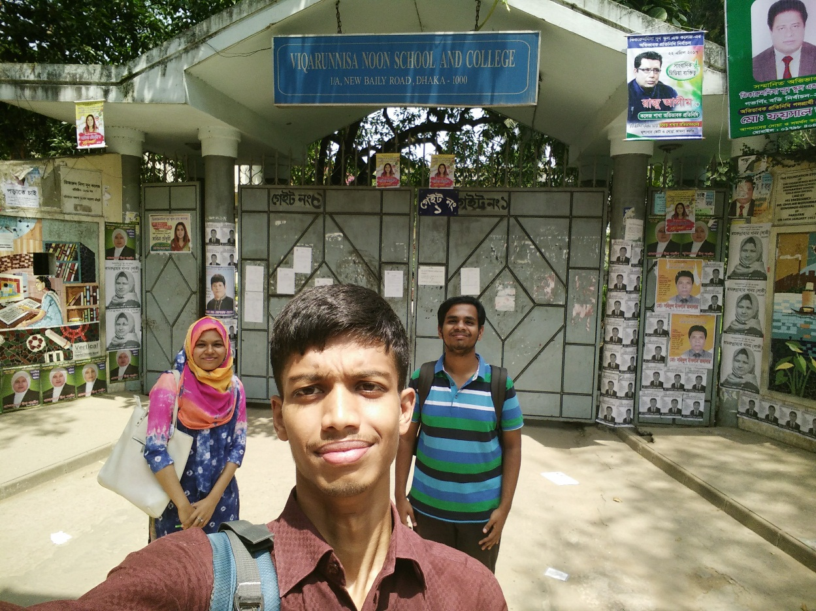
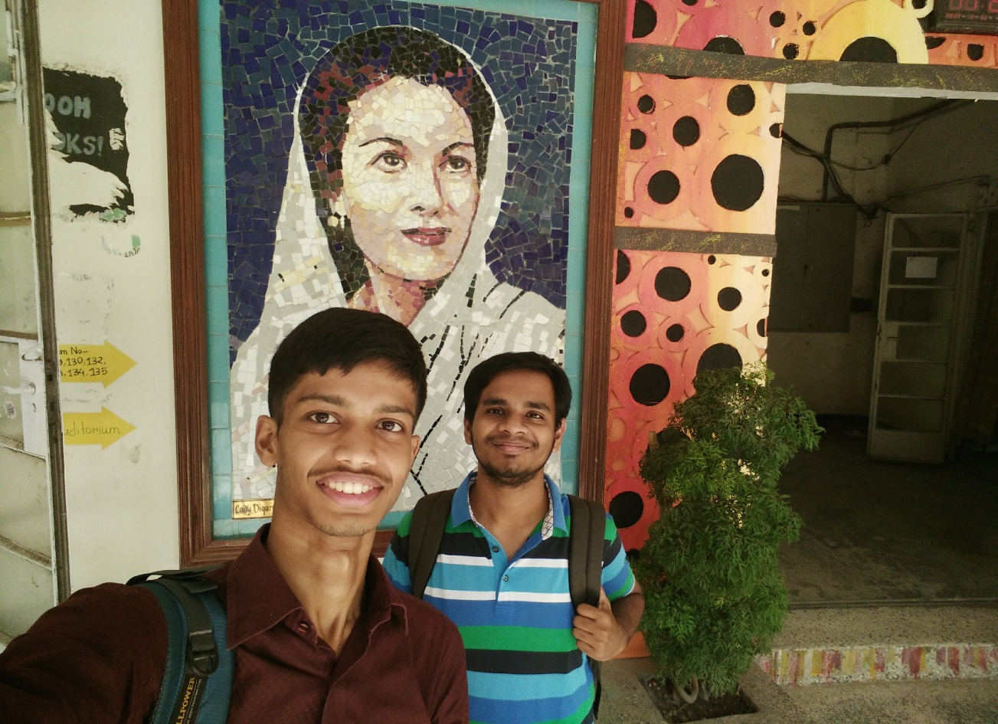
Visited Places: Viqarunnisa Noon School and College

Slide 33
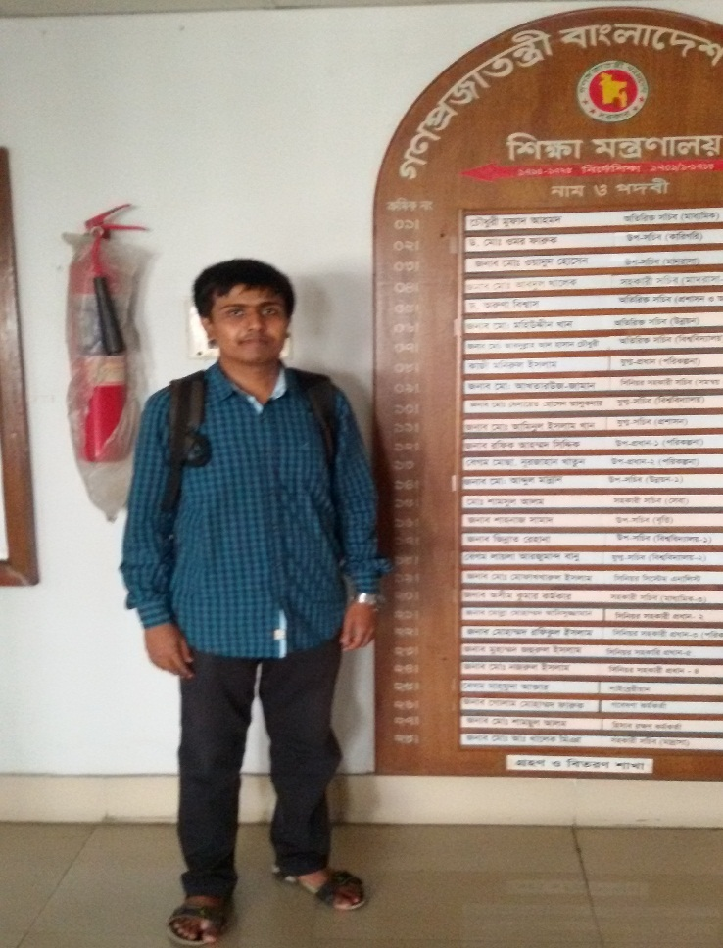
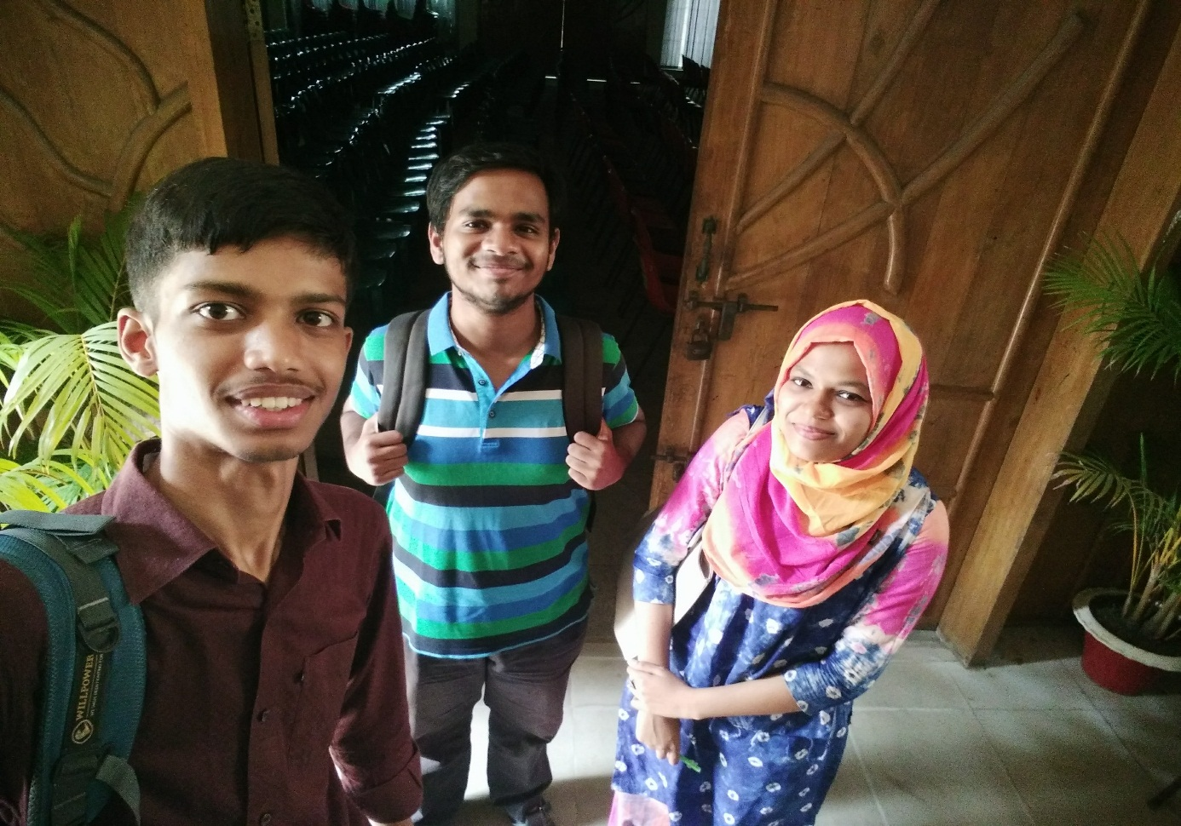
Visited Places: Ministry of Education

Slide 34
Reference
Strategic Priorities of Digital Bangladesh” prepared by Access to Information (A2I) Programme Prime Minister’s Office in 2011
ICT for Education in Secondary and Higher Secondary Level Project (ICT4E-SHSP) Organization name, country: Ministry of Education, Bangladesh )
National Education Policy 2010, Ministry of Education

Slide 35
Q/A

Slide 36
Thank you

