Slide 1

Ethics in Information Technology, Second Edition
Chapter 2
Ethics for IT Professionals and IT Users
Ethics in Information Technology, Second Edition

Slide 2
Objectives
What key characteristics distinguish a professional from other kinds of workers, and what is the role of an IT professional?
What relationships must an IT professional manage, and what key ethical issues can arise in each?
How do codes of ethics, professional organizations, certification, and licensing affect the ethical behavior of IT professionals?
Ethics in Information Technology, Second Edition

Slide 3
Objectives (continued)
What are the key tenets of four different codes of ethics that provide guidance for IT professionals?
What are the common ethical issues that face IT users?
What approaches can support the ethical practices of IT users?
Ethics in Information Technology, Second Edition

Slide 4
IT Professionals
Profession is a calling that requires
  Specialized knowledge
  Long and intensive academic preparation
Ethics in Information Technology, Second Edition

Slide 5
Are IT Workers Professionals?
Partial list of IT specialists
  Programmers
  Systems analysts
  Software engineers
  Database administrators
  Local area network (LAN) administrators
  Chief information officers (CIOs)
Ethics in Information Technology, Second Edition

Slide 6
Are IT Workers Professionals? (continued)
Legal perspective
  IT workers are not recognized as professionals
  Not licensed
  IT workers are not liable for malpractice
Ethics in Information Technology, Second Edition

Slide 7
Professional Relationships That Must Be Managed
IT professionals have many different relationships with:
  Employers
  Clients
  Suppliers
  Other professionals
  IT users
  Society at large
Ethics in Information Technology, Second Edition

Slide 8
Relationships Between IT Professionals and Employers
IT professionals must set an example and enforce policies regarding the ethical use of IT
Software piracy is the act of illegally making copies of software or enabling others to access software to which they are not entitled
Software piracy is an area in which IT professionals can be tempted to violate laws and policies
The Business Software Alliance (BSA) is a trade group that represents the world’s largest software and hardware manufacturers
  Its mission is to stop the unauthorized copying of software produced by its members
Ethics in Information Technology, Second Edition

Slide 9
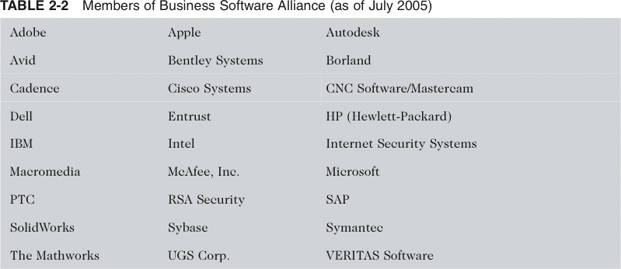
Members of Business Software Alliance (as of July 2005)
Ethics in Information Technology, Second Edition

Slide 10
Relationships Between IT Professionals and Employers (continued)
Trade secret
  Information used in business
  Generally unknown to the public
  Company has taken strong measures to keep confidential
Whistle-blowing
  Attracts attention to a negligent, illegal, unethical, abusive, or dangerous act that threatens the public interest
Ethics in Information Technology, Second Edition

Slide 11
Relationships Between IT Professionals and Clients
IT professional provides
  Hardware, software, or services at a certain cost and within a given time frame
Client provides
  Compensation
  Access to key contacts
  Work space
Relationship is usually documented in contractual terms
Ethics in Information Technology, Second Edition

Slide 12
Relationships Between IT Professionals and Clients (continued)
Ethical problems arise if a company recommends its own products and services to remedy problems they have detected
  A company is unable to provide full and accurate reporting of a project’s status
Ethics in Information Technology, Second Edition

Slide 13
Legal Overview:
Fraud, Misrepresentation, and Breach of Contract
Fraud
  Crime of obtaining goods, services, or property through deception or trickery
  Fraud is proven in court
Breach of contract
  One party fails to meet the terms of a contract
Ethics in Information Technology, Second Edition

Slide 14
Legal Overview:
Fraud, Misrepresentation, and
Breach of Contract (continued)
IT projects are joint efforts in which vendors and customers work together
  Difficult to assign blame
Ethics in Information Technology, Second Edition

Slide 15
Relationships Between IT Professionals and Suppliers
Develop good relationships with suppliers
  Deal fairly with them
  Do not make unreasonable demands
Bribery
  Providing money, property, or favors to someone in business or government to obtain a business advantage
  U.S. Foreign Corrupt Practices Act (FCPA) makes it a crime to bribe a foreign official, a foreign political party official, or a candidate for foreign political office
Ethics in Information Technology, Second Edition

Slide 16
Relationships Between IT Professionals and Suppliers (continued)
Bribery
  At what point does a gift become a bribe?
  No gift should be hidden
  Perceptions of donor and recipient can differ
Ethics in Information Technology, Second Edition

Slide 17
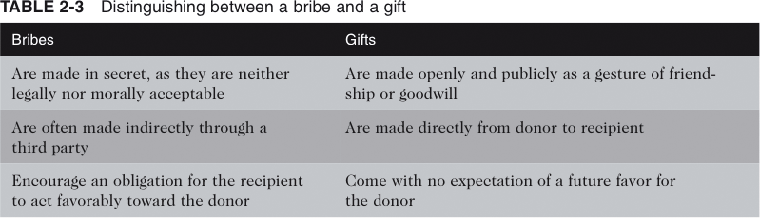
Distinguishing Between a Bribe and a Gift
Ethics in Information Technology, Second Edition

Slide 18
Relationships Between IT Professionals and Other Professionals
Professionals owe each other adherence to a profession’s code of conduct
Ethical problems between members of the IT profession
  Résumé inflation
  Inappropriate sharing of corporate information
Ethics in Information Technology, Second Edition

Slide 19
Relationships Between IT Professionals and IT Users
IT user is a person for whom a hardware or software product is designed
IT professionals’ duty
  Understand users’ needs and capabilities
  Deliver products and services that best meet those needs
  Establish an environment that supports ethical behavior by users
Ethics in Information Technology, Second Edition

Slide 20
Relationships Between IT Professionals and Society
Actions of an IT professional can affect society
Ethics in Information Technology, Second Edition

Slide 21
The Ethical Behavior of IT Professionals
Corporations are taking actions to ensure good business ethics among employees
Ethics in Information Technology, Second Edition

Slide 22
Professional Codes of Ethics
A professional code of ethics states the principles and core values that are essential to the work of a particular occupational group
Main parts:
  Outlines what the professional organization aspires to become
  Lists rules and principles by which members of the organization are expected to abide
Ethics in Information Technology, Second Edition

Slide 23
Professional Codes of Ethics (continued)
Benefits for individual, profession, and society
  Improves ethical decision making
  Promotes high standards of practice and ethical behavior
  Enhances trust and respect from the general public
  Provides an evaluation benchmark
Ethics in Information Technology, Second Edition

Slide 24
Professional Organizations
No universal code of ethics for IT professionals
No single, formal organization of IT professionals has emerged as preeminent
Most prominent organizations include:
  Association for Computing Machinery (ACM)
  Association of Information Technology Professionals (AITP)
  Computer Society of the Institute of Electrical and Electronics Engineers (IEEE-CS)
  Project Management Institute (PMI)
Ethics in Information Technology, Second Edition

Slide 25
Certification
Indicates a professional possesses a particular set of skills, knowledge, or abilities in the opinion of a certifying organization
Can also apply to products
Generally voluntary
Carries no requirement to adhere to a code of ethics
Ethics in Information Technology, Second Edition

Slide 26
Certification (continued)
Vendor certifications
  Some certifications substantially improve IT workers’ salaries and career prospects
  Relevant for narrowly defined roles
    Or certain aspects of broader roles
  Require passing a written exam
  Workers are commonly recertified as newer technologies become available
Ethics in Information Technology, Second Edition

Slide 27
Certification (continued)
Industry association certifications
  Require a certain level of experience and a broader perspective than vendor certifications
  Lag in developing tests that cover new technologies
Ethics in Information Technology, Second Edition

Slide 28
Government Licensing
Generally administered at the state level in the United States
Case for licensing IT professionals
  Encourage IT professionals to follow the highest standards of the profession
  Practice a code of ethics
  Violators would be punished
Ethics in Information Technology, Second Edition

Slide 29
Government Licensing (continued)
Issues associated with government licensing of IT professionals
  There are few international or national licensing programs for IT professionals
  No universally accepted core body of knowledge
  Unclear who should manage content and administration of licensing exams
  No administrative body to accredit professional education programs
  No administrative body to assess and ensure competence of individual professionals
Ethics in Information Technology, Second Edition

Slide 30
IT Professional Malpractice
Negligence has been defined as not doing something that a reasonable man would do, or doing something that a reasonable man would not do
Duty of care refers to the obligation to protect people against any unreasonable harm or risk
Courts consistently reject attempts to sue individual parties for computer-related malpractice
Ethics in Information Technology, Second Edition

Slide 31
IT Users
Employees’ ethical use of IT is an area of growing concern
Ethics in Information Technology, Second Edition

Slide 32
Common Ethical Issues for IT Users
Software piracy
Inappropriate use of computing resources
Inappropriate sharing of information
  Private data
  Confidential information
Ethics in Information Technology, Second Edition

Slide 33
Supporting the Ethical Practices of IT Users
Policies that protect against abuses:
  Establish boundaries of acceptable and unacceptable behavior
  Enable management to punish violators
Policy components include:
  Defining and limiting the appropriate use of IT resources
  Establishing guidelines for use of company software
  Structuring information systems to protect data and information
  Installing and maintaining a corporate firewall
Ethics in Information Technology, Second Edition

Slide 34
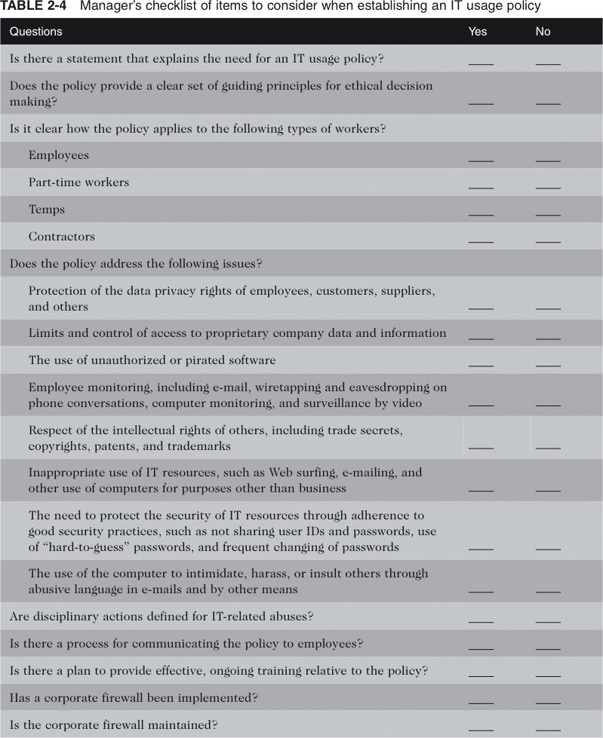
Manager’s Checklist of Items to Consider when Establishing an IT Usage Policy
Ethics in Information Technology, Second Edition

Slide 35
Summary
A professional from a legal standpoint
  Has passed the state licensing requirements
  Has earned the right to practice there
IT professionals have many different relationships
  Each with its own set of ethical issues and potential problems
Professional code of ethics
  States the principles and core values essential to the work of an occupational group
Ethics in Information Technology, Second Edition

Slide 36
Summary (continued)
Licensing and certification of IT professionals
  Many people feel that certification will increase the reliability and effectiveness of information systems
  Raises many issues
IT-related professional organizations have developed a code of ethics
IT usage policy defines appropriate and inappropriate IT user behavior
Ethics in Information Technology, Second Edition

