Slide 1
Ethics in Information Technology, Fourth Edition
Chapter 8
The Impact of Information Technology on Productivity and Quality of Life

Slide 2
Objectives
As you read this chapter, consider the following questions:
  What impact has IT had on the standard of living and worker productivity?
  What is being done to reduce the negative influence of the digital divide?
  What impact can IT have on improving the quality of healthcare and reducing its costs?
Ethics in Information Technology, Fourth Edition

Slide 3
Objectives (cont’d.)
What ethical issues are raised because some entities can afford to make significant investments in IT while others cannot and thus are blocked in their efforts to raise productivity and quality?
Ethics in Information Technology, Fourth Edition

Slide 4
The Impact of IT on the Standard of Living and Worker Productivity
Gross domestic product (GDP)
  Measurement of the material standard of living
  Equals total annual output of a nation’s economy
Standard of living in U.S. and developed countries
  Has improved for a long time
  Rate of change varies as a result of business cycles
Productivity
  Amount of output produced per unit of input
  Measured in many different ways
Ethics in Information Technology, Fourth Edition

Slide 5
The Impact of IT on the Standard of Living and Worker Productivity (cont’d.)
United States
  Labor productivity growth 2% annually
  Living standards have doubled about every 36 years
  Modern management techniques and automated technology increase productivity
Innovation
  Key factor in productivity improvement
  IT has an important role
Ethics in Information Technology, Fourth Edition

Slide 6
IT Investment and Productivity
Relationship between IT investment and productivity growth is complex
  Rate of productivity from 1995 to 2005 is only slightly higher than the long-term U.S. rate
  Possible lag time between:
    Application of innovative IT solutions
    Capture of significant productivity gains
Other factors besides IT influence worker productivity rates
Difficult to quantify how much the use of IT has contributed to worker productivity
Ethics in Information Technology, Fourth Edition

Slide 7
IT Investment and Productivity (cont’d.)
Factors that affect national productivity rates
  Business cycles of expansion and contraction
  Outsourcing to contractors can skew productivity
  Regulations make it easier to hire and fire workers
  More competitive markets for goods and services
  Difficult to measure output of some services
  IT investments don’t always yield tangible results
Ethics in Information Technology, Fourth Edition

Slide 8
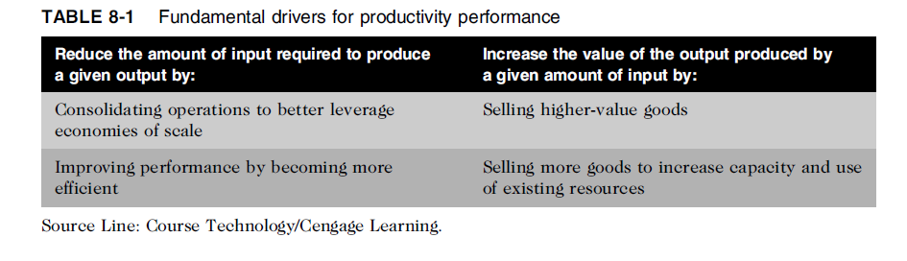
IT Investment and Productivity (cont’d.)
Ethics in Information Technology, Fourth Edition

Slide 9
IT Investment and Productivity (cont’d.)
Telework/Telecommuting
  Employee works away from the office
  Advances in technology enable communications
  Highly skilled workers demand more flexibility
  Laws passed to encourage telework
  Organizations must prepare guidelines and policies
  Some positions are not suited to telework
  Some individuals are not suited to be teleworkers
Ethics in Information Technology, Fourth Edition

Slide 10
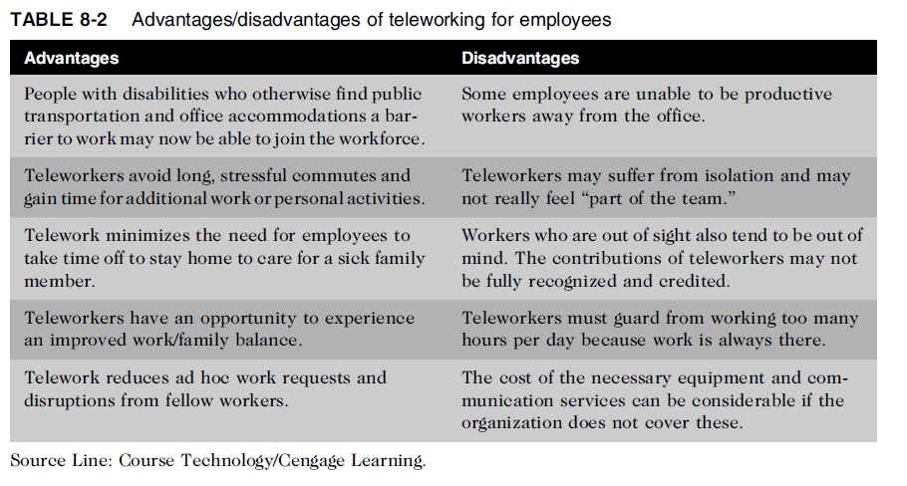
Ethics in Information Technology, Fourth Edition

Slide 11
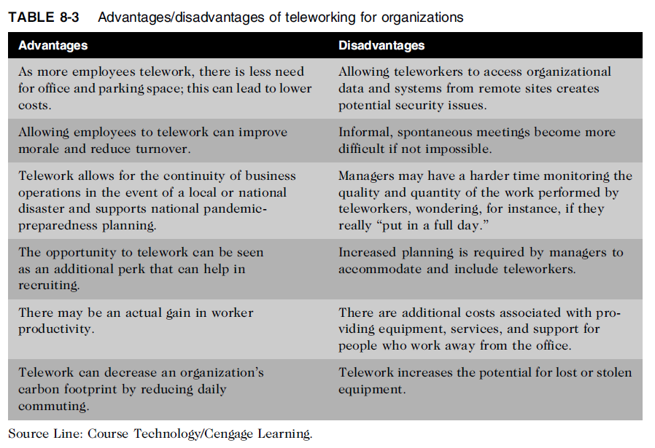
IT Investment and Productivity (cont’d.)
Ethics in Information Technology, Fourth Edition

Slide 12
The Digital Divide
Standard of living
  Level of material comfort measured by the goods, services, and luxuries available
Digital divide
  Gulf between those who do/don’t have access to:
    Cell phones
    Personal computers
    The Internet
  Gulf among age groups, economic classes, and cities/rural areas
Ethics in Information Technology, Fourth Edition

Slide 13
The Digital Divide (cont’d.)
Digital divide must be bridged to improve resolution of:
  Health emergencies
  Crime emergencies
  Other emergencies
Access to IT and communications technology:
  Enhances learning
  Provides educational and economic opportunities
  Influences cultural, social, and political conditions
Ethics in Information Technology, Fourth Edition

Slide 14
The Digital Divide (cont’d.)
Education Rate (E-Rate) program
  Created by the Telecommunications Act of 1996
  Goal to help schools and libraries obtain:
    Access to state-of-the-art services and technologies
    Discounted rates
  Supported with up to $2.25 billion per year from fees charged to telephone customers
  Administered by the Universal Service Administrative Company (USAC)
  Has not gone well but continues today
Ethics in Information Technology, Fourth Edition

Slide 15
The Digital Divide (cont’d.)
Low-cost computers for developing countries
  One Laptop per Child (OLPC)
    Provides low-cost laptop computers for education
  Classmate PC from Intel
  Eee notebook from Asus
Mobile phone
  Tool to bridge the digital divide
  Costs less than PC and more broadly available
Ethics in Information Technology, Fourth Edition

Slide 16
The Impact of IT on Healthcare Costs
Rapidly rising cost of healthcare is major challenge
  Spending increasing at 6.3% per year
  Grow from $2.6 trillion to $4.6 trillion by 2019
Increase (above inflation) due to new medical technology
  Diagnostic procedures and treatments
  Patients sometimes overuse medical resources
Patient awareness must be raised
Technology costs must be managed
Improved use of IT can lead to cost reductions
Ethics in Information Technology, Fourth Edition

Slide 17
Electronic Health Records
Electronic health record (EHR)
  Computer readable record of health-related information on an individual: patient demographics, medical history, family history, immunization records, lab data, health problems, progress notes, medications, vital signs, and radiology reports
  Summary of health information generated by each patient encounter in any healthcare delivery setting
  Effective use of EHR improves patient care and reduces costs
Ethics in Information Technology, Fourth Edition

Slide 18
Electronic Health Records (cont’d.)
Lack of patient data transparency results in:
  Diagnostic and medication errors
  Ordering of duplicate tests
  Compromise of patient safety
  At least 98,000 people die in hospitals each year due to preventable medical mistakes
Ethics in Information Technology, Fourth Edition

Slide 19
Electronic Health Records (cont’d)
Health Information Technology for Economic and Clinical Health Act (HITECH)
  Requires government to develop standards for nationwide exchange and use of health information
  Provides $20 billion in incentives
  Saves $10 billion through improvements in quality of care
  Strengthens protection of identifiable health information
Ethics in Information Technology, Fourth Edition

Slide 20
Use of Mobile and Wireless Technology in the Healthcare Industry
Healthcare industry is a leader in adopting mobile and wireless technology
  Means to access/update EHR at bedsides
  Scan barcodes to match patient with medications
  Communicate with healthcare employees
Ethics in Information Technology, Fourth Edition

Slide 21
Telemedicine
Employs modern telecommunications and information technologies
Provides medical care to people who live far away from healthcare providers
Store-and-forward telemedicine
  Acquires data, sound, images, and video from patient and transmits to medical specialist for evaluation at a later time
  Does not require presence of patient
Ethics in Information Technology, Fourth Edition

Slide 22
Telemedicine (cont’d.)
Live telemedicine
  Requires the presence of patient and healthcare provider at the same time
  Involves a video conference link between the two sites
Ethics in Information Technology, Fourth Edition

Slide 23
Telemedicine (cont’d.)
Use of telemedicine raises new ethical issues:
  Must physicians providing advice to patients at remote location be licensed at that location?
  Must healthcare system be required to possess a license from a state in which it has a virtual facility?
  Must minimum set of technology standards be met?
  What sort of system certification and verification is necessary?
  Does patient involvement with remote doctors have negative impact on the local doctor’s relationship?
Ethics in Information Technology, Fourth Edition

Slide 24
Medical Information Web Sites for Laypeople
People need reliable information on a wide range of medical topics to:
  Learn more about healthcare services
  Take more responsibility for their health
Web sites are not substitutes for professional medical advice, diagnosis, or treatment
Some healthcare providers and employers offer online tools that go beyond basic health information
Ethics in Information Technology, Fourth Edition

Slide 25
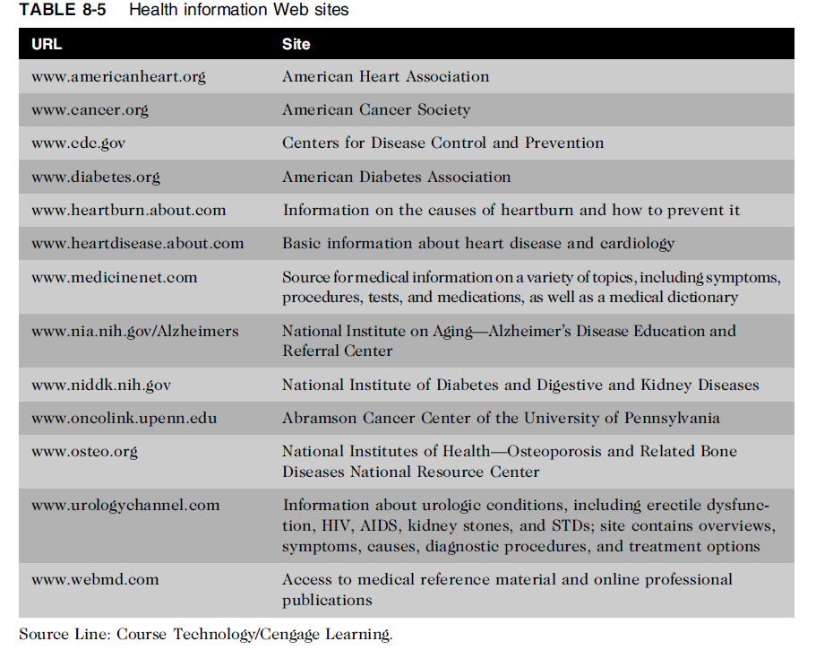
Ethics in Information Technology, Fourth Edition

Slide 26
Summary
Gross national product (GNP) measures material standard of living
Progressive management uses IT to innovate products, processes, and services
Telework opportunities can be used to:
  Reduce costs
  Increase productivity
  Reduce organization’s carbon footprint
  Prepare for potential local or widespread disasters
Ethics in Information Technology, Fourth Edition

Slide 27
Summary (cont’d.)
The digital divide exists:
  Between more and less developed countries
  Within countries, among:
    Age groups
    Economic classes
    People who live in cities versus those in rural areas
New information technologies can be used with little capital cost to reduce the digital divide
Ethics in Information Technology, Fourth Edition

Slide 28
Summary (cont’d.)
Healthcare costs are soaring out of control
  6.3% annual growth rate
  Will reach $4.6 trillion by 2019
Improved use of IT in the healthcare industry can lead to significantly reduced costs
  Electronic health records (EHRs)
  Telemedicine
  Web-based health information
Ethics in Information Technology, Fourth Edition

