Slide 1

Ethics in Information Technology, Second Edition
Chapter 1
An Overview of Ethics
Ethics in Information Technology, Second Edition

Slide 2
Objectives
What is ethics, and why is it important to act according to a code of principles?
Why is business ethics becoming increasingly important?
What are corporations doing to improve business ethics?
Why are corporations interested in fostering good business ethics?
Ethics in Information Technology, Second Edition

Slide 3
Objectives (continued)
What approach can you take to ensure ethical decision making?
What trends have increased the risk of using information technology unethically?
Ethics in Information Technology, Second Edition

Slide 4
What is Ethics?
Moral code
  Set of rules
  Establishes boundaries of generally accepted behavior
  Different rules often have contradictions
Morality
  Social conventions about right and wrong
  Widely shared
Ethics in Information Technology, Second Edition

Slide 5
What is Ethics? (continued)
Morality may vary by:
  Age
  Cultural group
  Ethnic background
  Religion
  Gender
Ethics in Information Technology, Second Edition

Slide 6
Definition of Ethics
Ethics is a set of beliefs about right and wrong behavior
Ethical behavior conforms to generally accepted social norms
Virtues
  Habits that incline people to do what is acceptable
Vices
  Habits of unacceptable behavior
Value system
  Scheme of moral values
Ethics in Information Technology, Second Edition

Slide 7
The Importance of Integrity
Integrity is a cornerstone of ethical behavior
People with integrity
  Act in accordance with a personal code of principles
  Extend to all people the same respect and consideration that you desire
  Apply the same moral standards in all situations
Ethics in Information Technology, Second Edition

Slide 8
Ethics in the Business World
Risk is the product of multiplying the likelihood of an event by the impact of its occurrence
Risks associated with inappropriate behavior have increased due to
  Globalization
  Heightened vigilance by
    Employees
    Shareholders
    Regulatory agencies
Ethics in Information Technology, Second Edition

Slide 9
Ethics in the Business World (continued)
Recent scandals in IT companies
  WorldCom
  Qwest Communications International Inc.
  Adelphia Communications Corp.
  Computer Associates (CA)
Ethics in Information Technology, Second Edition

Slide 10
Legal Overview:
The Sarbanes-Oxley Act
Enacted in response to public outrage over several major accounting scandals
Section 404 requires that the CEO and CFO sign any SEC filing to attest to its accuracy
Public Company Accounting Oversight Board (PCAOB) provides oversight for auditors of public companies
IT organizations must build controls that ensure information stands up to audit scrutiny
Ethics in Information Technology, Second Edition

Slide 11
Why Fostering Good Business Ethics Is Important
To gain the goodwill of the community
To create an organization that operates consistently
To produce good business
To protect the organization and its employees from legal action
To avoid unfavorable publicity
Ethics in Information Technology, Second Edition

Slide 12
Gaining the Goodwill of the Community
Basic responsibilities to society
  Declared in formal statement of company’s principles or beliefs
  Include:
    Making contributions to charitable organizations and nonprofit institutions
    Providing benefits for employees in excess of legal requirements
    Choosing economic opportunities that might be more socially desirable than profitable
Ethics in Information Technology, Second Edition

Slide 13
Gaining the Goodwill of the Community (continued)
Goodwill that socially responsible activities create can make it easier for corporations to conduct business
Ethics in Information Technology, Second Edition

Slide 14
Creating an Organization That Operates Consistently
Many business values include:
  Operating with honesty and integrity, staying true to corporate principles
  Operating according to standards of ethical conduct, in words and action
  Treating colleagues, customers, and consumers with respect
  Striving to be the best at what matters most to the company
  Accepting personal responsibility for actions
  Valuing diversity
  Making decisions based on facts and principles
Ethics in Information Technology, Second Edition

Slide 15
Good Ethics Can Mean Good Business
Produce safe and effective products
  Avoid costly recalls and lawsuits
Provide excellent service
  Maintain customers
Develop and maintain strong employee relations
  Suffer less turnover
  Enjoy better employee morale
Ethics in Information Technology, Second Edition

Slide 16
Good Ethics Can Mean Good Business (continued)
Suppliers and other business partners prefer companies that operate in a fair and ethical manner
Bad ethics can lead to bad business results
Ethics in Information Technology, Second Edition

Slide 17
Protecting the Corporation and Its Employees from Legal Actions
U.S. Justice Department sentencing guidelines suggest more lenient treatment for convicted executives if their companies had ethics programs
Fines for criminal violations can be lowered by up to 80 percent if the organization has implemented an ethics management program and cooperates with authorities
Ethics in Information Technology, Second Edition

Slide 18
Avoiding Unfavorable Publicity
Public reputation of company strongly influences
  Value of its stock
  How consumers regard products and services
  Degree of oversight received from government agencies
  Amount of support and cooperation received from business partners
Ethics in Information Technology, Second Edition

Slide 19
Improving Corporate Ethics
Risks of unethical behavior are increasing
Improvement of business ethics is becoming more important
Ethics in Information Technology, Second Edition

Slide 20
Appointing a Corporate Ethics Officer
Corporate ethics definition includes
  Ethical conduct
  Legal compliance
  Corporate social responsibility
Corporate ethics officer
  Is a senior-level manager
  Provides vision and direction in the area of business conduct
  Tries to establish an environment that encourages ethical decision making
Ethics in Information Technology, Second Edition

Slide 21
Appointing a Corporate Ethics Officer (continued)
Responsibilities include:
  Complete oversight of the ethics function
  Collecting and analyzing data
  Developing and interpreting ethics policy
  Developing and administering ethics education and training
  Overseeing ethics investigations
Ethics in Information Technology, Second Edition

Slide 22
Ethical Standards Set by Board of Directors
Board responsible for supervising management team
Directors of company are expected to
  Conduct themselves according to the highest standards of personal and professional integrity
  Set standard for company-wide ethical conduct
  Ensure compliance with laws and regulations
Ethics in Information Technology, Second Edition

Slide 23
Establishing a Corporate Code of Ethics
Code of ethics:
  Highlights an organization’s key ethical issues
  Identifies overarching values and principles important to an organization
  Focuses employees on areas of ethical risk
  Cannot gain company-wide acceptance unless
    Developed with employee participation
    Fully endorsed by organization’s leadership
  Must continually be applied to company’s decision making
Ethics in Information Technology, Second Edition

Slide 24
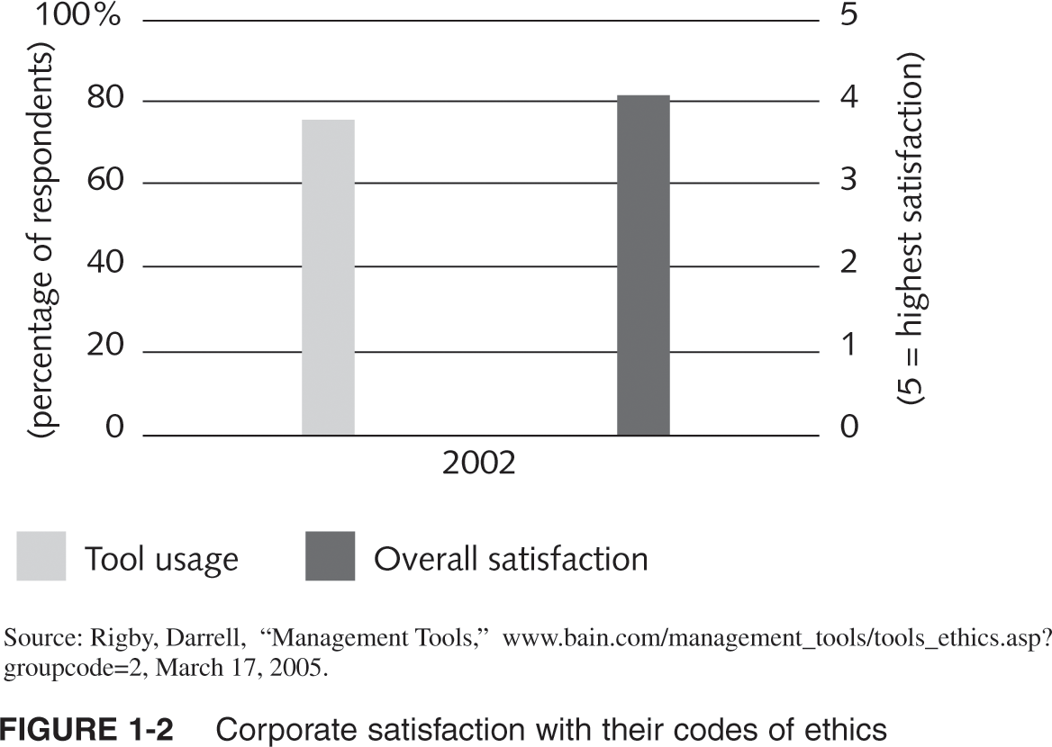
Corporate Satisfaction with their Codes of Ethics
Ethics in Information Technology, Second Edition

Slide 25
Conducting Social Audits
Social audit
  Identifies ethical lapses committed in the past
  Sets directives for avoiding similar missteps in the future
Ethics in Information Technology, Second Edition

Slide 26
Requiring Employees to Take Ethics Training
Comprehensive ethics education program encourages employees to act responsibly and ethically
  Often presented in small workshop formats
Principle-based decision making is based on principles in corporate code of ethics
Ethics in Information Technology, Second Edition

Slide 27
Including Ethical Criteria in Employee Appraisals
Some companies base a portion of employee performance evaluations on:
  Treating others fairly and with respect
  Operating effectively in a multicultural environment
  Accepting personal accountability
  Continually developing themselves and others
  Operating openly and honestly with suppliers, customers, and other employees
Ethics in Information Technology, Second Edition

Slide 28
When Good Ethics Result in Short-Term Losses
Operating ethically does not always guarantee business success
Organizations that operate outside the United States
  Deal with a “business as usual” climate
  Are placed at a significant competitive disadvantage
Hope good ethics will prove to be good business in the long term
Ethics in Information Technology, Second Edition

Slide 29
Creating an Ethical Work Environment
Good employees sometimes make bad ethical choices
May be encouraged to do “whatever it takes” to get the job done
Employees must have a knowledgeable and potent resource available to discuss perceived unethical practices
Ethics in Information Technology, Second Edition

Slide 30
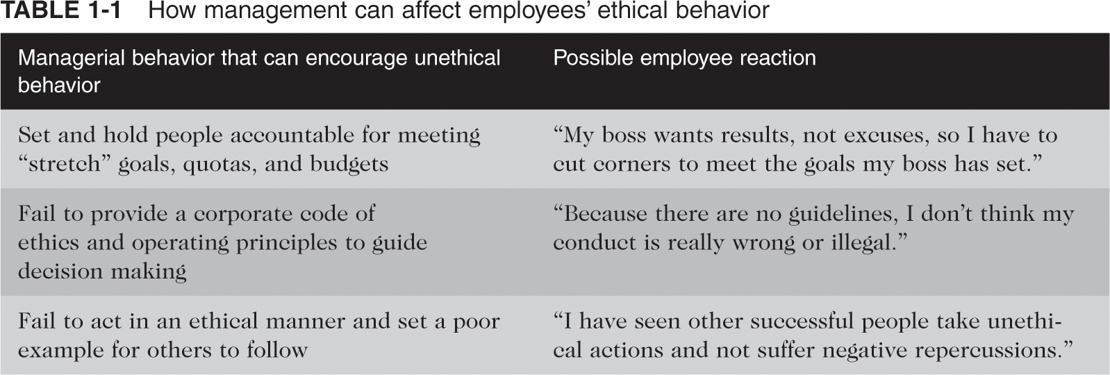
How Management Can Affect Employees’ Ethical Behaviour
Ethics in Information Technology, Second Edition

Slide 31
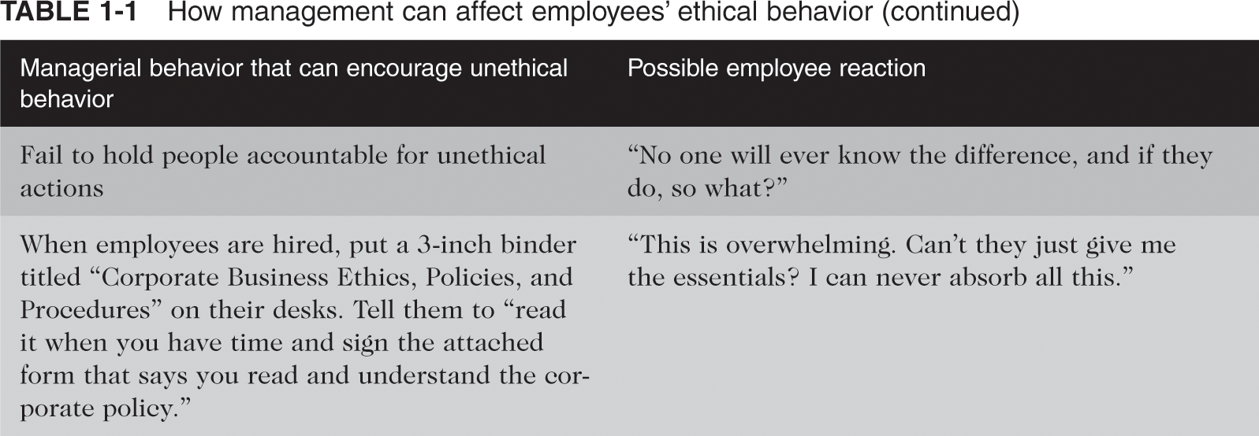
How Management Can Affect Employees’ Ethical Behaviour (continued)
Ethics in Information Technology, Second Edition

Slide 32
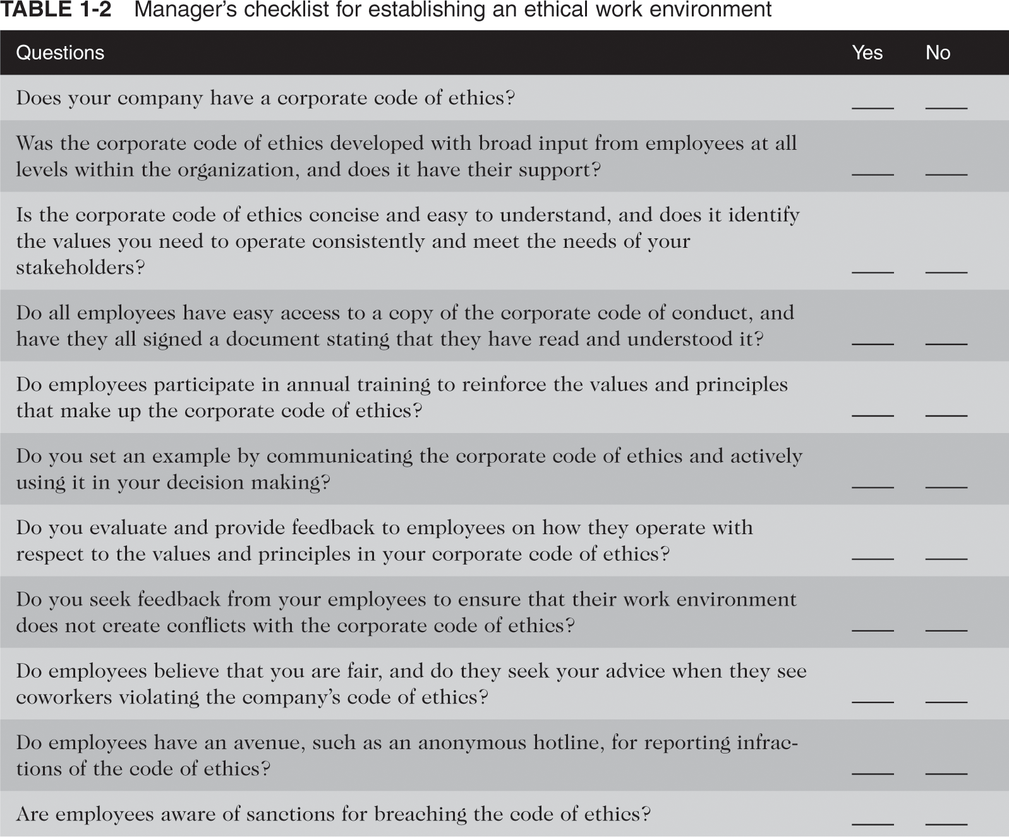
Manager’s Checklist
Ethics in Information Technology, Second Edition

Slide 33
Ethical Decision Making
Get the facts
Identify stakeholders and their positions
Consider the consequences of a decision
Weigh various guidelines and principles
Develop and evaluate options
Review a decision
Evaluate the results of a decision
Ethics in Information Technology, Second Edition

Slide 34
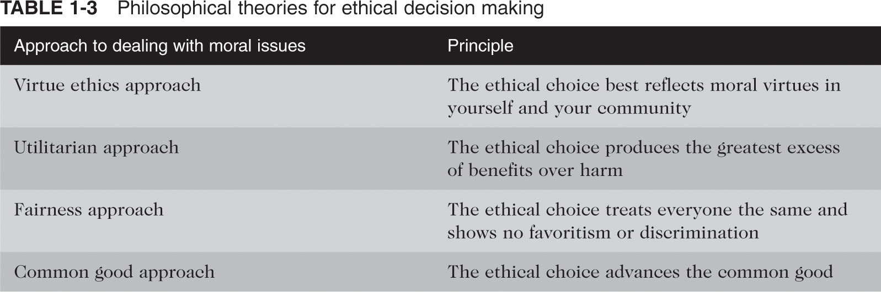
Philosophical Theories for Ethical Decision Making
Ethics in Information Technology, Second Edition

Slide 35
Ethics in Information Technology
Public concern about the ethical use of information technology includes:
  E-mail and Internet access monitoring
  Peer-to-peer networks violation of copyright
  Unsolicited e-mail
  Hackers and identify theft
  Plagiarism
  Cookies and spyware
Ethics in Information Technology, Second Edition

Slide 36
Ethics in Information Technology (continued)
The general public has not realized the critical importance of ethics as applied to IT
Important technical decisions are often left to technical experts
General business managers must assume greater responsibility for these decisions
They must be able to make broad-minded, objective, ethical decisions based on technical savvy, business know-how, and a sense of ethics
They must also try to create a working environment in which ethical dilemmas can be discussed openly, objectively, and constructively
Ethics in Information Technology, Second Edition

Slide 37
An Overview of This Text
Chapter 2
  Ethics is important to IT professionals and IT users
Chapter 3
  Computer crime
Chapter 4
  Personal data privacy
  Employee monitoring
Ethics in Information Technology, Second Edition

Slide 38
An Overview of This Text (continued)
Chapter 5
  Internet communications
  Freedom of expression
Chapter 6
  Protection of intellectual property rights through patents, copyrights, and trade secrets
Chapter 7
  Software development process
Ethics in Information Technology, Second Edition

Slide 39
An Overview of This Text (continued)
Chapter 8
  Use of nontraditional employees
  Implications of whistle-blowing
Chapter 9
  Impact of IT on society
Ethics in Information Technology, Second Edition

Slide 40
Summary
Ethics is a set of beliefs about right and wrong behavior
Ethics in business is becoming more important because the risks associated with inappropriate behavior have grown
Corporations want to protect themselves and their employees from legal action
Ethics in Information Technology, Second Edition

Slide 41
Summary (continued)
7-step approach to ethical decision making
Trends contributing to the risk of using information technology unethically include:
  Growth of the Internet
  Ability to capture and store vast amounts of personal data online
  Greater reliance on information systems
Ethics in Information Technology, Second Edition

