Slide 1
Ethics in Information Technology, Fourth Edition
Chapter 5
Freedom of Expression

Slide 2
Objectives
As you read this chapter, consider the following questions:
  What is the basis for the protection of freedom of expression in the United States, and what types of expression are not protected under the law?
  What are some key federal laws that affect online freedom of expression, and how do they impact organizations?
  What important freedom of expression issues relate to the use of information technology?
Ethics in Information Technology, Fourth Edition

Slide 3
First Amendment Rights
Right to freedom of expression
  Important right for free people everywhere
  Guaranteed by the First Amendment
Definition of free speech includes:
  Nonverbal, visual, and symbolic forms of expression
  Right to speak anonymously
Ethics in Information Technology, Fourth Edition

Slide 4
First Amendment Rights (cont’d.)
Not protected by the First Amendment
  Perjury
  Fraud
  Defamation
  Obscene speech
  Incitement of panic
  Incitement to crime
  “Fighting words”
  Sedition
Ethics in Information Technology, Fourth Edition

Slide 5
Obscene Speech
Based on Miller v. California, speech is considered obscene when:
  Average person finds the work appeals to the prurient interest
  Work depicts or describes sexual conduct in an offensive way
  Lacks serious literary, artistic, political, or scientific value
Ethics in Information Technology, Fourth Edition

Slide 6
Defamation
Oral or written statement of alleged fact that is:
  False
  Harms another person
    Harm is often of a financial nature
Slander
  Oral defamatory statement
Libel
  Written defamatory statement
Ethics in Information Technology, Fourth Edition

Slide 7
Freedom of Expression: Key Issues
Controlling access to information on the Internet
Anonymity on the Internet
Defamation and hate speech
Corporate blogging
Pornography
Ethics in Information Technology, Fourth Edition

Slide 8
Controlling Access to Information on the Internet
Freedom of speech on the Internet is complicated by ease by which children can access Internet
Communications Decency Act (CDA)
  Aimed at protecting children from pornography
  Broad language and vague definition of indecency
  Found unconstitutional in 1997
Ethics in Information Technology, Fourth Edition

Slide 9
Controlling Access to Information on the Internet (cont’d.)
Child Online Protection Act (COPA)
  Applies to communication for commercial purposes
  Imposes penalties for exposing minors to harmful material on the Web
  Found unconstitutional in 2004
Internet filtering
  Software installed with a Web browser
  Blocks access to certain Web sites deemed to contain inappropriate or offensive material
Ethics in Information Technology, Fourth Edition

Slide 10
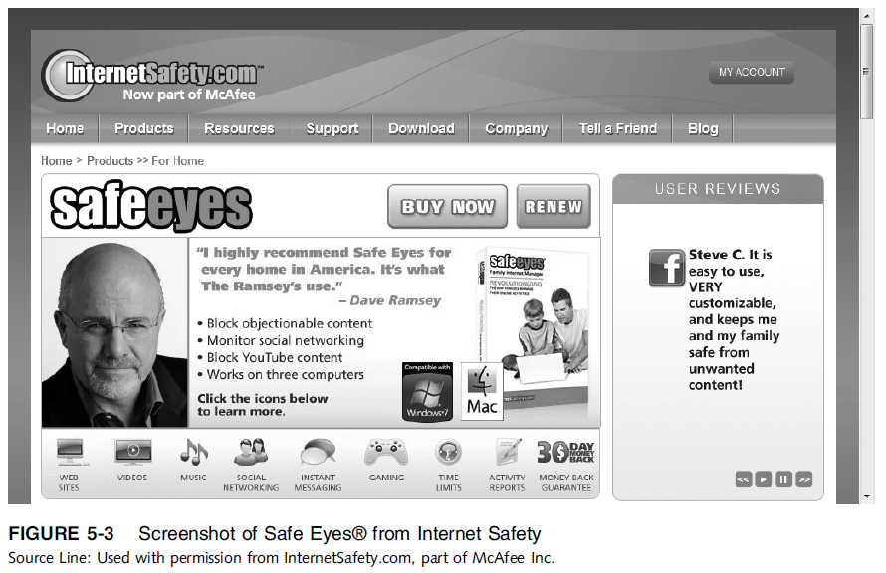
Ethics in Information Technology, Third Edition
Ethics in Information Technology,

Slide 11
Controlling Access to Information on the Internet (cont’d.)
URL filtering
  Blocks objectionable URLs or domain names
Keyword filtering
  Blocks keywords or phrases
Dynamic content filtering
  Web site’s content is evaluated immediately before being displayed
  Uses
    Object analysis
    Image recognition
Ethics in Information Technology, Fourth Edition

Slide 12
Controlling Access to Information on the Internet (cont’d.)
Top-rated Internet filters for home users
  NetNanny Parental Controls
  PureSight PC
  CYBERsitter
  SafeEyes
  CyberPatrol
Ethics in Information Technology, Fourth Edition

Slide 13
Controlling Access to Information on the Internet (cont’d.)
ICRA rating system
  Questionnaire for Web authors
  Generates a content label
    Platform for Internet Content Selection (PICS)
  Users configure browsers to read the label
  Relies on Web authors to rate their site
  Complement to other filtering techniques
Ethics in Information Technology, Fourth Edition

Slide 14
Controlling Access to Information on the Internet (cont’d.)
ISP blocking
  Blocking is performed on the ISP server
  ClearSail/Family.NET prevents access to certain Web sites
Ethics in Information Technology, Fourth Edition

Slide 15
Children’s Internet Protection Act (CIPA)
Federally financed schools and libraries must block computer access to:
  Obscene material
  Pornography
  Anything considered harmful to minors
Ethics in Information Technology, Fourth Edition

Slide 16
Children’s Internet Protection Act (CIPA)
Schools and libraries subject to CIPA do not receive Internet access discounts unless they:
  Put in place measures to filter pictures that are obscene, contain child pornography, or are harmful to minors
  Adopt a policy to monitor the online activities of minors
  Adopt a policy restricting minors’ access to materials harmful to them
Ethics in Information Technology, Fourth Edition

Slide 17
Children’s Internet Protection Act (CIPA) (cont’d.)
CIPA does not require the tracking of Internet use by minors or adults
Acceptable use policy agreement is an essential element of a successful program in schools
  Signed by:
    Students
    Parents
    Employees
Ethics in Information Technology, Fourth Edition

Slide 18
Children’s Internet Protection Act (CIPA) (cont’d.)
Difficulty implementing CIPA in libraries because their services are open to people of all ages
  Including adults with First Amendment rights
CIPA has been upheld as constitutional by U.S. Supreme Court (U.S. v American Library Association)
Ethics in Information Technology, Fourth Edition

Slide 19
Anonymity on the Internet
Anonymous expression is expression of opinions by people who do not reveal their identity
Freedom to express an opinion without fear of reprisal is an important right in democratic society
Anonymity is even more important in countries that do not allow free speech
Played important role in early formation of U.S.
In the wrong hands, it can be a tool to commit illegal or unethical activities
Ethics in Information Technology, Fourth Edition

Slide 20
Anonymity on the Internet (cont’d.)
Anonymous remailer service
  Computer program that strips the originating address from the email message
  Forwards the message to the intended recipient
  Ensures no header information can identify the author
  Keeps what is communicated anonymous
  What is communicated and whether it is ethical or unethical, legal or illegal, is up to the sender
Ethics in Information Technology, Fourth Edition

Slide 21
Anonymity on the Internet (cont’d.)
John Doe lawsuit
  Defendant communicates using a pseudonym or anonymously so identity of defendant is temporarily unknown
  Common in Internet libel cases
  Once John Doe lawsuit is filed, the company may request court permission to issue subpoenas
  ISPs frequently subpoenaed to provide the identity of anonymous “John Does”
  Anonymity on the Internet cannot be guaranteed
Ethics in Information Technology, Fourth Edition

Slide 22
Defamation and Hate Speech
Hate speech that can be prosecuted includes:
  Clear threats and intimidation against specific citizens
  Sending threatening private messages over the Internet to a person
  Displaying public messages on a Web site describing intent to commit acts of hate-motivated violence against specific individuals
  Libel directed at a particular person
Ethics in Information Technology, Fourth Edition

Slide 23
Defamation and Hate Speech (cont’d.)
Many ISPs reserve right to remove content that does not meet their standards
Such actions do not violate the subscriber’s First Amendment rights because these prohibitions are in the terms of service
  ISPs must monitor the use of their service
  Take action when terms are violated
Ethics in Information Technology, Fourth Edition

Slide 24
Defamation and Hate Speech (cont’d.)
Public schools and universities are legally considered agents of the government and must follow the First Amendment prohibition against speech restrictions
Corporations, private schools, and private universities not part of state or federal government
  May prohibit students, instructors, and employees from engaging in offensive speech
Ethics in Information Technology, Fourth Edition

Slide 25
Corporate Blogging
Some organizations allow employees to create their own personal blogs to:
  Reach out to partners, customers, and employees
  Improve their corporate image
Blogs can provide uncensored commentary and interaction
  Criticism of corporate policies and decisions
Could involve risk that employees might:
  Reveal company secrets
  Breach federal security disclosure laws
Ethics in Information Technology, Fourth Edition

Slide 26
Pornography
The Internet has been a boon to the pornography industry
  More than 4.2 million porn Web sites are accessible
  The sites generate an estimated $1 to $7 billion a year in revenue
  72 million estimated visitors to porn Web sites monthly
Individuals free to produce and publish what they want; however, if what they distribute is judged obscene, they are subject to prosecute
  California v Miller set precedent for what is obscene
Ethics in Information Technology, Fourth Edition

Slide 27
Pornography (cont’d.)
Many organizations take steps to stop access in the workplace
  Establishing a computer usage policy that prohibits access to pornography sites
  Identifying those who violate the policy
  Taking action against those users
  Failure to take action against pornography could result in sexual harassment lawsuit
Ethics in Information Technology, Fourth Edition

Slide 28
Pornography (cont’d.)
Numerous federal laws address child pornography
  Federal offense to produce or distribute
  Most states outlaw possession as well
At least seven states require computer technicians to report child pornography on clients’ computers
Sexting is sending of sexual messages, nude or seminude photos, or sexually explicit videos over a cell phone
  Fast-growing trend
Ethics in Information Technology, Fourth Edition

Slide 29
Pornography (cont’d.)
CAN-SPAM Act
  Specifies requirements that commercial retailers must follow when sending messages
  Each violation can result in $250 - $750 fine
  Federal Trade Commission charged with enforcing the act, but has not done so effectively
  Deterrent in fighting the dissemination of pornography
Ethics in Information Technology, Fourth Edition

Slide 30
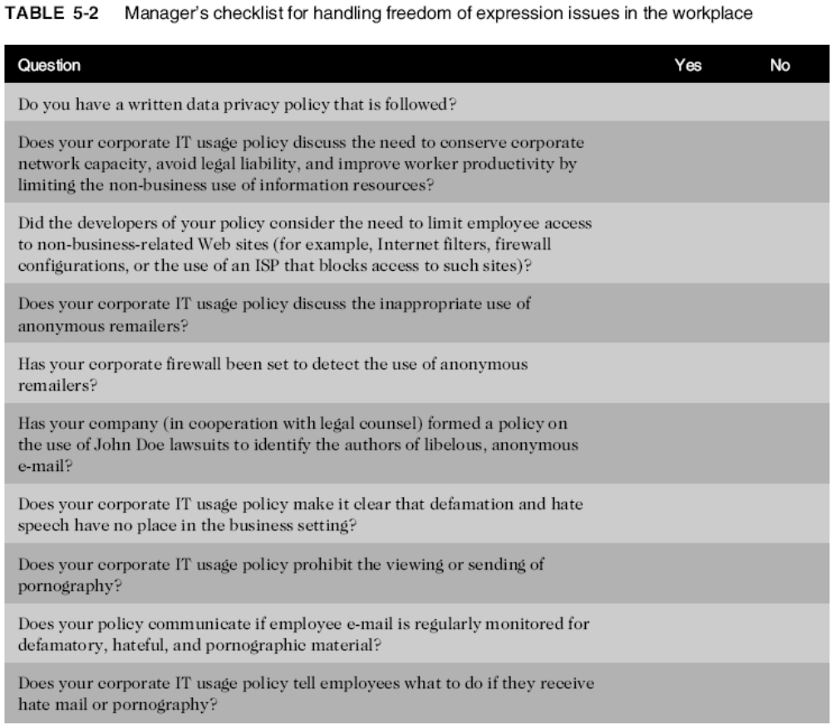
Ethics in Information Technology, Fourth Edition

Slide 31
Summary
First Amendment protects the right to:
  Freedom of religion and expression
Does not protect obscene speech, defamation
Key issues
  Controlling access to Internet information, especially for children
  Anonymous communication
  Spread of defamation and hate speech
  Access to pornography
  CAN-SPAM Act limitations on email messages
Ethics in Information Technology, Fourth Edition

