Slide 1
Ethics in Information Technology, Fourth Edition
Chapter 10
Ethics of IT Organizations

Slide 2
Objectives
As you read this chapter, consider the following questions:
  What are contingent workers, and how are they employed in the information technology industry?
  What key ethical issues are associated with the use of contingent workers, including H-1B visa holders and offshore outsourcing companies?
  What is whistle-blowing, and what ethical issues are associated with it?
Ethics in Information Technology, Fourth Edition

Slide 3
Objectives (cont’d.)
  What is an effective whistle-blowing process?
  What measures are members of the electronics manufacturing industry taking to ensure the ethical behavior of the many participants in their long and complex supply chains?
  What is green computing, and what are organizations doing to support this initiative?
Ethics in Information Technology, Fourth Edition

Slide 4
Key Ethical Issues for Organizations
Ethical topics are pertinent to organizations in the IT industry and organizations that make use of IT
  Use of nontraditional workers
  Whistle-blowing
  Green computing
  ICT code of ethics
Ethics in Information Technology, Fourth Edition

Slide 5
The Need for Nontraditional Workers
Bureau of Labor Statistics (BLS) forecast
  Network systems and data communications analysts will be 2nd fastest growing occupation from 2008-2018
  Employment of computer software engineers will grow 34%
Concern about a shortfall in the number of U.S. workers to fill these positions
Several IT positions in the top-ten paid majors for 2010-2011 bachelor’s degree graduates
Ethics in Information Technology, Fourth Edition

Slide 6
The Need for Nontraditional Workers (cont’d.)
Long-term shortage of IT workers
  Employers turning to nontraditional sources
Sources include:
  Contingent workers
  H-1B workers
  Outsourced offshore workers
Ethical decisions about whether to:
  Recruit new/more workers from these sources
  Develop their own staff to meet their needs
Ethics in Information Technology, Fourth Edition

Slide 7
Contingent Workers
Contingent work is a job situation in which an individual does not have an explicit or implicit contract for long-term employment
Contingent workers include:
  Independent contractors
  Temporary workers through employment agencies
  On-call or day laborers
  On-site workers provided by contract firms
Needed for pronounced IT staffing fluctuations
Workers hired for the life of the project only
Ethics in Information Technology, Fourth Edition

Slide 8
Contingent Workers (cont’d.)
Sources
  Temporary agencies
  Employee leasing
  Consulting organizations
Firms that provide temporary help:
  Recruit, train, and test their employees in a wide range of job categories and skill levels
  Assign them to clients
Ethics in Information Technology, Fourth Edition

Slide 9
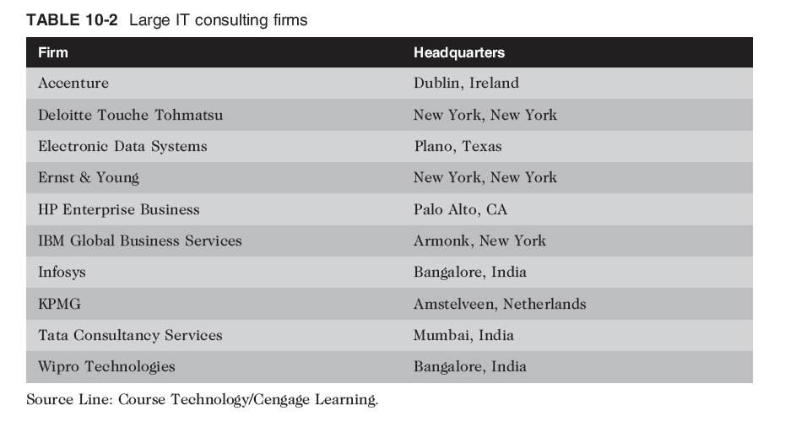
Ethics in Information Technology, Fourth Edition

Slide 10
Contingent Workers (cont’d.)
Employee leasing
  Business outsources all or part of its workforce to a professional employer organization
  Subject to special regulations regarding workers’ compensation and unemployment insurance
Coemployment relationship
  Two employers have actual or potential legal rights and duties with respect to the same employee or group of employees
Ethics in Information Technology, Fourth Edition

Slide 11
Contingent Workers (cont’d.)
Advantages of using contingent workers
  Business does not pay for benefits
  Can continually adjust the number of contingent workers to stay consistent with its business needs
  Does not customarily incur training costs
Ethics in Information Technology, Fourth Edition

Slide 12
Contingent Workers (cont’d.)
Disadvantages of using contingent workers
  Workers may lack a strong relationship with the firm
    Low commitment to the company and its projects
    High turnover rate
  Workers gain valuable practical experience working within a company’s structure and culture
    Lost when workers depart at the project’s completion
Ethics in Information Technology, Fourth Edition

Slide 13
Contingent Workers (cont’d.)
When deciding to use contingent workers:
  Recognize the trade-off between:
    Completing a single project quickly and cheaply
    Developing people in the organization
  When staffing is truly temporary:
    Use of contingent workers is a good approach
  Think twice about using contingent workers:
    When they are likely to learn corporate processes and strategies that are key to the company’s success
      Worker’s next assignment may be with major competitor
Ethics in Information Technology, Fourth Edition

Slide 14
Contingent Workers (cont’d.)
Deciding when to use contingent workers
  Can raise ethical and legal issues
  Potential liability for:
    Withholding payroll taxes
    Payment of employee retirement benefits
    Payment of health insurance premiums
    Administration of workers’ compensation
Ethics in Information Technology, Fourth Edition

Slide 15
Contingent Workers (cont’d.)
Deciding when to use contingent workers (cont’d.)
  Can be viewed as permanent employees by:
    Internal Revenue Service
    Labor Department
    State workers’ compensation agency
    State unemployment agencies
  Vizcaino v. Microsoft lawsuit
    Deciding factor is degree of control company exercises over employees
    Employers must exercise care in the treatment of contingent workers
Ethics in Information Technology, Fourth Edition

Slide 16
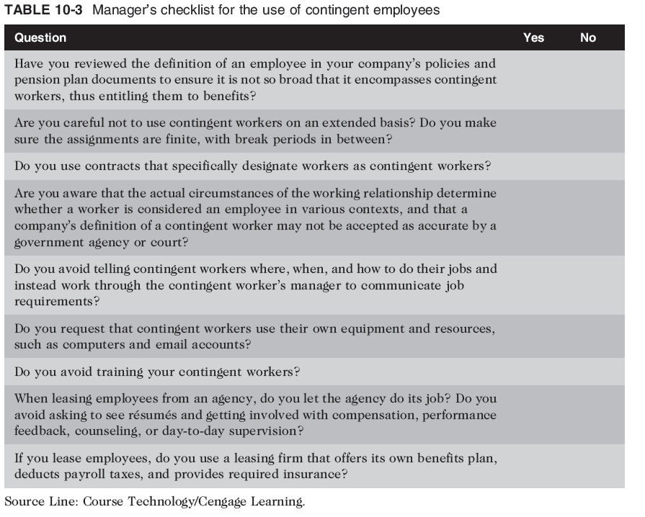
Ethics in Information Technology, Fourth Edition

Slide 17
H-1B Workers
Temporary work visa
  U.S. Citizenship and Immigration Services (USCIS)
  For people who work in specialty occupations
H-1B workers
  Meet critical business needs
  Have essential technical skills and knowledge not readily found in the U.S.
  Employers must pay H-1B workers the prevailing wage for the work being performed
Ethics in Information Technology, Fourth Edition

Slide 18
H-1B Workers (cont’d.)
Maximum continuous period of six years
  After six years, the foreign worker must remain outside the United States for one year before another H-1B petition can be approved
Continued use of H-1B workers
  Symptom of a larger, more fundamental problem
  U.S. not developing sufficient IT employees
Ethics in Information Technology, Fourth Edition

Slide 19
H-1B Workers (cont’d.)
Top five outsourcing countries
  India
  China
  Canada
  Philippines
  Korea
Federal cap of 65,000 for number of H-1B visas
  Applies only to certain IT professionals
  Large number of workers are exempt from cap
Ethics in Information Technology, Fourth Edition

Slide 20
H-1B Workers (cont’d.)
English as a second language
  Workers who are not fluent in English:
    May find it difficult and uncomfortable to participate
    May create their own cliques
    May stop trying to acclimate
    Can hurt a project team’s morale and lead to division
Managers and coworkers should:
  Strive to help improve H-1B workers’ English skills and cultural understanding
  Be sensitive to workers’ heritage and needs
Ethics in Information Technology, Fourth Edition

Slide 21
H-1B Workers (cont’d.)
H-1B application process
  Employer making job offer must also offer sponsorship
  Application has two stages
    Labor Condition Attestation (LCA)
    H-1B visa application
  If H-1B are more than 15% percent of company’s workforce:
    Must prove that it first tried to find U.S. workers
    Must prove not hiring H-1B after laying off similar U.S. worker
Ethics in Information Technology, Fourth Edition

Slide 22
H-1B Workers (cont’d.)
American Competitiveness in the Twenty-First Century Act (2000)
  Allows current H-1B holders to start working for employers as soon as their petitions are filed
Using H-1B workers instead of U.S. workers
  Good for short-term hiring
  Long-term hiring
    Lessens incentive to educate and develop U.S. workforces
    Does nothing to develop strong core of permanent U.S. IT workers needed in future
Ethics in Information Technology, Fourth Edition

Slide 23
H-1B Workers (cont’d.)
Potential exploitation of H-1B workers
  Salary abuse by unethical companies
  Some H1-B workers are paid $10,000 to $30,000 less than U.S. workers in the same job
  Visa Reform Act (2004)
    Defined a modified wage-rate system
  At end of the six-year visa term:
    If no green card, firm loses worker
    Suddenly unemployed worker must return home
Ethics in Information Technology, Fourth Edition

Slide 24
B - 1 Visa Controversy
B-1 visitor visa for people who wish to enter U.S. temporarily:
  For pleasure or medical treatment
  To travel for short periods of time to consult with business associates; attend convention or conference; negotiate a contract; or install or maintain machinery
B-1 visa faster, easier, and cheaper to obtain
  Lot of gray area in the use of B-1 visas
Ethics in Information Technology, Fourth Edition

Slide 25
Outsourcing
Outsourcing
  Approach to meeting staffing needs
  Long-term business arrangement
    Company contracts with an outside organization that has expertise in providing a specific function
Rationale
  Coemployment legal problems are minimal
  Lower costs
  Obtain strategic flexibility
  Keep staff focused on core competencies
Ethics in Information Technology, Fourth Edition

Slide 26
Offshore Outsourcing
Variation of outsourcing
  Services provided by an organization whose employees are in a foreign country
Companies reduce labor costs
Increasing in IT industry
As key processes move offshore, U.S. IT providers are forced to lower prices
Common to use offshore outsourcing for major programming projects
Ethics in Information Technology, Fourth Edition

Slide 27
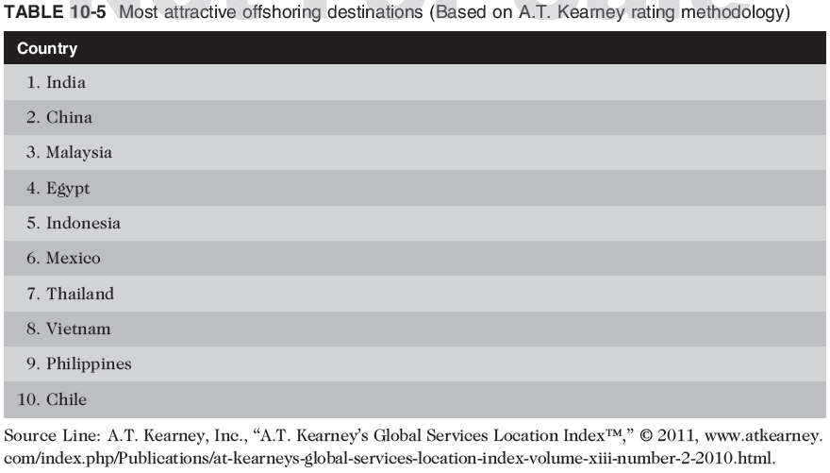
Offshore Outsourcing (cont’d.)
Ethics in Information Technology, Fourth Edition

Slide 28
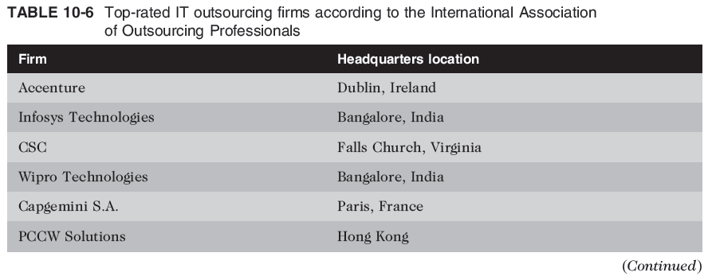
Offshore Outsourcing (cont’d.)
Ethics in Information Technology, Fourth Edition

Slide 29
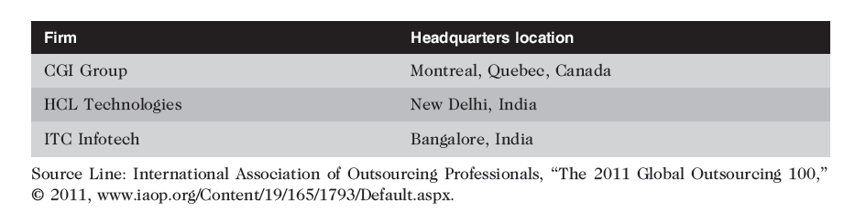
Offshore Outsourcing (cont’d.)
Ethics in Information Technology, Fourth Edition

Slide 30
Offshore Outsourcing (cont’d.)
Pros and cons of offshore outsourcing
  Low wages
    Demand for offshoring driving up salaries
  Dramatically speeds up development efforts
    Make progress on a project around the clock
  Can also result in new expenses
    Additional time to select an offshore vendor
    Additional costs for travel and communications
  Same ethical issues as H1-B and contingent workers
  Difficulty of communications over long distances and differences in culture and language
Ethics in Information Technology, Fourth Edition

Slide 31
Offshore Outsourcing (cont’d.)
Strategies for successful offshore outsourcing
  Expertise in technologies involved in the project
  Project manager speaks native language of employer
  Large staff available
  State-of-the-art telecommunications setup
  High-quality on-site managers and supervisors
Ethics in Information Technology, Fourth Edition

Slide 32
Whistle-Blowing
Effort to attract public attention to a negligent, illegal, unethical, abusive, or dangerous act by a company
Whistle-blower
  Usually has personal or special knowledge
  Risks own career
  Might even affect lives of friends and family
  Must choose between protecting society and remaining silent
Ethics in Information Technology, Fourth Edition

Slide 33
Whistle-Blowing (cont’d.)
Protection laws allow employees to alert authorities to employer actions that are unethical, illegal, or unsafe or that violate specific public policies
  No comprehensive federal law
  Each law has different:
    Filing provisions
    Administrative and judicial remedies
    Statutes of limitations
Ethics in Information Technology, Fourth Edition

Slide 34
Whistle-Blowing (cont’d.)
False Claims Act (“Lincoln Law”)
  Enacted during the Civil War
  Enticed whistle-blowers to come forward
  Offered a share of the money recovered
Qui tam provision allows private citizen to file in name of government
Violators are liable for three times the dollar amount the government is defrauded
Provides strong whistle-blower protection
Complexity requires advice of an attorney
Ethics in Information Technology, Fourth Edition

Slide 35
Whistle-Blowing (cont’d.)
Whistle-blower protection for private-sector workers
  Many states, not all, have laws that prevent workers from being fired because of an employee’s participation in “protected” activities
Whistle-blowers can file claims against their employers for retaliatory termination
Whistle-blowers are entitled to jury trials
If successful at trial, can receive punitive damage awards
Ethics in Information Technology, Fourth Edition

Slide 36
Whistle-Blowing (cont’d.)
Dealing with a whistle-blowing situation
  Assess the seriousness of the situation
  Begin documentation
  Attempt to address the situation internally
  Consider escalating the situation within the company
  Assess implications of becoming a whistle-blower
  Use experienced resources to develop action plan
  Execute the action plan
  Live with the consequences
Ethics in Information Technology, Fourth Edition

Slide 37
Green Computing
To manufacture truly “green” products, companies must:
  Produce product that requires less electricity
  Reduce the amount of hazardous materials used
  Increase amount of reusable or recyclable materials
  Help consumers dispose of their products in an environmentally safe manner at the end of the product’s useful life
Ethics in Information Technology, Fourth Edition

Slide 38
Green Computing (cont’d.)
Personal computers and cell phones contain thousands of components composed of many different materials
  Some harmful to humans and environment
  Workers along the entire supply chain at risk
  Users can also be exposed to these materials
Ethics in Information Technology, Fourth Edition

Slide 39
Green Computing (cont’d.)
EPEAT (Electronic Product Environmental Assessment Tool)
  Enables purchasers to evaluate, compare, and select electronic products
    Based on a total of 51 environmental criteria
    Products are ranked in three tiers of environmental performance
European Restriction of Hazardous Substances Directive
  Restricts use of many hazardous materials in computer manufacturing
Ethics in Information Technology, Fourth Edition

Slide 40
Green Computing (cont’d.)
How to safely dispose of obsolete computers
  Many states have recycling programs
  Some manufacturers have developed programs
Greenpeace environmental activist organization
  Issues quarterly ratings of manufacturers according to the manufacturers’ policies on toxic chemicals, recycling, and climate change
    Manufacturers have long way to go to meet the high standards
Ethics in Information Technology, Fourth Edition

Slide 41
ICT Industry Code of Conduct
Electronic Industry Citizenship Coalition (EICC)
  Promotes common code of conduct for ICT industry
  Focuses on the areas of:
    Worker safety and fairness
    Environmental responsibility
    Business efficiency
  Coalition membership is voluntary
Code of conduct defines performance, compliance, auditing, and reporting guidelines across five areas of social responsibility
Ethics in Information Technology, Fourth Edition

Slide 42
ICT Industry Code of Conduct (cont’d.)
Guiding principles of social responsibility
  Labor
    Must uphold the human rights of workers
  Health and safety
    Must provide safe and healthy work environment
  Environment
    Adverse effects minimized
  Management system
    Ensures compliance with code
  Ethics
    Must uphold the highest standards of ethics
Ethics in Information Technology, Fourth Edition

Slide 43
Summary
Contingent workforce includes:
  Independent contractors
  Temporary workers through employment agencies
  On-call or day laborers
  On-site workers provided by contract firms
Outsourcing
  Long-term business arrangement
  Contract for services with outside organization
  Expertise in providing a specific function
Ethics in Information Technology, Fourth Edition

Slide 44
Summary (cont’d.)
Whistle-blowing
  Effort to attract public attention to negligent, illegal, unethical, abusive, or dangerous acts by company
  Whistle-blowing process
    Assess the seriousness of the situation
    Begin documentation
    Attempt to address the situation internally
    Consider escalating the situation within the company
    Assess the implications of becoming a whistle-blower
    Use experienced resources to develop an action plan
    Execute the action plan
    Live with the consequences
Ethics in Information Technology, Fourth Edition

Slide 45
Summary (cont’d.)
Green computers
  Use less electricity
  Include fewer hazardous materials
  Contain reusable or recyclable material
Manufacturers must help consumers:
  Dispose of products in an environmentally safe manner at the end of the product’s useful life
EPEAT (Electronic Product Assessment Tool)
  Purchasers can evaluate, compare, and select
  Based on 51 environmental criteria
Ethics in Information Technology, Fourth Edition

