Slide 1
Ethics in Information Technology, Fourth Edition
Chapter 9
Social Networking

Slide 2
Objectives
As you read this chapter, consider the following questions:
  What are social networks, how do people use them, and what are some of their practical business uses?
  What are some of the key ethical issues associated with the use of social networking Web sites?
  What is a virtual life community, and what are some of the ethical issues associated with such a community?
Ethics in Information Technology, Fourth Edition

Slide 3
What Is a Social Networking Web Site?
Creates an online community of Internet users that eliminates barriers created by time, distance, and cultural differences
Allows people to interact with others online by sharing opinions, insights, information, interests, and experiences
Members may use the site to interact with friends, family members, and colleagues they already know
Members may also wish to develop new personal and professional relationships
Ethics in Information Technology, Fourth Edition

Slide 4
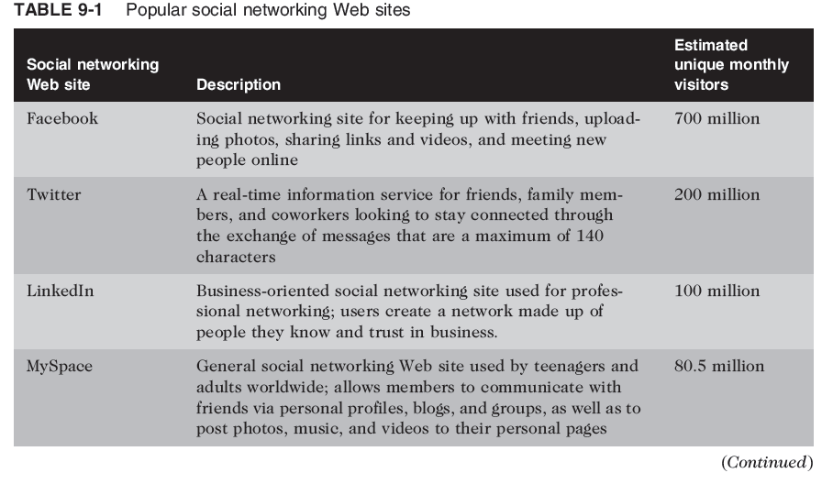
Ethics in Information Technology, Fourth Edition

Slide 5
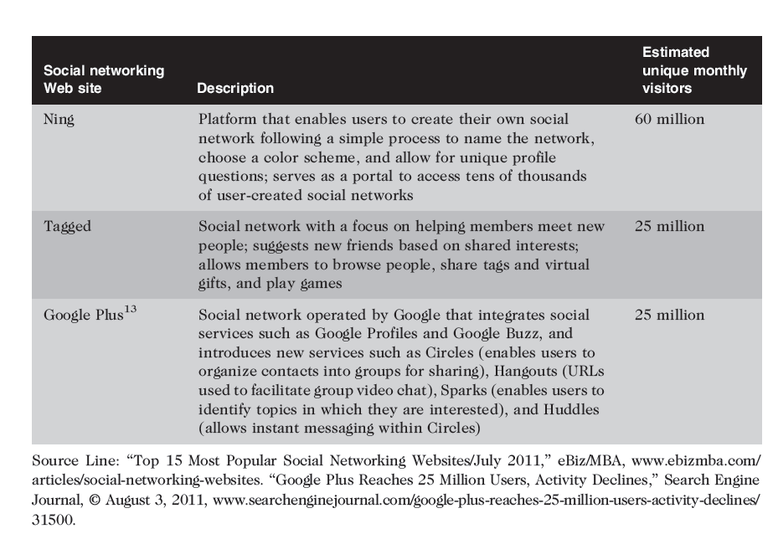
Ethics in Information Technology, Fourth Edition

Slide 6
What Is a Social Networking Web Site? (cont’d.)
Endless range of interests and a wide range of social networking Web sites catering to those interests
Over 314.5 million social network users worldwide
Average visitor spends almost six hours per month
Popularity increasing mostly rapidly among those aged 50 and older
Ethics in Information Technology, Fourth Edition

Slide 7
Business Applications of Online Social Networking
Social network advertising
  Uses social networks to communicate and promote the benefits of products and services
Social network advertising strategies
  Direct advertising
    Banner ads on social networking Web site
  Advertising using an individual’s network of friends
    People frequently make decisions based on input from their close group of friends
    Ethical issues with exploiting an individual’s personal relationships for the financial benefit of a company
Ethics in Information Technology, Fourth Edition

Slide 8
Business Applications of Online Social Networking (cont’d.)
Social network advertising strategies (cont’d.)
  Indirect advertising through groups
    Interested users can join by becoming “fans”
    Fans gained in this manner may not remain loyal
  Company-owned social networking Web site
    Users can talk about what new products, services, or improvements they would like to see
  Viral marketing
    Users pass along marketing message to others, creating the potential for exponential growth
Ethics in Information Technology, Fourth Edition

Slide 9
The Use of Social Networks in the Hiring Process
89% of recruiters use some form of social media in the recruiting process
Employers can and do look at the social networking profiles of job candidates when hiring
Companies may reject candidates who post:
  Information about their drinking or drug use
  Provocative or inappropriate photos
  Discriminatory remarks relating to race, gender, or religion
  Confidential information
Ethics in Information Technology, Fourth Edition

Slide 10
The Use of Social Networks in the Hiring Process (cont’d.)
Employer cannot legally screen applicants based on race or ethnicity, but:
  Members of social networking Web sites frequently provide sex, age, marital status, sexual orientation, religion, and political affiliation data
  Personal photos may reveal a disability or user’s race or ethnicity
  Individuals may reveal data that are protected by civil rights legislation
Ethics in Information Technology, Fourth Edition

Slide 11
Use of Social Media to Improve Customer Service
Consumers use social networks to share their experiences, both good and bad, with others
Also seek help and advice on how to use products more effectively and how to deal with special situations
Unless organizations monitor social networks, customers are left to resolve questions and issues on their own, risking loss of customers and future sales
Ethics in Information Technology, Fourth Edition

Slide 12
Social Shopping Web Sites
Combine two highly popular online activities: shopping and social networking
Shoppers and sellers can share information and make recommendations while shopping online
Revenue is generated through retailer advertising or by sharing with retailers data about their members’ likes and dislikes
Retailers can design product improvements based on input and get ideas for new product lines
Great way for small businesses to boost sales
Ethics in Information Technology, Fourth Edition

Slide 13
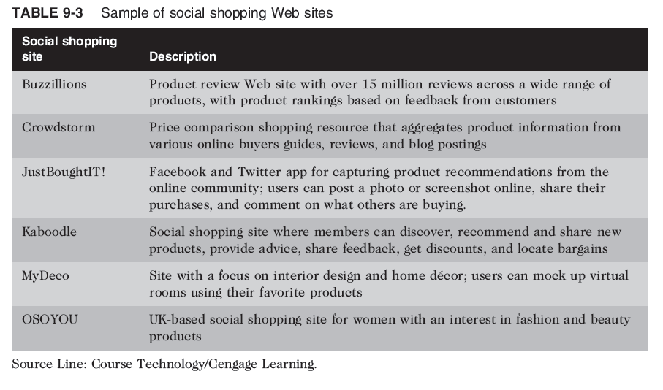
Ethics in Information Technology, Fourth Edition

Slide 14
Social Networking Ethical Issues
Ethical issues for social networking Web sites are:
  Cyberbullying
  Cyberstalking
  Sexual predators
  Uploading inappropriate material
Cyberbullying
  Harassment, torment, humiliation, or threatening of one minor by another minor or group of minors via the Internet or cell phone
  Cyberbullying can become so intense, child commits suicide
Ethics in Information Technology, Fourth Edition

Slide 15
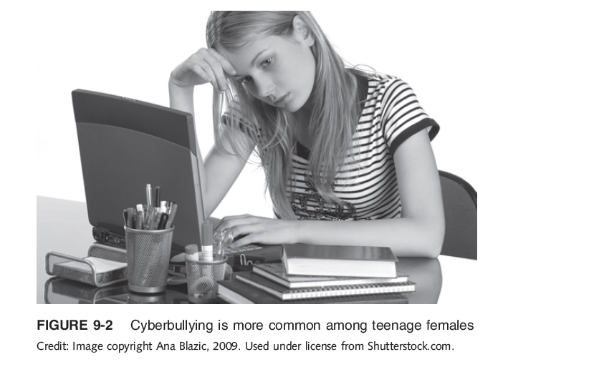
Ethics in Information Technology, Fourth Edition

Slide 16
Social Networking Ethical Issues (cont’d.)
Numerous forms of cyberbullying
  Sending mean-spirited or threatening messages
  Sending thousands of text messages to victim’s cell phone and running up a huge cell phone bill
  Impersonating victim and sending inappropriate messages to others
  Stealing victim’s password and modifying his or her profile to include racist, homophobic, sexual, or other inappropriate data that offends others or attracts the attention of undesirable people
Ethics in Information Technology, Fourth Edition

Slide 17
Social Networking Ethical Issues (cont’d.)
Numerous forms of cyberbullying (cont’d.)
  Posting mean, personal, or false information about the victim in the cyberbully’s blog
  Creating a Web site whose purpose is to humiliate or threaten the victim
  Taking inappropriate photos of the victim and either posting online or sending to others via cell phone
  Setting up an Internet poll to elicit responses to embarrassing questions regarding victim
  Sending inappropriate messages while playing interactive games
Ethics in Information Technology, Fourth Edition

Slide 18
Social Networking Ethical Issues (cont’d.)
Cyberstalking
  Threatening behavior or unwanted advances using the Internet or online and electronic communications
  Adult version of cyberbullying
  Can escalate into:
    Abusive or excessive phone calls
    Threatening or obscene mail
    Trespassing
    Vandalism
    Physical stalking
    Physical assault
Ethics in Information Technology, Fourth Edition

Slide 19
Social Networking Ethical Issues (cont’d.)
Cyberstalking (cont’d.)
  Over three dozen states have laws prohibiting cyberstalking
  Current federal statues address some forms of cyberstalking, but there are large gaps in federal and state law
Ethics in Information Technology, Fourth Edition

Slide 20
Social Networking Ethical Issues (cont’d.)
Encounters with sexual predators
  Some social networking Web sites are criticized for not protecting minors from sexual predators
    MySpace banned 90,000 registered sex offenders from its site
  Legislators are pushing social networking Web sites to adopt stronger safety measures
Ethics in Information Technology, Fourth Edition

Slide 21
Social Networking Ethical Issues (cont’d.)
Uploading of inappropriate material
  Social networking Web sites have policies against uploading videos depicting violence or obscenity
  Most social networking Web sites have terms of use agreements that give the sites the right to delete material and terminate users accounts that violate their policy
  Most Web sites do not have sufficient resources to review all material posted
Ethics in Information Technology, Fourth Edition

Slide 22
Online Virtual Worlds
Virtual world is a shared multimedia, computer-generated environment in which users represented by avatars can act, communicate, create, retain ownership of what they create, and exchange assets with each other
  Massively multiplayer online game (MMOG) is multiplayer video game capable of supporting hundreds or even thousands of concurrent players
    Massively multiplayer online role playing game (MMORPG) provides huge online world in which players take on the role of a character and control that character’s action
Ethics in Information Technology, Fourth Edition

Slide 23
Online Virtual Worlds (cont’d.)
Avatars can do everything one can do in real life
  Shop, hold jobs, run for political office
  Develop relationships with other avatars
  Start up new businesses
  Engage in criminal activities
Ethics in Information Technology, Fourth Edition

Slide 24
Crime in Virtual Worlds
Should law enforcement—real or virtual—get involved in acts that occur in virtual worlds?
Criminal acts in a virtual world:
  Can be clearly illegal, such as trafficking in actual drugs or stolen credit cards
  May not be real-life crime, such as virtual muggings and sex crimes that can cause real life anguish
  May be in the gray area, for example, unfair operation of virtual casinos
Ethics in Information Technology, Fourth Edition

Slide 25
Crime in Virtual Worlds (cont’d)
Virtual worlds have rules against offensive behavior in public, such as using racial slurs or performing overtly sexual actions, but:
  Consenting adults can travel to private areas and engage in socially unacceptable behavior
  Bad deeds done online can often be mediated by game administrators based on rules of the game
Ethics in Information Technology, Fourth Edition

Slide 26
Educational and Business Uses of Virtual Worlds
New Media Consortium (NMC)
  International consortium of hundreds of organizations
  Explores new media and technologies to improve teaching, learning, and creative expression
  Also builds custom virtual learning worlds, simulations, and learning games
Ethics in Information Technology, Fourth Edition

Slide 27
Educational and Business Uses of Virtual Worlds
Second Life Work Microsites
  Enable businesses and government agencies to use Second Life for virtual meetings, events, training, and simulations
  Stimulates engaged, collaborative learning to augment their traditional curriculum
Ethics in Information Technology, Fourth Edition

Slide 28
Summary
Social networking Web sites
  Create an online community of Internet users
  Break down barriers created by time, distance, and cultural differences
  Allow people to interact with others online by sharing opinions, insights, information, interests, and experiences
Social network advertising uses social networks to inform, promote, and communicate the benefits of products and services
Ethics in Information Technology, Fourth Edition

Slide 29
Summary (cont’d.)
Social network advertising strategies
  Direct advertising
  Advertising using network of friends
  Indirect advertising through groups
  Advertising via company-owned Web sites
  Viral marketing
Employers look at the social network profiles of job candidates when hiring
Ethics in Information Technology, Fourth Edition

Slide 30
Summary (cont’d)
Consumers use social networks to share their experiences and seek help and advice
Unless organizations monitor social networks, customers are left to resolve questions and issues on their own, risking loss of customers and future sales
Ethical issues for social networking Web sites are:
  Cyberbullying
  Cyberstalking
  Sexual predators
  Uploading inappropriate material
Ethics in Information Technology, Fourth Edition

Slide 31
Summary (cont’d.)
Online virtual world is a computer-simulated world
  Visitor can move in three-dimensional space
  Visitor can communicate and interact with other visitors
  Visitor can manipulate elements of the simulated world
Ethics in Information Technology, Fourth Edition

