Slide 1

Bengali Braille to Text Translator
Supervised by
Dr. Ahmedul Kabir
Assistant Professor
Presented by
Atiq Ahammed
BSSE0817
Institute of information Technology
University of Dhaka

Slide 2
Project Overview

Slide 3
Bengali Braille to Text Translator
Desktop Application
Translate Bengali Braille Code to Corresponding Text
Input Scanned Image of Bengali Braille Document

Slide 4

Braille code of the Bengali Text “আমার সোনার বাংলা”
}
}
}
সোনার
আমার
বাংলা

Slide 5
Methodology

Slide 6
Image Preprocessing
Dot Identification
Line
Identification
Letter Recognition
Decimal Code Generation
Braille Cell Framing
Word Recognition
Final Bengali Text

Slide 7
Image Preprocessing
Image Acquisition (RGB to Gray)
Noise Filtering
Otsu's Thresholding
Binary Image Conversion
Morphological Operation (Dilation - Erosion)

Slide 8
Example of Braille code and Bengali text

Slide 10
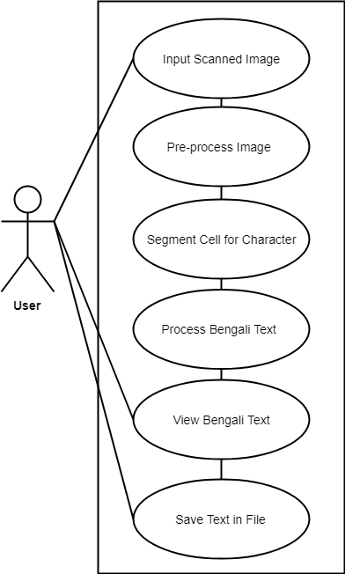
Use Case Diagram 1.1

Slide 11
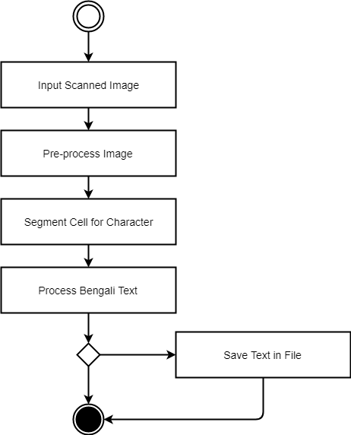
Activity Diagram Level-1

Slide 12
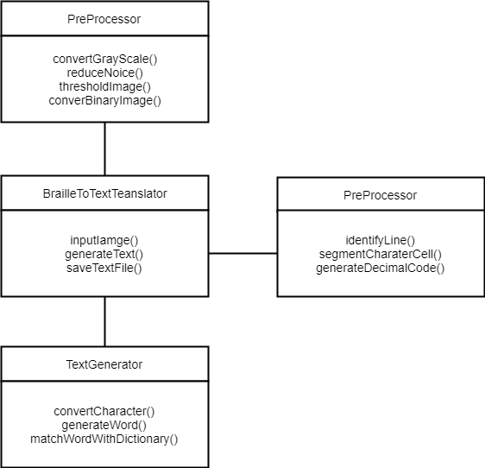
Class Diagram

Slide 13
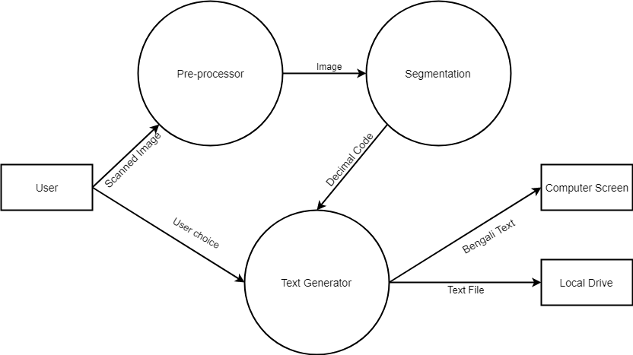
Data Flow Diagram Level-1

Slide 14
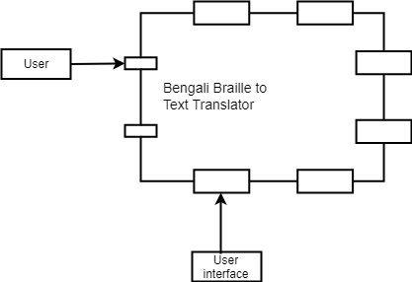
Architectural Context Diagram

Slide 15
Tools & Technologies

Slide 16


Backend

Slide 17

Frontend

Slide 18
Progress
Preprocessing
Noise Reduction to Identify Dot

Slide 19
References
S. D. Al-Shamma, "Arabic Braille Recognition and Transcription into Text and Voice," Cairo International Biomedical Engineering Conference, p. 228, 2010.
M. Gadag, "Generation of English Text from Scanned Braille Document," International Journal of Engineering Science and Computing, vol. 6, no. 4, p. 4447, 2016.
S.Padmavathi, "CONVERSION OF BRAILLE TO TEXT IN ENGLISH, HINDI AND TAMIL LANGUAGES," International Journal of Computer Science, Engineering and Applications, vol. 3, no. 3, p. 25, 2013.

Slide 20
Q & A

Slide 21
Thank You

