Slide 1
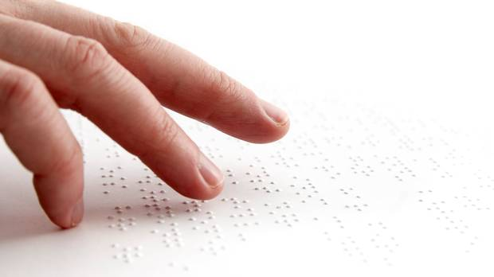
Bengali Braille to Text Translator
Supervised by
Dr. Ahmedul Kabir
Assistant Professor
Presented by
Atiq Ahammed
BSSE0817
Institute of information Technology
University of Dhaka

Slide 2
Bengali Braille
Reading and writing system
Read with the sense of touch
Used by blind and visually impaired people

Slide 3
Character is made using a combination of 6 dots which is arranged in two columns and three rows
Braille code of Bengali character ‘আ’

Slide 4
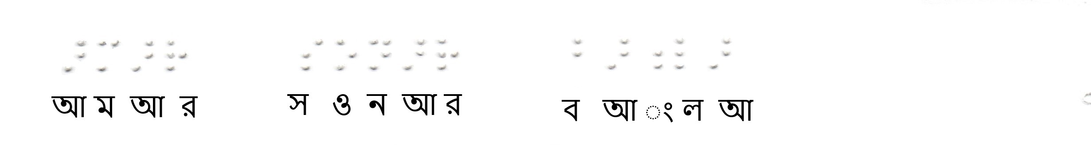
Braille code of the Bengali Text “আমার সোনার বাংলা”
}
}
}
সোনার
আমার
বাংলা

Slide 5
Project Overview
Desktop Application
Preprocessing
Converting the image to Gray Level
Image enhancement
Image thresholding
Converting image to binary image

Slide 6
Project Overview
Braille Characters Identification
Dot identification
Line identification
Braille cell identification
Character identification

Slide 7
Project Overview
Post Processing
Word identification
Spell checking
Bengali text generation

Slide 8
Existing Work
Braille to Text Translator for
English
Arabic
Gujarati

Slide 9
Thank You

