Slide 1

Software Project Lab(SPL)-01 Name: Ammar Nomany Tanvir Roll: BSSE 0904
SPL Title: A Simple Program For Parsing & Analyzing
Primitive Variables In Java.
Supervisor: Nadia Nahar

Slide 2

Objectives
Finding out the variables (especially primitive types)
Estimating the amount of memory consumed by those variables while running this code
Presenting them by a graph

Slide 3
Advantage
Getting a visualization of memory consumption by the variables
Can get a better idea about the chances of segmentation fault

Slide 4
My Approach
I have analyzed the program with AspectJ for tracing variables. AspectJ does this dynamically.
I have also made a static analysis for finding local variables of methods. Why?
Using Thread I have done both simultaneously.

Slide 5
What is Thread?
Thread is basically a lightweight sub-process, a smallest unit of processing. Threads are independent.
Advantages :
achieves multitasking
saves memory
independent

Slide 6
And AspectJ ?
AOP is a programming paradigm that aims to increase modularity by adding additional behavior to existing code without modification of the code itself.
AspectJ implements these concerns using extensions of Java programming language.

Slide 7
Aspect Creation
AspectJ provides an implementation of AOP and has three core concepts:
Join Point Pointcut Advice
Join point :
well-defined moments in the execution of a program, like method call, object instantiation, or variable access.

Slide 8
Aspect Creation
Pointcut :
A regular expression that matches join points. An advice is associated with a pointcut expression and runs at any join point that matches the pointcut.
e.g.
pointcut set() : execution(* set*(..) ) && this(Point);

Slide 9
Structure Of My Program
RunThreads.java
ReadIt.java Main.java
ClassVariableAndParameterCounting.aj
VarNameCollector.java ShowVariable.java
LocalVariableCounting.java
BarChart.java
BarChart.java
Thread
Thread

Slide 10
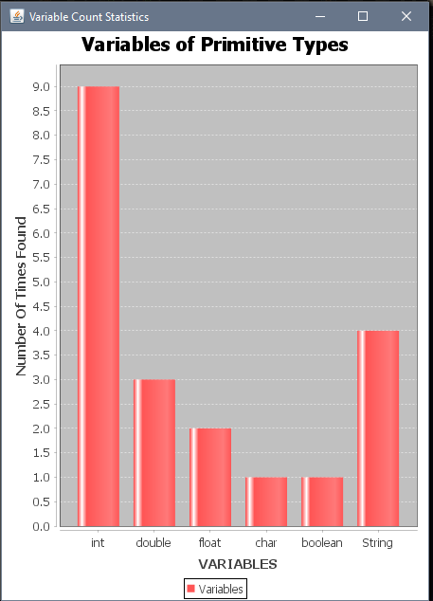
Output
Fig : Bar Chart

Slide 11
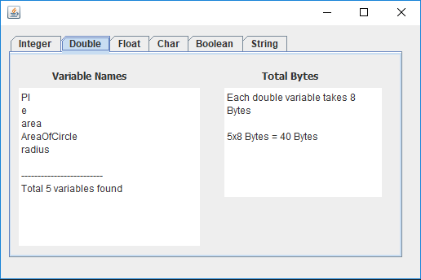
Output
Fig : Variable Name Window

Slide 12
Ramzan ul Mubarak
Thanks

