Slide 1
Data Preparation
Machine Learning at its most basic is the practice of using algorithms to parse data, learn from it, and then make a determination or prediction about something in the world.” – Nvidia
“Machine learning is the science of getting computers to act without being explicitly programmed.” – Stanford
“Machine learning is based on algorithms that can learn from data without relying on rules-based programming.”- McKinsey & Co.

Slide 2
Feature Engineering
Feature
A feature is a numeric representation of raw data. There are many ways to turn raw data into numeric measurements, which is why features can end up looking like a lot of things.
The number of features is also important.
Feature Engineering
Feature engineering is the process of formulating the most appropriate features given the data, the model, and the task.
Notes:
The number of features is also important. If there are not enough informative
features, then the model will be unable to perform the ultimate task. If there are
too many features, or if most of them are irrelevant, then the model will be more
expensive and tricky to train. Something might go awry in the training process
that impacts the model’s performance.

Slide 3
Goals of Feature Engineering
Preparing the proper input dataset, compatible with the machine learning algorithm requirements.
Improving the performance of machine learning models.

Slide 4
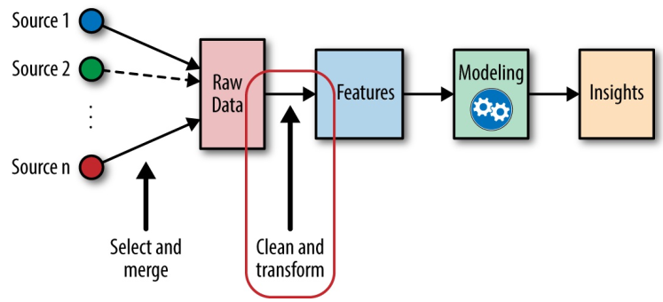
Feature Engineering
Notes:
Features and models sit between raw data and the desired insights (see Figure 1-
2). In a machine learning workflow, we pick not only the model, but also the
features. This is a double-jointed lever, and the choice of one affects the other.
Good features make the subsequent modeling step easy and the resulting model
more capable of completing the desired task. Bad features may require a much
more complicated model to achieve the same level of performance. In the rest of
this book, we will cover different kinds of features and discuss their pros and
cons for different types of data and models. Without further ado, let’s get started!

Slide 5
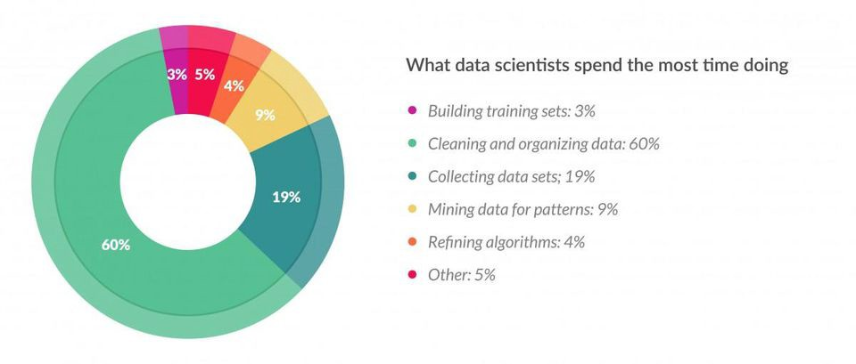
Feature Engineering
According to a survey in Forbes, data scientists spend 80% of their time on data preparation:

Slide 6
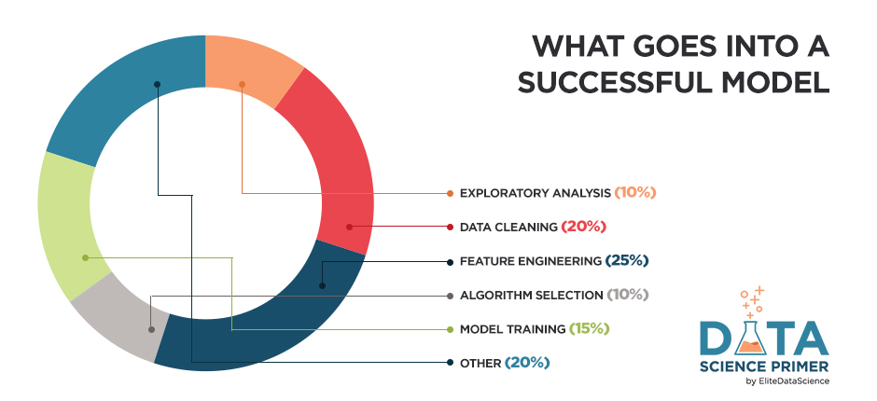
Feature Engineering

Slide 7
Choosing Feature Engineering Method
The best way to achieve expertise in feature engineering is practicing different techniques on various datasets and observing their effect on model performances.

Slide 8
Feature Engineering Techniques
Imputation
Handling Outliers
Binning
Log Transform
One-Hot Encoding
Grouping Operations
Feature Split
Scaling
Extracting Date

Slide 9
Data Missing
Why missing data is important?
Missing values affect the performance of the machine learning models.
Most of the algorithms do not accept datasets with missing values and gives an error.
Solution
Dropping
Imputation
Imputation is the process of replacing missing data with substituted values.
Notes:
Missing values are one of the most common problems you can encounter when you try to prepare your data for machine learning. The reason for the missing values might be human errors, interruptions in the data flow, privacy concerns, and so on. Whatever is the reason, missing values affect the performance of the machine learning models.
Some machine learning platforms automatically drop the rows which include missing values in the model training phase and it decreases the model performance because of the reduced training size. On the other hand, most of the algorithms do not accept datasets with missing values and gives an error.
The most simple solution to the missing values is to drop the rows or the entire column. There is not an optimum threshold for dropping but you can use 70% as an example value and try to drop the rows and columns which have missing values with higher than this threshold.

Slide 10
Imputation
Imputation is a more preferable option rather than dropping because it preserves the data size.
Applying imputation
Numerical Imputation: Considering a possible default value of missing values in the column.
Categorical Imputation: Replacing the missing values with the maximum occurred value in a column is a good option for handling categorical columns.
Notes:
Numerical Imputation
Imputation is a more preferable option rather than dropping because it preserves the data size. However, there is an important selection of what you impute to the missing values. I suggest beginning with considering a possible default value of missing values in the column. For example, if you have a column that only has 1 and NA, then it is likely that the NA rows correspond to 0. For another example, if you have a column that shows the “customer visit count in last month”, the missing values might be replaced with 0 as long as you think it is a sensible solution.
Another reason for the missing values is joining tables with different sizes and in this case, imputing 0 might be reasonable as well.
Except for the case of having a default value for missing values, I think the best imputation way is to use the medians of the columns. As the averages of the columns are sensitive to the outlier values, while medians are more solid in this respect.
Categorical Imputation
Replacing the missing values with the maximum occurred value in a column is a good option for handling categorical columns. But if you think the values in the column are distributed uniformly and there is not a dominant value, imputing a category like “Other” might be more sensible, because in such a case, your imputation is likely to converge a random selection.

Slide 11
Handling Outliers
Statistical methodologies are open to making mistakes, whereas visualizing the outliers gives a chance to take a decision with high precision.
Techniques to handle outliers:
Outlier Detection with Standard Deviation
Outlier Detection with Percentiles
An Outlier Dilemma: Drop or Cap
Notes:
If a value has a distance to the average higher than x * standard deviation, it can be assumed as an outlier. Then what x should be?
There is no trivial solution for x, but usually, a value between 2 and 4 seems practical.
Another mathematical method to detect outliers is to use percentiles. You can assume a certain percent of the value from the top or the bottom as an outlier. The key point is here to set the percentage value once again, and this depends on the distribution of your data as mentioned earlier.
Additionally, a common mistake is using the percentiles according to the range of the data. In other words, if your data ranges from 0 to 100, your top 5% is not the values between 96 and 100. Top 5% means here the values that are out of the 95th percentile of data.
Another option for handling outliers is to cap them instead of dropping. So you can keep your data size and at the end of the day, it might be better for the final model performance.
On the other hand, capping can affect the distribution of the data, thus it better not to exaggerate it.

Slide 12
Binning
Binning works on both numerical and categorical data.
Example:
#Numerical Binning
Value Bin
0-30 -> Low
31-70 -> Mid
71-100 -> High
Notes:
Numerical Imputation
Imputation is a more preferable option rather than dropping because it preserves the data size. However, there is an important selection of what you impute to the missing values. I suggest beginning with considering a possible default value of missing values in the column. For example, if you have a column that only has 1 and NA, then it is likely that the NA rows correspond to 0. For another example, if you have a column that shows the “customer visit count in last month”, the missing values might be replaced with 0 as long as you think it is a sensible solution.
Another reason for the missing values is joining tables with different sizes and in this case, imputing 0 might be reasonable as well.
Except for the case of having a default value for missing values, I think the best imputation way is to use the medians of the columns. As the averages of the columns are sensitive to the outlier values, while medians are more solid in this respect.
Categorical Imputation
Replacing the missing values with the maximum occurred value in a column is a good option for handling categorical columns. But if you think the values in the column are distributed uniformly and there is not a dominant value, imputing a category like “Other” might be more sensible, because in such a case, your imputation is likely to converge a random selection.

Slide 13
Binning
#Categorical Binning Example
Value Bin
Spain -> Europe
Italy -> Europe
Chile -> South America
Brazil -> South America
# The main motivation of binning is to make the model more robust and prevent overfitting, however, it has a cost to the performance.
Notes:
The main motivation of binning is to make the model more robust and prevent overfitting, however, it has a cost to the performance. Every time you bin something, you sacrifice information and make your data more regularized. (Please see regularization in machine learning)
The trade-off between performance and overfitting is the key point of the binning process. In my opinion, for numerical columns, except for some obvious overfitting cases, binning might be redundant for some kind of algorithms, due to its effect on model performance.
However, for categorical columns, the labels with low frequencies probably affect the robustness of statistical models negatively. Thus, assigning a general category to these less frequent values helps to keep the robustness of the model. For example, if your data size is 100,000 rows, it might be a good option to unite the labels with a count less than 100 to a new category like “Other”.

Slide 14
Binning Trade-off
# The trade-off between performance and overfitting is the key point of the binning process.
# For numerical columns, except for some obvious overfitting cases, binning might be redundant for some kind of algorithms, due to its effect on model performance.
# For categorical columns, the labels with low frequencies probably affect the robustness of statistical models negatively. Thus, assigning a general category to these less frequent values helps to keep the robustness of the model.
Notes:
The main motivation of binning is to make the model more robust and prevent overfitting, however, it has a cost to the performance. Every time you bin something, you sacrifice information and make your data more regularized. (Please see regularization in machine learning)
The trade-off between performance and overfitting is the key point of the binning process. In my opinion, for numerical columns, except for some obvious overfitting cases, binning might be redundant for some kind of algorithms, due to its effect on model performance.
However, for categorical columns, the labels with low frequencies probably affect the robustness of statistical models negatively. Thus, assigning a general category to these less frequent values helps to keep the robustness of the model. For example, if your data size is 100,000 rows, it might be a good option to unite the labels with a count less than 100 to a new category like “Other”.

Slide 15
Log Transform
Benefits of log transform:
It helps to handle skewed data and after transformation, the distribution becomes more approximate to normal.
In most of the cases the magnitude order of the data changes within the range of the data.
It also decreases the effect of the outliers, due to the normalization of magnitude differences and the model become more robust.
Equation:
Log(x+1)
Notes:
Log Transform
For instance, the difference between ages 15 and 20 is not equal to the ages 65 and 70. In terms of years, yes, they are identical, but for all other aspects, 5 years of difference in young ages mean a higher magnitude difference. This type of data comes from a multiplicative process and log transform normalizes the magnitude differences like that.
A critical note: The data you apply log transform must have only positive values, otherwise you receive an error. Also, you can add 1 to your data before transform it. Thus, you ensure the output of the transformation to be positive.

Slide 16
One-hot encoding
This method spreads the values in a column to multiple flag columns and assigns 0 or 1 to them. These binary values express the relationship between grouped and encoded column.
Why One-hot?
If we have N distinct values in the column, it is enough to map them to N-1 binary columns, because the missing value can be deducted from other columns.
Notes:
This method changes your categorical data, which is challenging to understand for algorithms, to a numerical format and enables you to group your categorical data without losing any information. (For details please see the last part of Categorical Column Grouping)
Why One-Hot?: If you have N distinct values in the column, it is enough to map them to N-1 binary columns, because the missing value can be deducted from other columns. If all the columns in our hand are equal to 0, the missing value must be equal to 1. This is the reason why it is called as one-hot encoding. However, I will give an example using the get_dummies function of Pandas. This function maps all values in a column to multiple columns.

Slide 17
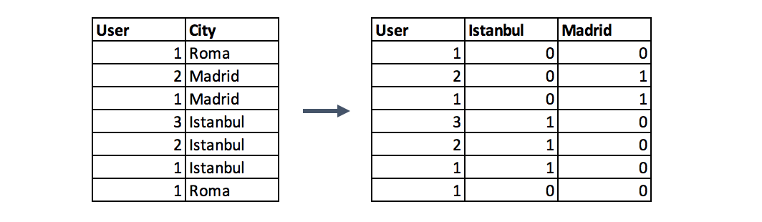
One-hot encoding
Example:
Notes:
This method changes your categorical data, which is challenging to understand for algorithms, to a numerical format and enables you to group your categorical data without losing any information. (For details please see the last part of Categorical Column Grouping)
Why One-Hot?: If you have N distinct values in the column, it is enough to map them to N-1 binary columns, because the missing value can be deducted from other columns. If all the columns in our hand are equal to 0, the missing value must be equal to 1. This is the reason why it is called as one-hot encoding. However, I will give an example using the get_dummies function of Pandas. This function maps all values in a column to multiple columns.

Slide 18
Grouping Operations
“Tidy datasets are easy to manipulate, model and visualize, and have a specific structure: each variable is a column, each observation is a row, and each type of observational unit is a table.”
— Hadley Wickham
The key point of group by operations is to decide the aggregation functions of the features. For numerical features, average and sum functions are usually convenient options, whereas for categorical features it more complicated.
Notes:
Tidy Data: In most machine learning algorithms, every instance is represented by a row in the training dataset, where every column show a different feature of the instance. This kind of data called “Tidy”.
Datasets such as transactions rarely fit the definition of tidy data above, because of the multiple rows of an instance. In such a case, we group the data by the instances and then every instance is represented by only one row.
The key point of group by operations is to decide the aggregation functions of the features. For numerical features, average and sum functions are usually convenient options, whereas for categorical features it more complicated.

Slide 19
Grouping Operations
Categorical Grouping
Highest frequency
Pivot table
One-hot encoding
# Highest frequency:
Select the label with the highest frequency. In other words, this is the max operation for categorical columns.
# Pivot table:
Defined as aggregated functions for the values between grouped and encoded columns.
Notes:
# Highest Frequency
The first option is to select the label with the highest frequency. In other words, this is the max operation for categorical columns, but ordinary max functions generally do not return this value, you need to use a lambda function for this purpose.
#Pivot table
Second option is to make a pivot table. This approach resembles the encoding method in the preceding step with a difference. Instead of binary notation, it can be defined as aggregated functions for the values between grouped and encoded columns. This would be a good option if you aim to go beyond binary flag columns and merge multiple features into aggregated features, which are more informative.

Slide 20
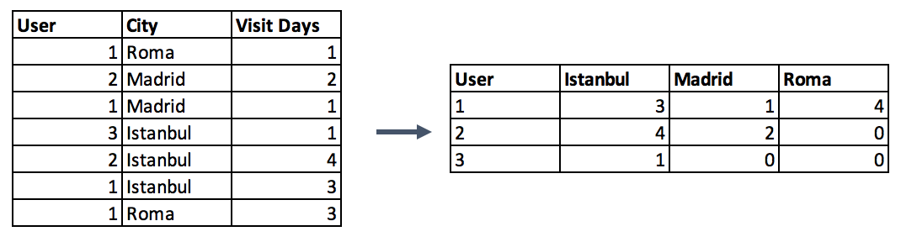
Grouping Operations
Pivot Table Example:
Notes:
Second option is to make a pivot table. This approach resembles the encoding method in the preceding step with a difference. Instead of binary notation, it can be defined as aggregated functions for the values between grouped and encoded columns. This would be a good option if you aim to go beyond binary flag columns and merge multiple features into aggregated features, which are more informative.

Slide 21
Grouping Operations
Numerical Column Grouping
Numerical columns are grouped using sum and mean functions in most of the cases. Both can be preferable according to the meaning of the feature.
For example, if you want to obtain ratio columns, you can use the average of binary columns. In the same example, sum function can be used to obtain the total count either.

Slide 22
Feature Splitting
By extracting the utilizable parts of a column into new features:
We enable machine learning algorithms to comprehend them.
Make possible to bin and group them.
Improve model performance by uncovering potential information.
Example:
0 Luther N. Gonzalez
1 Charles M. Young
2 Terry Lawson
3 Kristen White
4 Thomas Logsdon
Notes:
Splitting features is a good way to make them useful in terms of machine learning. Most of the time the dataset contains string columns that violates tidy data principles. By extracting the utilizable parts of a column into new features:
We enable machine learning algorithms to comprehend them.
Make possible to bin and group them.
Improve model performance by uncovering potential information.
Split function is a good option, however, there is no one way of splitting features. It depends on the characteristics of the column, how to split it. Let’s introduce it with two examples. First, a simple split function for an ordinary name column:

Slide 23
Feature Splitting
#Extracting first names
0 Luther
1 Charles
2 Terry
3 Kristen
4 Thomas
#Extracting last names
0 Gonzalez
1 Young
2 Lawson
3 White
4 Logsdon
Notes:
Splitting features is a good way to make them useful in terms of machine learning. Most of the time the dataset contains string columns that violates tidy data principles. By extracting the utilizable parts of a column into new features:
We enable machine learning algorithms to comprehend them.
Make possible to bin and group them.
Improve model performance by uncovering potential information.
Split function is a good option, however, there is no one way of splitting features. It depends on the characteristics of the column, how to split it. Let’s introduce it with two examples. First, a simple split function for an ordinary name column:

Slide 24
Extracting Date
Though date columns usually provide valuable information about the model target, they are neglected as an input or used nonsensically for the machine learning algorithms.
Three types of preprocessing for dates:
Extracting the parts of the date into different columns: Year, month, day, etc.
Extracting the time period between the current date and columns in terms of years, months, days, etc.
Extracting some specific features from the date: Name of the weekday, Weekend or not, holiday or not, etc.
Notes:
Extracting Date
Though date columns usually provide valuable information about the model target, they are neglected as an input or used nonsensically for the machine learning algorithms. It might be the reason for this, that dates can be present in numerous formats, which make it hard to understand by algorithms, even they are simplified to a format like "01–01–2017".
Building an ordinal relationship between the values is very challenging for a machine learning algorithm if you leave the date columns without manipulation. Here, I suggest three types of preprocessing for dates:
Extracting the parts of the date into different columns: Year, month, day, etc.
Extracting the time period between the current date and columns in terms of years, months, days, etc.
Extracting some specific features from the date: Name of the weekday, Weekend or not, holiday or not, etc.
If you transform the date column into the extracted columns like above, the information of them become disclosed and machine learning algorithms can easily understand them.

Slide 25
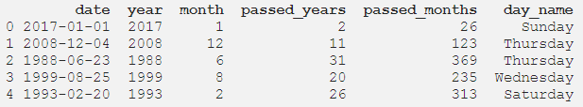
Extracting Date
Notes:
Extracting Date
Though date columns usually provide valuable information about the model target, they are neglected as an input or used nonsensically for the machine learning algorithms. It might be the reason for this, that dates can be present in numerous formats, which make it hard to understand by algorithms, even they are simplified to a format like "01–01–2017".
Building an ordinal relationship between the values is very challenging for a machine learning algorithm if you leave the date columns without manipulation. Here, I suggest three types of preprocessing for dates:
Extracting the parts of the date into different columns: Year, month, day, etc.
Extracting the time period between the current date and columns in terms of years, months, days, etc.
Extracting some specific features from the date: Name of the weekday, Weekend or not, holiday or not, etc.
If you transform the date column into the extracted columns like above, the information of them become disclosed and machine learning algorithms can easily understand them.

Slide 26
Feature Scaling
Feature scaling is a method used to normalize the range of independent variables or features of data. It is also known as data normalization.
Most of the times, our dataset will contain features highly varying in magnitudes, units and range. But since, most of the machine learning algorithms use Euclidian distance between two data points in their computations, this is a problem.

Slide 27

Feature Scaling
Tiny Features vs Mega Features
Notes:
If left alone, these algorithms only take in the magnitude of features neglecting the units. The results would vary greatly between different units, 5kg and 5000gms. The features with high magnitudes will weigh in a lot more in the distance calculations than features with low magnitudes.
To supress this effect, we need to bring all features to the same level of magnitudes. This can be acheived by scaling.

Slide 28
Feature Scaling
There are four common methods to perform Feature Scaling and Normalization:
Standardization
Mean Normalization
Min-Max Scaling
Unit Vector
Feature Normalization
Feature Scaling
Notes:
Scaling vs. Normalization: What’s the difference?
One of the reasons that it’s easy to get confused between scaling and normalization is because the terms are sometimes used interchangeably and, to make it even more confusing, they are very similar! In both cases, you’re transforming the values of numeric variables so that the transformed data points have specific helpful properties. The difference is that, in scaling, you’re changing the range of your data while in normalization you’re changing the shape of the distribution of your data. Let’s talk a little more in-depth about each of these options.

Slide 29

Feature Scaling
Standardization:
Standardization replaces the values by their Z scores.
This redistributes the features with their mean μ = 0 and standard deviation σ =1.

Slide 30

Feature Scaling
Mean Normalization:
This distribution will have values between -1 and 1with μ=0.
Standardization and Mean Normalization can be used for algorithms that assumes zero centric data like Principal Component Analysis (PCA).

Slide 31

Feature Scaling
Min-Max Scaling:
Normalization (or min-max normalization) scale all values in a fixed range between 0 and 1. This transformation does not change the distribution of the feature and due to the decreased standard deviations, the effects of the outliers increases. Therefore, before normalization, it is recommended to handle the outliers.

Slide 32

Feature Scaling
Unit Vector:
Scaling is done considering the whole feature vector to be of unit length.
Min-Max Scaling and Unit Vector techniques produces values of range [0,1]. When dealing with features with hard boundaries this is quite useful. For example, when dealing with image data, the colors can range from only 0 to 255.

Slide 33
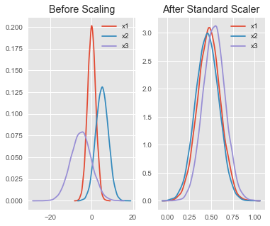
Where to use Feature Scaling?
The Real World dataset includes features that highly vary in magnitudes, units, and range. Normalization should be executed when the scale of a feature is pointless or misleading and not should Normalize when the scale is meaningful.

Slide 34
Feature Scaling
Some examples of algorithms where feature scaling matters are:
k-nearest neighbors with an Euclidean distance measure is sensitive to magnitudes and hence should be scaled for all features to weigh in equally.
Scaling is critical, while performing Principal Component Analysis(PCA). PCA tries to get the features with maximum variance and the variance is high for high magnitude features. This skews the PCA towards high magnitude features.
We can speed up gradient descent by scaling. This is because θ will descend quickly on small ranges and slowly on large ranges, and so will oscillate inefficiently down to the optimum when the variables are very uneven.

Slide 35
Feature Scaling
Algorithms where feature scaling has less or no effect:
Tree based models are not distance based models and can handle varying ranges of features. Hence, Scaling is not required while modelling trees.
Algorithms like Linear Discriminant Analysis(LDA), Naive Bayes are by design equipped to handle this and gives weights to the features accordingly. Performing a features scaling in these algorithms may not have much effect.

