Slide 1
Complexity Analysis

Slide 2
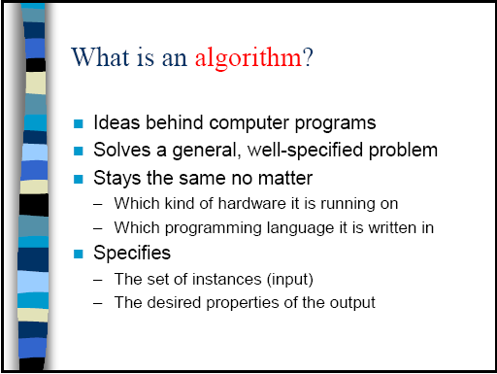

Slide 3
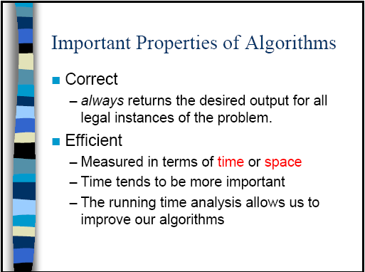

Slide 4
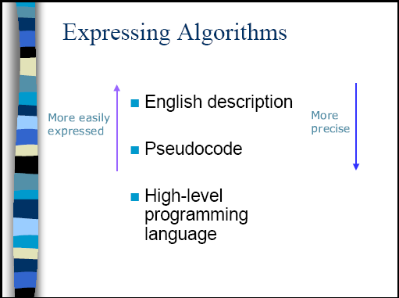

Slide 5
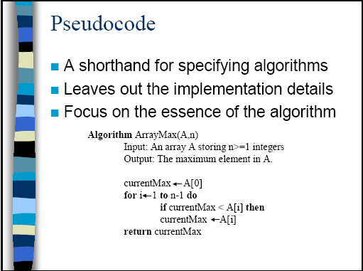

Slide 6
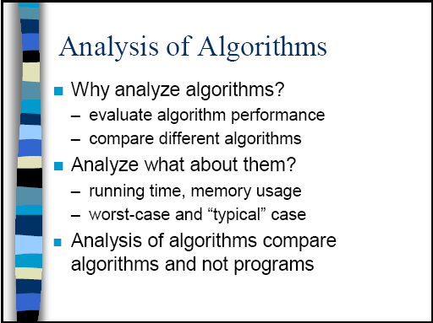

Slide 7
What is Running Time?
Actual Time or Number of Steps?
Actual time (seconds, minutes, hours) different for different computers
Actual time different for different Operating System, Programming Language
But, number of steps (addition, comparison, assignment, etc…) is same for a program
So, number of steps is the running time

Slide 8
Analysis of Algorithms (cont.)
Most algorithms varies number of steps based on the input size
Efficiency of the algorithm is always based on the input size
  Input size usually represented by n

Slide 9
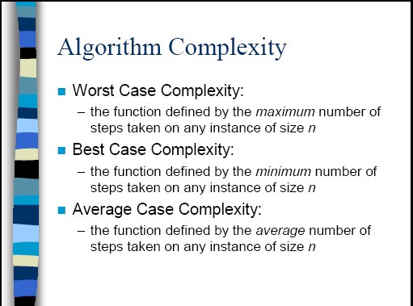

Slide 10
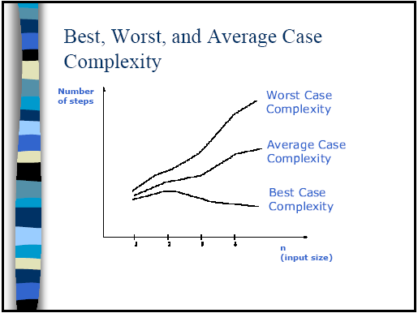

Slide 11
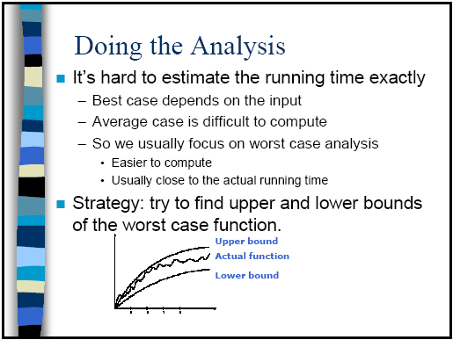

Slide 12
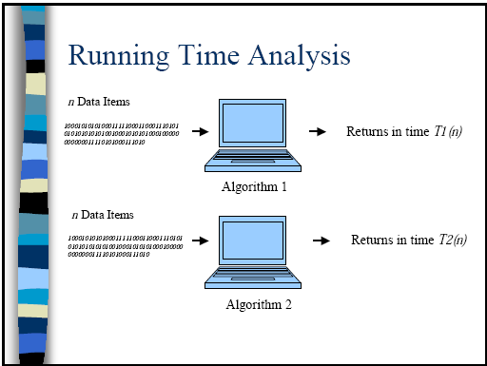

Slide 13
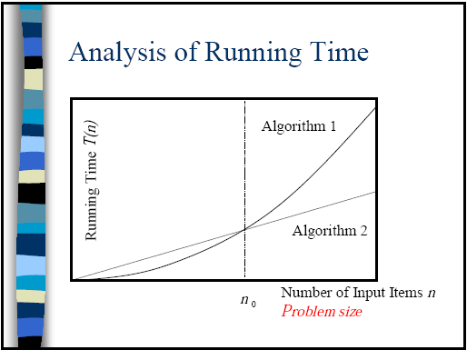

Slide 14
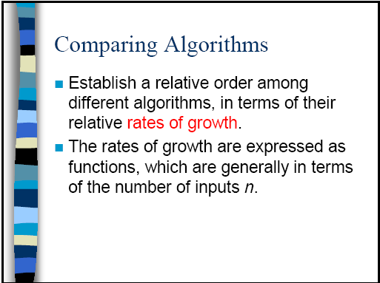

Slide 15
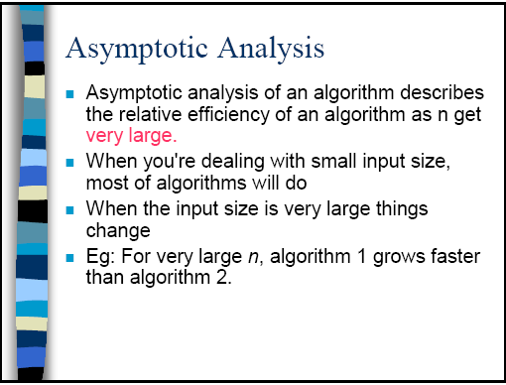
good

Slide 16
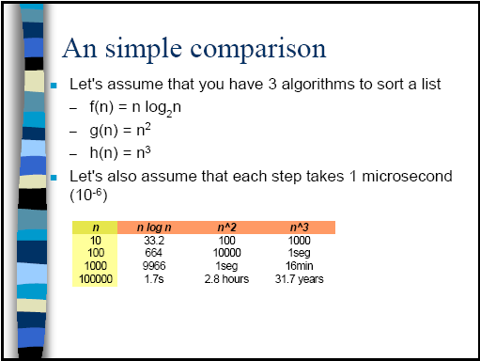

Slide 17
But there can be more than one term
f(n) = n² + 2n + 5log n
f(n) = n³ + n² + nlogn + 1000
Example:
  How many work here?
  1+2+3+…+n = n(n+1)/2 = n²/2 + n/2
So, we go for approximation to the dominating term (the highest term without constant)
    for i = 1 to n do
      for j = 1 to i do
        do some work

Slide 18
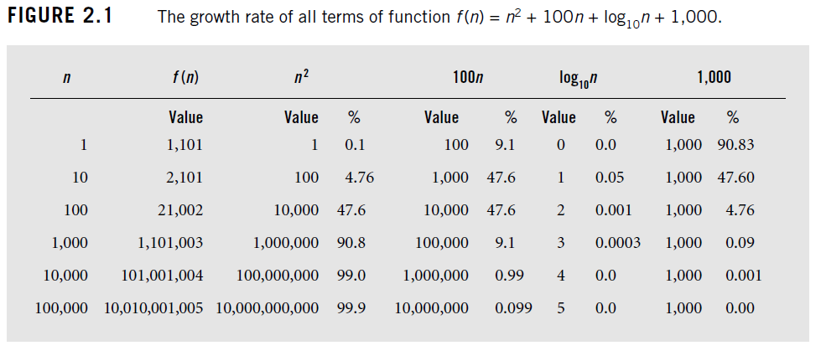
Who dominates? When?

Slide 19
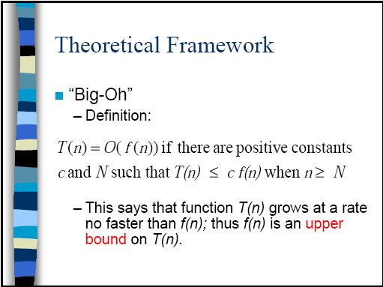

Slide 20
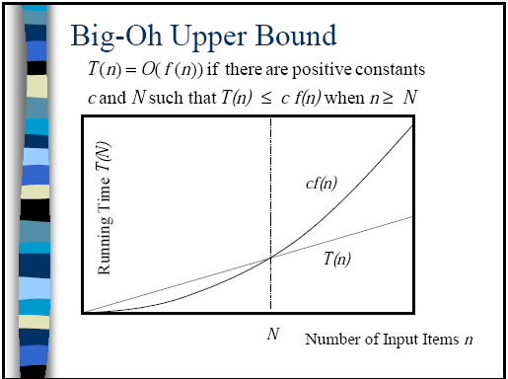

Slide 21
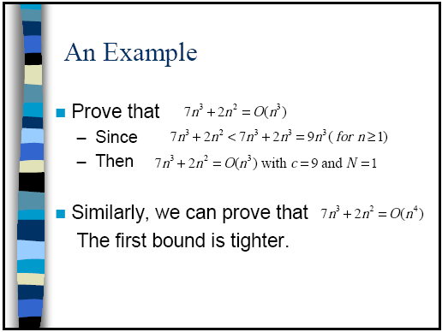
We take the tighter/closest bound (which is the best answer)

Slide 22
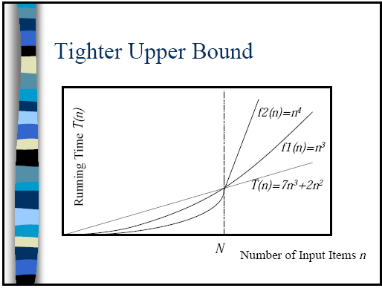
So, we take T(n) = O(n³)

Slide 23
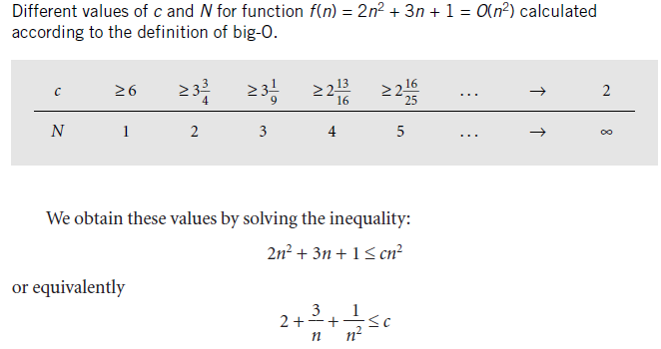
Different c, N possible

Slide 24
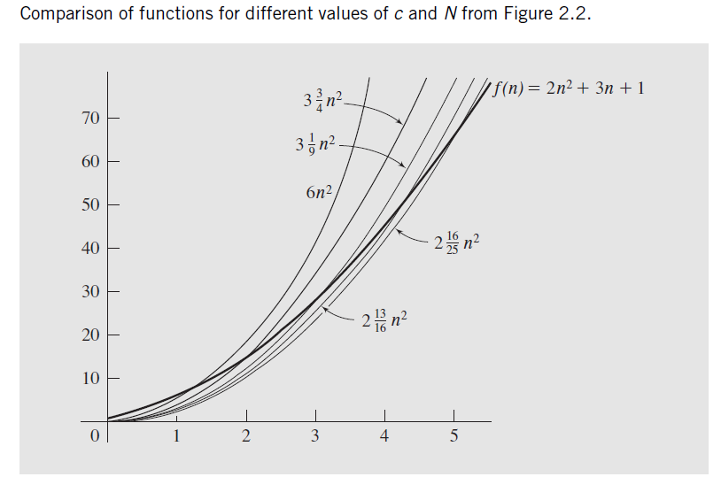
Different c, N possible

Slide 25
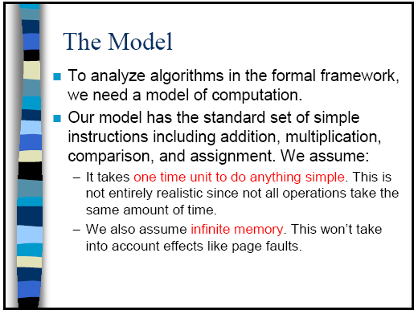
memory/space

Slide 26
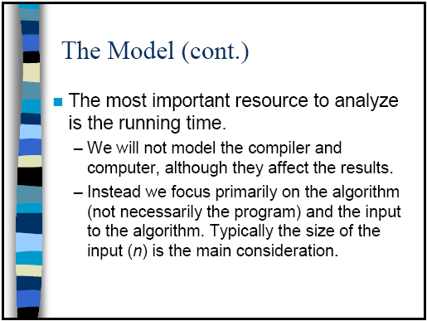

Slide 27
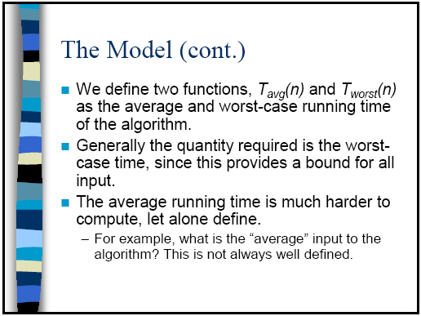

Slide 28
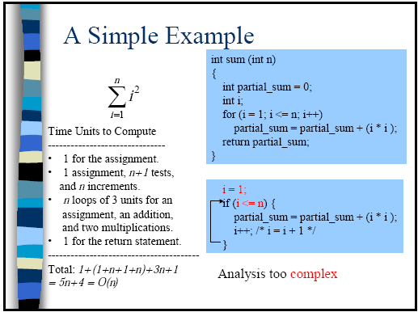

Slide 29
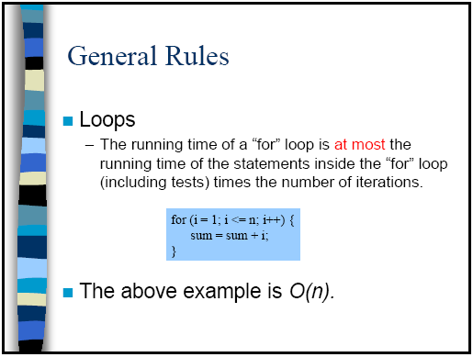

Slide 30
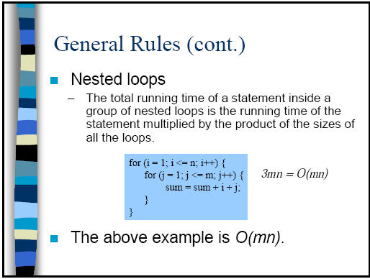

Slide 31
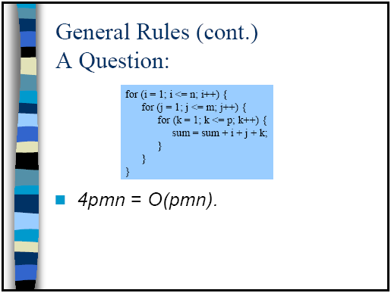

Slide 32
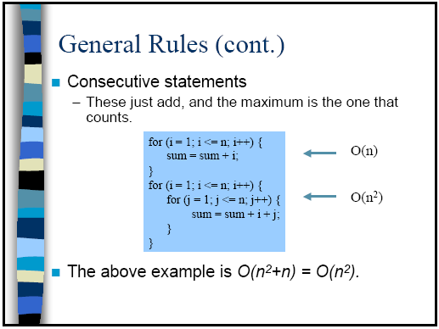

Slide 33
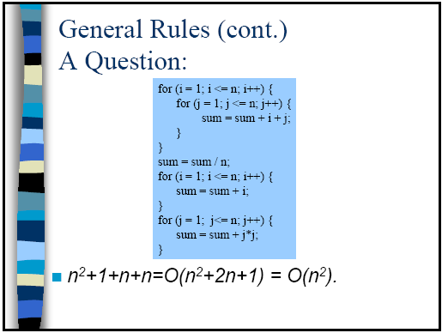

Slide 34
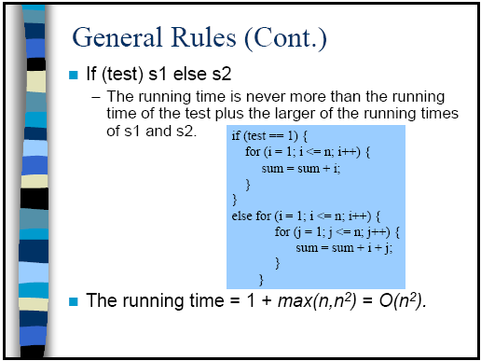

Slide 35
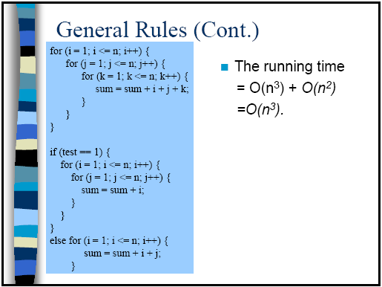

Slide 36
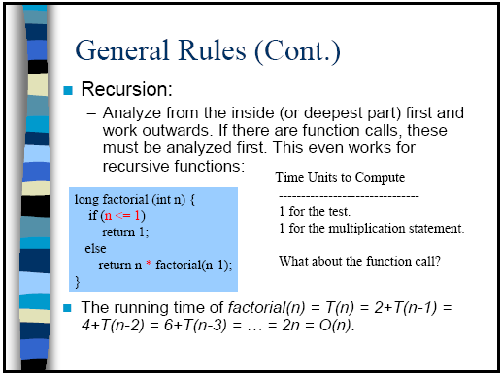

Slide 37
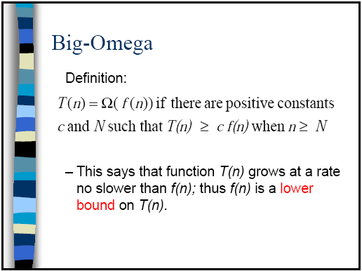

Slide 38
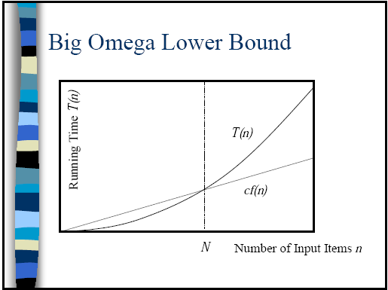

Slide 39
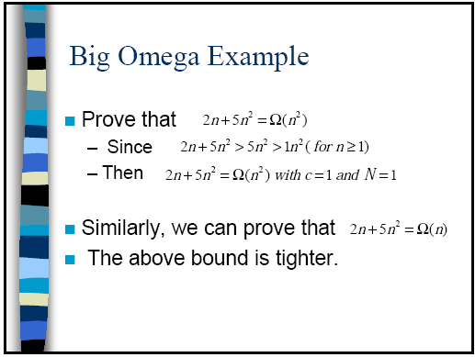

Slide 40
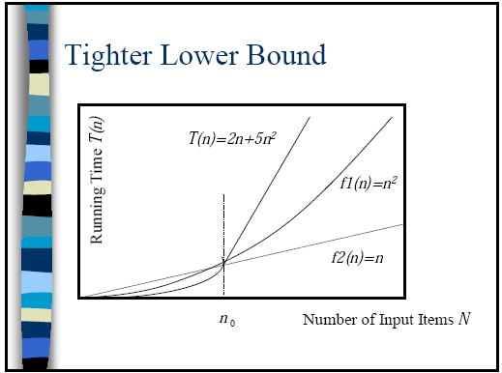
So, we take T(n) = Ω(n²)

Slide 41
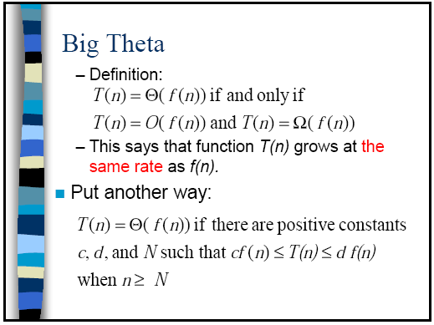

Slide 42
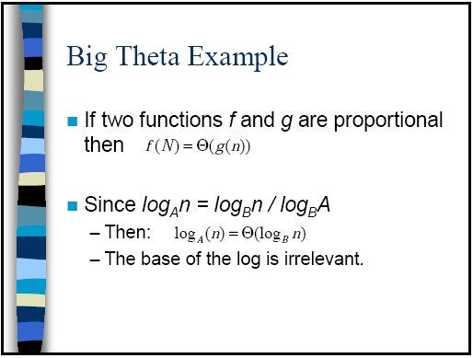
Constant

Slide 43
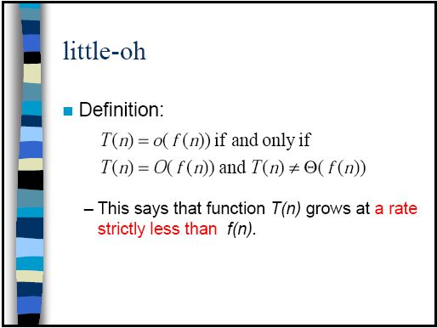
Example:
  n²+3n+100 = o(n³)
  n log n = o(n²)

Slide 44
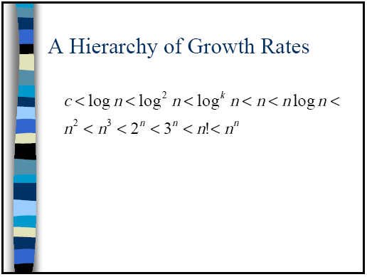
log^{k} n = log n * log n * log n …. k times
log n < n^{c}. For example, log n < n^{0.2}

Slide 45
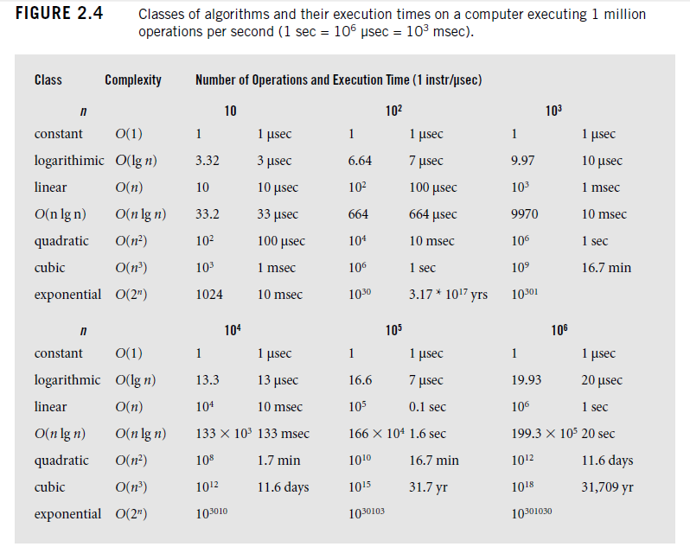
Comparison of growth rates

Slide 46
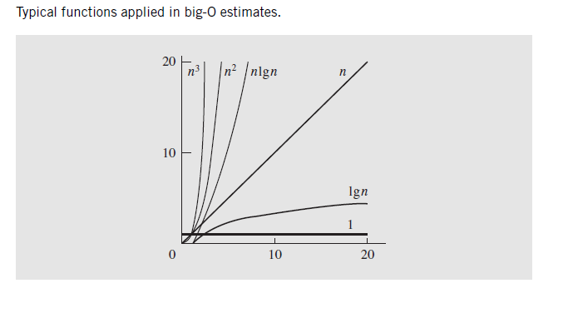
Comparison of growth rates

Slide 47
Properties of O
If f(n) = O(g(n)) and g(n) is O(h(n)), then f(n) = O(h(n))
If f(n) = O(h(n)) and g(n) is O(h(n)), then f(n)+g(n) = O(h(n))
If f(n) = O(g(n)) and g(n) is O(h(n)), then f(n) = O(h(n))
an^{k} = O(n^{k})
n^{k} = O(n^{k+j})
log_{a}n = O(log_{b}n)
Proofs are easy, see the text book.

Slide 48
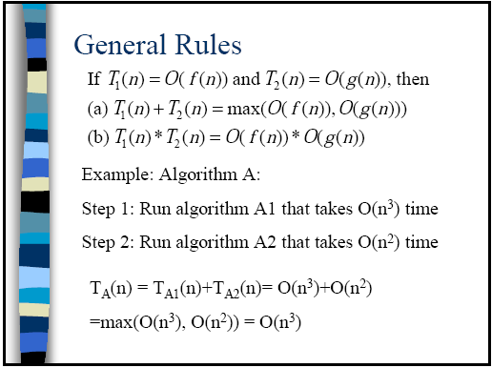

Slide 49
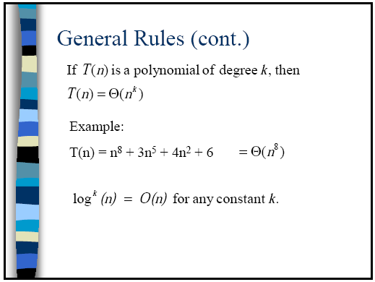

Slide 50
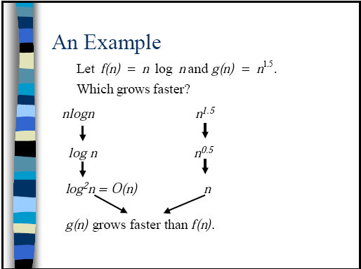
So, n log n < n^{1.5}, and log n < n^{0.5}.
Actually, we can prove similarly that log n < n^{c} for any c

Slide 51
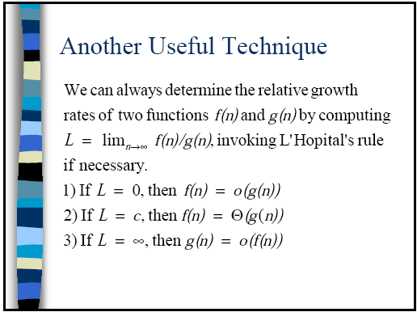

Slide 52
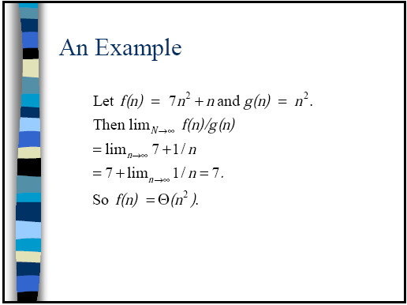

Slide 53
Example of Best/Average/Worst Case Complexity
Program for searching an item in an array of n items
What are the number of steps (mainly, comparison) required by this program?
  Best case: 1, because the program finds at the beginning
  Worst Case: n or n+1., because the program finds it at the end (so n comparisons) or does not find (n+1 comparison)
  Average case: Not straight forward, needs probability. An easy way for this program is: (best + worst)/2 = (n+1)/2
found = false
For i = 1 to n
  If item = A[i] then found = true

