Slide 1



Slide 2
Contents
Why Openfire?
Openfire Installation
Running Openfire Server
Spark (XMPP Client )
Live Demo
References

Slide 3
Introduction
Openfire is an instant messaging server that implements the XMPP(jabber) protocol.
XMPP(Extensible Messaging and Presence Protocol) is an open XML technology for real-time communication.
The server is written in Java
It has a plugin architecture
It is compatible with majority of clients like Spark, Adium, Pidgium, JBrother,etc.

Slide 4
Openfire Installation
Which Platforms does Openfire support?
1. Windows
2. Linux
3. Mac

Slide 5
Openfire Installation
Installation on Windows:
1. Download Openfire from here http://www.igniterealtime.org/downloads/index.jsp:
2.Then click on the link mentioning Openfire_3.X.X.exe Includes Java JRE(recommended)
3. Install openfire.exe and once the installation is finished
4. Then openfire will start automatically with a pop-up showing options Stop, Launch Admin, Quit.

Slide 6
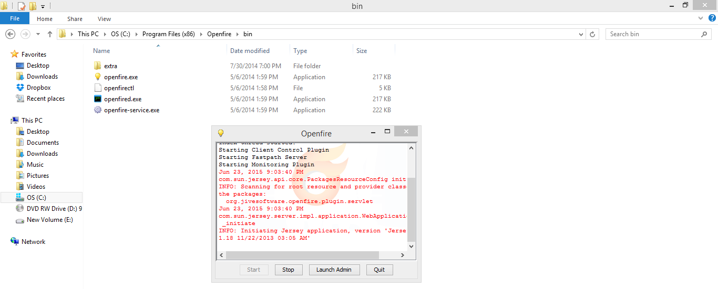
OpenFire Installation
Click on Launch Admin Button

Slide 7
Running OpenFire
We have the following 5 steps to complete the configuration:
  1. Language Selection
  2. Server Settings
  3. Database Settings
  4. Profile Settings
  5. Admin Accounts
Let’s discuss them one by one.

Slide 8
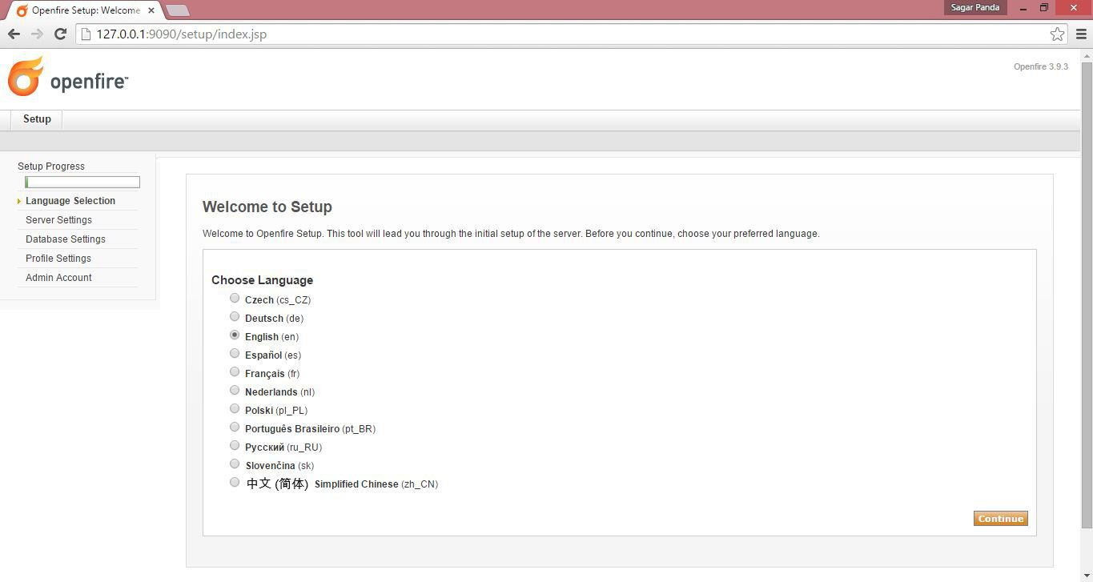
Step 1: Language Selection

Slide 9
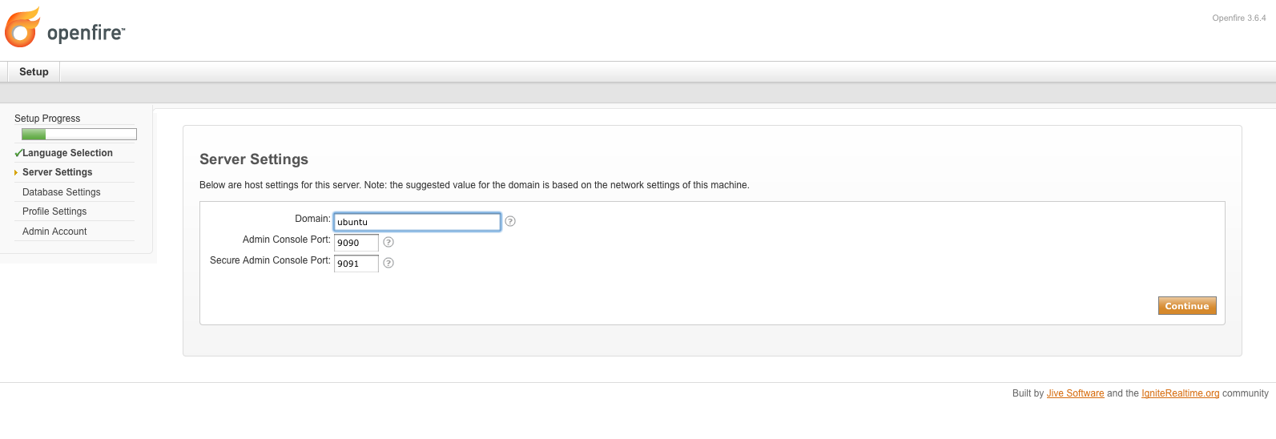
Step 2: Server Settings

Slide 10
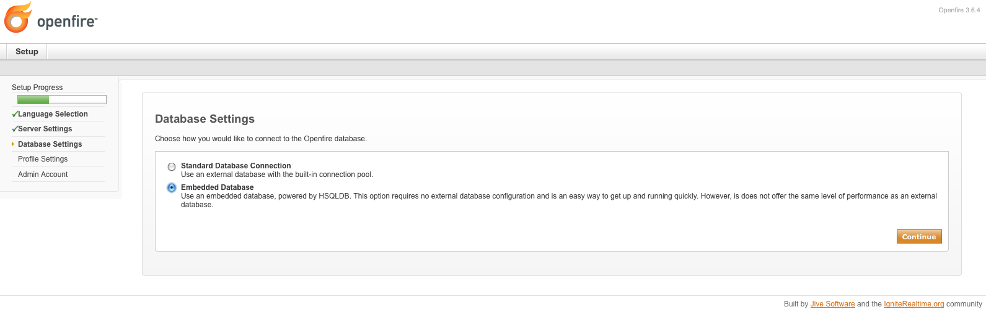
Step 3: Database Settings

Slide 11
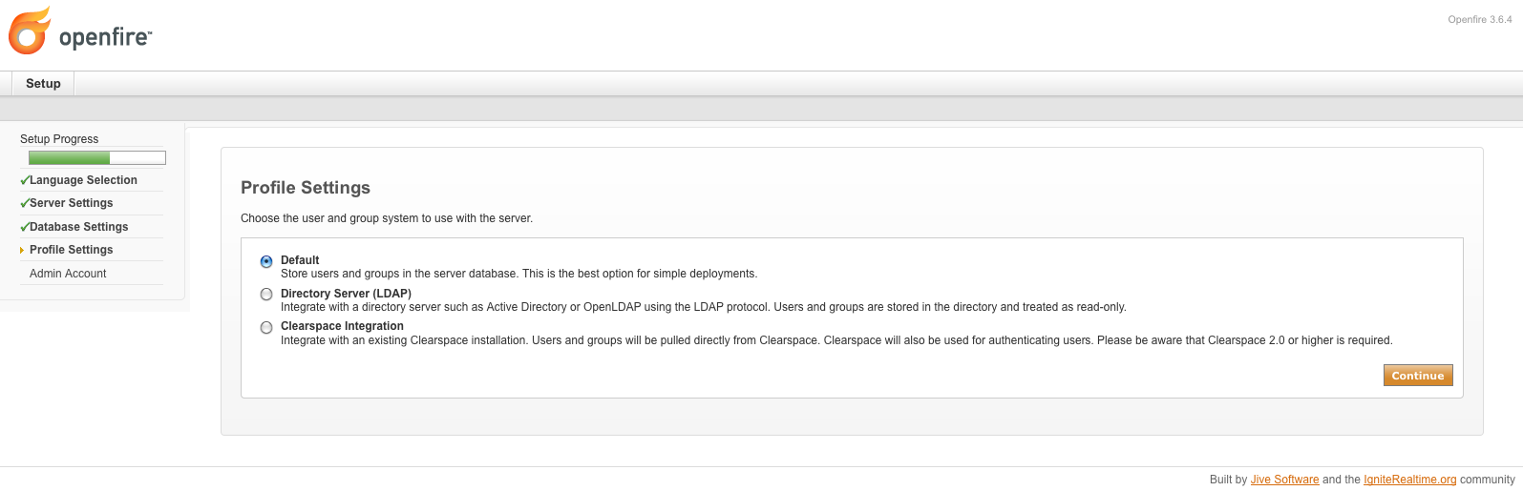
Step 4: Profile Settings

Slide 12
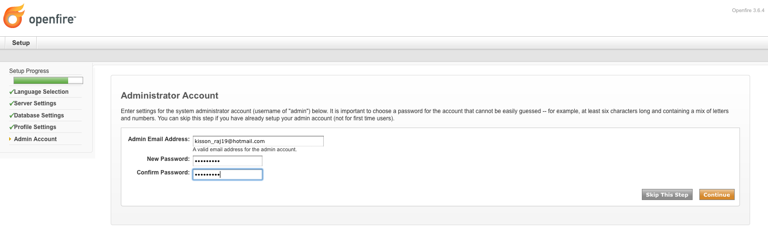
Step 5: Admin Account

Slide 13
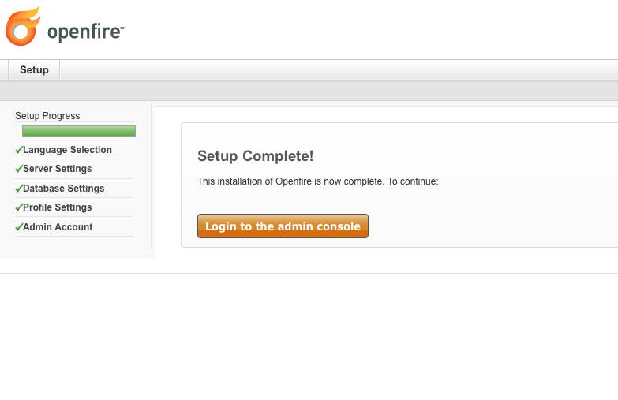

Slide 14
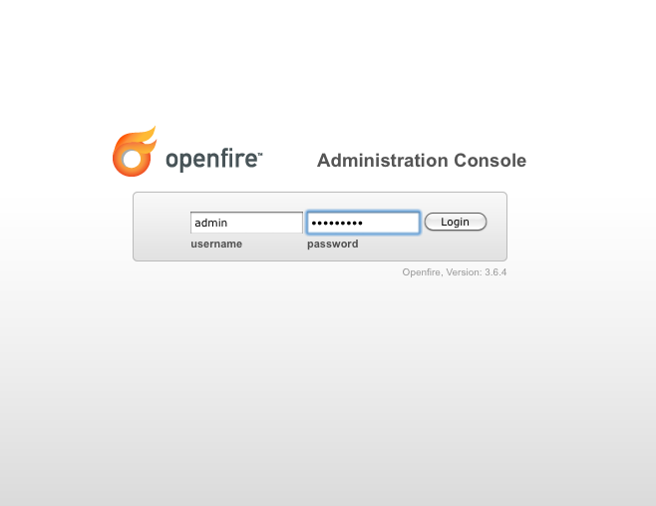
OpenFire Admin Console

Slide 15
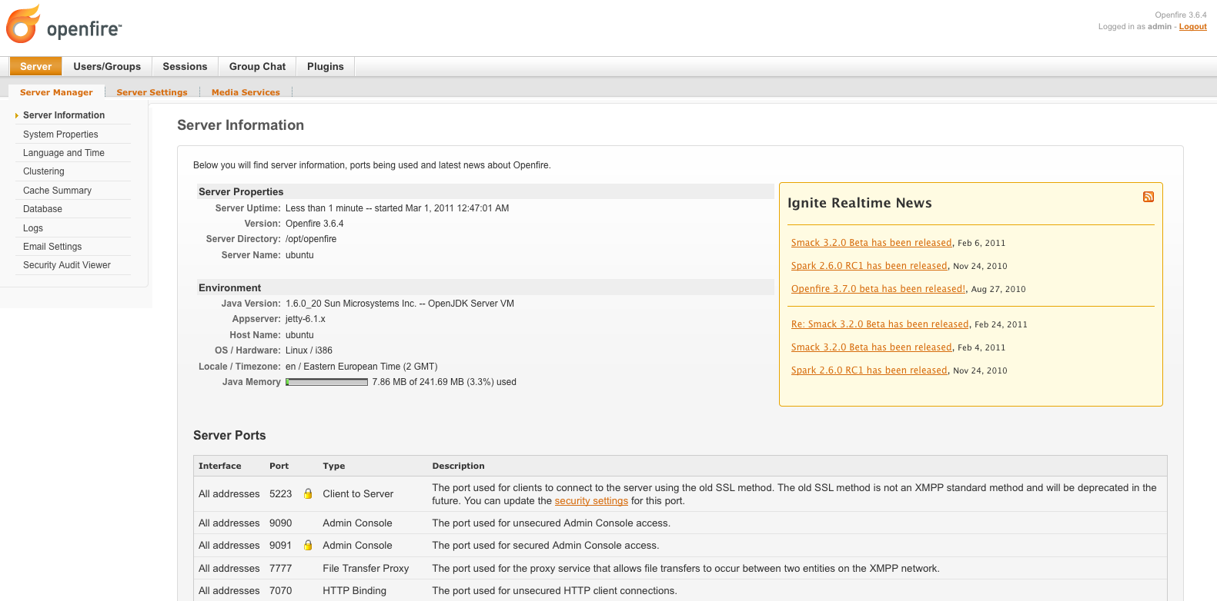
Server Information

Slide 16
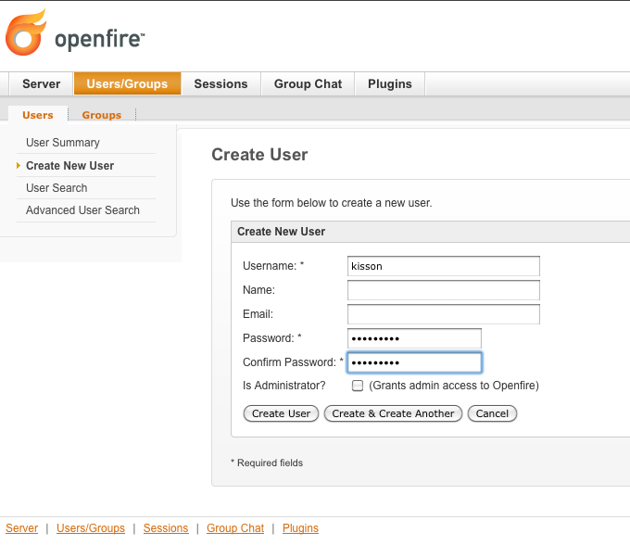
Creating a user:

Slide 17
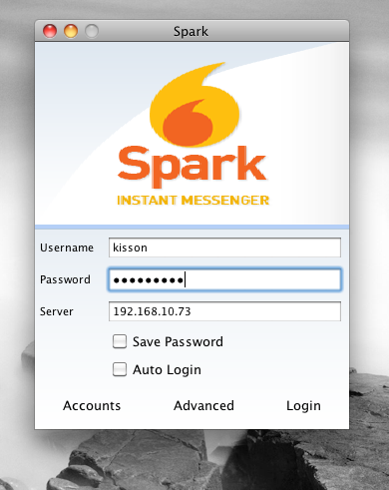
SPARK

Slide 18
SPARK
Spark is an Open Source, cross-platform IM client optimized for businesses and organizations.
It features built-in support for group chat, telephony integration, and strong security.
It also offers a great end-user experience with features like in-line spell checking, group chat room bookmarks, and tabbed conversations.

Slide 19
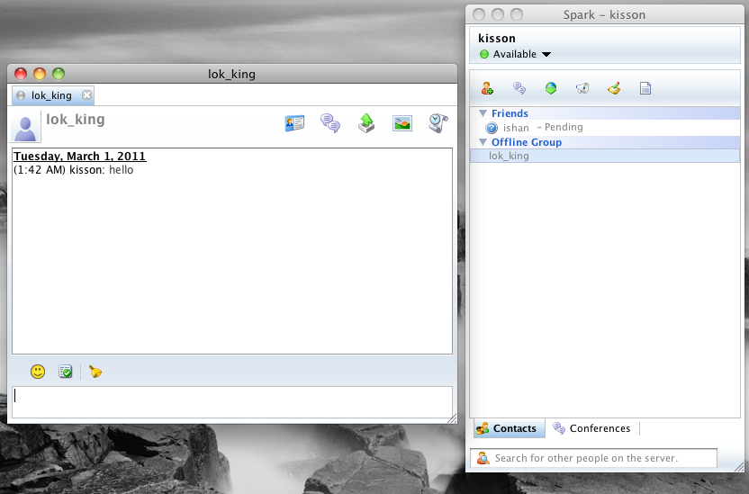
SPARK

Slide 20
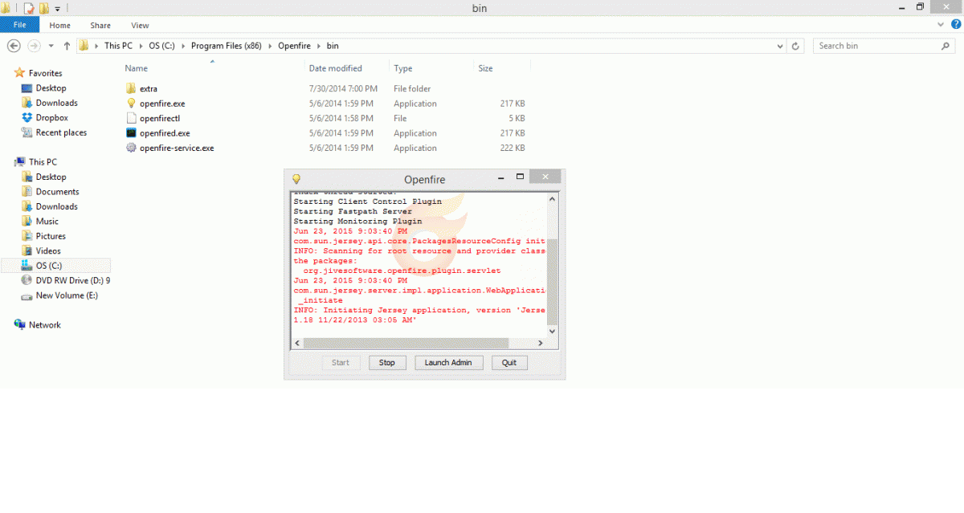
Live Demo

Slide 21
Thank You…Any Questions?

Slide 22
References
http://www.igniterealtime.org/support/index.jsp
https://xmpp.org
https://www.igniterealtime.org/projects/spark/
http://xmpp.org/software/servers.html
http://xmpp.org/software/libraries.html
http://xmpp.org/software/clients.html

