Slide 1
EDES 301 Audio Spectrum Visualizer Proposal
<Sunday, October 5th>
<Atishay Lalgudi>

Slide 2
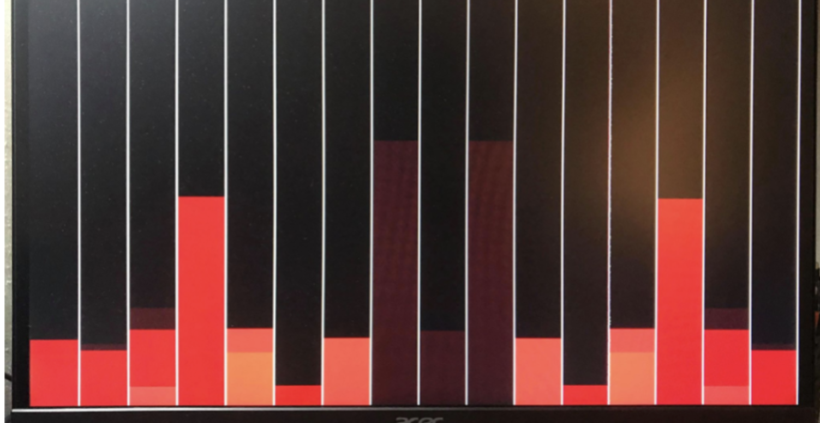
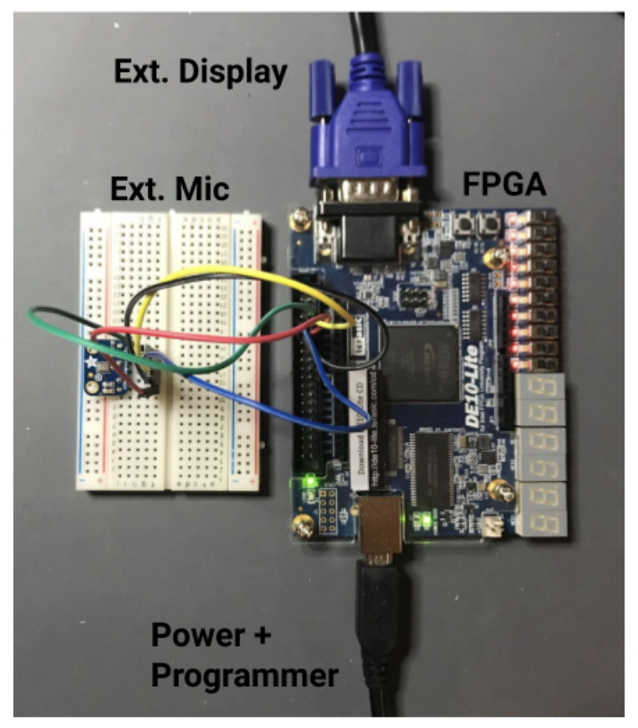
Background Information
What is being proposed?
https://github.com/kennych418/FPGA_AudioVisualizer
What improvements / additions over existing project
Unlike prior FPGA-only spectrum visualizer projects (such as the DE10-Lite I²S microphone design), this project integrates a PocketBeagle single-board computer with the FPGA to form a complete embedded system. The FPGA performs real-time FFT computation, while the PocketBeagle manages configuration, data transfer, and visualization through a Python-based OLED or web dashboard interface. This adds runtime control, data logging, and network accessibility. The result is an open-source platform demonstrating full hardware/software co-design rather than a fixed-function FPGA display.
Also I want FPGA experience
and like audio stuff :)

Slide 3
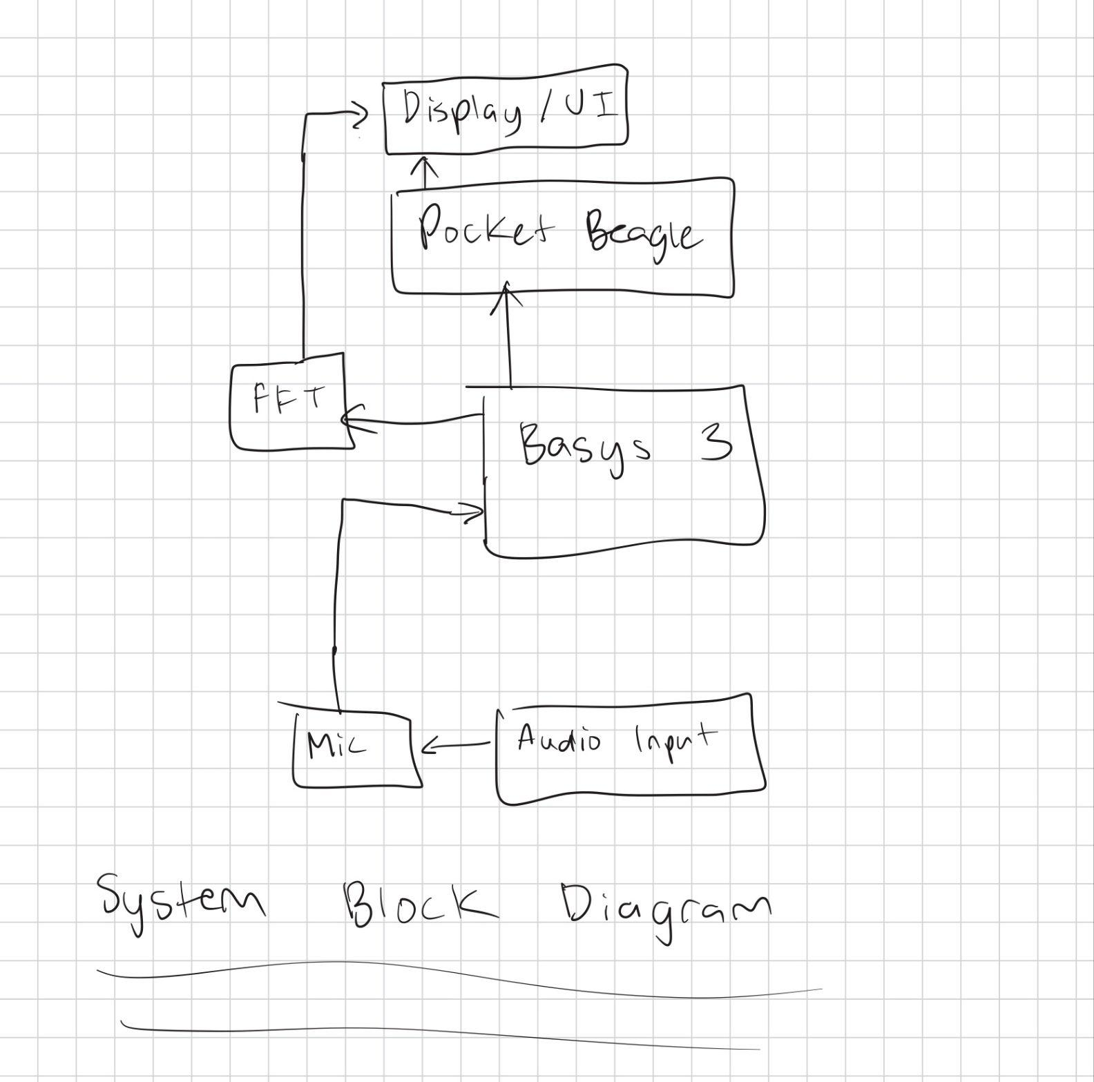
System Block Diagram
Create a System Block Diagram
Label interfaces (I2C, SPI, GPIO, etc.; You do not need to know all of the connections)
Components (part numbers if possible)

Slide 4
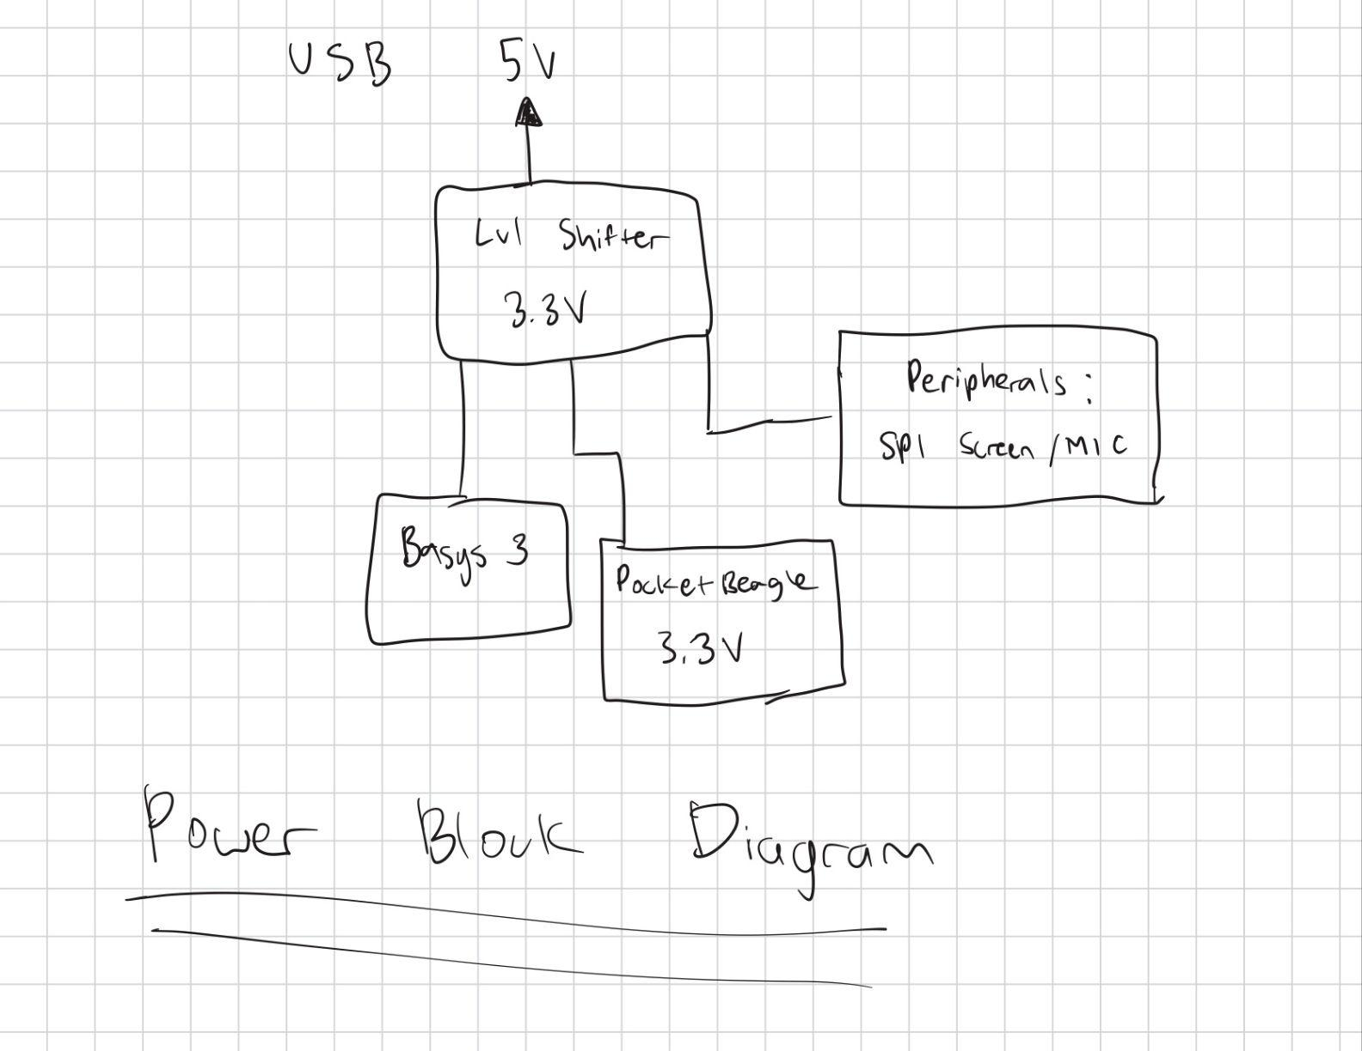
Power Block Diagram
Create a Power Block Diagram
Label voltages / currents of components

Slide 5
Components / Budget
Component | EDES301 to Buy? | Cost
Digilent Basys 3 Artix-7 FPGA Trainer Board | Amazon | $165
Adafruit I2S MEMS Microphone Breakout | Adafruit | $7
SPI Screen | Adafruit | $30
TXS0108E High Speed Full Duplex Logic Level Converter 8 Channel SPI 8 Way 3.3V 5V IIC 8-Bit Bi-Directional Converter | Amazon | $3
PocketBeagle | OEDK | $0
Wires | OEDK | $0
TOTAL | N/A | $205

Slide 6
Component Selection (Remove slide for submission)
All components must be from either: Amazon, Adafruit, Sparkfun, Digi-Key, or Mouser
Select no more than two (2) components that are not on approved component spreadsheet
See Canvas 🡪 Files 🡪 assignments 🡪 EDES301_project_01_parts_list.xlsx
If there is a cheaper part that you would like to use, we can discuss in the project meeting
All components needed for the project should be listed on Slide 5
All components should have links to the website where they can be purchased
Please trim URLs for links to Amazon
EDES301 will supplement $25 to $35 dollars for components
Please indicate what components need to be purchased by EDES301
If you have a special request, we can discuss in the project meeting

