Slide 1

Stock Market Prediction using Deep Learning
Course Code - BCSE 498J
Guided by Presented by
Rahul Shrivastava
Assistant Professor Sr. Grade 1 Shubh Malasi (21BCE0305)
Associate Professor Senior–SCOPE Anurag Arora (21BCE2821)
Vellore Institute of Technology Atishay Jain (21BCE2862)

Slide 2
Contents
Introduction
Objectives
Literature Review
Research gaps
Hardware and software specification
Gantt chart with Work breakdown structure
Requirement Analysis (SRS)
Work flow model (Any form of diagrammatic representation)
Module design and Implementation (Minimum 30%)

Slide 3
Introduction
Hybrid Deep Learning Approach – Combining LSTM’s long-term memory retention with GRU’s computational efficiency enhances stock market prediction accuracy.
Data-Driven Forecasting – The project leverages historical S&P 500 data, applies preprocessing techniques (normalization, feature engineering), and evaluates performance using RMSE and MAE.
Future Enhancements – Integrating real-time data, such as news sentiment, macroeconomic indicators, and social media trends, can further improve market forecasting and decision-making.

Slide 4
Objectives
Advanced Deep Learning Models – The project utilizes LSTM and CNN, which are well-suited for time-series forecasting, to analyze historical stock data and predict future price movements.
Comprehensive Data Processing – The approach includes data normalization, feature selection, and data splitting to enhance model accuracy and ensure high-quality input data.
Performance Evaluation – Model effectiveness is assessed using Mean Absolute Error (MAE) and Root Mean Squared Error (RMSE) to ensure accurate and reliable stock price predictions.

Slide 5
Literature Review
CNN & Bi-LSTM for Stock Prediction (Eapen et al., 2019)
A hybrid model using CNN for feature extraction and Bi-LSTM for long-term dependency capture.
Results show improved accuracy in stock price prediction using RMSE and MAE metrics.
Bi-LSTM & GRU Hybrid Model (Karim et al., 2022)
Combines Bi-LSTM’s sequential learning and GRU’s computational efficiency.
Achieves better accuracy and stability than standalone models for financial forecasting.
Deep Learning & Sentiment Analysis (Nan Jing et al., 2021)
Integrates investor sentiment analysis with deep learning for stock price prediction.
Outperforms traditional models by incorporating both financial and qualitative sentiment data.

Slide 6
Literature Review
Stacked LSTM for COVID-19 Market Impact (Singh & Jain, 2022)
Uses stacked LSTM architecture to predict stock prices during the COVID-19 crisis.
Effectively captures volatile market trends caused by economic disruptions.
Algorithmic Trading & ML Models (Joiner et al., 2022)
Explores state-of-the-art ML techniques for high-frequency trading and financial forecasting.
Highlights challenges like noise, overfitting, and market adaptability in algorithmic trading.

Slide 7
Gaps Identified
Overfitting: Models like LSTMs memorize patterns but fail to generalize to new data due to market volatility.
Insufficient Data Diversity: Training on limited datasets leads to poor adaptability across different market conditions.
Black-Box Nature: Deep learning models lack transparency, making decision-making difficult in financial trading.

Slide 8
Gaps Identified
Lack of Financial Insights: Predictions are data-driven but often fail to explain the underlying financial rationale.
Inability to Handle Real-Time Data: Most models rely on batch processing and struggle in high-frequency trading.
Lack of Adaptive Learning: Models fail to quickly adjust to sudden market changes, such as economic crises.

Slide 9
Hardware and software specification
Hardware Requirements:-
Processor: Intel Core i5/i7 or AMD Ryzen 5/7 (or higher)
RAM: Minimum 8GB (Recommended: 16GB for faster training)
Storage: At least 50GB free space (SSD preferred for performance)
GPU: NVIDIA GPU with CUDA support (e.g., GTX 1660, RTX 3060, or higher) for deep learning acceleration
Internet Connection: Required for data fetching, model training, and cloud services

Slide 10
Hardware and software specification
Software Requirements:-
Operating System: Windows 10/11, macOS, or Linux (Ubuntu preferred)
Programming Language: Python 3.x
IDE: Jupyter Notebook, Google Colab, or VS Code
Libraries & Frameworks:
TensorFlow / Keras – Deep learning model development
Scikit-learn – Data preprocessing & model evaluation
Pandas & NumPy – Data manipulation
Matplotlib & Seaborn – Data visualization
Database: CSV/JSON datasets or SQL for structured storage

Slide 11
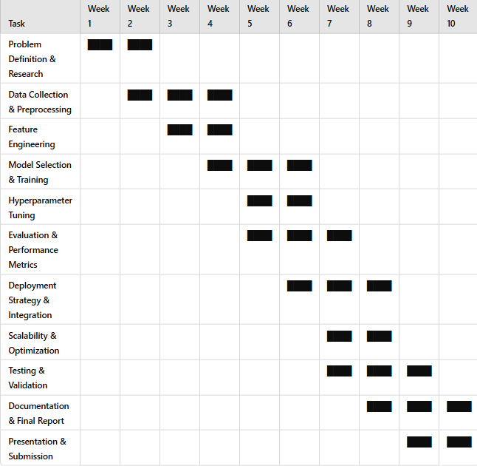
Gantt chart

Slide 12
Requirement Analysis (SRS)
Functional Requirements:-
Import data: The system should be able to import the stock price data for S&P 500 from a specified
data source or file.
● Data analysis and preprocessing: The system should be able to analyse and preprocess the data
before training the models. This includes tasks such as data normalisation, handling missing values,
and feature engineering.
● Model training: The system should be able to train different types of RNN models such as LSTM,
GRU, and hybrid models using a specified set of parameters. This includes splitting the data into
training, testing, and validation sets, setting the number of epochs, and specifying the optimizer and
loss function.
● Model selection: The system should be able to select the best model based on the evaluation metrics
(MSE and MAE) and deploy the selected model for future predictions.
● Prediction: The system should be able to take in new data and use the selected model to generate
predictions for future stock prices.
● Deployment: The system should be able to deploy the selected model in a production environment
and provide access to the predictions for external applications.

Slide 13
Requirement Analysis (SRS)
Non-Functional Requirements
● Scalability: The system should be able to handle large amounts of data and be able to scale
horizontally and vertically as the data volume and user traffic increase.
● Reliability: The system should be reliable and available at all times, with minimal downtime or
disruptions.
● Security: The system should be designed with security in mind and implement measures to protect
user data and prevent unauthorised access.
● Usability: The system should be user-friendly and easy to use, with clear documentation and user
guides.
● Portability: The system should be able to run on different operating systems and platforms, with
minimal dependencies and installation requirements

Slide 14
Architecture diagram of the proposed system
Data Import & Exploration
Import S&P 500 time series data.
Analyze data structure and trends for better understanding.
Data Splitting & Preprocessing
Split data into training, validation, and testing sets.
Normalize and preprocess data to prepare for model training.
Model Training & Evaluation
Train models:
RNN (Recurrent Neural Network)
GRU (Gated Recurrent Unit)
LSTM (Long Short-Term Memory)
Hybrid Model (LSTM + GRU with Dropout)
Evaluate each model using Mean Squared Error (MSE) and Mean Absolute Error (MAE).
Model Selection & Deployment
Compare models based on MSE and MAE values.
Select the best-performing model for deployment.
Deploy the final model for stock price prediction.

Slide 15
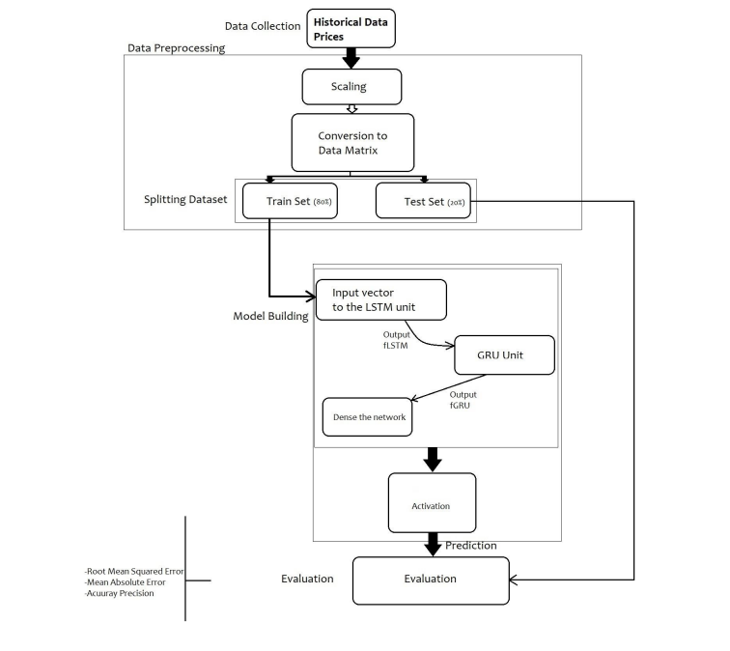
Architecture diagram of the proposed system

Slide 16
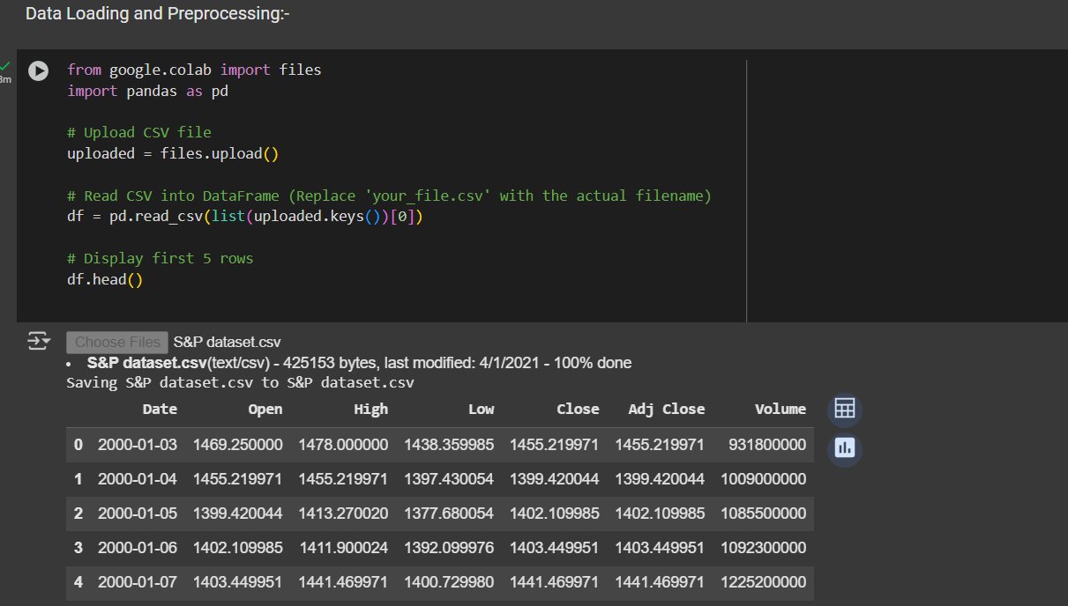
Module Design and Implementation

Slide 17
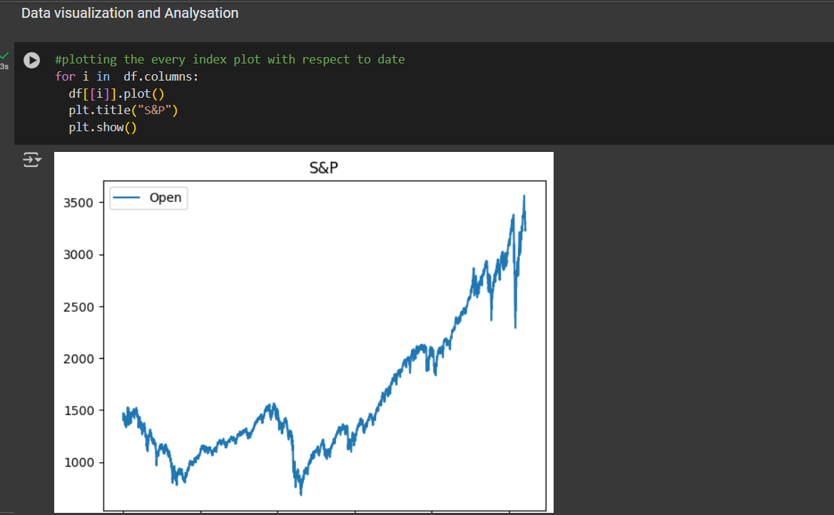
Module Design and Implementation

Slide 18
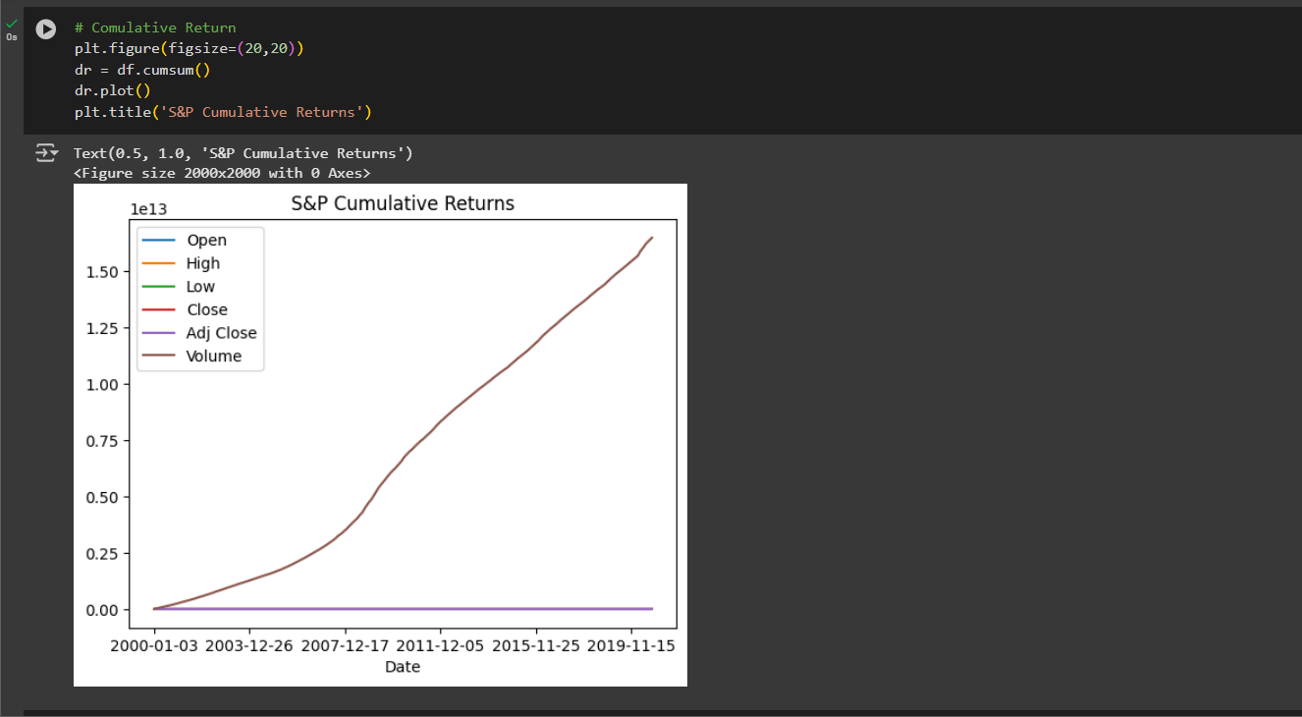
Module Design and Implementation

Slide 19
References
1.J. Eapen, D. Bein and A. Verma, "Novel Deep Learning Model with CNN and
Bi-Directional LSTM for Improved Stock Market Index Prediction," 2019 IEEE 9th
Annual Computing and Communication Workshop and Conference (CCWC), Las
Vegas, NV, USA, 2019
2. Qiu J, Wang B, Zhou C (2020) Forecasting stock prices with long-short term memory
neural network based on attention mechanism. PLOS ONE 15(1): e0227222.
3. Karim, Md & Foysal, Md & Das, Sunanda. (2022). Stock Price Prediction Using Bi-LSTM
and GRU-Based Hybrid Deep Learning Approach. 701-711.
4. J. Eapen, D. Bein and A. Verma, "Novel Deep Learning Model with CNN and
Bi-Directional LSTM for Improved Stock Market Index Prediction," 2019 IEEE 9th
Annual Computing and Communication Workshop and Conference (CCWC), Las
Vegas, NV, USA, 2019

Slide 20
References
5. Nan Jing, Zhao Wu, Hefei Wang, A hybrid model integrating deep learning with investor
sentiment analysis for stock price prediction, Expert Systems with Applications, Volume 178,
2021, 115019, ISSN 0957-4174, 6. A. Singh and S. Jain, "Stock Market Prediction During COVID Using Stacked LSTM," 2022
6.IEEE 9th Uttar Pradesh Section International Conference on Electrical, Electronics and
Computer Engineering (UPCON), Prayagraj, India, 2022
7. D. Joiner, A. Vezeau, A. Wong, G. Hains and Y. Khmelevsky, "Algorithmic Trading and
Short-term Forecast for Financial Time Series with Machine Learning Models; State of the
Art and Perspectives," 2022 IEEE International Conference on Recent Advances in Systems
Science and Engineering (RASSE), Tainan, Taiwan, 2022
8. A. R. Nugraha, E. C. Djamal and R. Ilyas, "Stock Prediction of Multivariable Using Bi-Long
Short Term Memory and Capsule Neural Network," 2022 9th International Conference on
Electrical Engineering, Computer Science and Informatics (EECSI), Jakarta, Indonesia, 2022,

Slide 21
THANK YOU!

