Slide 1

Multimodal Cryptocurrency Price Forecasting with Explainable AI and Sentiment Analysis
Atishay Jain
A20609413

Slide 2
Research Problem & Motivation
Crypto markets are volatile and difficult to forecast.
Traditional models fail to capture non-linear patterns.
Deep learning models can better learn complex trends.
Goal: Forecast Bitcoin using N-BEATS and TFT architectures.

Slide 3
Architecture

Slide 4
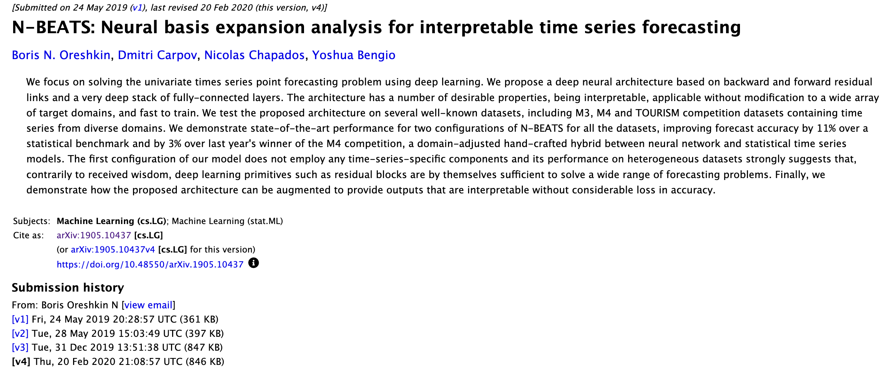
Reference Paper 1

Slide 5
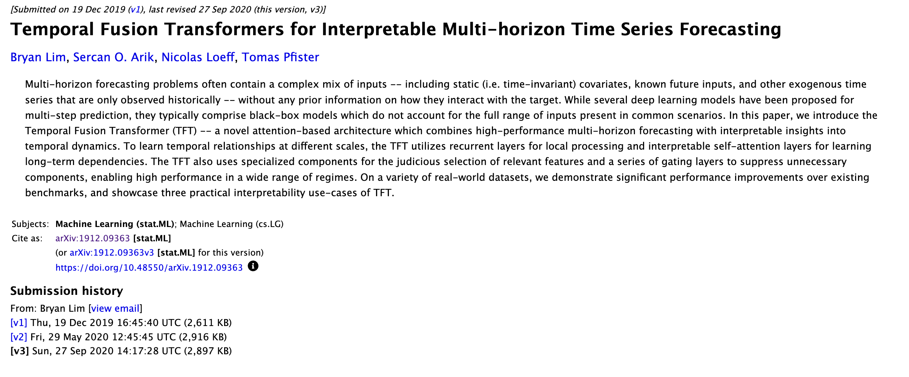
Reference Paper 2

Slide 6
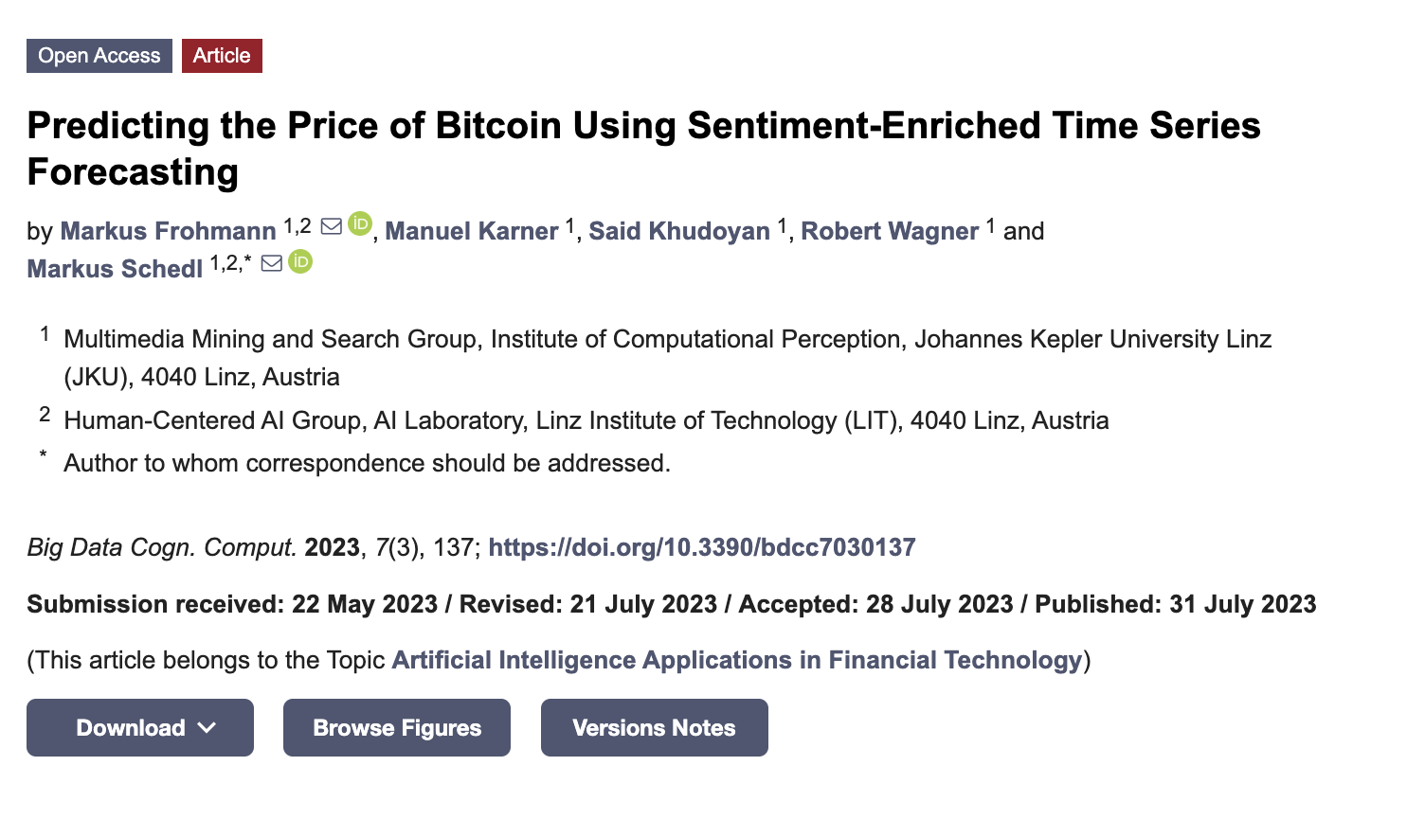
Reference Paper 3

Slide 7
Data Acquisition Pipeline
Crypto.iit.edu -September 23, 2019 at 00:00:00 UTC to May 9, 2024 at 00:00:00 UTC
Used CryptoCompare and Binance.US APIs for BTC/USDT data.
Combined historical, current, and recent datasets from January 1, 2014 to1st April 29, 2025 at 18:00:00 UTC
Cleaned, merged, and aligned timestamps across sources.
Result: high-resolution, continuous hourly dataset.

Slide 8
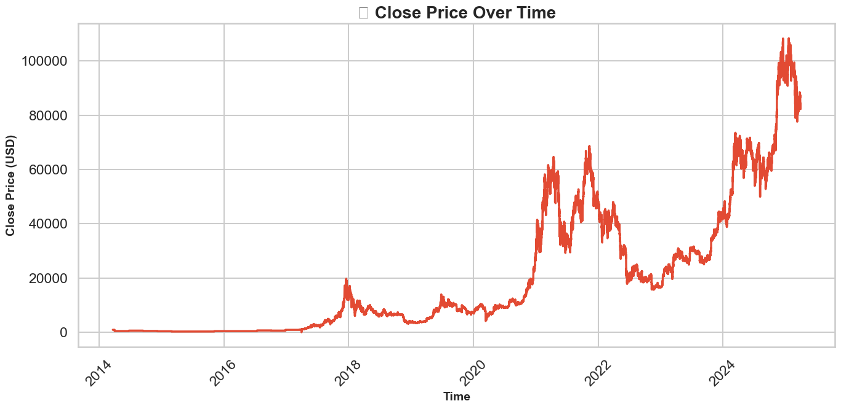
Final Data Plot

Slide 9
Step | What it Does | Why It Helps the Model
Datetime Parsing & Resampling | Converts timestamps to hourly intervals and fills missing data | Ensures time consistency and regular input spacing for sequence models
Stationarity Check (ADF Test) | Tests if price series has constant statistical properties | Determines if transformation (like differencing) is needed
Differencing (close.diff()) | Converts non-stationary price to stationary returns (close_diff) | Helps model learn on stable, mean-reverting data rather than drifting prices
Technical Indicators (e.g., RSI, MACD, OBV) | Adds expert-designed market signals | Enriches model with signals traders use — improves context
Lag Features (close_lag_1, ..., close_lag_6) | Adds previous close values | Lets the model learn temporal dependencies and price momentum
Log Returns & Volatility | Computes log returns and rolling volatility | Helps model understand price risk and scale of movement
Calendar Features (hour, day, etc.) | Encodes time-based patterns | Captures seasonality, like hourly or weekly trading behavior
Fourier Features | Adds continuous seasonality components | Improves model performance on cyclical trends (like hourly spikes)
Scaling (Scaler.fit_transform) | Normalizes input features per type | Prevents certain features from dominating due to scale differences

Slide 10
Preprocessing & Feature Engineering
- Handled missing values and ensured stationarity.
- Added technical indicators: RSI, MACD, BB, etc.
- Created past/future covariates including Fourier transforms.
- Scaled data using Darts Scaler utility.

Slide 11
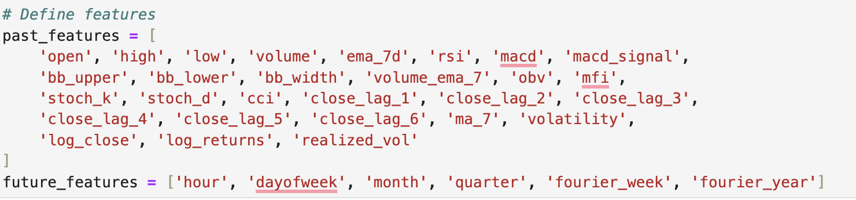
Preprocessing & Feature Engineering

Slide 12
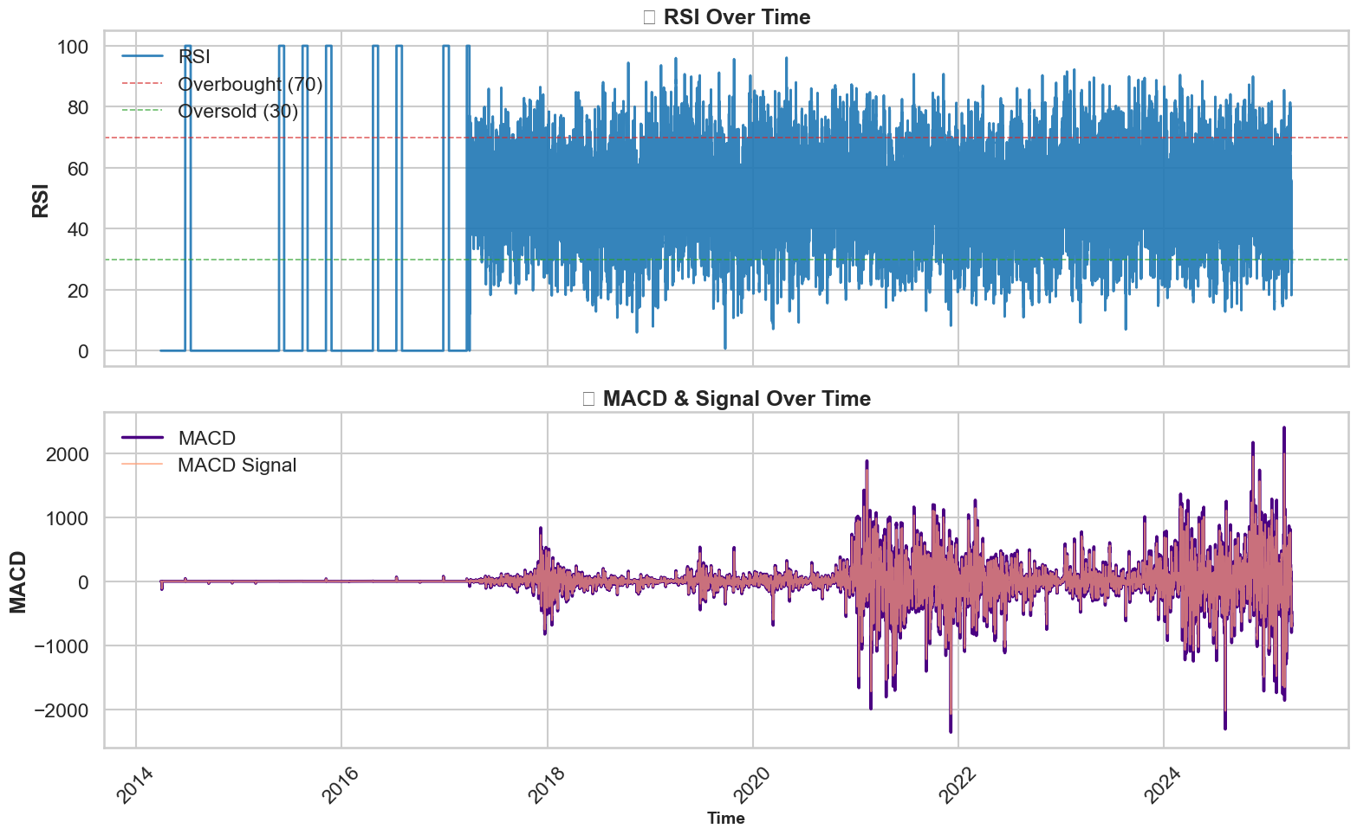
Features Over Time

Slide 13
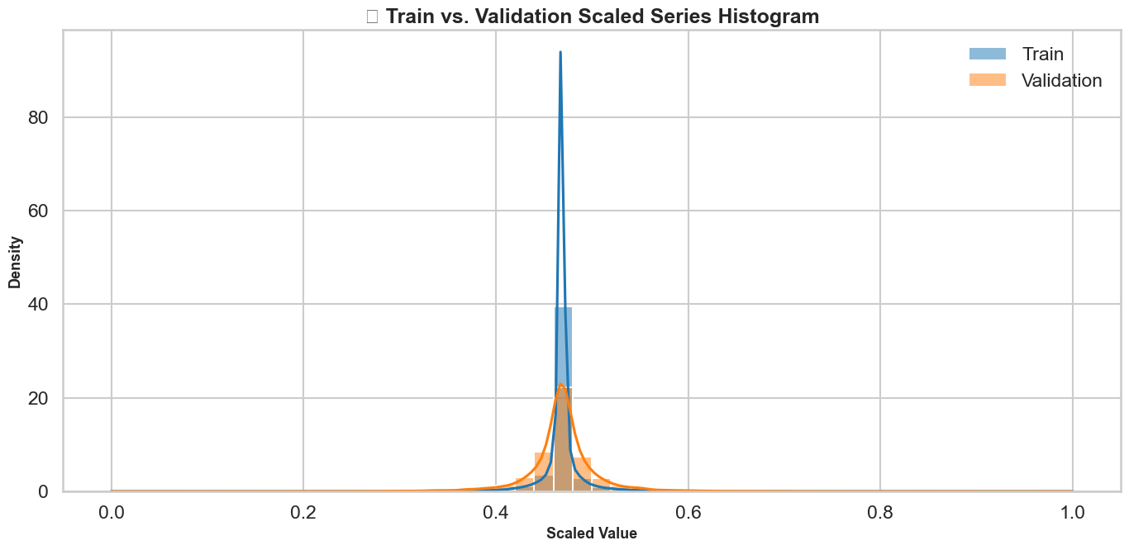

Slide 14
Modeling with Darts Library
Used Darts' NBEATSModel and TFTModel implementations.
01
Configured with input/output chunk lengths of 24 hours.
02
TFT used both past and future covariates for context.
03
Models trained with PyTorch Lightning backend.
04

Slide 15
N – BEATS
TFT
Fully connected neural network for time series forecasting.
Learns trend and seasonality from data directly.
Configurable stacks and blocks (3 blocks, 256 width).
Effective on noisy and non-stationary financial series.
Combines LSTM encoder with attention-based decoder.
Handles future-known covariates explicitly.
Gating and attention provide interpretability.
Yields probabilistic forecasts (quantile regression).

Slide 16
Training & Optimization
Used EarlyStopping and ModelCheckpoint callbacks.
Validation split: 80/20 with walk-forward evaluation.
Scaled data and monitored training/validation loss.
- Tuned hyperparameters via Optuna search.

Slide 17
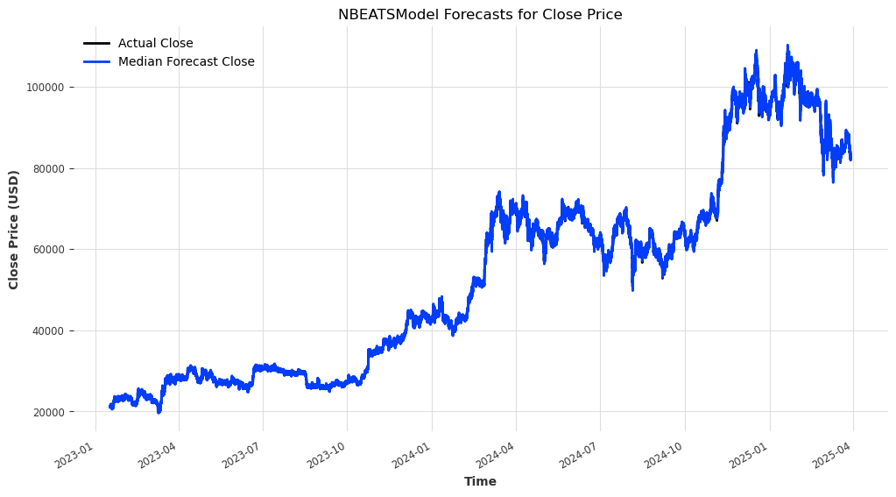

Slide 18
Model Evaluation Metrics
N-BEATS MAE: 547.5 | TFT MAE: 463.8 | Combined: 504.8
TFT performed best overall with R² = 0.6916.
Combining forecasts helped smooth volatility and improved robustness.

Slide 19
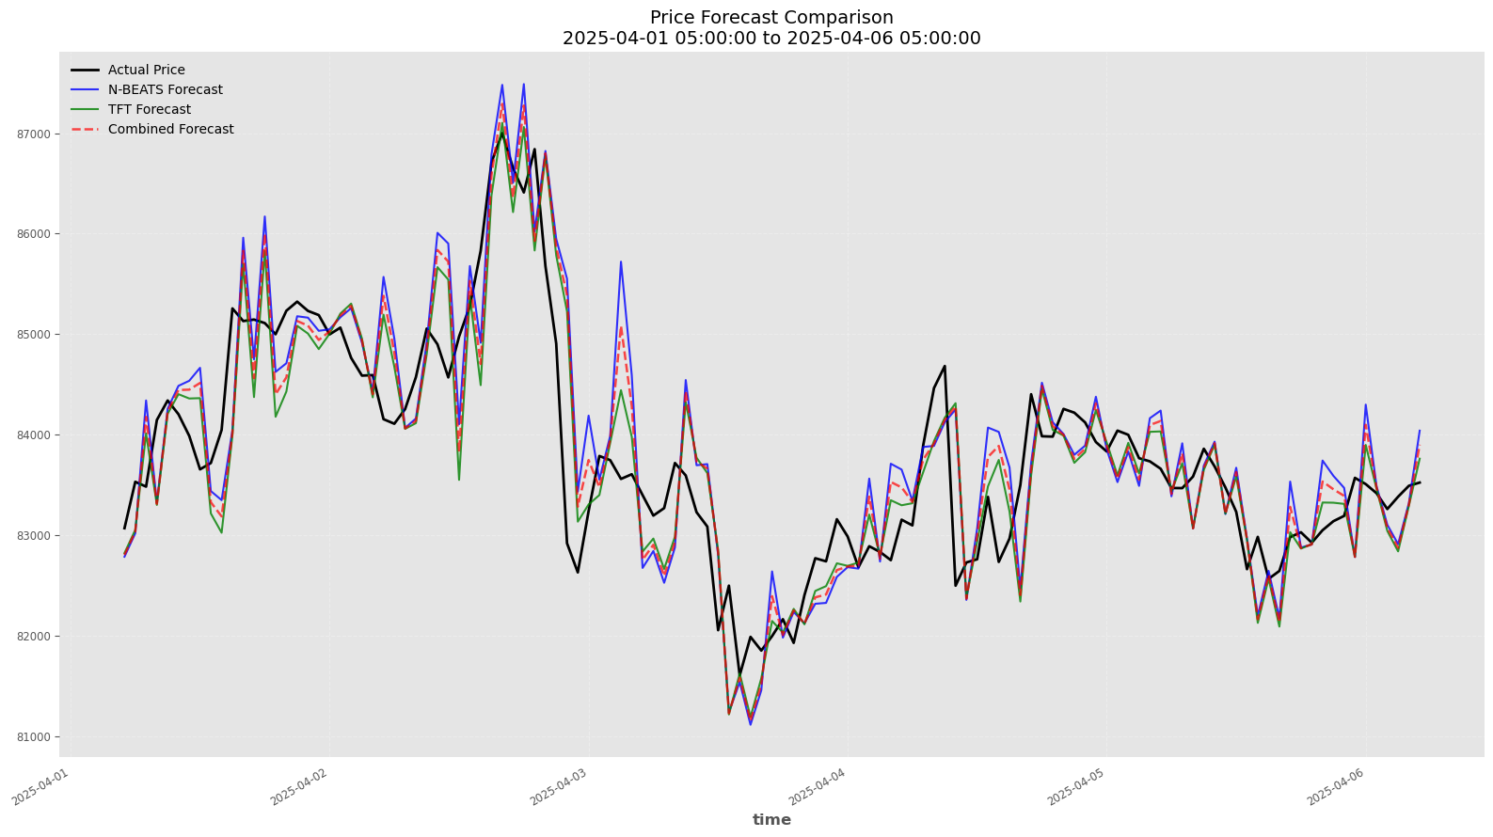

Slide 20
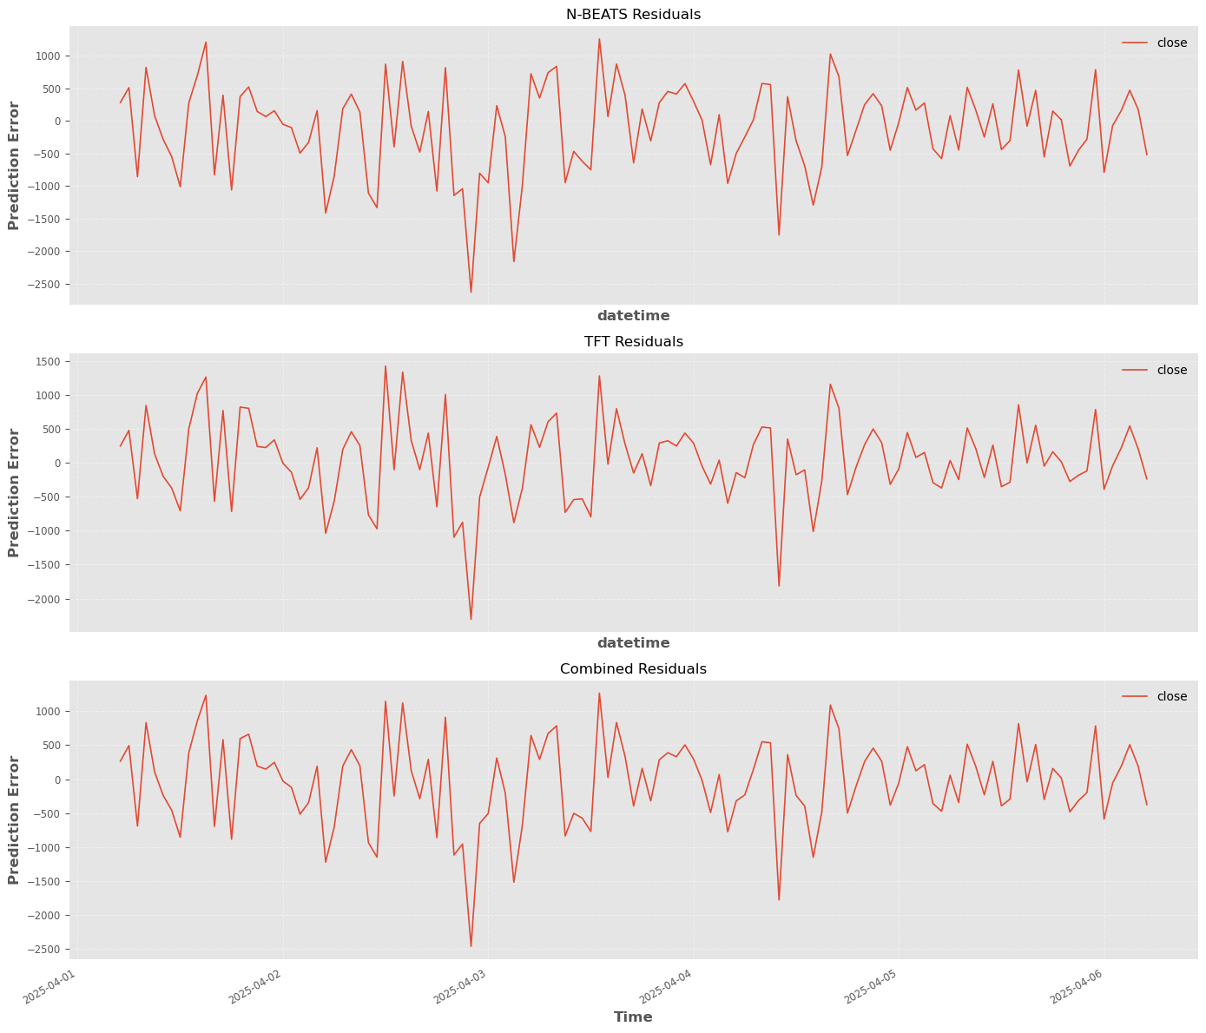

Slide 21
Conclusion & Future Work
Multimodal inputs lead to better-informed and more robust models.
Future work: incorporate real-time sentiment.
Also explore LLMs like Llama3 for explanability.

Slide 22

Thank you!

