Slide 1


Welcome to All well
Your personalized stress relief platform

Slide 2
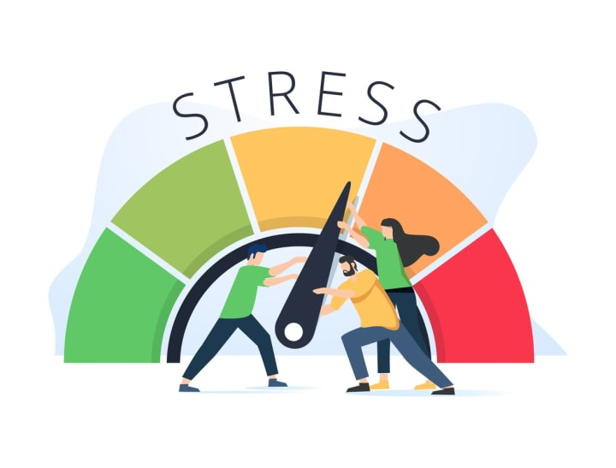
Problem statement
The problem
Many people suffer from chronic stress due to personal, professional, and academic pressures .
Limited access to affordable and convenient stress-relief methods .
Lack of awareness about effective stress management techniques .

Slide 3
Our solution to stress
Accessible anywhere : Our platform offers a variety of stress relief therapies that can be accessed from the comfort of home , making it easy for users to manage stress anytime, anywhere .
Personalized therapies : We offer customized therapy options like audio therapy, reading therapy, yoga therapy, laughing therapy, talking therapy .
Simple and engaging : Each therapy is designed to be user-friendly and engaging , ensuring users stay motivated and find relief easily

Slide 4

Holistic approach : By addressing both mental and physical aspects of stress , our therapies promotes overall well-being .
Professional guidance : for users experiencing more intense stress , we provide access to professional assistance (like consuming a doctor)for more comprehensive solution .

Slide 5

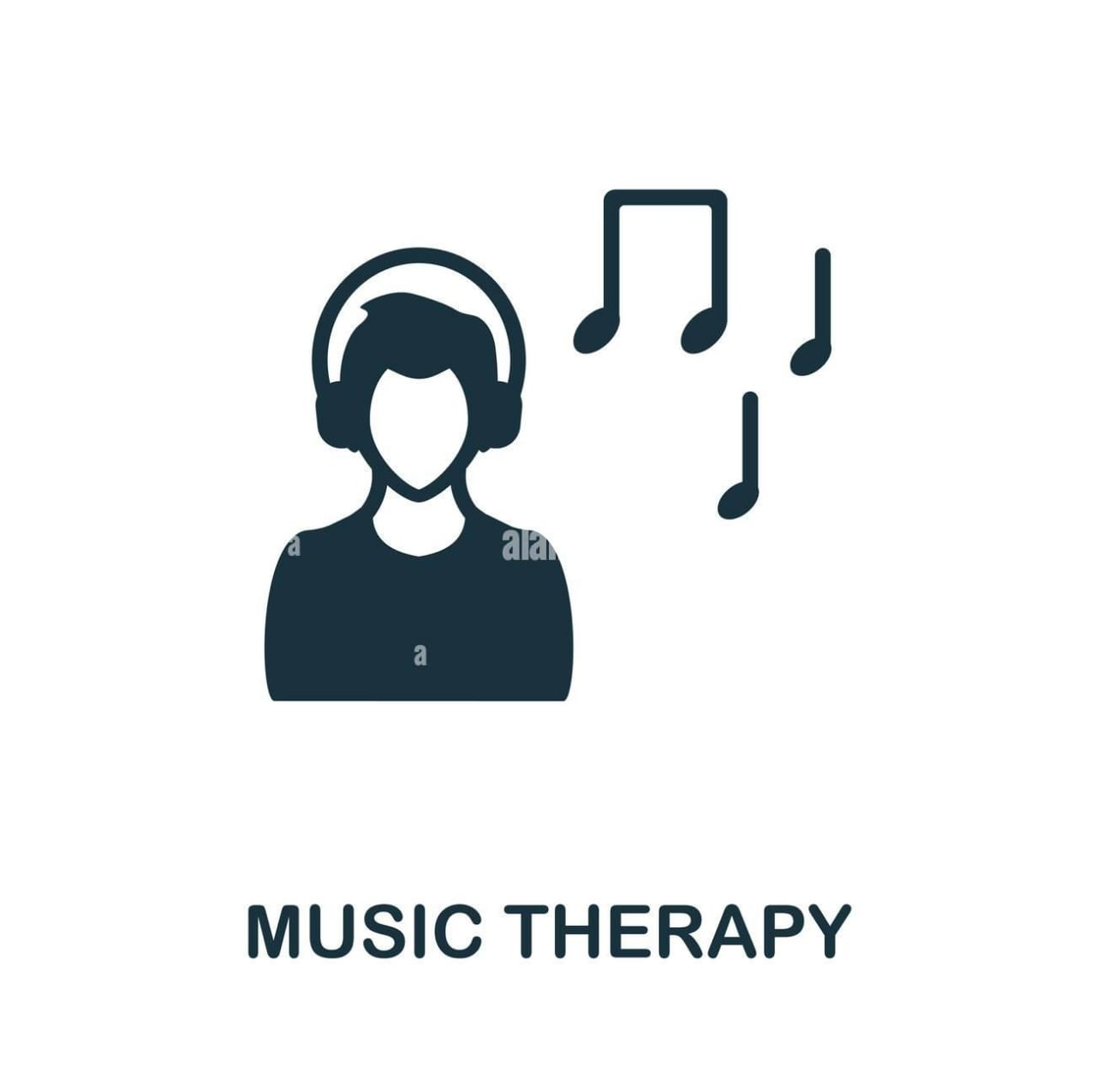

Our services Stress relief therapies
Audio therapy : Relaxing sounds and music to calm the mind.
Reading therapy : Guided reading sessions to distract and focus the mind.
Yoga therapy : Simple, accessible yoga routines for physical and mental health relaxation.
Laughing therapy : Laughter-based exercises to boost mood.
Coming soon : Additional therapies to enhance stress management.

Slide 6
Coming soon
Future development
New therapies in development.
Expansion into more personalized therapy options.
integrating AI-based stress tracking and management tools.

Slide 7
Conclusion
In conclusion, our platform addresses the prevalent issue of chronic stress by offering accessible, personalized, and engaging therapies that users can easily incorporate into their daily lives. By combining a holistic approach with professional guidance and a variety of therapeutic options, we aim to empower individuals to manage stress effectively and improve their overall well-being.

