Slide 1

Volunteer Management System
Empowering Volunteer Engagement with Smart Management

Slide 2
Abstract: Volunteer Management System
Managing volunteers manually is inefficient and time-consuming. The Volunteer Management System is a web-based platform that automates event registration, attendance tracking, feedback collection, and rewards using Appwrite (backend) and React.js (frontend).
It offers role-based access, secure authentication, and real-time data management to streamline volunteer coordination. This system enhances engagement and efficiency for organizations, with future improvements like AI-based recommendations, gamification, and advanced analytics.

Slide 3
System Overview
Role Management
Event Registration
This feature allows administrators to define various volunteer roles with specific permissions and responsibilities. Volunteers can be assigned to roles based on their skills and experience, ensuring efficient task allocation and workflow.
Volunteers can easily register for events through a streamlined online portal. The system manages event calendars, schedules, and volunteer availability, ensuring optimal event staffing.
Attendance Tracking
Rewards System
The system accurately tracks volunteer attendance at events and activities. This helps to monitor volunteer engagement and participation, enabling better data-driven decision-making and resource allocation.
A robust rewards system acknowledges and incentivizes volunteer contributions. Points, certificates, or other rewards can be awarded based on attendance, hours volunteered, and overall impact, motivating continued engagement.

Slide 4
Why We Need This
Traditional Issues
Our Solution
Manual tracking
Automated processes
Communication gaps
Real-time updates
Inefficient scheduling
Smart scheduling

Slide 5
Fact Finding Techniques
Fact-Finding Technique
Description
Purpose/Outcome
Surveys & Questionnaires
Collect data from volunteers and organizations through structured forms.
Identify challenges and pain points in volunteer management.
Interviews
Conduct 1-on-1 or group discussions with key stakeholders (admins, volunteers).
Gather in-depth feedback on user needs and system requirements.
Observation
Observe current manual processes of volunteer registration and event management.
Recognize inefficiencies and areas for automation or improvement.
Document Analysis
Analyze existing records like registration forms and attendance sheets.
Design optimized database structures and user interfaces.
Prototyping
Develop a basic version of the system and collect feedback from users.
Test initial assumptions and improve the system based on real user feedback.

Slide 6
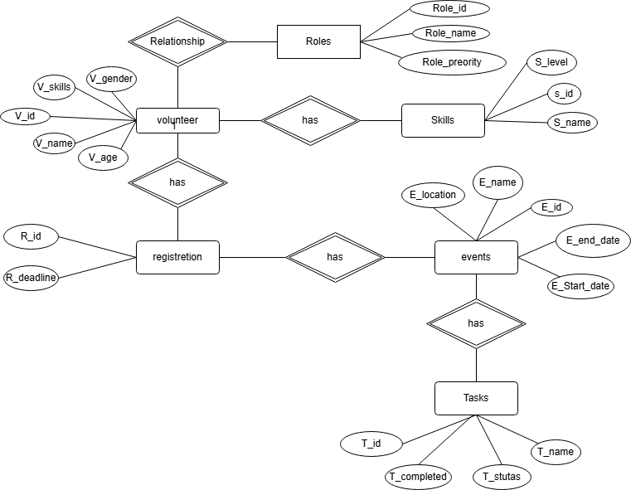
ER Diagram
1
m
m
1
1
1
m
1
1
m

Slide 7
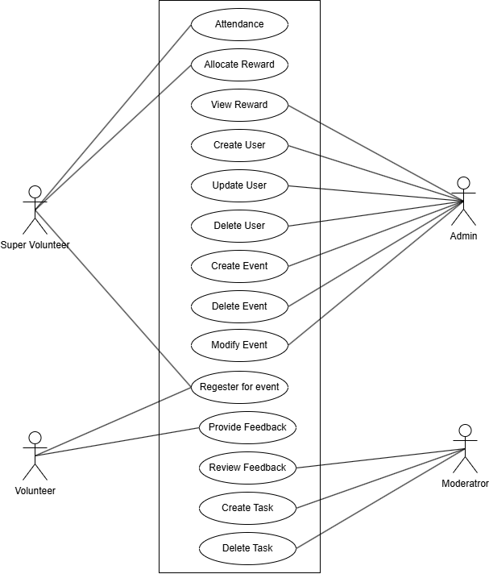
USE CASE Diagram

Slide 8
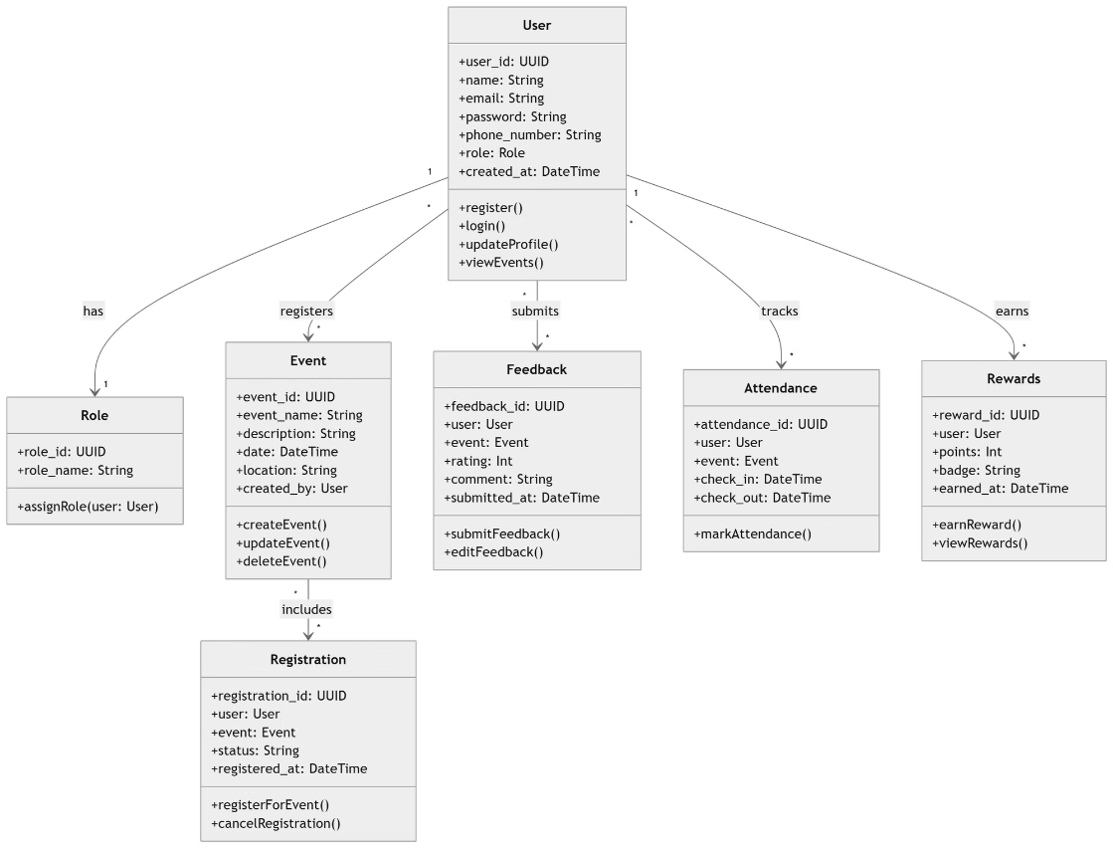
UML Diagram

Slide 9
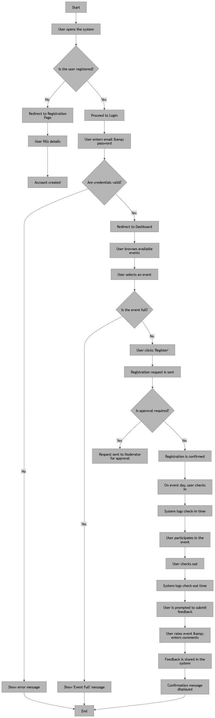
Acitivity Diagram

Slide 10
System Requirements
Category | Description | Requirement
Software Requirements | Appwrite (Database, Authentication, Storage) | Backend
 | HTML, CSS, JavaScript, React.js, Bootstrap (UI Design) | Frontend
 | Appwrite Database | Database
 | Git, GitHub / GitLab for repository management | Version Control
 | VS Code (IDE) | Development Tools
Hardware Requirements | PC or Laptop or Mobile | Development Device

Slide 11
Conclusion
The Volunteer Management System successfully streamlines volunteer coordination by automating registration, event management, attendance tracking, and rewards distribution. By utilizing Appwrite for backend services, React.js for frontend, and a secure authentication system, our platform enhances efficiency, reduces manual workload, and improves engagement for both volunteers and administrators.
This system provides a centralized and user-friendly approach, ensuring a smooth experience for organizations managing volunteers and events. With features like role-based access, feedback collection, and location-based suggestions, it offers a scalable and efficient solution for modern volunteer management.

Slide 12
Thank You

