Slide 1
VSTS – ALM On Cloud - Atishay Shukla

Slide 2
What is VSTS?
Any non-trivial software development that is being done by a team of developers requires certain support for successful collaboration
This support is in the form of versioning the code, creating the components and their releases, managing the process of development, and managing issues that may block such software development
Microsoft Team Foundation Server (TFS) - It is an on premises installed product which provides development support for the entire organization
Microsoft started offering the same set of services it was offering on-premises (TFS), now from Azure cloud. After many changes in the brand name of these services, Microsoft has zeroed it down to “Microsoft Visual Studio Team Services (VSTS)” (previously known as Visual Studio Online)

Slide 3
Why VSTS - Advantages
No need to install and maintain Team Foundation Server on our premises
Services offered are with optimal hardware so that our infrastructure cost is avoided
Since the VSTS services are available on the internet, they can be easily used by teams that are distributed across multiple locations, without having any additional cost of VPN and overheads of security
VSTS gets the new updates before on-premises

Slide 4
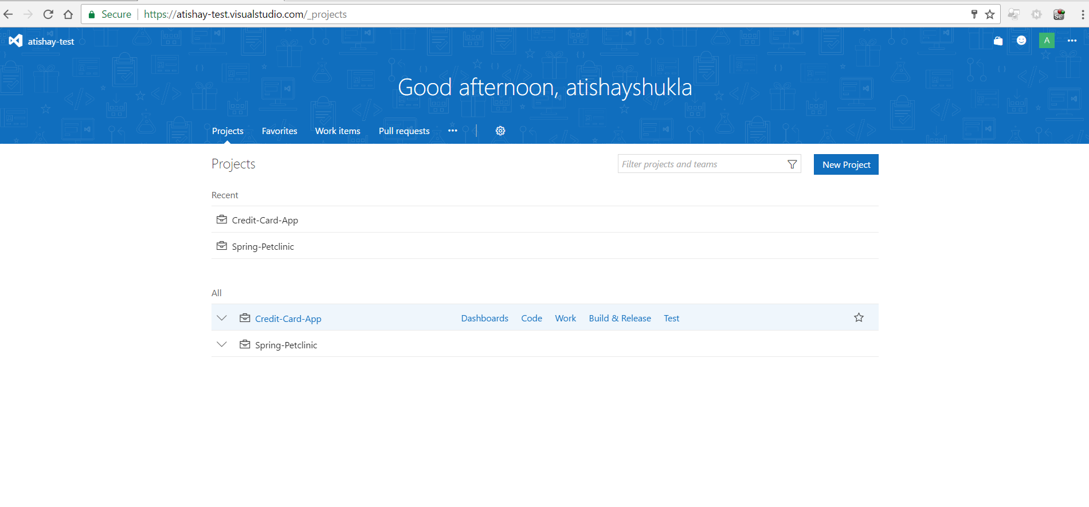

Slide 5
Features
Source and Version Control
Build Management
Release Management Service
Work Item Tracking Service

Slide 6
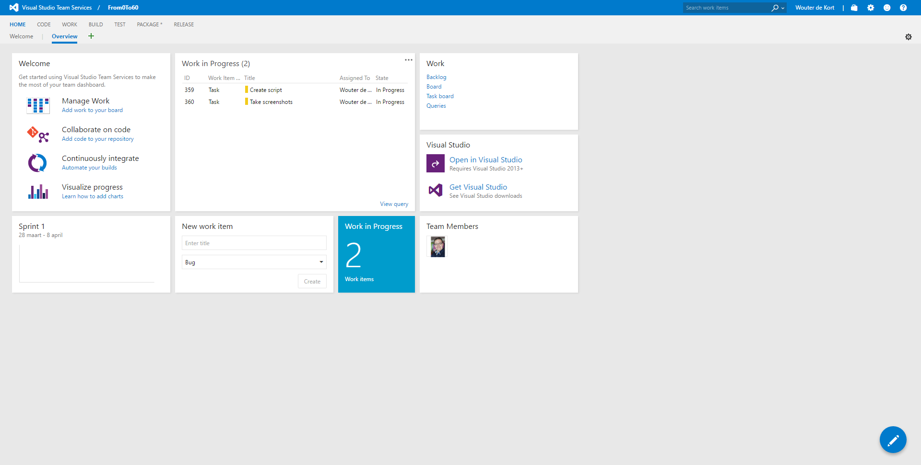

Slide 7
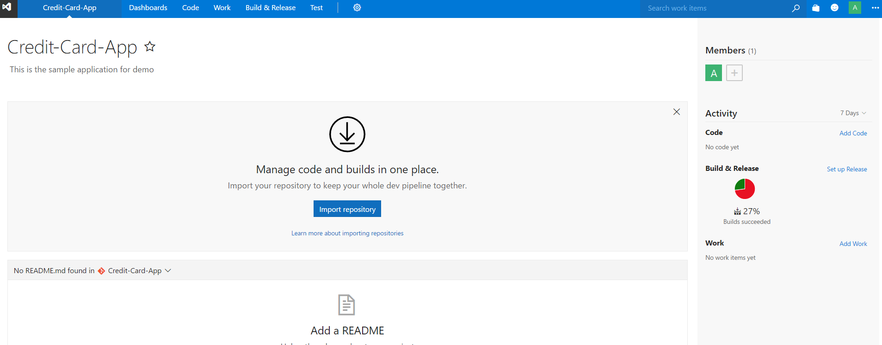
VSTS – Dashboard Team Project
Team Project is a logical container for all the entities related to the unit of software that you are developing.

Slide 8
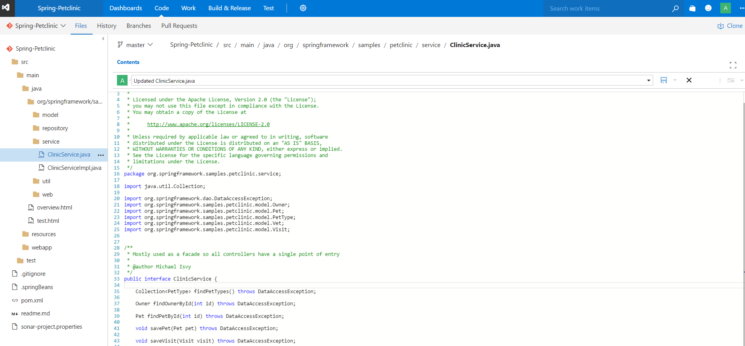
Source Code Repository – Editor in build

Slide 9
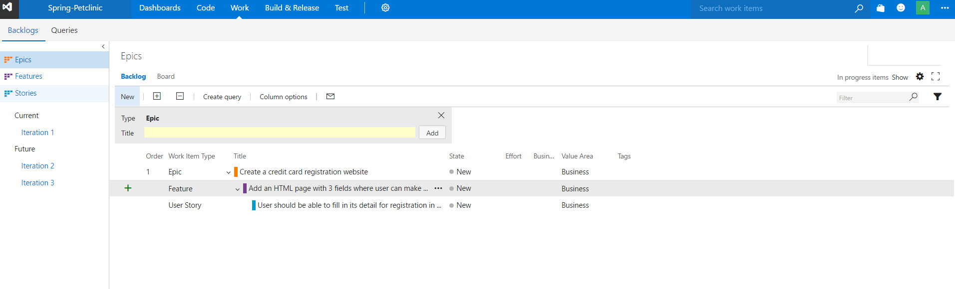
Work Tracking

Slide 10
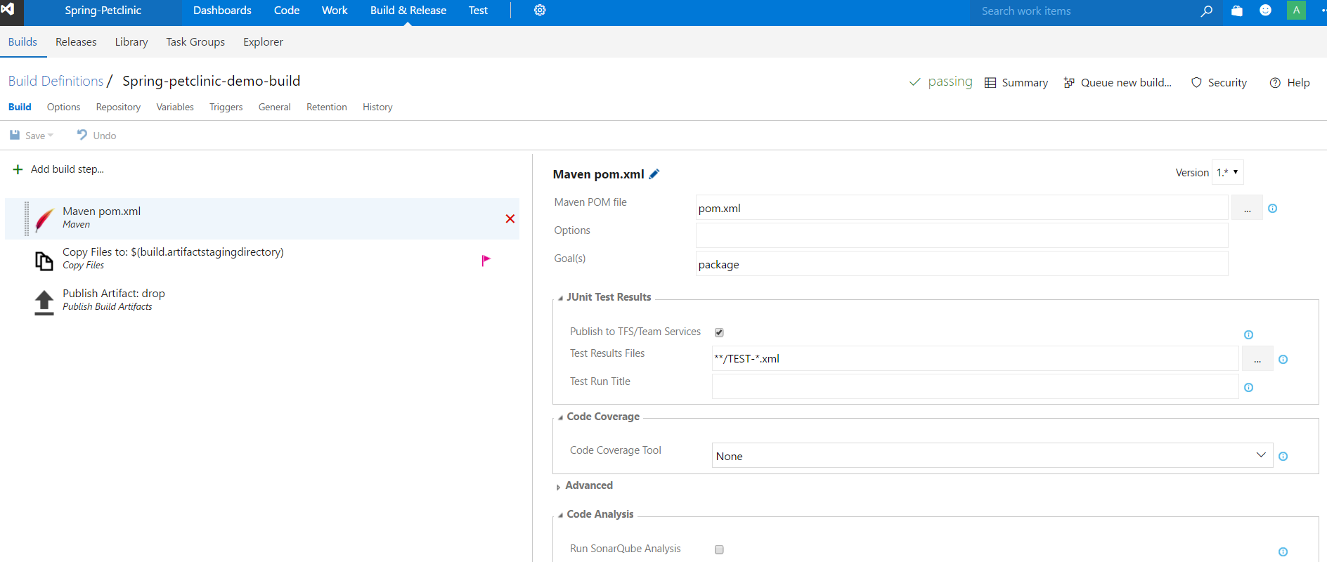
Build Management

Slide 11
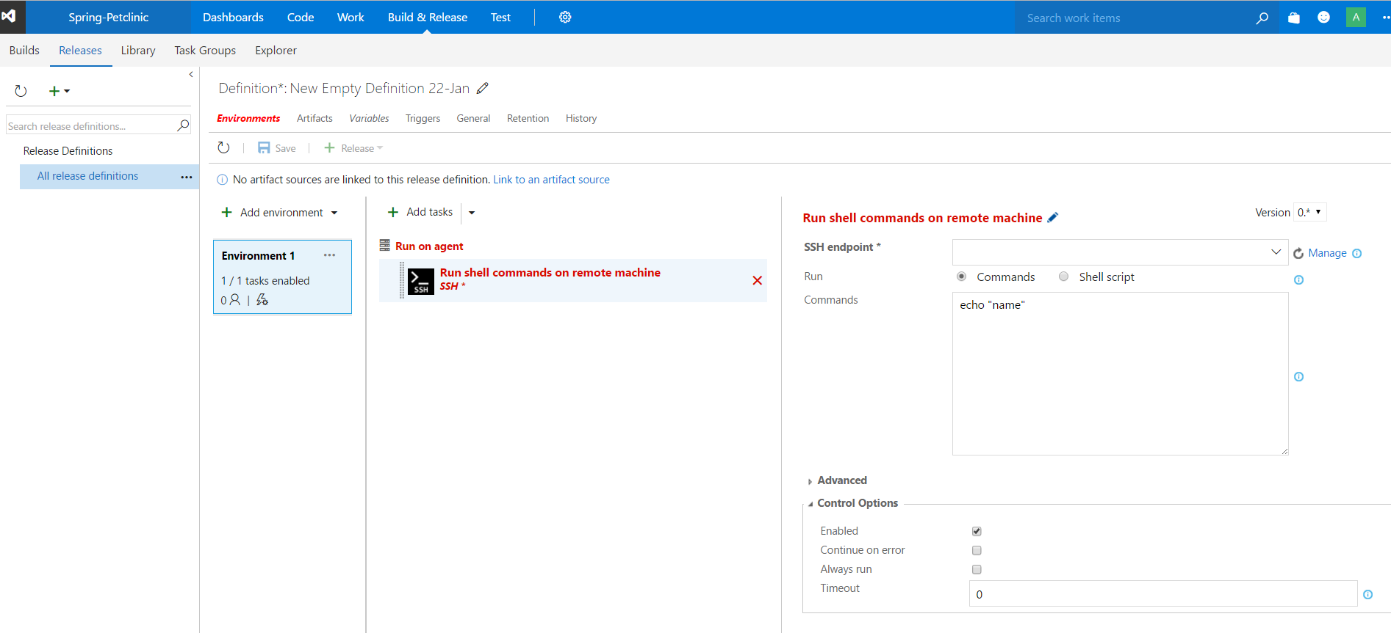
Release Management

Slide 12
Q & A ? Thank you

