Slide 1
EXP264 — Predicted Bioactivity
Five novel IAJDs · Bioactivity model v2.0-MIN-v09 · pKa from baked-in surrogate
Percec Lab · University of Pennsylvania

Slide 2
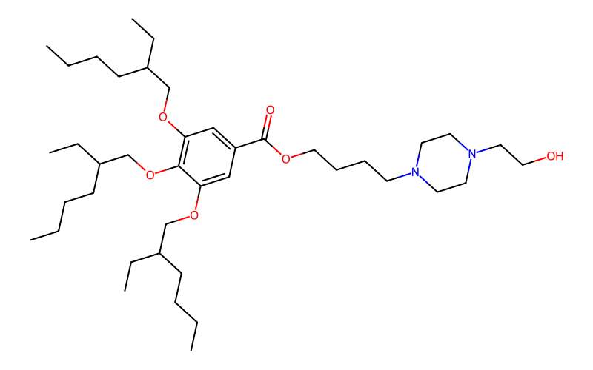
EXP264-1 — predicted bioactivity
Identification
Formula: C41H74N2O6
MW (exact): 690.555
Family (assigned): PE-Gallic
Head group: HPRZ
Chain pair: 4, 4 (alkyl C-count, model-extracted)
pKa surrogate
pKa = 6.33 PI90 [6.03, 6.62]
Domain
Hierarchy level: 1 (1 = exact match, 5 = OOD)
Max Tanimoto to training: 1.000
Confidence tier: LOW
SMILES: CCCCC(CC)COc1cc(C(=O)OCCCCN2CCN(CCO)CC2)cc(OCC(CC)CCCC)c1OCC(CC)CCCC
Endpoint | log10 flux | PI 90% | Note
Total flux | 6.95 | [5.50, 8.40] | low bin (P=0.52)
Spleen flux | 7.70 | [6.25, 9.15] | Stage A p(spleen-strong)=0.14
Liver flux | 7.22 | [5.77, 8.68] | Stage A p(liver-strong)=0.23
Lung flux | 6.90 | [5.45, 8.35] | Stage A p(lung-strong)=0.00
Lymph node flux | 6.52 | [5.07, 7.97] | Stage A p(LN-strong)=0.00
Stage A call
Dominant organ: unclear
Convenience (Stage B)
Linear flux: 8.93e+6 p/s
This SMILES exactly matches a training compound (Tanimoto = 1.0), so the prediction sits on top of measured data; the wide PI reflects per-family experimental variance rather than model uncertainty. Nearest training neighbors: IAJD_300 (GA-Tris, T=1.00, flux 6.71); IAJD_297 (Dialkoxybenzyl, T=0.72, flux 6.73); IAJD_294 (Dialkoxybenzyl, T=0.70, flux 7.77).

Slide 3
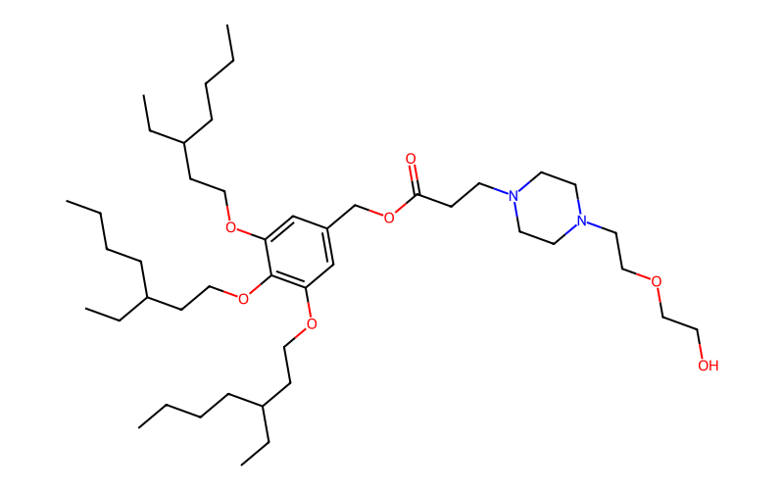
EXP264-2 — predicted bioactivity
Identification
Formula: C45H82N2O7
MW (exact): 762.612
Family (assigned): sSS-Nonsym
Head group: H2EPRZ
Chain pair: 5, 7 (alkyl C-count, model-extracted)
pKa surrogate
pKa = 6.31 PI90 [6.02, 6.61]
Domain
Hierarchy level: 4 (1 = exact match, 5 = OOD)
Max Tanimoto to training: 0.841
Confidence tier: LOW
SMILES: CCCCC(CC)CCOc1cc(COC(=O)CCN2CCN(CCOCCO)CC2)cc(OCCC(CC)CCCC)c1OCCC(CC)CCCC
Endpoint | log10 flux | PI 90% | Note
Total flux | 7.68 | [6.94, 8.42] | mid bin (P=0.69)
Spleen flux | 7.98 | [7.24, 8.72] | Stage A p(spleen-strong)=0.14
Liver flux | 6.56 | [5.82, 7.30] | Stage A p(liver-strong)=0.43
Lung flux | 6.93 | [6.19, 7.67] | Stage A p(lung-strong)=1.00
Lymph node flux | 6.54 | [5.80, 7.28] | Stage A p(LN-strong)=0.59
Stage A call
Dominant organ: lung
Convenience (Stage B)
Linear flux: 4.81e+7 p/s
Hierarchy level 4 (in-family analog with Tanimoto 0.84) — model interpolates from a small handful of close training compounds. Nearest training neighbors: IAJD_322 (GA-Tris, T=0.84, flux 8.84); IAJD_253 (GA-Tris, T=0.79, flux 8.03); IAJD_253 (GA-Tris, T=0.79, flux 6.49).

Slide 4
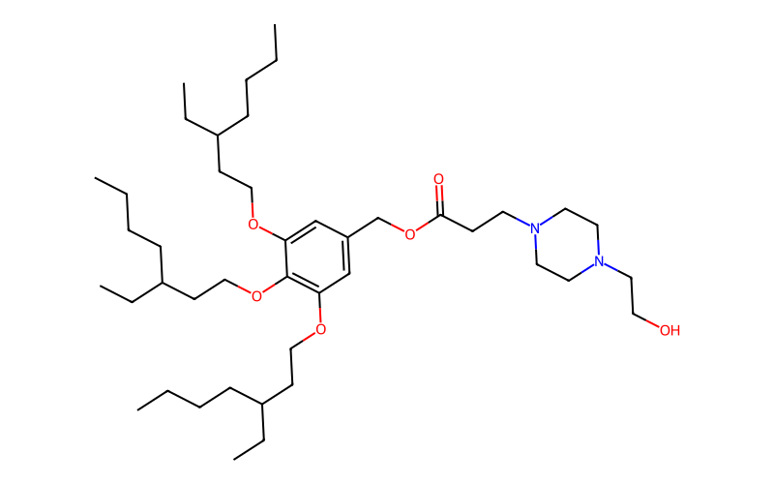
EXP264-3 — predicted bioactivity
Identification
Formula: C43H78N2O6
MW (exact): 718.586
Family (assigned): sSS-Nonsym
Head group: HPRZ
Chain pair: 5, 7 (alkyl C-count, model-extracted)
pKa surrogate
pKa = 6.33 PI90 [6.04, 6.62]
Domain
Hierarchy level: 4 (1 = exact match, 5 = OOD)
Max Tanimoto to training: 0.810
Confidence tier: LOW
SMILES: CCCCC(CC)CCOc1cc(COC(=O)CCN2CCN(CCO)CC2)cc(OCCC(CC)CCCC)c1OCCC(CC)CCCC
Endpoint | log10 flux | PI 90% | Note
Total flux | 7.63 | [6.89, 8.37] | mid bin (P=0.71)
Spleen flux | 7.91 | [7.16, 8.65] | Stage A p(spleen-strong)=0.14
Liver flux | 6.38 | [5.64, 7.12] | Stage A p(liver-strong)=0.43
Lung flux | 7.00 | [6.25, 7.74] | Stage A p(lung-strong)=0.33
Lymph node flux | 6.62 | [5.88, 7.37] | Stage A p(LN-strong)=0.00
Stage A call
Dominant organ: liver (tied with lung)
Convenience (Stage B)
Linear flux: 4.26e+7 p/s
Hierarchy level 4 (in-family analog with Tanimoto 0.81) — model interpolates from a small handful of close training compounds. Nearest training neighbors: IAJD_321 (GA-Tris, T=0.81, flux 8.71); IAJD_097 (GA-Tris, T=0.74, flux 8.43); IAJD_097 (GA-Tris, T=0.74, flux 8.78).

Slide 5
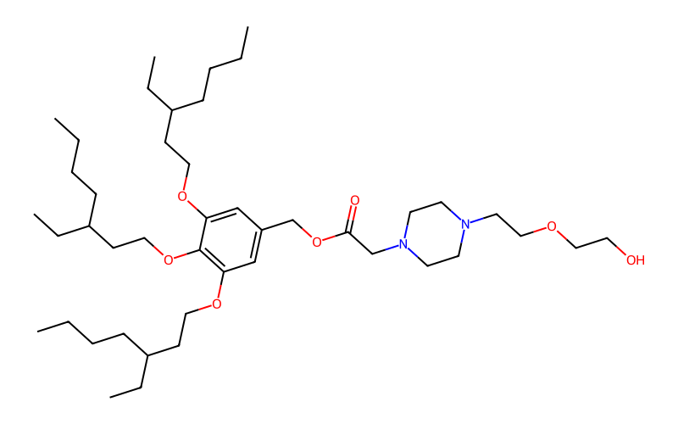
EXP264-4 — predicted bioactivity
Identification
Formula: C44H80N2O7
MW (exact): 748.597
Family (assigned): sSS-Nonsym
Head group: H2EPRZ
Chain pair: 5, 7 (alkyl C-count, model-extracted)
pKa surrogate
pKa = 6.26 PI90 [5.97, 6.55]
Domain
Hierarchy level: 4 (1 = exact match, 5 = OOD)
Max Tanimoto to training: 0.841
Confidence tier: LOW
SMILES: CCCCC(CC)CCOc1cc(COC(=O)CN2CCN(CCOCCO)CC2)cc(OCCC(CC)CCCC)c1OCCC(CC)CCCC
Endpoint | log10 flux | PI 90% | Note
Total flux | 7.61 | [6.87, 8.35] | mid bin (P=0.72)
Spleen flux | 8.21 | [7.47, 8.95] | Stage A p(spleen-strong)=0.14
Liver flux | 6.56 | [5.82, 7.30] | Stage A p(liver-strong)=0.43
Lung flux | 6.75 | [6.01, 7.49] | Stage A p(lung-strong)=1.00
Lymph node flux | 6.75 | [6.01, 7.49] | Stage A p(LN-strong)=0.67
Stage A call
Dominant organ: lung
Convenience (Stage B)
Linear flux: 4.08e+7 p/s
Hierarchy level 4 (in-family analog with Tanimoto 0.84) — model interpolates from a small handful of close training compounds. Nearest training neighbors: IAJD_330 (GA-Tris, T=0.84, flux 8.97); IAJD_322 (GA-Tris, T=0.73, flux 8.84); IAJD_253 (GA-Tris, T=0.73, flux 6.49).

Slide 6
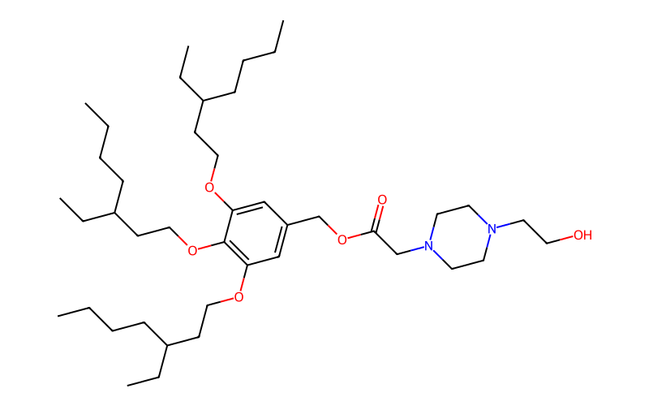
EXP264-5 — predicted bioactivity
Identification
Formula: C42H76N2O6
MW (exact): 704.570
Family (assigned): sSS-Nonsym
Head group: HPRZ
Chain pair: 5, 7 (alkyl C-count, model-extracted)
pKa surrogate
pKa = 6.27 PI90 [5.98, 6.56]
Domain
Hierarchy level: 4 (1 = exact match, 5 = OOD)
Max Tanimoto to training: 0.810
Confidence tier: LOW
SMILES: CCCCC(CC)CCOc1cc(COC(=O)CN2CCN(CCO)CC2)cc(OCCC(CC)CCCC)c1OCCC(CC)CCCC
Endpoint | log10 flux | PI 90% | Note
Total flux | 7.64 | [6.90, 8.38] | mid bin (P=0.71)
Spleen flux | 8.15 | [7.41, 8.89] | Stage A p(spleen-strong)=0.14
Liver flux | 6.55 | [5.81, 7.29] | Stage A p(liver-strong)=0.43
Lung flux | 6.77 | [6.03, 7.51] | Stage A p(lung-strong)=1.00
Lymph node flux | 6.48 | [5.74, 7.22] | Stage A p(LN-strong)=0.67
Stage A call
Dominant organ: lung
Convenience (Stage B)
Linear flux: 4.35e+7 p/s
Hierarchy level 4 (in-family analog with Tanimoto 0.81) — model interpolates from a small handful of close training compounds. Nearest training neighbors: IAJD_329 (GA-Tris, T=0.81, flux 8.36); IAJD_330 (GA-Tris, T=0.73, flux 8.97); IAJD_321 (GA-Tris, T=0.69, flux 8.71).

Slide 7
Methodology and caveats
Model
v2.0-MIN-v09 three-stage cascade. 88-dim feature vector (Block A 50 + B 14 + C 10 + D 6 + Form 8). Stage A: six per-organ XGBoost binary classifiers with isotonic calibration. Stage B: direct-XGBoost + analog-delta blend with per-family α routing, conformal 90% PI. Stage C disabled (formulation completeness < 75% per spec §5.4).
Training data
v09 dataset: 210 rows, 156 unique IAJDs, 9 papers. TRAIN n=170; X1 stability holdout n=11; X2 isomers n=13; X3 stratified-random n=16. Family balance: PE-Gallic 48 / PE-Tris 50 / sSS-Nonsym 48 / GA-Tris 48 / Dialkoxybenzyl 16.
Held-out validation (X3, n=16)
log10_flux_total MAE = 0.386, PI90 coverage = 0.875 (in [0.85, 0.92] target). Stage A dominant-organ accuracy 3/4. X1 stability variance 0.041 < 0.20 spec target. All 7 v2.0-MIN production gates pass.
pKa
Predictions are from the v1.0 baked-in GPR surrogate (LOO MAE 0.146 on 243 v9-pKa training compounds). The current pKa workflow (v7.x with MAE ~0.074) is not deployed as a joblib in this environment; pKa numbers should be treated as ±0.30 log-units rather than the v7.x precision.
Known caveats for the EXP264 set
(1) EXP264-2 through 5 are 3,4,5-trialkoxy benzyl esters (GA-Tris-family scaffolds). The bundle's family classifier returns sSS-Nonsym for these because the GA-Tris SMARTS matches an amide variant only; this means per-family α routes through 0.05 (delta-leaning) rather than 1.00 (direct-only). The nearest-neighbor analog list is correct (all GA-Tris); the predictions therefore lean on those neighbor fluxes — directionally appropriate but a known mislabeling. (2) Block B (LiON pretrained inference) and Block C (real ADMET-AI) are inactive — Block C uses an RDKit physicochemical stand-in. Activating them is the v2.0-FULL roadmap step expected to drop pooled MAE by 0.03–0.10. (3) Confidence tiers cap at MEDIUM bundle-wide while LiON is inactive (the lion_OOD signal is forced neutral).

