Slide 1
Health, Income, and Emission Effects from Energy Generation
By: Alex H, Evan O, Scott M, Robbie G, and Jennifer H

Slide 2
Probing Question
How much does energy generation effect the health, income, and emissions of states and the people therein?

Slide 3
Overview
Energy Source Generation and Emissions
Emissions and Respiratory Health
Energy Source Generation and Income
Impact of Findings
Future Projects/Limitations of Data
Q&A

Slide 4
Energy Source Generation and Emissions
Since 1996, CO2 levels have increased, levelled off in the Mid-2000’s, then decreased in the US
Since 1996, NOx and SO2 has been on a decline
The only significant increase of emissions has been in CH4 emissions, presumably as we’ve moved away from coal to Natural Gas and Petroleum energy production
-Robby

Slide 5
Emissions and Respiratory Health

Slide 6
Energy Source Generation and Income

Slide 7
Impact of Findings

Slide 8
Current Limitations and Future Projects
Difficulties of the project as well… such as navigating github and the repo
Emission data does not exist for every year, and some emission types were not tracked by the EPA prior to 2005

Slide 9
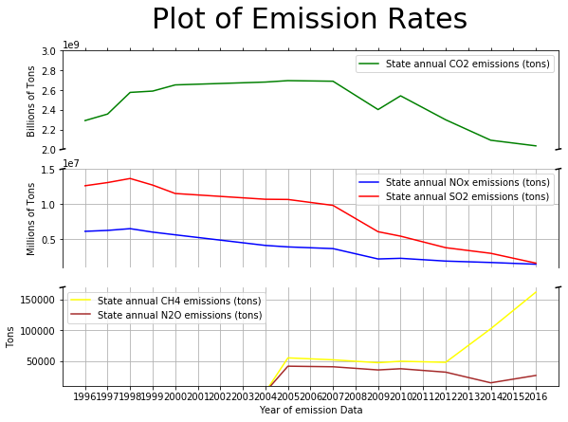

Slide 10
Questions?

Slide 11
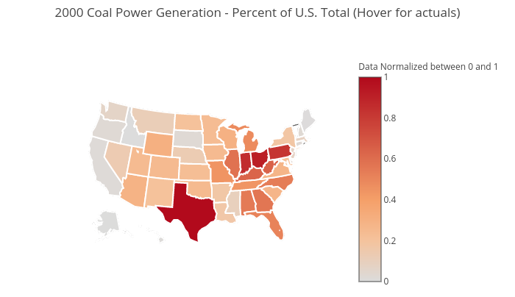
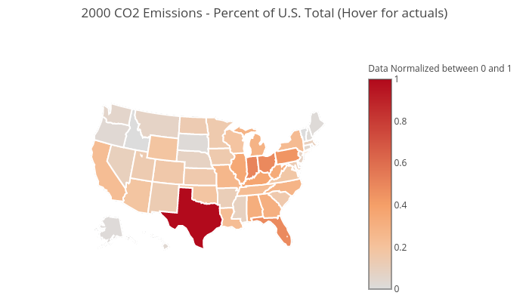
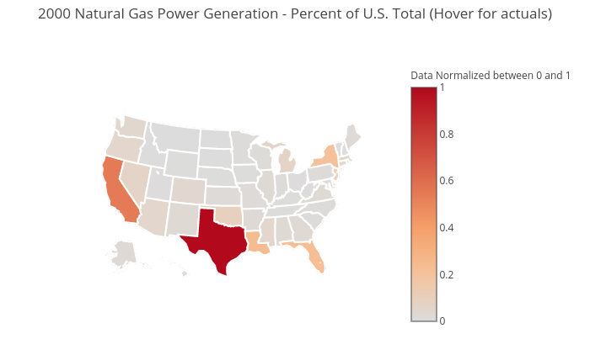
How does the fluctuation of energy source generation effect emissions? Year 2000
Click map to view actuals

Slide 12
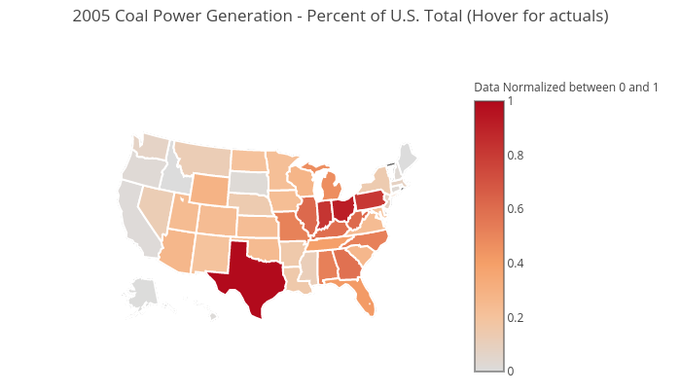
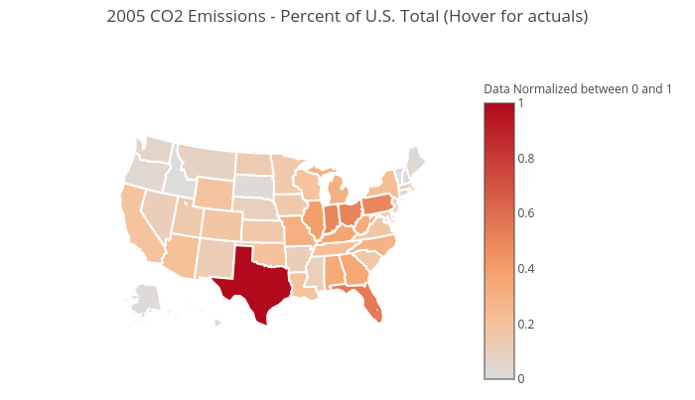
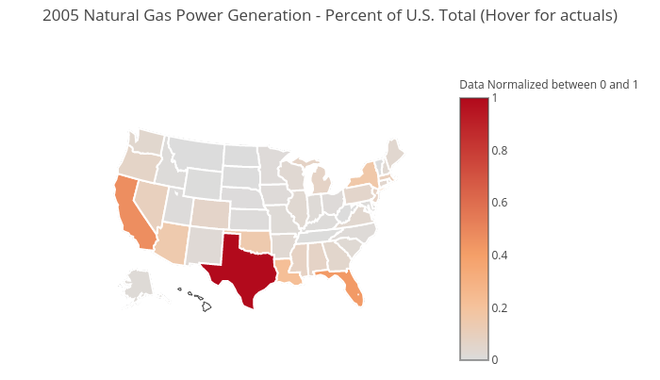
How does the fluctuation of energy source generation effect emissions? Year 2005
Click map to view actuals

Slide 13


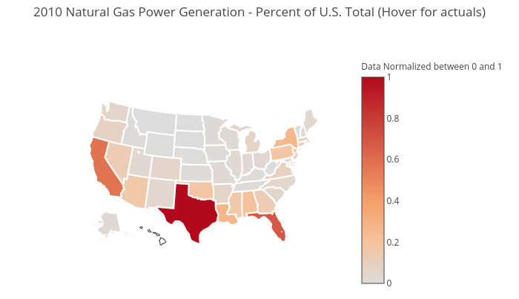
How does the fluctuation of energy source generation effect emissions? Year 2010
Click map to view actuals

Slide 14
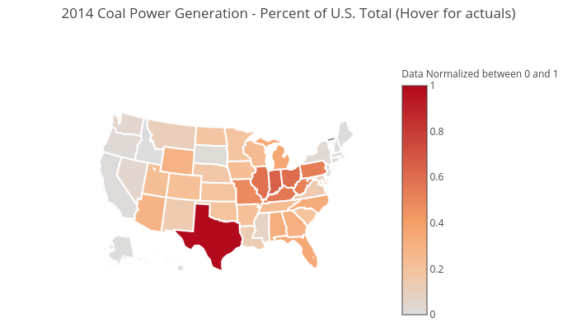

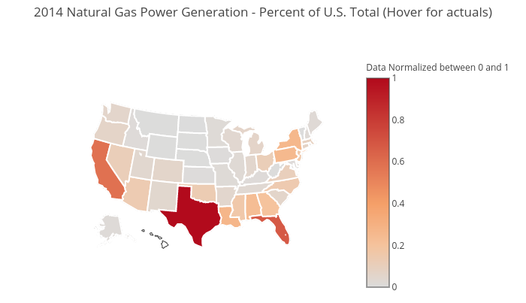
How does the fluctuation of energy source generation effect emissions? Year 2014
Click map to view actuals

Slide 15
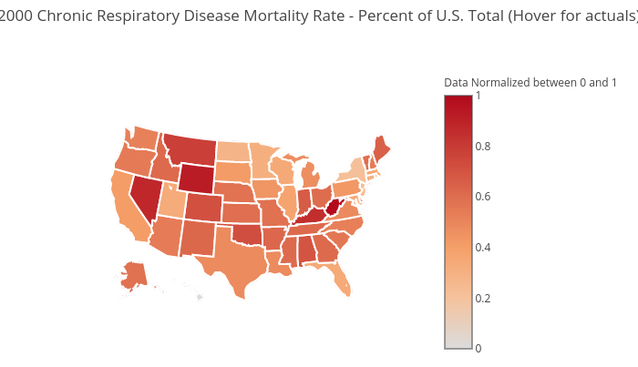
How does emissions effect respiratory health? Year 2000
Chronic Respiratory Disease Mortality Rate
CO2 Emissions
Click map to view actuals

Slide 16

How does emissions effect respiratory health? Year 2005
Chronic Respiratory Disease Mortality Rate
CO2 Emissions
Click map to view actuals

Slide 17

How does emissions effect respiratory health? Year 2010
Chronic Respiratory Disease Mortality Rate
CO2 Emissions
Click map to view actuals

Slide 18
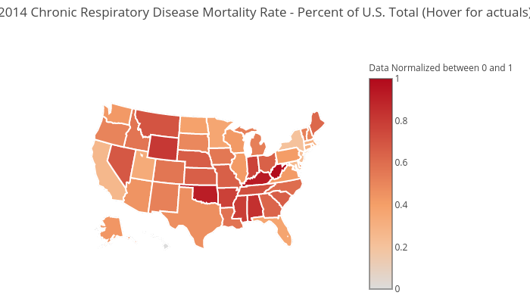
How does emissions effect respiratory health? Year 2014
Chronic Respiratory Disease Mortality Rate
CO2 Emissions
Click map to view actuals

Slide 19
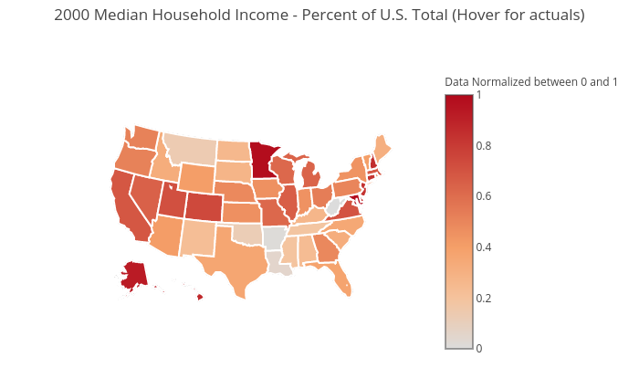
How does energy source generation relate to income? Year 2000
Click map to view actuals

Slide 20
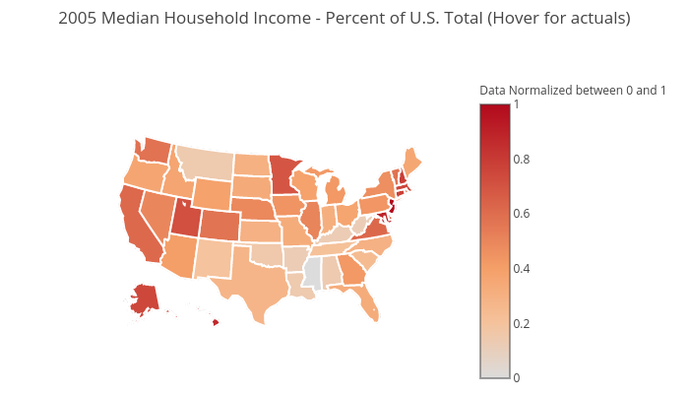
How does energy source generation relate to income? Year 2005
Click map to view actuals

Slide 21
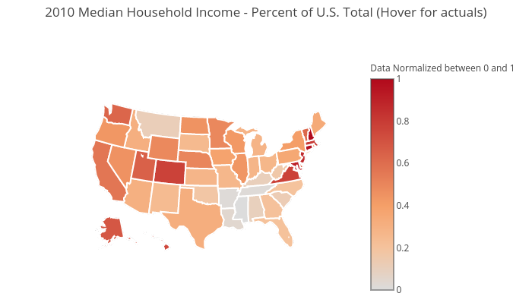
How does energy source generation relate to income? Year 2010
Click map to view actuals

Slide 22
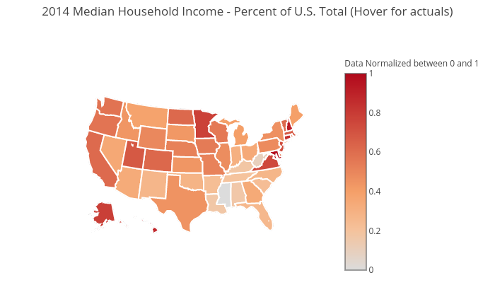
How does energy source generation relate to income? Year 2014
Click map to view actuals

Slide 23
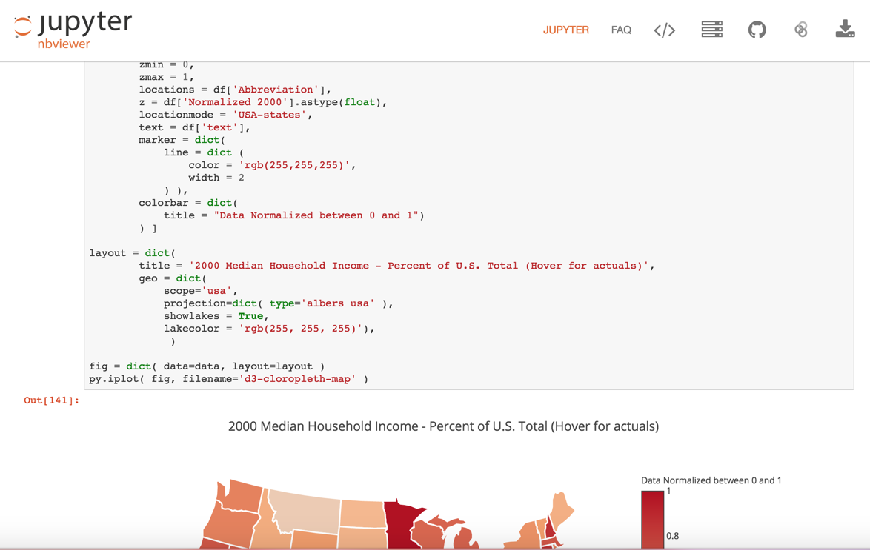
View Map Code on Jupyter nbviewer

Slide 24
Click map to view actuals

Slide 25
Coal Power Generation vs CO2 Emissions Year 2000
Coal Power Generation
CO2 Emissions
Click map to view actuals

Slide 26
Natural Gas Power Generation vs CO2 Emissions Year 2000
Natural Gas Power Generation
CO2 Emissions
Click map to view actuals

Slide 27
Chronic Respiratory Disease Mortality Rate vs CO2 Emissions Year 2000
Chronic Respiratory Disease Mortality Rate
CO2 Emissions
Click map to view actuals

Slide 28
Chronic Respiratory Disease Mortality Rate vs Median Household Income Year 2000
Chronic Respiratory Disease Mortality Rate
Median Household Income
Click map to view actuals

Slide 29
Coal Power Generation vs Median Household Income Year 2000
Coal Power Generation
Median Household Income
Click map to view actuals

Slide 30
Natural Gas Power Generation vs Median Household Income Year 2000
Natural Gas Power Generation
Median Household Income
Click map to view actuals

Slide 31
Click map to view actuals

Slide 32
Coal Power Generation vs CO2 Emissions Year 2005
Coal Power Generation
CO2 Emissions
Click map to view actuals

Slide 33
Natural Gas Power Generation vs CO2 Emissions Year 2005
Natural Gas Power Generation
CO2 Emissions
Click map to view actuals

Slide 34
Chronic Respiratory Disease Mortality Rate vs CO2 Emissions Year 2005
Chronic Respiratory Disease Mortality Rate
CO2 Emissions
Click map to view actuals

Slide 35
Chronic Respiratory Disease Mortality Rate vs Median Household Income Year 2005
Chronic Respiratory Disease Mortality Rate
Median Household Income
Click map to view actuals

Slide 36
Coal Power Generation vs Median Household Income Year 2005
Coal Power Generation
Median Household Income
Click map to view actuals

Slide 37
Natural Gas Power Generation vs Median Household Income Year 2005
Natural Gas Power Generation
Median Household Income
Click map to view actuals

Slide 38
Click map to view actuals

Slide 39
Coal Power Generation vs CO2 Emissions Year 2010
Coal Power Generation
CO2 Emissions
Click map to view actuals

Slide 40
Natural Gas Power Generation vs CO2 Emissions Year 2010
Natural Gas Power Generation
CO2 Emissions
Click map to view actuals

Slide 41
Chronic Respiratory Disease Mortality Rate vs CO2 Emissions Year 2010
Chronic Respiratory Disease Mortality Rate
CO2 Emissions
Click map to view actuals

Slide 42
Chronic Respiratory Disease Mortality Rate vs Median Household Income Year 2010
Chronic Respiratory Disease Mortality Rate
Median Household Income
Click map to view actuals

Slide 43
Coal Power Generation vs Median Household Income Year 2010
Coal Power Generation
Median Household Income
Click map to view actuals

Slide 44
Natural Gas Power Generation vs Median Household Income Year 2010
Natural Gas Power Generation
Median Household Income
Click map to view actuals

Slide 45
Click map to view actuals

Slide 46
Coal Power Generation vs CO2 Emissions Year 2014
Coal Power Generation
CO2 Emissions
Click map to view actuals

Slide 47
Natural Gas Power Generation vs CO2 Emissions Year 2014
Natural Gas Power Generation
CO2 Emissions
Click map to view actuals

Slide 48
Chronic Respiratory Disease Mortality Rate vs CO2 Emissions Year 2014
Chronic Respiratory Disease Mortality Rate
CO2 Emissions
Click map to view actuals

Slide 49
Chronic Respiratory Disease Mortality Rate vs Median Household Income Year 2014
Chronic Respiratory Disease Mortality Rate
Median Household Income
Click map to view actuals

Slide 50
Coal Power Generation vs Median Household Income Year 2014
Coal Power Generation
Median Household Income
Click map to view actuals

Slide 51
Natural Gas Power Generation vs Median Household Income Year 2014
Natural Gas Power Generation
Median Household Income
Click map to view actuals

Slide 52
How does the fluctuation of energy source generation effect emissions? Year 2014

