Slide 1



EMOTION DETECTION FROM TV SERIES AUDIO CLIPS
BY
TUNCAY KÖSE
ADVISOR
DR. ÖZLEM ÖZTÜRK

Slide 2
OUTLINE
Problem Statement and Objectives
Dataset Overview (MELD)
Dataset Cleaning & Filtering
Whisper Transcription + PyAnnote Diarization
Audio Preprocessing
Data Augmentation
Feature Extraction
Feature Selection & Dimensionality Reduction
Undersampling (KMeans + PCA)
Models Used (ML, DL, and SOTA)
Model Training and Evaluation
Prediction and Experimental Results
GUI Interface (Real-time Deployment)
Tools, Libraries, and IDEs Used
Conclusion and Future Work
Acknowledgements & Q/A

Slide 3
Problem Statement and Objectives
  Why This Project?
    Real-world SER is still challenging
      Especially in noisy, multi-speaker environments (TV shows, movies, podcasts)
    Existing studies use clean lab data
      Fails to capture spontaneous, emotional speech patterns
  Problem Statement
    How can we build an accurate, speaker-personalized, and real-world Speech Emotion Recognition system that works on spontaneous TV dialogues?
    Case study: Joey from Friends
      Consistent speaker → Controlled prosodic patterns → Reliable emotion modeling

Slide 4
Problem Statement and Objectives cont’d
Project Objectives
  Develop a speaker-specific SER system
    Using only raw audio from natural dialogues (no text/video cues)
  Design a modeling pipeline
    ML (handcrafted features)
    DL (spectrograms, 1D audio)
    SOTA Transformers (Wav2Vec2.0, HuBERT)
  Build a robust preprocessing pipeline
    Transcription (Whisper), Diarization (PyAnnote), Alignment metrics (WER, Levenshtein), Denoising, Silence trimming
  Balance data via audio augmentation
    Pitch shift, echo, filters, time-stretch, etc.
  Compare multiple feature strategies
    Prosodic/spectral (MFCC, jitter, formants)
    Visual (Mel/MFCC spectrograms)
    Transformer embeddings (CLS token, end-to-end)
  Evaluate on speaker-specific test set
    Metrics: Accuracy, F1-macro, confusion matrix
  Deploy with user-friendly GUI
    Enables real-time predictions with any selected model

Slide 5
Problem Statement and Objectives cont’d
Scientific Motivation
  Domain Adaptation Needed
  Lab-trained models struggle with spontaneous speech
  Transformer Models are Promising
  Strong features but need comparison with classical methods
  Audio-only Systems are Still Relevant
  Multimodal fusion is often impractical in real-life scenarios
This project bridges lab research and real-world use, offering a scalable, speaker-personalized, audio-only SER solution.

Slide 6
Dataset Overview (MELD)
What is MELD?
  Multimodal EmotionLines Dataset (MELD) is a benchmark corpus for emotion recognition in multi-party conversations.
  Derived from the Friends TV show, it includes synchronized text, and video modalities.
  Used in this project only for speech-based emotion recognition (audio modality).
Dataset Details
  Total: ~13,000 utterances across 1,400+ dialogues
  7 emotion labels: Anger, Disgust, Sadness, Joy, Neutral, Surprise, Fear
  CSV Columns: Utterance, Speaker, Emotion, Dialogue_ID, Utterance_ID, StartTime, EndTime, (+ added Gender and FileName)
Dataset Structure
  Split into: train_sent_emo.csv, dev_sent_emo.csv, test_sent_emo.csv
  Video files (.mp4) named as: diaX_uttY.mp4
  Audio extracted via ffmpeg, saved as diaX_uttY.wav (mono, 16kHz)
Why MELD?
  Real-life, emotionally rich, naturalistic dialogues
  Ideal for training robust and realistic SER models

Slide 7
Dataset Cleaning & Filtering
Purpose
  Prepare a clean subset focused only on Joey (single male voice)
Cleaning Steps
  File Matching Check
    Verified consistency between video files and transcript CSVs
    Matched using: diaX_uttY.mp4 ↔︎ Dialogue_ID, Utterance_ID
  File Integrity & Usability
    Checked if each video can be opened and processed using ffmpeg
    Verified that each video contains audible speech (not silent)
  Short Audio Removal
    Removed clips shorter than 0.5 seconds (based on librosa)
  Speaker Filtering
    Retained only utterances spoken by Joey (one consistent male voice)

Slide 8
Whisper Transcription + PyAnnote Diarization
🎯 Why This Was Done
  MELD audio files were often misaligned or inconsistent with the transcripts
  Some audio files contained multiple speakers, making speaker-specific modeling unreliable
  Goal: extract accurate, Joey-only utterances with aligned text and clean audio
What Was Done
1. Transcription:
  Used Whisper (large-v3) to generate transcripts from .wav files
  Calculated multiple text similarity metrics compared to MELD reference:
  WER, CER, Levenshtein, SequenceMatcher, Cosine (with all-MiniLM-L6-v2), Jaccard
  Combined into a Meta_Confidence score (0–1)
2. Speaker Diarization:
  Used PyAnnote to detect number of speakers (Speaker_Count)
  Files with Meta_Confidence ≥ 0.85 and Speaker_Count = 1 marked as clean
3. Segment-Level Filtering (for noisy files):
  Whisper segment-level timestamps analyzed
  For each segment, calculated:
  Cosine Similarity (all-MiniLM-L6-v2)
  SequenceMatcher ratio
  Jaccard similarity
  Segments passing thresholds (0.75 / 0.75 / 0.50) merged into new transcript

Slide 9
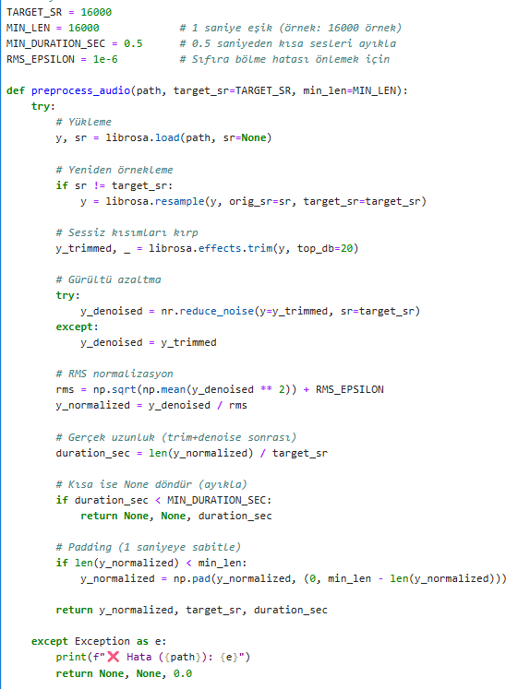
Audio Preprocessing
Preprocessing Pipeline
  Resample to 16kHz if needed
  Trim silent parts using energy-based detection
  Denoise with noisereduce to remove background noise
  RMS normalization to standardize volume levels
  Discard audio files shorter than 0.5 seconds
  Pad short files to a minimum of 1 second duration
  Save all processed files as 16-bit PCM WAVs

Slide 10
Data Augmentation
Why Augmentation?
  To address class imbalance in the Joey-filtered MELD dataset
  To expose models to diverse acoustic variations within each emotion class
  To improve robustness and generalization of ML, DL, and SOTA models
What Was Done?
  White noise addition
  Pitch shifting
  Time stretching
  Volume change
  Time shifting
  Echo addition
  Bandpass & lowpass filtering
  Audio reversal

Slide 11
Feature Extraction
Feature extraction was performed differently for each type of model:
  ML & DL (Torch/Keras MLP) –
    Tools: Librosa, Parselmouth, PyWavelets, Scipy, openSMILE
    Total: ~1480-dimensional feature vectors per sample
    Aggregated via statistical descriptors: mean, std, min, max, skewness, kurtosis
    Feature Groups:
      MFCCs + Δ + Δ² (Cepstral)
      Chroma & Mel Spectrogram (Spectral)
      Spectral contrast, centroid, rolloff, bandwidth
      Pitch (YIN), ZCR, RMS, DFT, Wavelet, TEO
      Voice quality: Jitter, Shimmer, HNR, Formants
      eGeMAPSv01a (OpenSMILE Toolkit)

Slide 12
Feature Extraction cont’d
  DL (CNN, LSTM, BiLSTM, ResNet, EfficientNet) –
    Deep learning models utilized visual and sequential representations extracted from audio signals:
    Tools: Librosa, Matplotlib, PIL, NumPy
    ➤ Techniques:
      Mel Spectrogram (grayscale) (128×128 or 224×224)
      MFCC Image (grayscale) (128×128)
      RGB Fusion: R=MFCC, G=Delta, B=Delta²
      Multi-Input CNN: Parallel MFCC and Mel inputs
      [T, 120] shape: 40 MFCC + 40 Delta + 40 Delta²

Slide 13
Feature Extraction cont’d
  SOTA (Transformer-based Models) –
    Tools: HuggingFace Transformers, torchaudio, PyTorch, Sklearn
    Pretrained Embedding + MLP Classifier
      SSL Models: WavLM, HuBERT, Wav2Vec2
      Audio → Transformer → Frozen Embedding (CLS token or mean-pooled)
      Embedding dim: 768–1024
      Input to separate MLP classifier
    End-to-End Fine-tuned Transformer
      Raw waveform input directly fed into the transformer
      Entire model trained for 7-class emotion classification
      HuggingFace Trainer, Pytorch custom training

Slide 14
Feature Selection & Dimensionality Reduction
To manage the high-dimensional feature space (~1480 features), several feature selection and dimensionality reduction techniques were applied:
Goal: Reduce overfitting, improve generalization, accelerate training
Selected feature sets were saved as CSVs and used across ML and MLP models
Feature Selection Techniques:
  Boruta (RF-based wrapper)
  SelectKBest (Mutual Info)
  Random Forest Importance
  RFE (Recursive Feature Elimination)
  SFFS (Sequential Floating Forward Selection)
Dimensionality Reduction:
  Autoencoder: Learned latent embeddings
  Boruta + Autoencoder
  Boruta + RF
  Boruta + Autoencoder + RF

Slide 15
Undersampling
To address the class imbalance (especially over-represented neutral class), custom undersampling strategies were applied:
ML Models:
  Feature-based undersampling using KMeans on "neutral" vectors
  N representative samples selected via clustering
DL Models:
  PCA + KMeans clustering applied on MFCC/Mel/RGB images
SOTA Models (Pretrained):
  Embedding-level clustering with PCA + KMeans on transformer features
SOTA (End-to-End):
  Random undersampling of N samples (no feature available)

Slide 16
Models Used (ML, DL, and SOTA)
A wide variety of models were implemented to explore different learning paradigms:
Classical Machine Learning (9 Models):
  SVM, Random Forest, XGBoost
  KNN, Bagging Classifier, Gradient Boosting
  Sklearn MLP
  Hard-Voting, Soft-Voting
Each trained with 11 distinct feature sets
Total: 99 models

Slide 17
Models Used (ML, DL, and SOTA) cont’d
Deep Learning (11 Models):
  CNN-based: Mel, MFCC, RGB, Multi-Input
  Transfer Learning: ResNet18, EfficientNetB0
  Sequential: BiLSTM (PyTorch/Keras), CNN-BiLSTM
  Torch/Keras MLP
Torch/Keras MLP trained with 11 distinct feature sets
Total: 31 models

Slide 18
Models Used (ML, DL, and SOTA) cont’d
SOTA Transformers (9 Models):
Pretrained :
  WavLM + MLP: microsoft/wavlm-base-plus
  WavLM + MLP: microsoft/wavlm-large
  HuBERT + MLP: facebook/hubert-base-ls960
  HuBERT + MLP: facebook/hubert-large-ls960-ft
  Wav2Vec2 + MLP: facebook/wav2vec2-large-960h-lv60
  Wav2Vec2 + MLP: ehcalabres/wav2vec2-lg-xlsr-en-speech-emotion-recognition
End-to-End Fine-Tuned:
  WavLM: microsoft/wavlm-base-plus
  HuBERT: facebook/hubert-base-ls960
  Wav2Vec2: facebook/wav2vec2-base
Total: 9 models

Slide 19
Models Used (ML, DL, and SOTA) cont’d
Model Name | HuggingFace Identifier | Feature Dim
WavLM-large | microsoft/wavlm-large | 1024
WavLM-base-plus | microsoft/wavlm-base-plus | 768
Wav2Vec2-large | facebook/wav2vec2-large-960h-lv60 | 1024
Wav2Vec2-SER | ehcalabres/wav2vec2-lg-xlsr-en-speech-emotion-recognition | 1024
HuBERT-large | facebook/hubert-large-ls960-ft | 1024
HuBERT-base | facebook/hubert-base-ls960 | 768
Model Name | HuggingFace Identifier | Strategy
WavLM (Fine-tuned) | microsoft/wavlm-base-plus | PyTorch Trainer
HuBERT (Fine-tuned) | facebook/hubert-base-ls960 | HuggingFace
Wav2Vec2.0 (Fine-tuned) | facebook/wav2vec2-base | HuggingFace

Slide 20
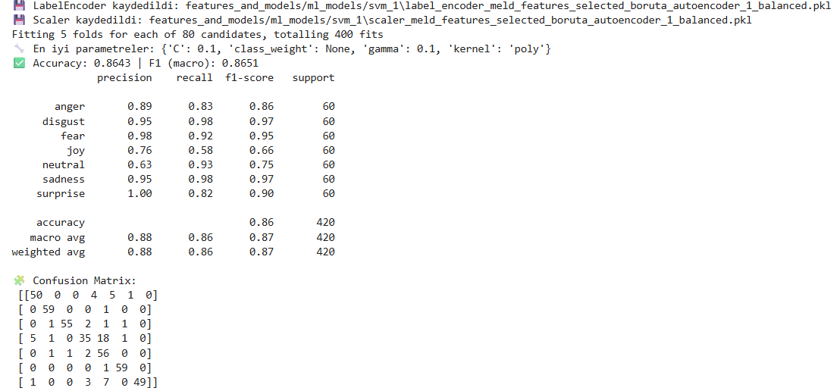
Model Training and Evaluation
ML Training Summary:
  GridSearchCV used to tune hyperparameters (e.g., C, gamma, depth, estimators)
  11 Feature Sets tested across 9 Models
  Evaluation Metrics:
    Accuracy, F1-Score (Macro), Confusion Matrix
    Svm → Boruta + Autoencoder Feature Set

Slide 21
Model Training and Evaluation cont’d
SVM
  High accuracy in Disgust and Fear; weak performance in Joy and Neutral. Best overall ML performance
Soft Voting Classifier
  Strong generalization due to ensemble structure; confusion present in low-arousal classes → Joy and Neutral often confused
Hard Voting Classifier
  Balanced results via model combination. Stable results through model combination; difficult to distinguish Joy and Neutral
XGBoost
  Fast and effective, High performance; strong distinction of Fear and Sadness
Gradient Boosting
  Strong results through detailed hyperparameter search, Effective hyperparameter tuning; difficult to separate Joy
BaggingClassifier
  Solid performance on Sadness and Disgust classes
Random Forest
  Tree-based balance; strong on Sadness, weak on Neutral
KNN
  Proximity-based intuitive classification; strong on Fear, weak on Joy vs Neutral
Sklearn MLP
  Deep learning with handcrafted features; good separation of Disgust

Slide 22
Model Training and Evaluation cont’d
ML Models
Model | Best Feature Set | Accuracy | F1-Macro | Key Parameters (GridSearchCV)
SVM | Boruta + Autoencoder | 86.43% | 86.51% | C=0.1, gamma=0.1, kernel=poly
Random Forest | Boruta | 80.24% | 79.48% | n_estimators=100, max_depth=10
XGBoost | Boruta + Autoencoder | 82.86% | 82.53% | learning_rate=0.05, max_depth=5
KNN | Boruta + Autoencoder | 82.14% | 81.77% | n_neighbors=3, weights=‘distance’, metric=‘euclidean’
Sklearn-MLP | Boruta | 80.24% | 79.52% | hidden=(256,128), solver=adam, learning=adaptive
Gradient Boosting | Boruta | 83.57% | 83.46% | n_estimators=400, loss='log_loss'
Bagging | Boruta | 83.33% | 83.23% | base_estimator=DT(max_depth=5), n_estimators=150
Hard Voting | Boruta | 84.29% | 84.09% | majority vote from top 3 models
Soft Voting | Boruta | 84.29% | 84.13% | probability-based averaging

Slide 23
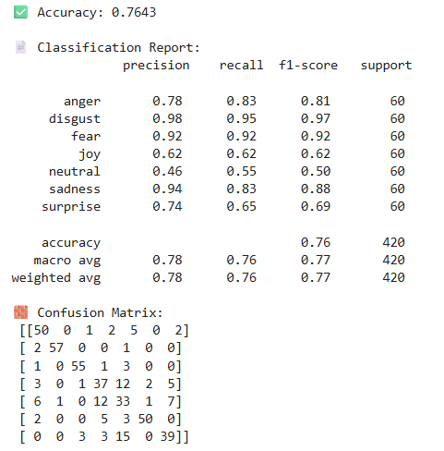
Model Training and Evaluation cont’d
DL Training Summary:
  Image-based CNNs trained on spectrograms or RGB
  MLP trained on advanced handcrafted features
  Transfer Learning models fine-tuned on MELD (Joey subset)
  Regularization:
    Dropout, Batch Normalization, Early Stopping
  Optimizers:
    Adam, SGD, Learning Rate Scheduling
    Cnn-mel spectrogram

Slide 24
Model Training and Evaluation cont’d
Mel-Spectrogram CNN
  Performs well on high-frequency classes; weak on Joy
MFCC-CNN
  Captures short emotional bursts through MFCC representation
RGB-CNN (MFCC + Δ + Δ²)
  Time-frequency-difference representations; Disgust is clearly separated
CNN Multi-Input (Mel + MFCC)
  Multi-input combination; effective for Fear and Sadness
ResNet18 + Mel Spectrogram
  Transfer learning approach; strong separation of Disgust and Fear
EfficientNetB0 + RGB Fusion
  Strong separation with multi-channel input; good performance on Fear and Sadness
BiLSTM (Handcrafted Features)
  Effective temporal tracking; Neutral often confused
Keras BiLSTM / GRU
  Effective for rhythmic patterns; better predictions for Surprise
Torch MLP (Autoencoder Features)
  DL architecture using ML-style features; strong on Disgust and Fear
Keras MLP (Boruta Features)
  MLP supported with feature selection; weak on Joy and Neutral
CNN + BiLSTM (Mel)
  Temporal structure; strong distinction of Surprise

Slide 25
Model Training and Evaluation cont’d
DL Models:
Model | Input Type | Accuracy | F1-Macro | Notes
CNN (Mel Spectrogram) | Mel Image (128x128) | 76.43% | 76.70% | Early stopping, dropout
CNN (MFCC Image) | MFCC (128x128) | 71.90% | 70.85% | Delta + Delta² not used here
CNN (RGB Fusion) | MFCC + Δ + Δ² | 76.90% | 75.82% | RGB Channel Mapping
CNN (Multi-Input) | MFCC + Mel Fusion | 74.05% | 72.92% | Two-branch CNN
ResNet18 (Transfer) | Mel (224x224) | 70.24% | 69.20% | Pretrained on ImageNet
EfficientNetB0 (RGB Fusion) | RGB Image (224x224) | 78.33% | 78.17% | Best DL model (Sadness, Fear ↑)
BiLSTM (Keras) | [T,120] | 77.14% | 77.01% | Bidirectional + Dropout
BiLSTM (Torch) | [T,120] | 76.19% | 75.42% | Torch implementation
CNN + BiLSTM | Mel image → CNN+LSTM | 77.14% | 75.92% | Mixed architecture
Torch MLP | Feature vector | 83.10% | 82.88% | ML-style pipeline
Keras MLP | Feature vector | 58.10% | 57.00% | Comparable to Torch MLP

Slide 26
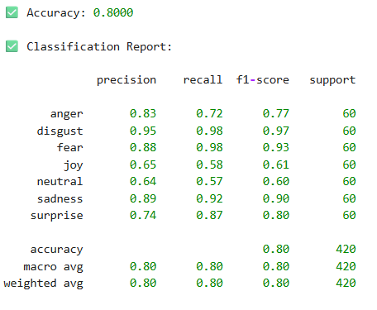
Model Training and Evaluation cont’d
SOTA Training Summary:
  SOTA Models (WavLM, Wav2Vec2.0, HuBERT) used in 2 ways:
    Feature Extraction + MLP
    End-to-End Fine-Tuning
  HuggingFace Transformers used
  Models trained on raw waveform audio
  Accuracy and F1-Score monitored on test set
  Wavlm + mlp → microsoft/wavlm-base-plus

Slide 27
Model Training and Evaluation cont’d
WavLM (Large – + MLP)
  Strong: sadness – Weak: joy and neutral
WavLM (Base+ – MLP)
  Strong: disgust, fear, sadness – Weak: joy and neutral
HuBERT (Base – + MLP)
  Rich representations; high performance on Fear and Disgust
HuBERT (Large – MLP)
  Excellent on Disgust, weak on Joy and neutral
Wav2Vec2.0 (Large – + MLP)
  Weak: joy
Wav2Vec2.0 SER (Pretrained SER)
  Weak: joy, neutral
Wav2Vec2.0 (Base – Fine-tuned)
  Strong: disgust,fear and sadness
HuBERT (Base – Fine-tuned)
  Weak: joy
WavLM (Base+ – Fine-tuned)
  Weak: joy and surprise, Strong: disgust

Slide 28
Model Training and Evaluation cont’d
SOTA Models:
Model Type | Version / Name | Approach | Accuracy | F1-Macro
WavLM | microsoft/wavlm-large | SSL Feature + MLP | 75.29% | 74.66%
WavLM | microsoft/wavlm-base-plus | SSL Feature + MLP | 80.54% | 80.12%
Wav2Vec2.0 | facebook/wav2vec2-large-960h-lv60 | SSL Feature + MLP | 63.10% | 61.00%
Wav2Vec2.0 SER | ehcalabres/wav2vec2-lg-xlsr-en-speech | SSL Feature + MLP | 55.11% | 53.94%
HuBERT | facebook/hubert-large-ls960-ft | SSL Feature + MLP | 69.05% | 69.12%
HuBERT | facebook/hubert-base-ls960 | SSL Feature + MLP | 76.19% | 76.03%
HuBERT | facebook/hubert-base-ls960 | End-to-End Fine-tune | 66.43% | 66.20%
WavLM | microsoft/wavlm-base-plus | End-to-End Fine-tune | 54.52% | 54.01%
Wav2Vec2.0 | facebook/wav2vec2-base | End-to-End Fine-tune | 77.86% | 77.60%

Slide 29
Prediction and Experimental Results
ML Prediction Pipeline (Classical Machine Learning)
  Total models: 9 algorithms × 11 feature sets = 99 configurations
  Feature extraction: Advanced handcrafted features (MFCCs, pitch, spectral, ZCR, jitter, shimmer, wavelet, formants, TEO, GeMAPS)
  Feature selection: Boruta, RFE, Autoencoder, RF Importance
  Model loading: .pkl files for model, scaler, and label encoder
  Prediction: Each test file was transformed and passed to the model; soft voting averaged probabilities
  Evaluation: CSV outputs, confusion matrices, and classification reports generated
  Test set: 264 utterances
  Output: Prediction CSVs + Confusion Matrices + Class-wise F1-scores

Slide 30
Prediction and Experimental Results cont’d
ML Prediction Results
  Best accuracy: SVM – 98.11%, F1-macro: 98.67%
  Other strong models: Soft Voting (94.32%), Gradient Boosting (93.56%), XGBoost (93.94%)
  Top features: Boruta and Boruta + Autoencoder yielded highest performance
  Class-wise Highlights:
    Strongly predicted: Fear, Disgust, Sadness, Anger
  Challenging classes:
    Joy: Often confused with neutral
    Neutral: Misclassified in RF, KNN (recall as low as 71%)
  SVM: Near-perfect, only one error
  RF & KNN: Struggled with neutral → misclassified as joy/sadness
  Soft Voting: Most balanced; F1 > 0.88 for all classes
  Boruta + AE combinations improved generalization

Slide 31
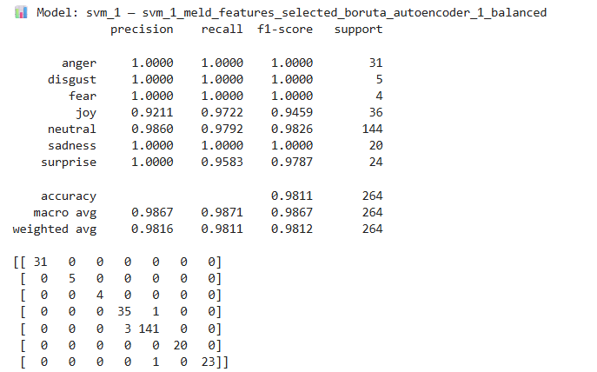
Prediction and Experimental Results cont’d
ML Predict Results
Model | Feature Set Used | Accuracy (%) | F1-macro (%)
SVM | Boruta + Autoencoder | 98.11 | 98.67
Random Forest | Boruta | 87.12 | 85.22
XGBoost | Boruta | 93.94 | 92.78
K-Nearest Neighbors | Boruta ∩ RF | 83.71 | 78.31
MLP (sklearn) | Boruta | 87.88 | 85.06
Gradient Boosting | Boruta | 93.56 | 95.81
Bagging Classifier | Boruta + Autoencoder | 91.29 | 87.45
Hard Voting Classifier | Boruta | 87.88 | 85.96
Soft Voting Classifier | Autoencoder | 94.32 | 94.84

Slide 32
Prediction and Experimental Results cont’d
DL Prediction Pipeline (Deep Learning)
  Total models: 11 DL models (CNNs, BiLSTM, CNN-BiLSTM, MLPs)
  Input formats:
    CNNs: Spectrogram or MFCC images (128×128 or 224×224)
    BiLSTM: Sequential MFCCs + delta + delta² (padded to fixed length)
    MLPs: Handcrafted features + selection (Boruta/Autoencoder)
  Model loading:
    Keras .h5 or PyTorch .pt models
    label_encoder.pkl used for all predictions
  Prediction process: Model-specific preprocessing → scaling → reshaping → inference
  Evaluation: Predictions saved as CSVs; confusion matrices and reports visualized
  Test set: 264 utterances
  Output: Prediction CSVs + Confusion Matrices + Metrics

Slide 33
Prediction and Experimental Results cont’d
DL Prediction Results
  Best accuracy: BiLSTM – 91.29%, F1-macro: 92.45%
  Other strong models: CNN (Mel) – 89.02%, Keras-MLP – 85.98%, CNN+BiLSTM – 77.65%
  Weakest models: CNN-RGB (65.91%), CNN Multi-Input (62.12%)
  Class-wise Highlights:
    Best predicted: Fear, Disgust, Sadness
  Struggled classes:
    Joy: Misclassified as Neutral or Surprise
    Neutral: High recall but low precision in RGB-based models
  CNN-RGB & Multi-Input: High confusion between Joy–Neutral, Surprise–Joy
  1D sequential inputs (BiLSTM, MLP) outperformed image-based models

Slide 34
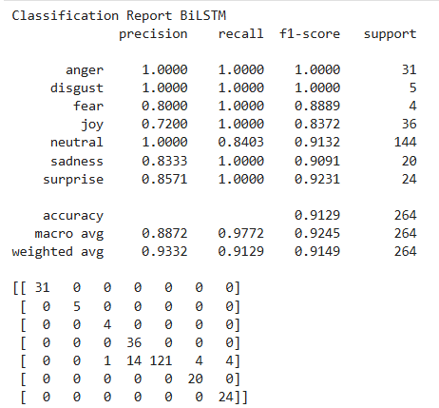
Prediction and Experimental Results cont’d
DL Predict Results
No | Model | Input Type | Accuracy | F1-Macro
1 | CNN (Mel) | Mel Spectrogram (128×128) | 89.02% | 89.20%
2 | CNN (MFCC) | MFCC Spectrogram (128×128) | 87.12% | 84.06%
3 | CNN (RGB Fusion) | RGB Fusion (128×128) | 65.91% | 61.13%
4 | CNN (Multi-Input) | MFCC + Mel Dual Input | 62.12% | 55.79%
5 | ResNet18 (Mel) | Mel Spectrogram (224×224) | 75.00% | 74.50%
6 | EfficientNetB0 (RGB) | RGB Fusion (224×224) | 79.17% | 77.72%
7 | BiLSTM | Acoustic Features (1D) | 91.29% | 92.45%
8 | Keras-BiLSTM | Acoustic Features (1D) | 71.97% | 68.92%
9 | Torch-MLP | Handcrafted Features | 78.41% | 76.21%
10 | Keras-MLP | Handcrafted Features | 85.98% | 85.48%
11 | CNN + BiLSTM | Mel Spectrogram (128×128) | 77.65% | 75.22%

Slide 35
Prediction and Experimental Results cont’d
SOTA Prediction Pipeline (Transformer-Based Models)
  Total models: 9
    6 with frozen embeddings + MLP classifier
    3 fine-tuned end-to-end transformers
  Input: Raw .wav (16kHz) processed with Torchaudio + HuggingFace APIs
  Pretrained models: Extracted embeddings using AutoModel; passed to trained MLP
  Fine-tuned models: End-to-end classification using Wav2Vec2, HuBERT, or WavLM
  Model loading: from_pretrained() + .eval() + .to(device)
  Prediction: Logits → softmax → predicted label (argmax)
  Evaluation: Results saved as CSVs; confusion matrices and reports computed
  Test set: 264 utterances
  Output: CSVs + Confusion Matrices + F1-scores

Slide 36
Prediction and Experimental Results cont’d
SOTA Prediction Results
  Best model: Wav2Vec2.0 (fine-tuned) – Accuracy: 84.09%, F1-macro: 79.73%
  Other top models: WavLM (Large + MLP), HuBERT (Large + MLP), HuBERT (Fine-tuned)
  Lower performers: WavLM (Fine-tuned) – F1-macro: 49.53%
  Class-wise Highlights:
    Strongest emotions: Disgust, Fear, Sadness
    Neutral: Precision high in MLP-based models, recall lower in some fine-tuned ones
    Weakest: Joy and Surprise – often confused with Neutral or each other
  HuBERT Fine-tuned: Strong predictions for Sadness, Surprise
  WavLM Fine-tuned: Confused Joy and Fear with Neutral
  Fine-tuning improves performance, especially for nuanced emotions
  Imbalanced classes (e.g., Disgust, Fear) were predicted well by robust models

Slide 37
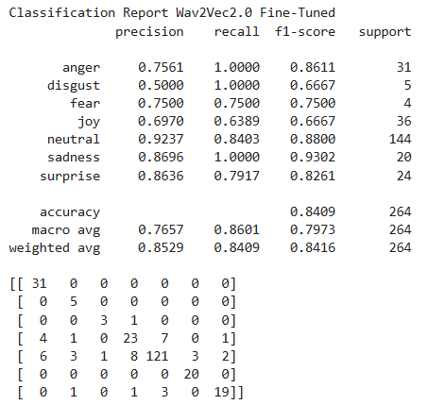
Prediction and Experimental Results cont’d
SOTA Predict Results
No | Model | Accuracy (%) | F1-macro (%)
1 | WavLM (Large) + MLP | 82.95 | 79.11
2 | WavLM (Base+) + MLP | 76.89 | 72.58
3 | Wav2Vec2.0 (facebook/960h) + MLP | 70.45 | 66.64
4 | Wav2Vec2.0 (ehcalabres) + MLP | 65.15 | 63.36
5 | HuBERT (Large) + MLP | 77.27 | 74.18
6 | HuBERT (Base) + MLP | 76.14 | 73.49
7 | HuBERT (Fine-tuned, PyTorch) | 77.65 | 79.45
8 | WavLM (Fine-tuned, PyTorch) | 63.64 | 49.53
9 | Wav2Vec2.0 (Fine-tuned, PyTorch) | 84.09 | 79.73

Slide 38
GUI Interface (Real-time Deployment)
A user-friendly PyQt5-based GUI was developed for real-world deployment.
Allows users to load audio files and run emotion recognition using trained ML, DL, or SOTA models.
Includes:
  Dropdown menus for selecting model type and feature set
  File selector for uploading .wav audio files
  Buttons for prediction and exporting results
Automatically performs:
  Feature extraction
  Preprocessing
  Model loading based on user selection
Supports real-time predictions with emotion output and confidence scores.
Designed for easy extension, with modular backend scripts for each model type.

Slide 39
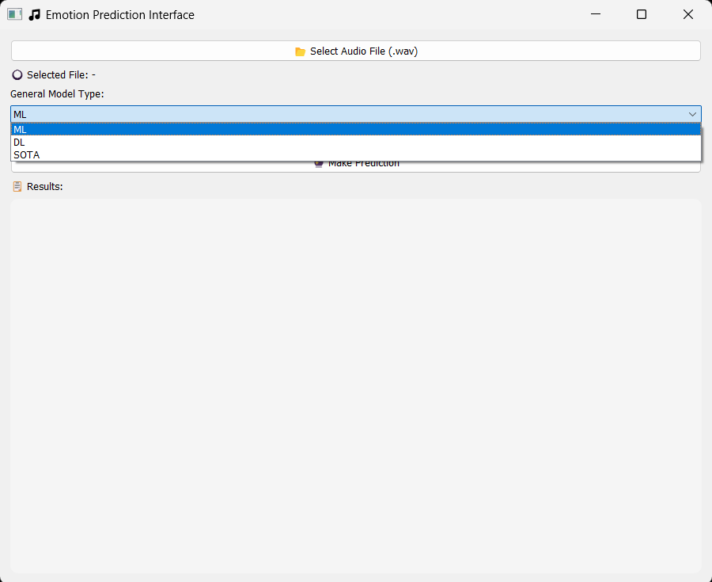
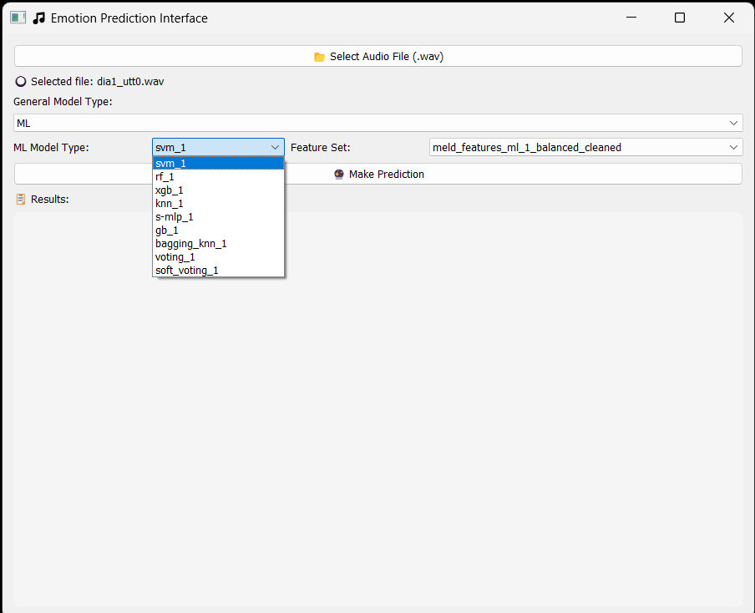
GUI Interface (Real-time Deployment) cont’d

Slide 40
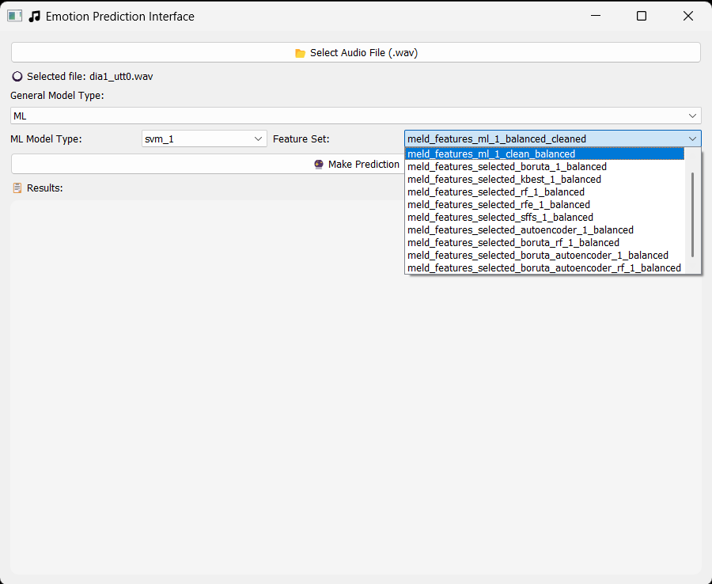
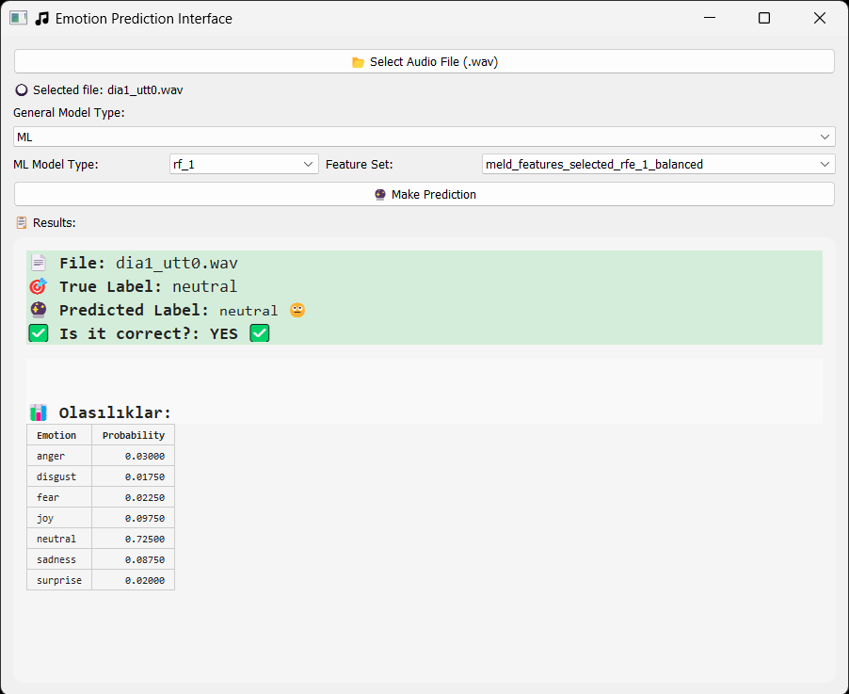
GUI Interface (Real-time Deployment) cont’d

Slide 41
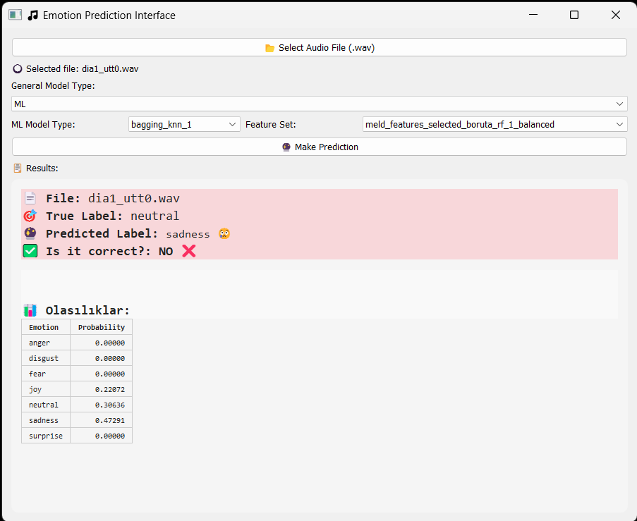
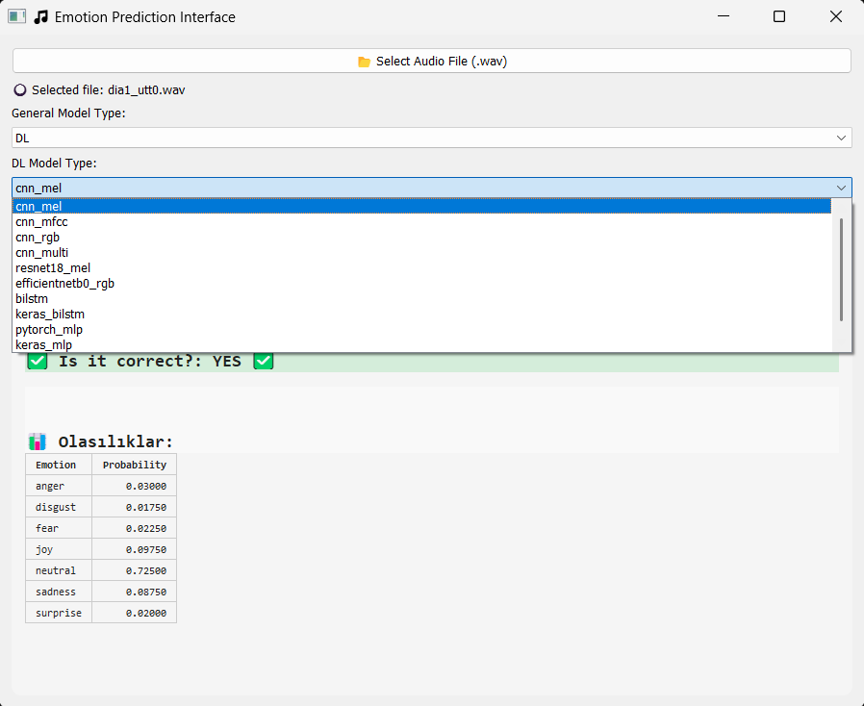
GUI Interface (Real-time Deployment) cont’d

Slide 42
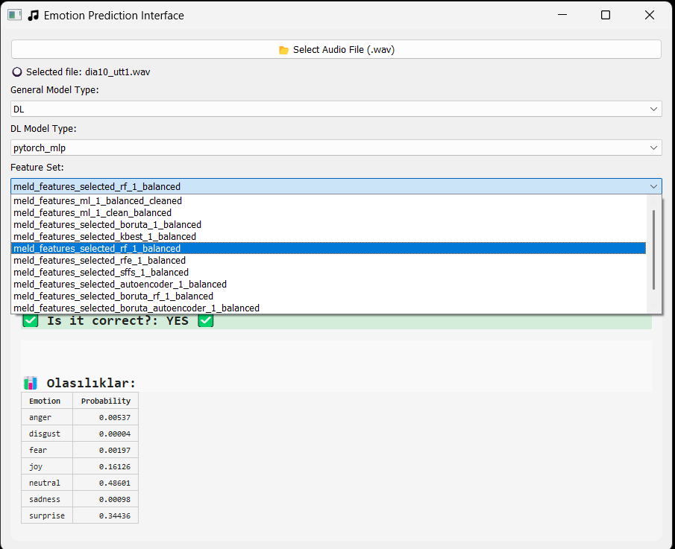
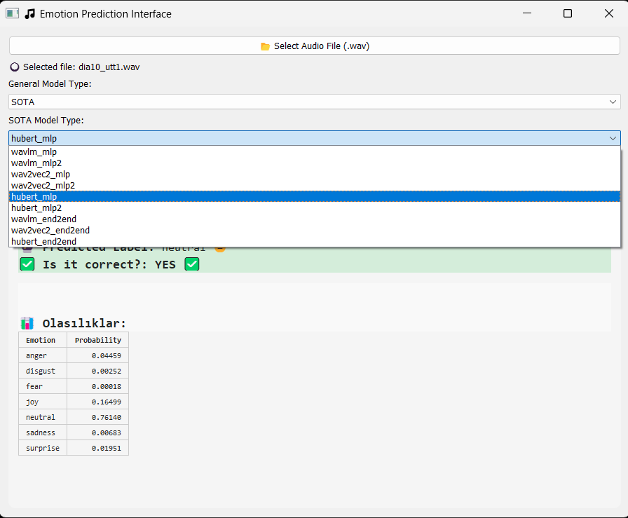
GUI Interface (Real-time Deployment) cont’d

Slide 43
Tools, Libraries, and IDEs Used
Programming Language
  Python 3.9+
Core Libraries
  NumPy, Pandas – data handling
  Librosa, SoundFile – audio processing
  Scikit-learn – ML models, feature selection
  Joblib – model saving/loading
  Matplotlib, Seaborn – visualization
Machine Learning & Deep Learning
  Scikit-learn – classical ML algorithms
  TensorFlow / Keras – MLP, BiLSTM models
  PyTorch – CNNs, BiLSTM, MLP, hybrid models
SOTA / Transformers
  Hugging Face Transformers – Wav2Vec2, WavLM, HuBERT
  Torchaudio – audio loading & processing
  Hugging Face Datasets & Tokenizers
Speech & Transcription
  OpenAI Whisper – speech transcription
  PyAnnote-Audio – speaker diarization
  ffmpeg-python – audio extraction from video
GUI Development
  PyQt5 – graphical interface
  OS / Glob / Sys – file and path handling
IDEs and Development Platforms
  Google Colab –
    Whisper transkript + pyannote diarization
    training SOTA models
  Jupyter Notebook – all operations
  Spyder – gui development

Slide 44
Conclusion and Future Work
Conclusion
  A robust speech emotion recognition (SER) system was developed using the MELD dataset (Joey subset).
  Implemented ML, DL, and SOTA transformer models, with extensive preprocessing, feature engineering, and data balancing.
  Best overall results:
    SVM (98.11% accuracy, ML)
    BiLSTM (92.45% F1, DL)
    Fine-tuned Wav2Vec2.0 (84.09% accuracy, SOTA)
  GUI interface enabled real-time emotion prediction from audio files using any trained model.
  Experimental results demonstrated strong performance on high-arousal emotions (fear, disgust, sadness), but difficulty in classifying joy and neutral.
Future Work
  Integrate multimodal emotion recognition using audio + text + visual inputs.
  Extend dataset beyond a single speaker (Joey) to improve generalizability.
  Deploy the system as a web application or mobile app for real-world use.
  Experiment with newer SSL models (e.g., SeamlessM4T, SpeechT5) for further performance gains.

Slide 45
Acknowledgements & Q/A
I would like to express my gratitude to my advisor, Dr. Özlem ÖZTÜRK, for her availability and encouragement during the project.
Special thanks to the open-source community and developers of key tools like:
  Whisper, PyAnnote, Hugging Face Transformers, and others
I am grateful for the authors of online tutorials, blogs, and academic resources that helped deepen my understanding of Speech Emotion Recognition (SER).
                Any Questions?

