Slide 1

Πανεπιστήμιο Θεσσαλίας
Εργασία 3^{η}
Δικτυακό σύστημα αρχείων
ΟΜΑΔΑ 1
Καρανίκα Αθανασία 2530
Λευκοπούλου Ελένη Μαρία 2557
Εαρινό εξάμηνο 2020-2021

Slide 2
Περιεχόμενα
Client
Hidden memory
Server
Init
Open
Read
Write
Seek
Truncate

Slide 3
Client
Client app
Client api
Client files class
Structures in client api

Slide 4
Client app
You can call the functions that api provides with the following ways :
Init : I <cacheblocks> <blocksize> <freshT>
Open : O <filename> <flags> returns an fd
flags can be : O_CREAT, O_EXCL, O_TRUNC, O_RDWR, O_RDONLY, O_WRONLY
Read : R <fd> <number_of_bytes> returns the number of readden bytes
Write : W <fd> <data_to_write> return the number of bytes that is written
Seek : S <fd> <offset_to_move> <frag to whence> return 0 in success and -1 in failure
flags can be : SEEK_SET, SEEK_END , SEEK_CUR
Truncate : T <fd> <new_file_size> return the new size of file
Close : C <fd>

Slide 5
Client api
Has lists for the different types of requests(read_request , write_request, truncate_request , seek_request).
Has a sequent number (seqno) that is increasing and corresponds to each request (it is used as identifier to understand when a retransmit happen).
Has a list for the open files with specific information about the name of the file , the corresponding code name for the api layer , the number of fd which is returned to the app layer and the flags.
Has a thread that runs read_from_socket() function. This function receive the messages that are sent from server and analyze the information based on the type of the message.
If someone call a function with wrong fd the function returns without send any message to server

Slide 6
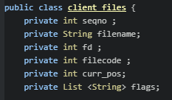
Client files class
Seqno : take the seqno of the open request
Filename : the name of the file that the client has open
Fd : the file descriptor that client use to call thee different functions
Filecode : the code name of the file . Is an int which resulting from the compination of current version of server and a counter that server increases. This filecode is received from server after an open message.
Curr pos : the current position in the file
Flags : the properties that the client ask when he open the file

Slide 7
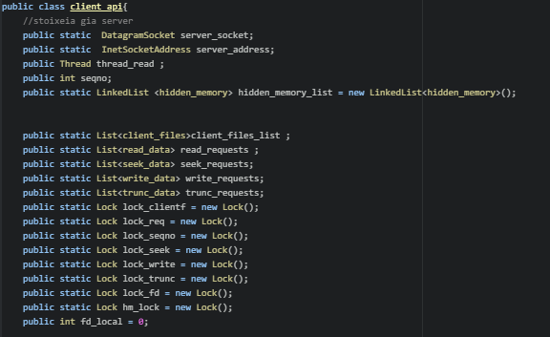
Structures in client api

Slide 8
Hidden memory
Hidden memory in client
Meaning and use of hidden memory

Slide 9
Hidden memory in client
Client has a hidden memory as a list.
The hidden memory size is initialized from user when the program start.
Every time that memory is full we use FIFO (first in first out) to through one block and add the new one.
Into the class of the hidden memory we keep into about the number of block of a file. This number is calculated based on the blocksize that user give on the beginning.

Slide 10
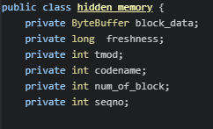
Hidden memory class
Block_data : here is keeped the bytes from a block
Freshness : the time of the last update
Tmod : the version of the file from which I have the data
Codename : the code name of the file
Num_of_block : number of the block hat is saved

Slide 11
Meaning and use of hidden memory(1/2)
The meaning of hidden memory is to keep in store some of the blocks that we have used in the past and when we need them again if is not expired use it from memory instead of the server send it again and again.
What about the freshness ? In hidden memory we keep the last time that server inform us about this block.
When the client need that data again check if there is in memory and if they are look if current_time – last_update_time > freshT.
If it is that means that maybe the data is expired. So send a message to server and ask if tmod(the number that equals to the version of the file ) is right .
The server answer with ok if the tmod is the same and the client use the data from memory but if the tmod is different the server send the new tmod + the new data.

Slide 12
Meaning and use of hidden memory(1/2)
If current_time – last_update_time < freshT then the client use the data directly from hidden memory.
The lower the freshT the greater the validity of the data. That means that if for example the freshT is 0 we get the newest data every time but we load more the server with out request. In the other hand if the freshT is very big we might read old data without understand it.
From the server side …we keep for each file a tmod and every time that someone write or truncate the file we increase it.

Slide 13
Server
SERVER API
Server Sturctures

Slide 14
Server api
The server receive messages from client
Open files , read from them or write to them , truncate them .
Make client believes that is his own file system , but in reality is a distributed remote file system based on the server host.
Has a thread which run the read _from_socket_function()
Keep info about the files that have open with the filename and the codename that has send to the clients and also the tmod which is the number of last version of the file.
The communication is with udp so the client resent the messages until he get response.
The client is possible to receive an answer more than one time but he is capable of understand that this is an answer for retransmition and ignore it

Slide 15
Server api functions
Init() : Create or open a file if exist to read the current version and then write to file the new version and initialize the socket for the communication.
read_from_socket() : Reading the messages from client and analyzing them based on the type .

Slide 16
Init
INIT CLIENT SIDE

Slide 17
Init client side
Init function is useful because give the opportunity to the user to choose the chacheblock the blockize and the freshT.
In this way it is easy to do more experiments and measurments about the data that is used each time and the messages that are send in each situation.
The init also initialize the socket with an ip and a port ant make the client capable to communicate with the server.

Slide 18
Open
Open client side
Open server side

Slide 19
Open client side(1/2)
int mynfs_open(String filename, List <String>flags)
type | Open_seqno | Filename_length | Num_of_ flags | filename | flags
1 byte | 4 bytes | 4 bytes | 4 bytes | 1*filename_length bytes | 4 * num_of_flags bytes
Type is O.
The seqno is an increasing number for client requests
Flags are converted to a corresponding ints so to the server we send a list of ints not a list of strings.

Slide 20
Open client side(2/2)
Every time that myfns_open is called the api add a new client_file node and wait until the field of codename take a value.
If it do not take value for a specific time we resend the open message to the server.
Returns an fd to the app layer which is an int >0 or -1 in failure.
The thread that receive the open response put the data in the node from list that we keep info for files.
The current position is set to 0.

Slide 21
Open server side(1/2)
Check if file exist
If exist and client has gave O_CREAT and O_EXCL → failure’
Else check if exist already in the list with open files , if is already open take the data from the node else open the file with RandomAccessFile
Create a new codename for this file
If the file does not exist and client has gave O_CREAT → success and create a file with a given filename else →failure
If a failure come of on the opening or on the creating the servevr return to client a failure code.

Slide 22
Open server side(2/2)
type | codename | seqno
4 bytes | 4 bytes | 4 bytes
Type is O .
Codename is the combination of version and a number
If an error occur codename is set to -1
Seqno is the characteristic number for the request.

Slide 23
Read
Read client side
Read server side

Slide 24
Read client side (1/2)
Calculate in which block the information are.
If he do not have this block on memory or if the freshness has expired he send message to the server to ask these blocks.
If we has the block in memory and it is not expired take the data .
If a response do not come in a specific time send the request again.

Slide 25
Read client side (2/2)
int mynfs_read(int fd ,rw_data data)
type | seqno | codename | start_position | num_of_bytes
1 byte | 4 bytes | 4 bytes | 4 bytes | 4 bytes
Type is R .
Start position is the position in file from which the server will start read.
Num of bytes is the number of bytes that we want the server read.
This message is send when we do not have a block in hidden memory.

Slide 26
Read server side (1/2)
Type is R in every situation
type | seqno | Readden bytes number | tmod
1 byte | 4 bytes | 4 bytes | 4 bytes
In first case readden bytes are 0 . That means that the position that the client wants is out of the length of the file.
The tmod is the last version of the file.
type | seqno | Read bytes number
1 byte | 4 bytes | 4 bytes
In this situation the read bytes is set to -1 and it means that an error occur on read
So the client api will also return -1 to user.

Slide 27
Read server side (1/2)
type | seqno | Read bytes number | tmod | data
1 byte | 4 bytes | 4 bytes | 4 bytes | 1byte *read bytes number
In this case is when the bytes have been readden right .
The read bytes is the number of the bytes that have been readen.

Slide 28
Mod message client side
type | seqno | codename | start_position | Num_of_bytes | tmod
1 byte | 4 bytes | 4 bytes | 4 bytes | 4 bytes | 4 bytes
Type is M .
Start position is the position in file from which the server will start read.
Num of bytes is the number of bytes that we want the server read.
Tmod is the version of the file from which we keep the data .
This message is send when the freshness is expired but the data is in memory.

Slide 29
Mod message server side(1/2)
Type is M in every situation .
type | seqno | tmod | readden_bytes
1 byte | 4 bytes | 4 bytes | 4 bytes
In this case tmod is 0 and readden bytes is -1 and that means that the current tmod is the same with this that client send us so we just send a confirmation
type | seqno | tmod | readden_bytes
1 byte | 4 bytes | 4 bytes | 4 bytes
In this case tmod is equal to the current tmod and readden bytes is 0.
That means that the client wants data out of the file length. (maybe some truncate happen and the client have still the old data)

Slide 30
Mod message server side(2/2)
type | seqno | tmod | readden_bytes
1 byte | 4 bytes | 4 bytes | 4 bytes
In this case tmod is equal to -1 and readden bytes equals to -1.
That means that the tmod that client send us is from an older version but an error occur on read so return -1.
type | seqno | tmod | readden_bytes | data
1 byte | 4 bytes | 4 bytes | 4 bytes | readden_bytes *1 byte
In this case tmod is the current tmod and readden bytes is the bytes that we return to the client.

Slide 31
Write
Write client side
Write server side

Slide 32
Write client side
Type | seqno | codename | Write pos | datasize | data
1 byte | 4 bytes | 4 bytes | 4 bytes | 4 bybtes | 1byte * datasize
Type is W.
Write pos is the position from which we want start to write.
Data is the data that we want to write to the file
And datasize their length

Slide 33
Write server side
Type | seqno | datasize
1byte | 4bytes | 4 bytes
Type is W.
Datasize is the size that have been written

Slide 34
Seek
Seek client side
Seek Server side

Slide 35
Seek in client side(1/2)
When the app want to do seek and call the mynfs_seek :
If the whence is SEEK_SET or SEE_CUR the client do the calculation locally and set the current position to the right new position and later when he want to read or to write he has this position as start.
On the other hand if the whence is SEEK_END he must communicate with the server because he do not know the current size of the file .

Slide 36
Seek in client side(2/2)
int mynfs_seek(int fd , int how , String whence)
type | seqno | codename
1 byte | 4 bytes | 4 bytes
Type is S .
Seqno is the characteristic number for the request
Codename is the combination of version and a number
If an error occur codename is set to -1

Slide 37
Seek server side
type | seqno | File_length
1 byte | 4 bytes | 4 bytes
Type is S.
Seqno is the characteristic of the file
File length is the size of the file

Slide 38
Truncate
CLIENT SIDE
Server Side

Slide 39
Client side truncate
mynfs_ftrancate(int fd, int len)
type | seqno | codename | length
1 byte | 4 bytes | 4 bytes | 4 bytes
Every time that client wants to truncate a file he must send a message to the server with the final bytes that the file will have.
To make a successful truncate the client should have open the file with O_TRUNC
Type is T.
Length is the wanted size

Slide 40
Truncate on the server side
type | seqno | number
1 byte | 4 byte | 4 bytes
The server truncates the file when he receives a message with type T and respond.
Type is T.
Number is 0 if the truncate is successful .

Slide 41
Server shut down
WHAT happens ?

Slide 42
What happens when the server shut down?
The codename is a combination of version of server combined with a single number that increased.
Every time that server is down and then is up again the client keep sending some requests.
When the client decode the filecode and understand that the request is from another version of him send an error message to client api.
The api reopen the file and then do the request again.
All these happened without the use(app) understand that the server was down foe some time.

Slide 43
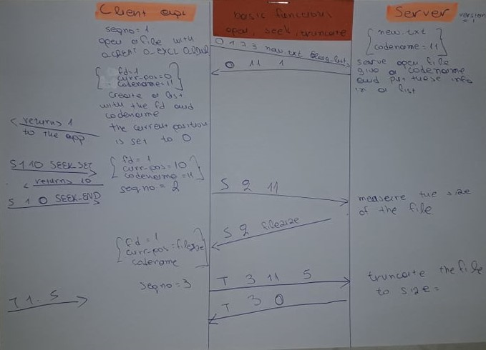

Slide 44
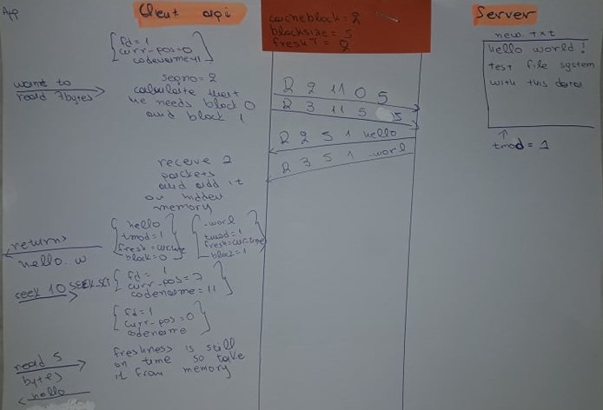

Slide 45
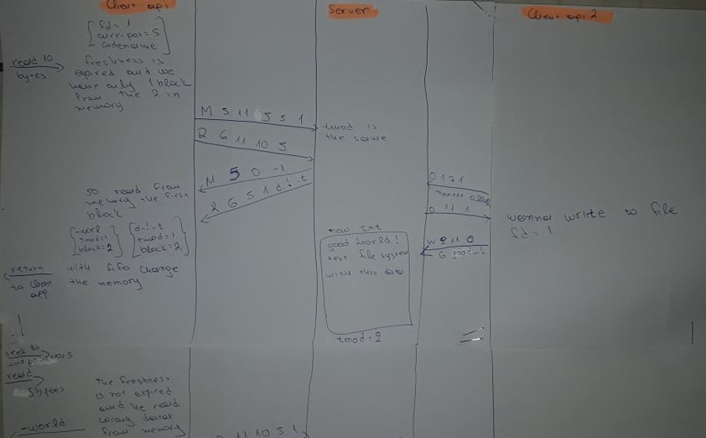

Slide 46
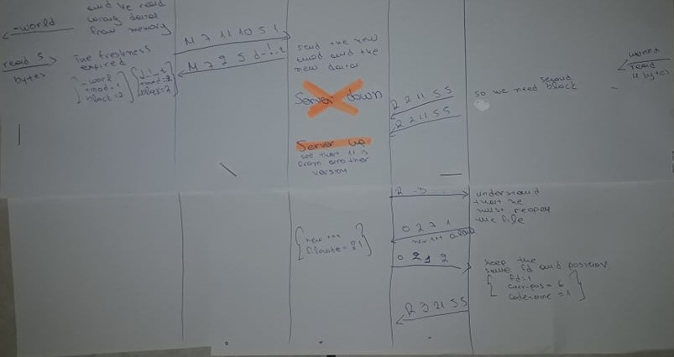

Slide 47
END

