Slide 1

Πανεπιστήμιο Θεσσαλίας
Εργασία 4^{η}
Περιβάλλον κατανεμημένης εκτέλεσης με διαφανή μετανάστευση και εξισορρόπηση φορτίου
ΟΜΑΔΑ 1
Καρανίκα Αθανασία 2530
Λευκοπούλου Ελένη Μαρία 2557
Εαρινό εξάμηνο 2020-2021

Slide 2
Περιεχόμενα
Compiler
Coordinator
Run
List
Kill
Migrate
Print
Send
Load Balance

Slide 3
Main.java
This is the main program. Each “client” run the Main.java in which the compiler code exists.

Slide 4
Functions of main program
read_from_socket() : This function is running from a thread and waiting for the messages that a client may send to another client . The messages have specific types and are either for acknowledgment or for info/messages for the migrated threads.
read_from_coor_socket() : This function is also run from a thread and receiving the number for a new team that is created.
compilation_run() : This is the function that is used to compile and run the programs that user want to run.
main(): In main we init the lists and the sockets and the locks. Then a while loop run and scanner from terminal the commands that user give.

Slide 5
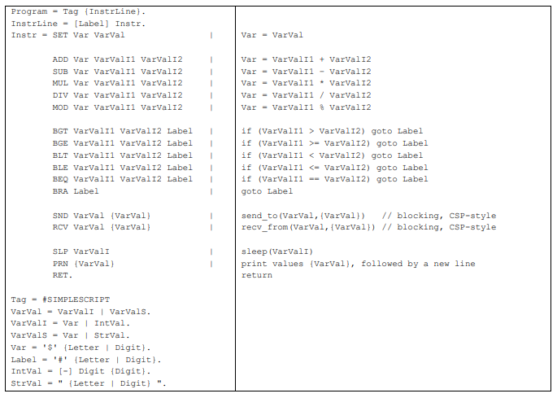
Compiler(1/2)

Slide 6
Compiler(2/2)
Based on the previous image about simplescript language the compiler check if the code has syntax errors and execute it.
If there is an error the compiler prints the line in which the error occurs.
Some of the basics things that the script must have is :
The #SIMPLESCRIPT as header .
Do not have more variables or less than a instruction needs.
Do not have a string instead of number.
Do not goto to a label that does not exist
There is a list with the variables that are created and the values that they take while the program is running. The arguments of the program are also kept in this list so every time that someone wants to use either a variable or an argument we search in this list.
There is also a list that every time that a new label is detected we keep the line and the name of the label so if a goto is read we seek the filedescriptor to the appropriate position.

Slide 7
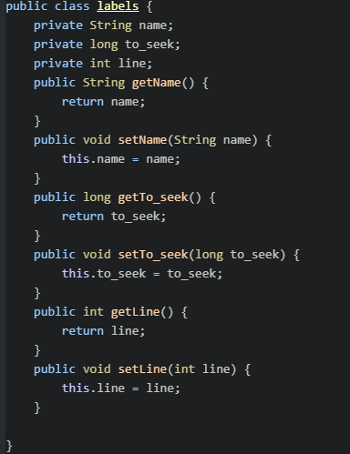
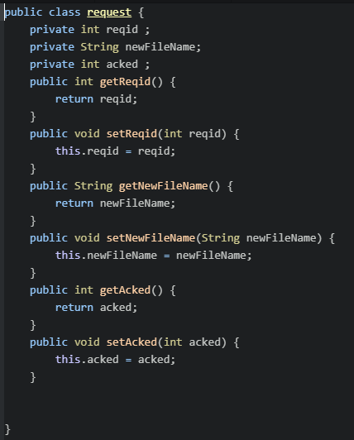
Classes
This class is useful for the labels
This class is useful for the request that we send while a migration happens .
When we receive an ack the field for acks is change value and we can stop the retransmitions.

Slide 8
COORDINATOR
This program is running all the time and every time that someone wants to create a new team send to him a message to take the right number for the new team.

Slide 9
Team message from the client side
type
1 byte
Type is T. Is the characteristic message that is send to coordinator to take back a team number.
This situation with the coordinator that he must give us a number for the new team is helpful because when the migrations will begin we do not want to have the same numbers for 2 different teams.

Slide 10
Team message from the coordinator side
type | Team_code
1 byte | 4 bytes
Type is T.
Team_code : is the code for the new team and is increasing every time that a new message is arrive.

Slide 11
RUN run <progname1> <arg1> … <argN> || <progname2> <arg1> … <argN> || … || <progname3> <arg1> … <argN>
You can give the 2 following commands :
run program1 arg1 arg2 : run the progam1 with arguments arg1 and arg2
run program2 arg1 || program3 : run program2 with arg1 and program3 without arguments

Slide 12
What happens when a run command is detected ?
Every time that a new run command is detected is splited at || and a new thread is created for each program that we want to send.
A new team is created and is added on team_list with the team_code that coordinator send us.
Into the team node a list for team members is created .
Each new thread is added into the list and take a thread_code that is an increasing number for members starting from the 0 every time that a new team is created.
The node for each thread has the appropriate information for the running code the thread_code ,the ip address and others.

Slide 13
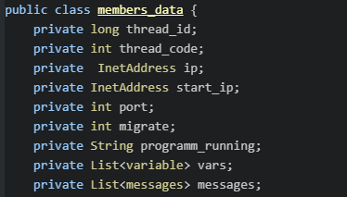
Members data class
Thread_id : the system thread_id.
Thread_code : an increasing numbers for the threads that belongs to a team.
Ip : the current ip that a thread runs to.
Port : the current port that a thread run to.
Start_ip : the ip of the amchine that wants to run this code…before a migration happen.
Start_port : same as start_ip.
Migrate : is 0 if the number is migrated to another machine and 0 if the thread run to the current machine.
Programm_running : the name of the file that the code that thread run is at.
Vars : a list with the variables of the program .Is inited only when a migration is happened.
Messages : a list with the messages that is send to the specific thread

Slide 14
LIST
list : the list command print the threads that running now in this machine with their team code and thread_code.

Slide 15
How the program knows which are the current active threads ?
There is the team list and every time that someone type list the program iterate the team list and for each node iterate the member list.
If for a member the migrate is one that means that the current thread of team is migrated to another machine.
If is 0 we print his information.

Slide 16
KILL
kill < team_id> : With this instruction we give the signal to kill all the threads of this team.

Slide 17
What happen when a kill command is read?
We call the kill_add(team_code) function in which :
We find the team node on the list and we iterate the members list.
If the migrate field is zero just kill the thread with thread_id(id that system has gave tot thread)
If the migrate field is 1 we send a message to the team that the thread is migrated.
The kill function is also called when a thread have an error on a line of code … to be more specific if a thread failed to end the program all the team must die.
After killing all the threads remove the node from the list.

Slide 18
Kill message
typev | seqno | Team_code
1 byte | 4 bytes | 4 bytes
Type is K.
Find the team with code = team_code and kill the treads that is running on this machine. Then remove the team from the list.
Send a k message as an acknowledgment .

Slide 19
Kill acknowledgment
type | seqno
1 byte | 4 bytes
Type is k.
When we receive a message k we search the request list and change the field for acks to 1

Slide 20
MIGRATE
migrate <team_code><thread_code><ip_to><port_to> : This command is for migrate a specific thread for a specific team to another machine with the given ip and the given port and to continue running the code from the right line.

Slide 21
What happens when a thread migrate ?
First of all we need to send some information to the new host.
We send the filename and we waiting until get an ack.
If the filename existing on the new host he create a new file with a new filename and respond us with this else he create a new file with the given filename and send the filename just for ack.
Then we send the code of the file with purpose to be written on the new file that the host has created.
And then we send data like information for the team of the migrated team the line in which the running has reach and a list with variables and their values at the time that the thread migrated.
When a thread migrate we change also on list the migrate field to 1 and also the ip and the port to know where to send the kills or the sends.
When all the data have been send we return from the thread in the starting host and the new host create a thread to keep running the code for th right line.

Slide 22
File message
type | seqno | Filename_length | filename
1 byte | 4 bytes | 4 bytes | Filename_length*1
Type is F.
Filename is the filename of the code that the thread on the starting host running and we request the new host to create a file with this name

Slide 23
File acknowledgment
type | seqno | Filename_length | filename
1 byte | 4 bytes | 4 bytes | Filename_length*1
Type is f.
The filename is either the filename that the starting host send to us or the new filename which is a combination of the team_code ip and has the suffix that the requested filename has.

Slide 24
Code message
type | seqno | Filename_length | number_of_bytes | flag | filename | data
1 byte | 4 bytes | 4 bytes | 4 bytes | 1 byte | Filename_length*1 | 1byte * number_of_bytes
Type is C.
Flag is 0 if it is not the last block of code and 1 if it is the last.
Data is the bytes of the code file.
We send the bytes into block … we put bytes ubtil we fill 1024 bytes of packet and if we reach 1024 we send the next packet as a next block.

Slide 25
Code acknowledgment
type | seqno
1 byte | 4 bytes
Type is c.

Slide 26
Migrate message
type | seqno | Filename_length | number_of_bytes | line | position | filename | data
1 byte | 4 bytes | 4 bytes | 4 bytes | 4 bytes | 4bytes | Filename_length * 1byte | 1byte * number_of_bytes
Type is M.
Line is the last line that has been executed.
Position is the position that the new host must be seek to start execute.
Data is the team node with the members node. Only into the node of the migrated thread we put the variables of his last state.
The new host add the team on the teams and change all the migration that equals to 0 to 1 and this one that equals 1 to 0 to understand which thread run on his machine.

Slide 27
Migrate acknowledgment
type | seqno
1 byte | 4 bytes
Type is m.

Slide 28
PRINT
When in code there is a print or a message occur and the thread do not run on the starting host and it is migrated we want to send the staff to be printed on the starting host.

Slide 29
SEND

Slide 30
Send and receive with CSP
The send and receive with CSP means that the threads shared the variables.
So when someone send a message we put it on the message list and the thread that wants to receive it search the list.
But if the thread that we want to send is migrated we have to send the message throw a socket.

Slide 31
LOAD BALANCE
The load balance is coordinator’s job

