Slide 1
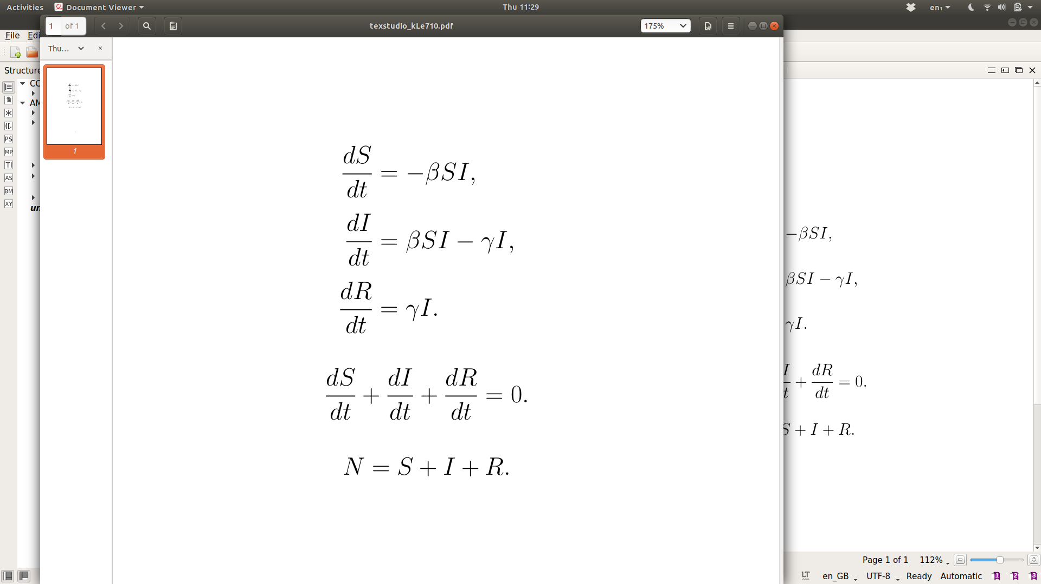

To go from an SIS model to an SIR model, we add one more compartment, R, representing the proportion of the population that have recovered (or died) from the disease. Individuals in the R compartment cannot be infected with the disease again. In this form of the model, we assume that the immunity gained after recovering from the disease is indefinite.

Slide 2
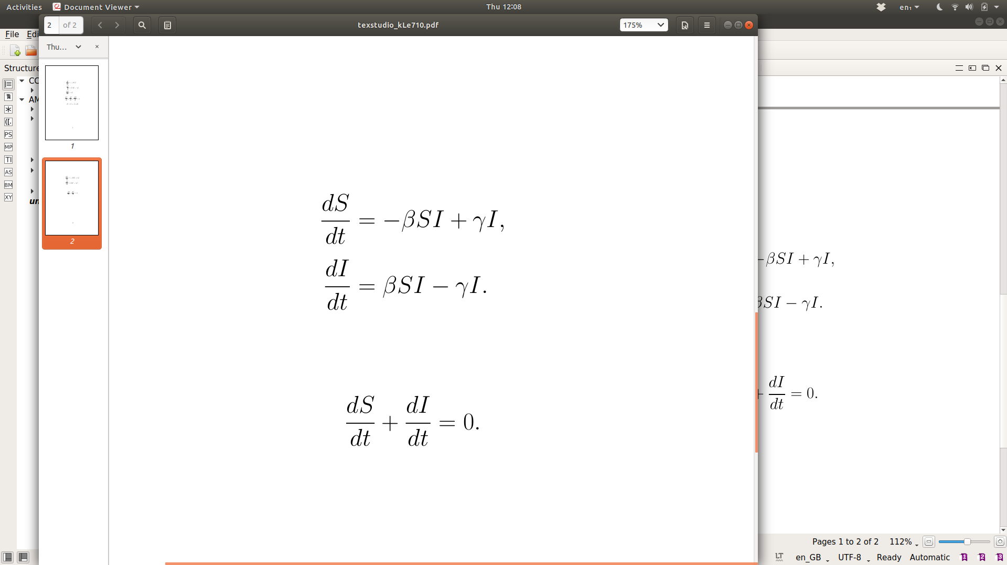
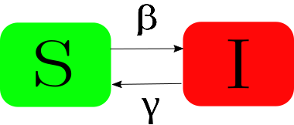
The first compartmental model we introduce is an SIS model. In this model we split the population into two compartments:
S: the proportion of the population that are currently Susceptible to the disease, and
I: the proportion of the population that are currently Infected with the disease.
We assume that the ‘transmission rate’ of the disease is constant and given by &beta;. The ‘recovery rate’ from the disease is also constant and given by &gamma;. Note that &gamma; is the reciprocal of the length of the infection. For an SIS model, after an individual recovers they move back into the susceptible compartment, hence they do not gain immunity to the disease (e.g. flu, chlamydia).
We represent this model mathematically using a system of Ordinary Differential Equations (ODEs). Each equation calculates the rate of change of one compartment. For example, the rate of change of S depends on the amount of individuals who become infected (-&beta;SI) and the amount who recover from infection (&gamma;I). The full system is provided on the right.

Slide 3
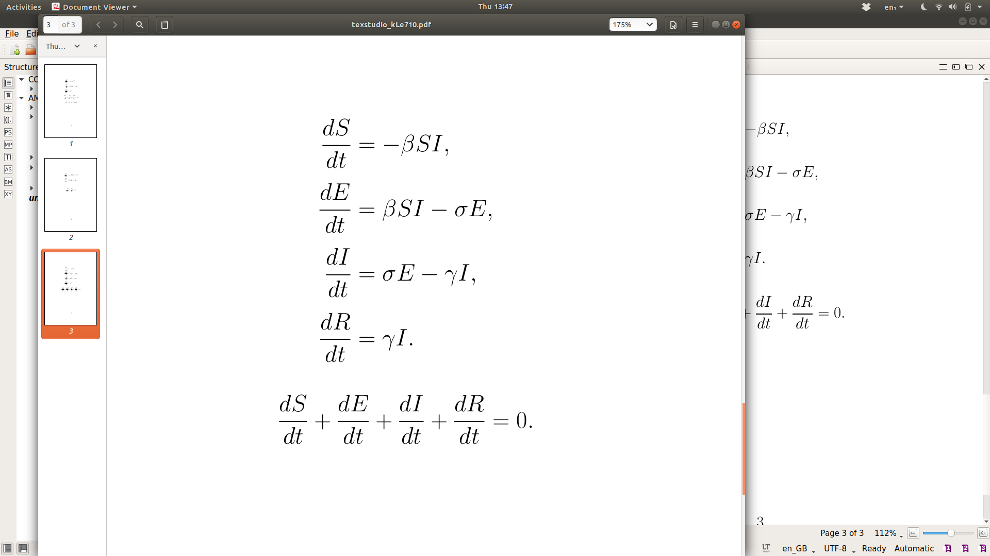

Slide 4
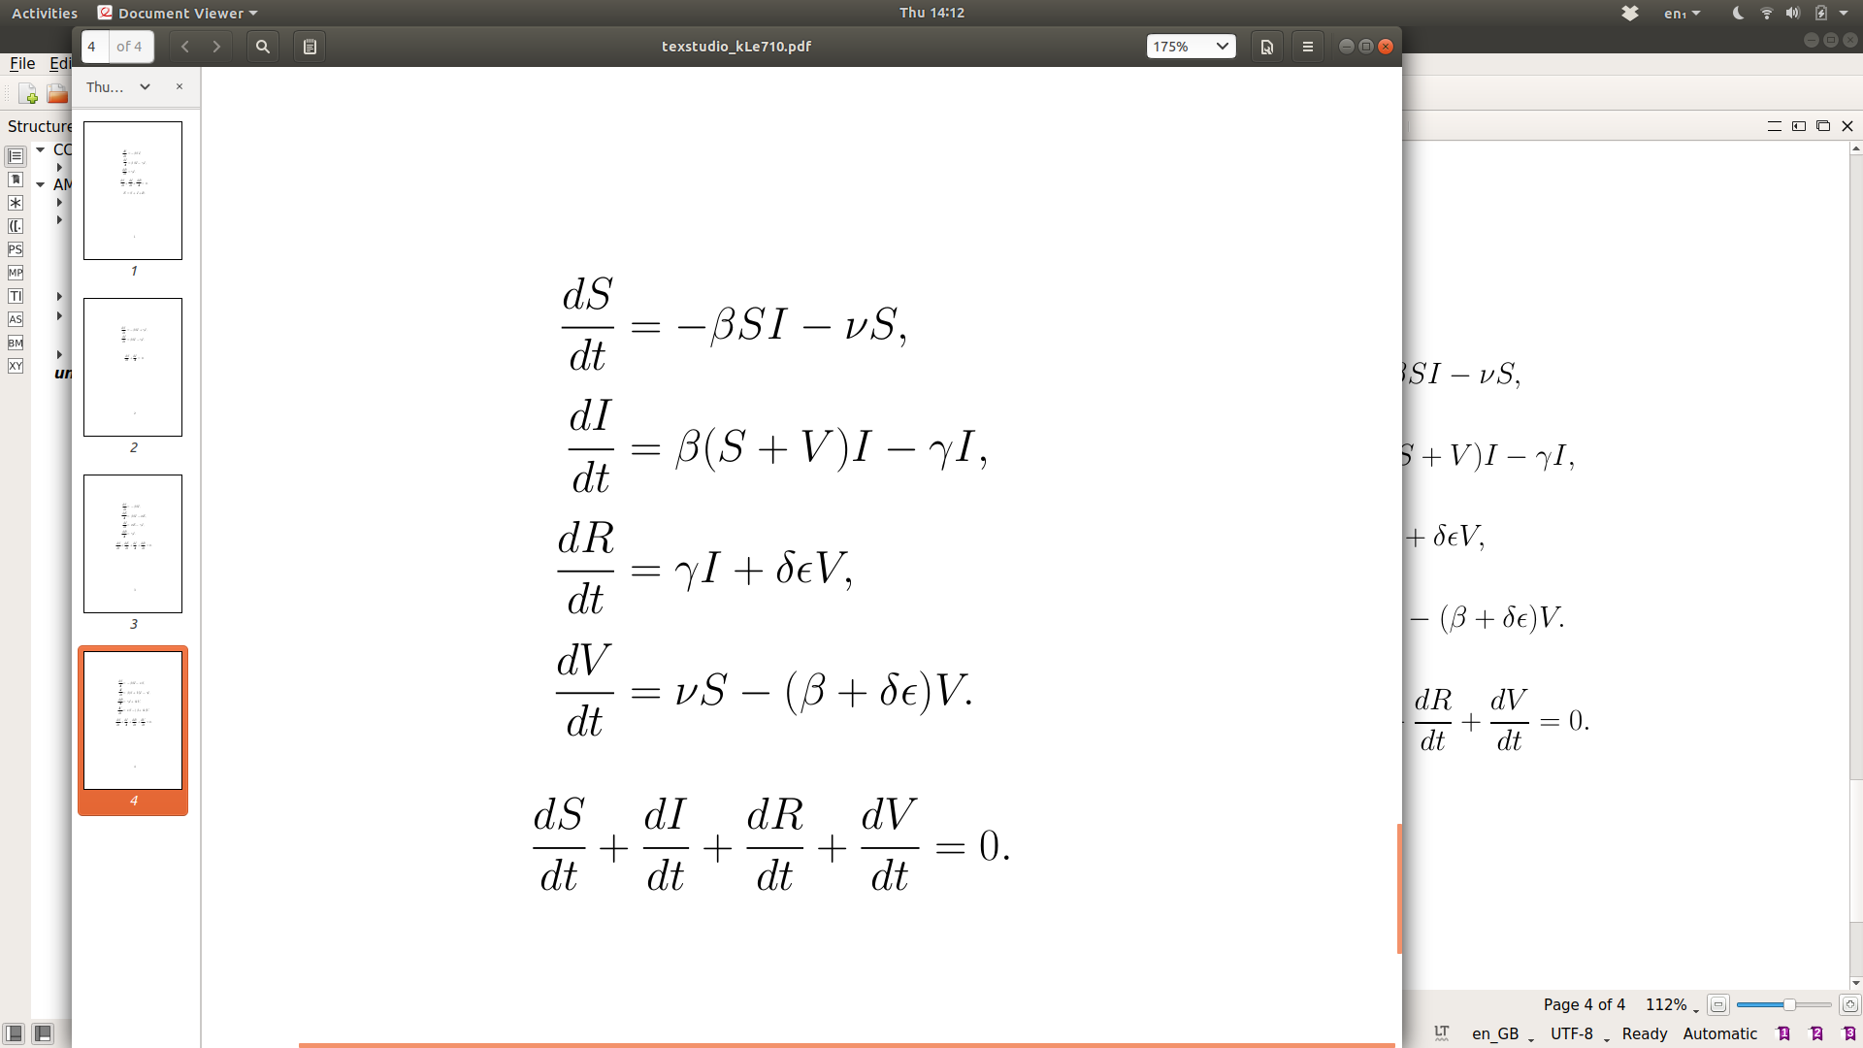
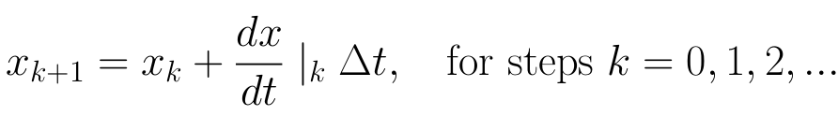

Slide 5
