Slide 1
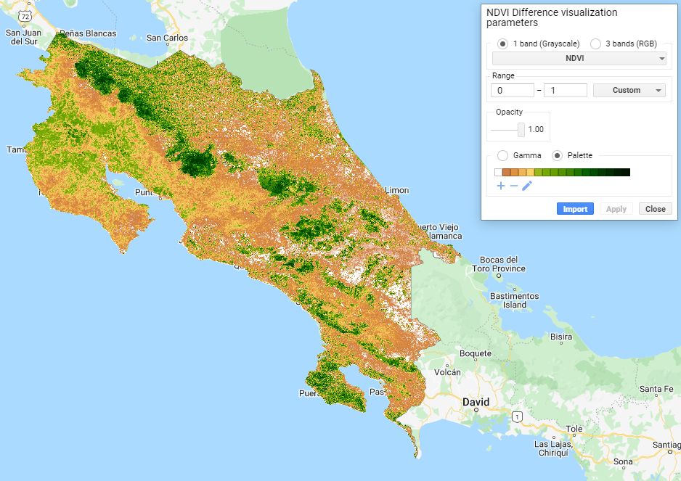

Slide 2
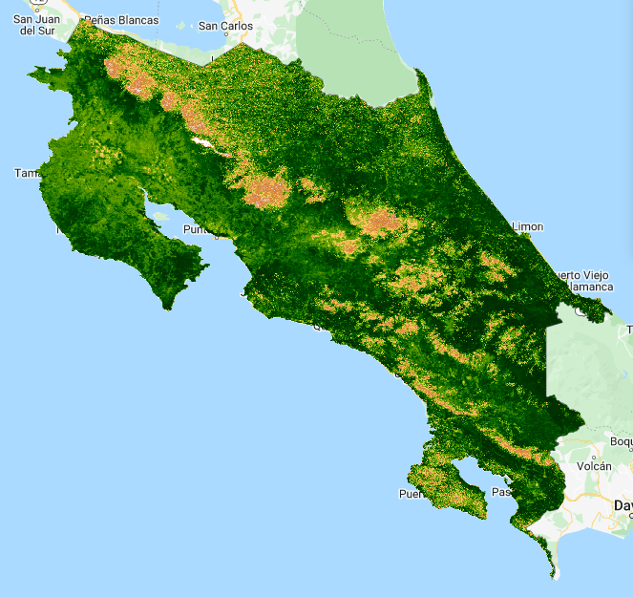
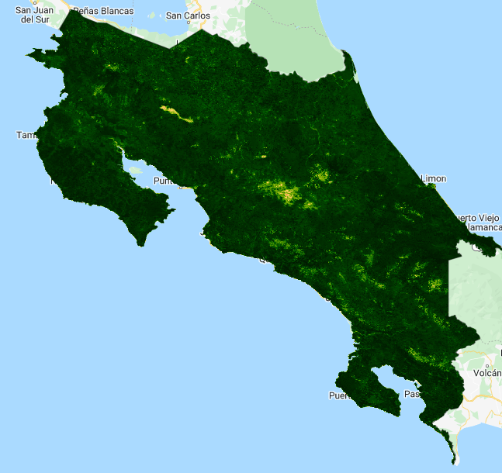
1
0
Dry Season Minimum NDVI
Wet Season Maximum NDVI
Seasonal NDVI Difference

