Slide 1
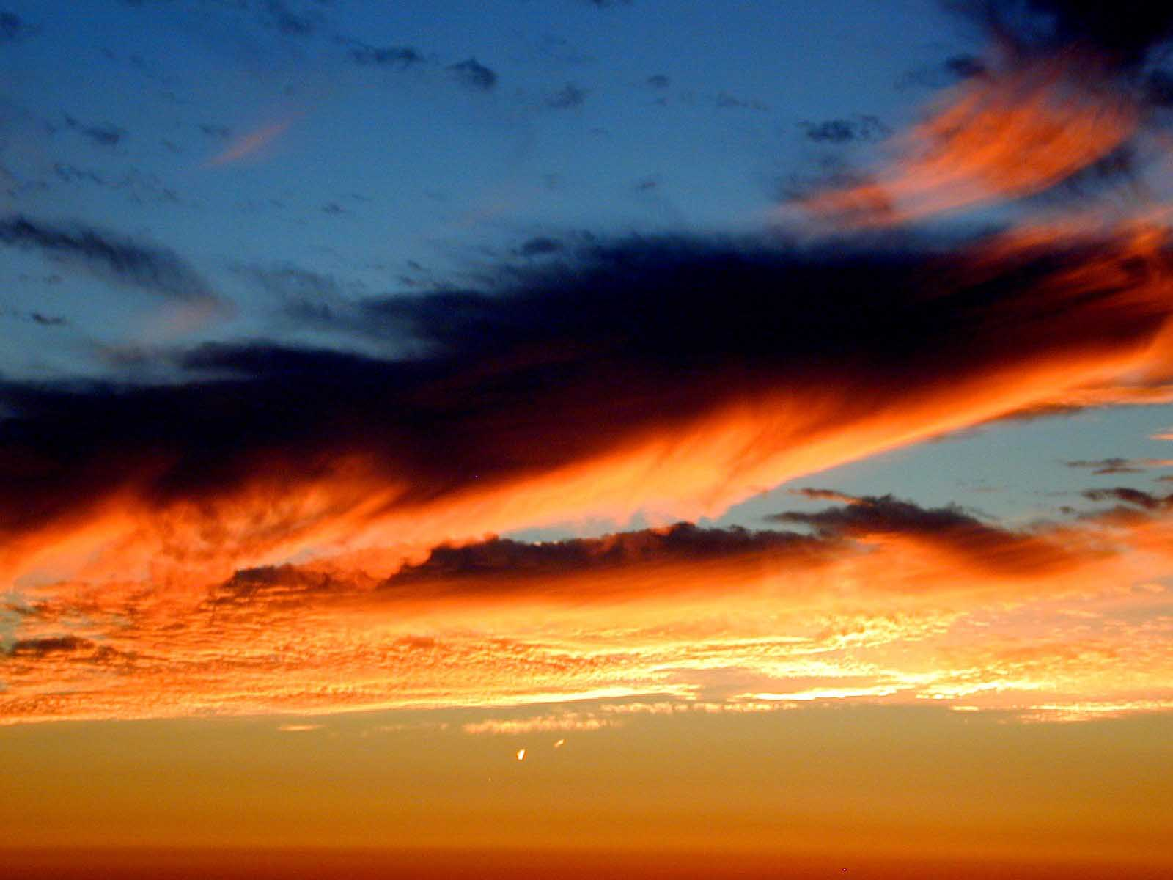
Weather and Climate

Slide 2
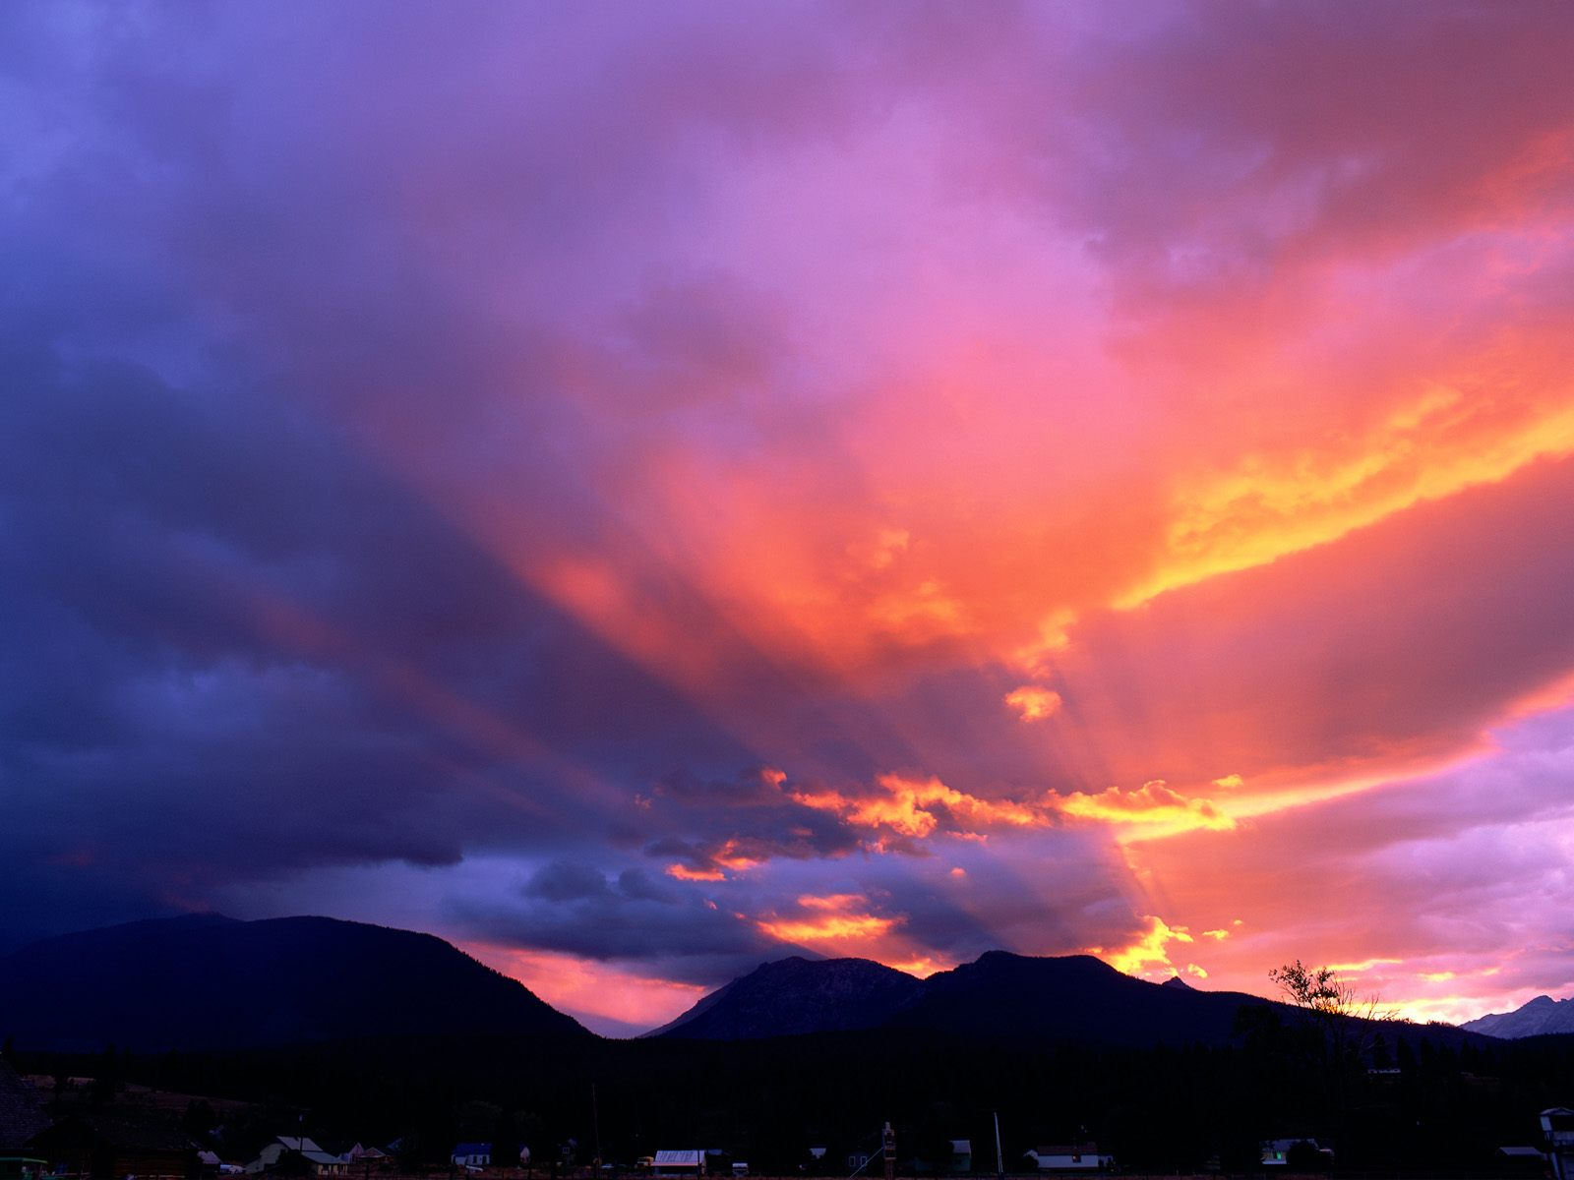
Terminology . . .
Humidity
Relative Humidity
Absolute Humidity
Saturation
Dew Point
Supersaturation
Supercooling
Condensation
Dew
Frost

Slide 3
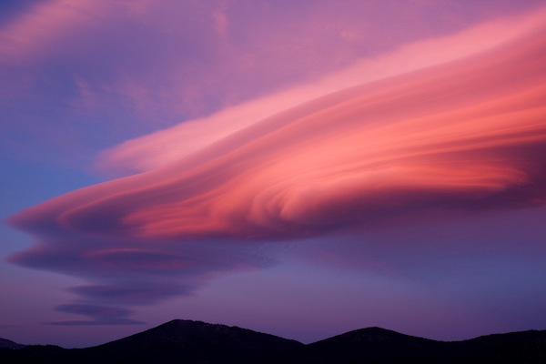
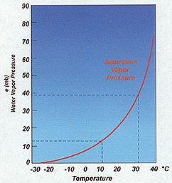
HUMIDITY

Slide 4
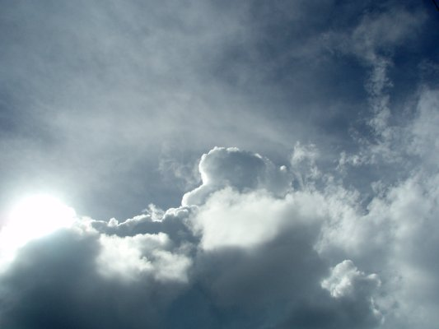
Relative Humidity – The ratio of the amount of water vapor in a given volume of air divided by the maximum amount of water vapor that can be held by that air at a given temperature, expressed as a percentage.
Absolute Humidity – The mass of water vapor in a given volume of air, expressed in a mass per volume metric (e.g. grams per cubic meter (g m⁻³)).

Slide 5
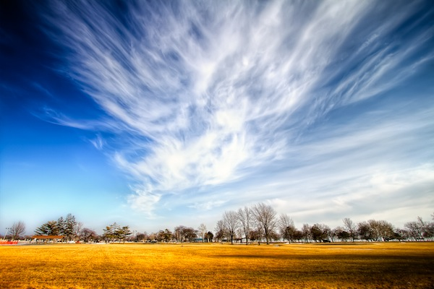
Things you ought to know . . .
Condensation occurs when moist air cools below its dew point.
Clouds are visible manifestations of this process.
Air cools by three ways:
1) radiative cooling
2) cool surface contact
3) rising

Slide 6
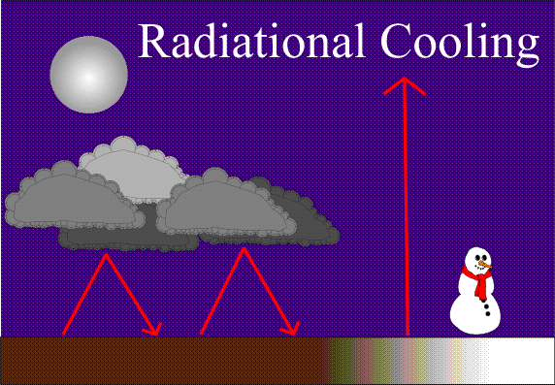

Slide 7
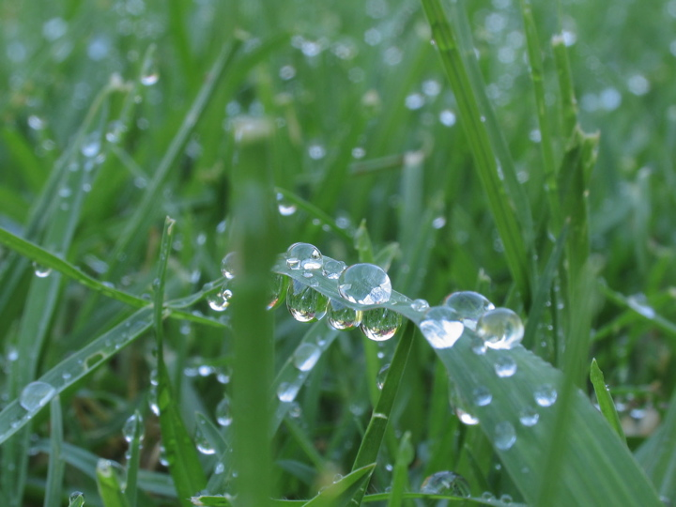
Cool surface contact

Slide 8
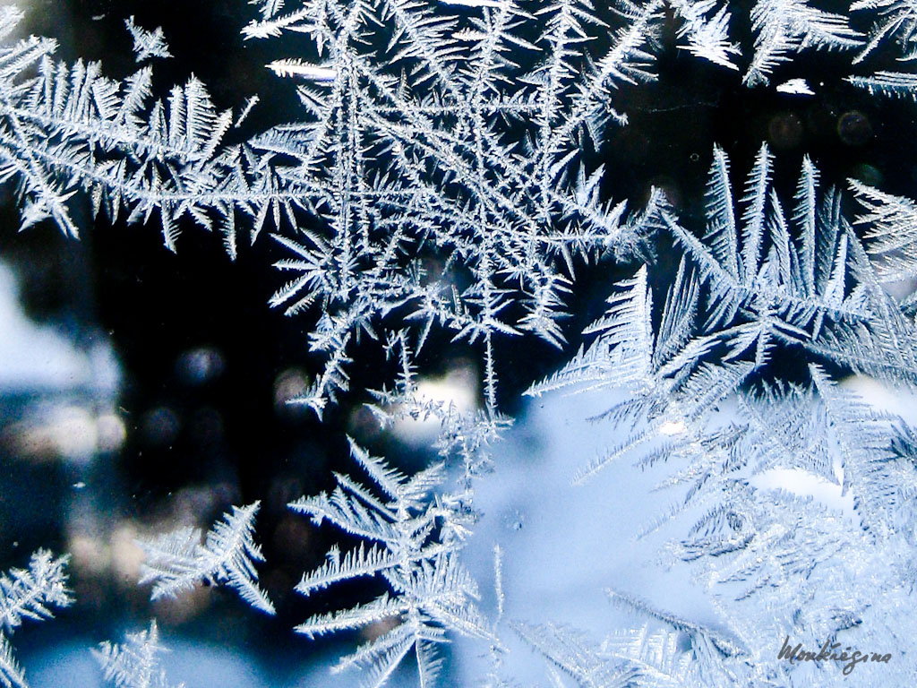

Slide 9
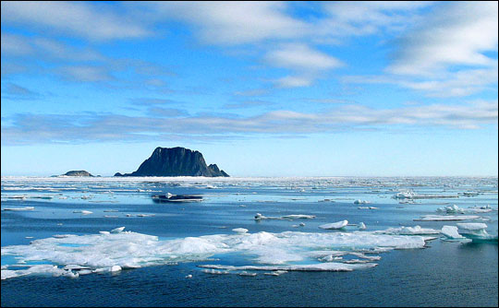
How does the air cool by rising, you ask?
Most cloud formation and precipitation occur when air cools as it rises.
This brings us to a few crucial points. One, being lapse rate.
First, we need to look at our atmosphere.

Slide 10
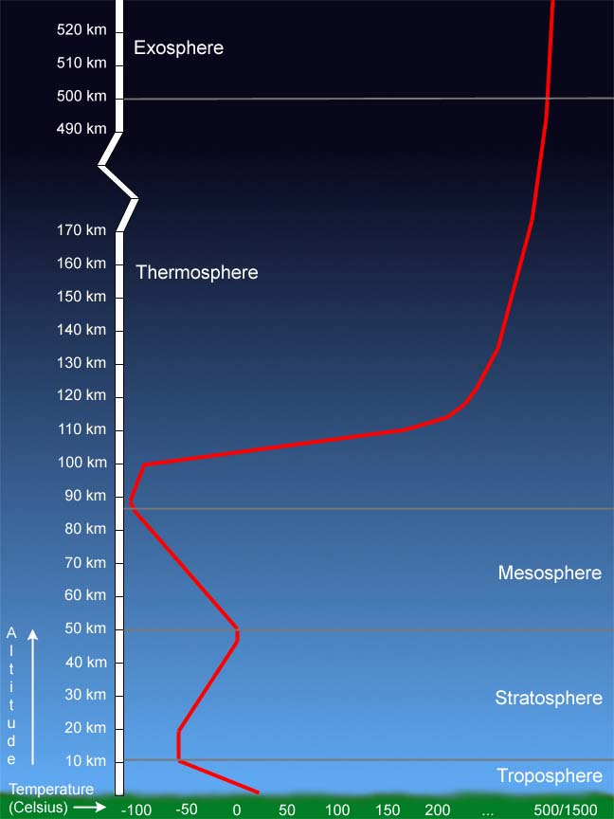
As we discussed previously in the semester, our atmosphere is a thin shell surrounding our planet.
For a matter of scale, almost all of our weather takes place in the troposphere. The troposphere also contains 80% of the atmosphere’s mass and 99% of the moisture and aerosols.
Mt. Everest is ~ 9 km high, as is the cruising height of most commercial air flight.
That’s all below that tiny pink line over there.
Felix Baumgartner (36 km)

Slide 11

Let’s look at the adiabatic process!

Slide 12
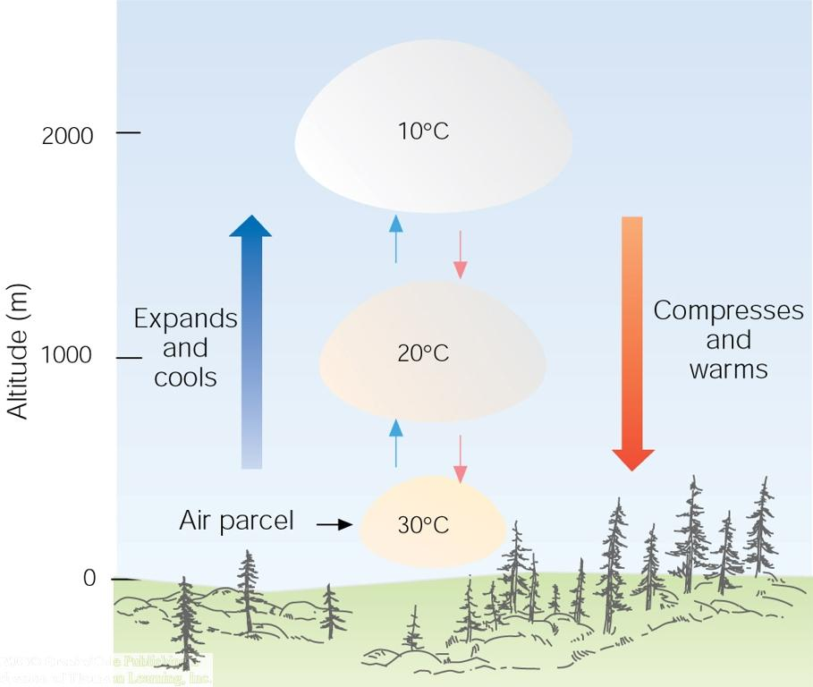

Slide 13
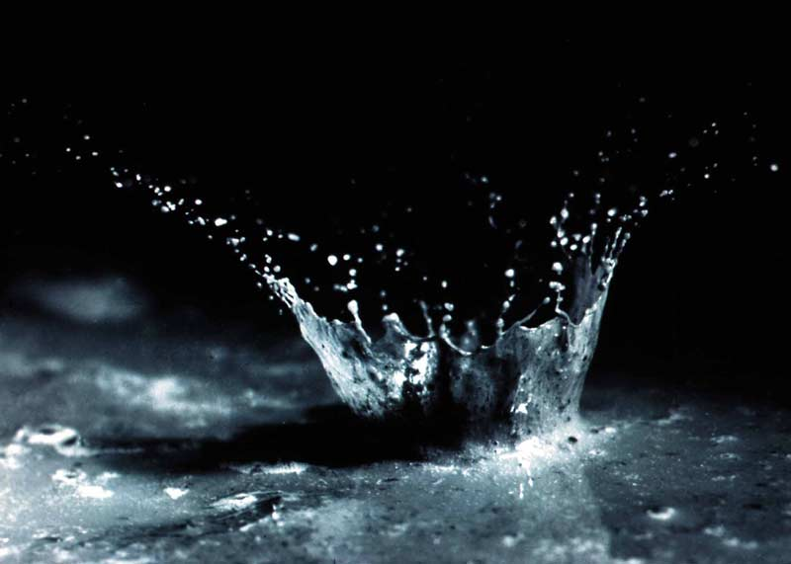
Precipitation

Slide 14
Types of precipitation
How many can you name?

Slide 15
How does precipitation form?

Slide 16
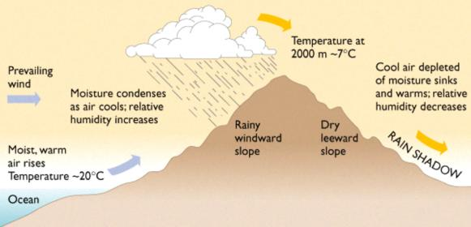
Orographic lifting

Slide 17
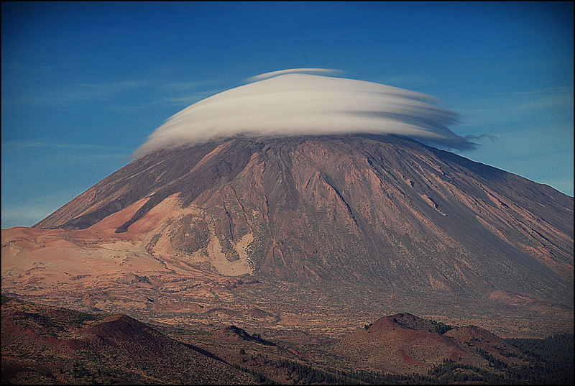

Slide 18
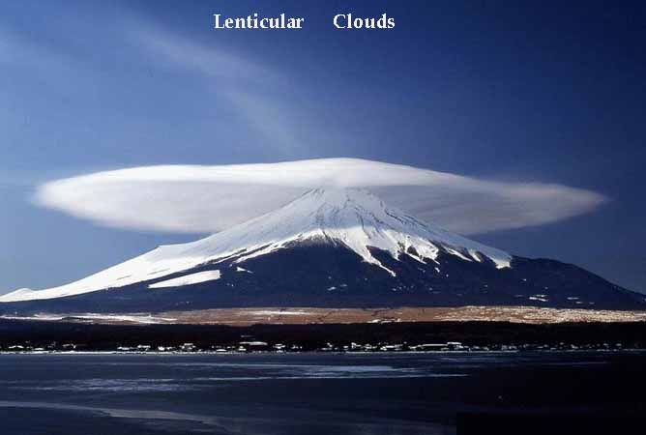

Slide 19
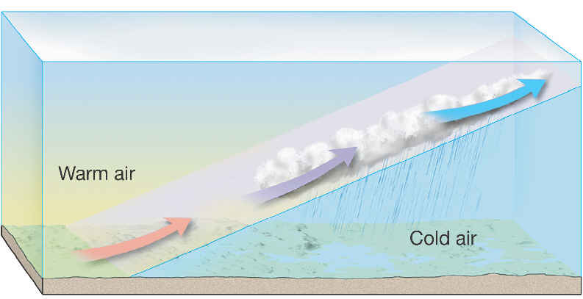

Slide 20
Convection-convergence
Consider the sun heating the earth’s surface and
the subsequent convection and its effects on a
parcel of air.
Let’s just draw this one on the board.

Slide 21
TYPES OF CLOUDS

Slide 22
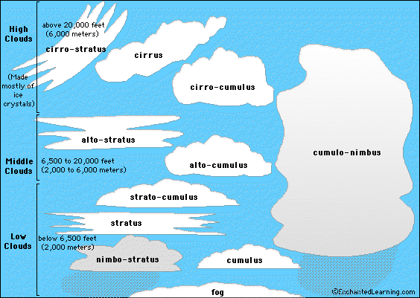

Slide 23
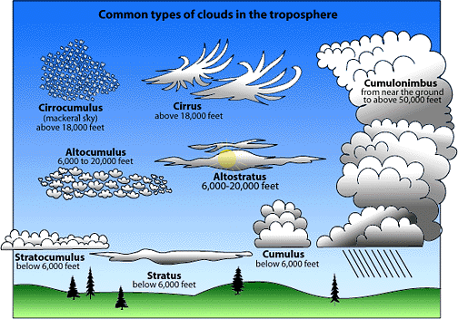

Slide 24
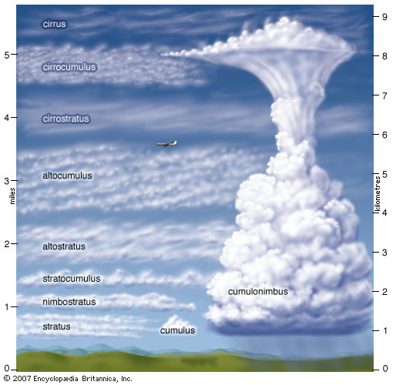

Slide 25
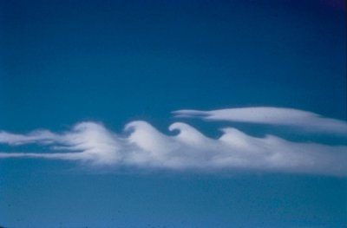

Slide 26
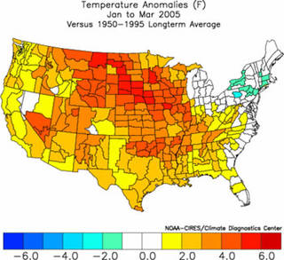
Climate vs. weather

Slide 27
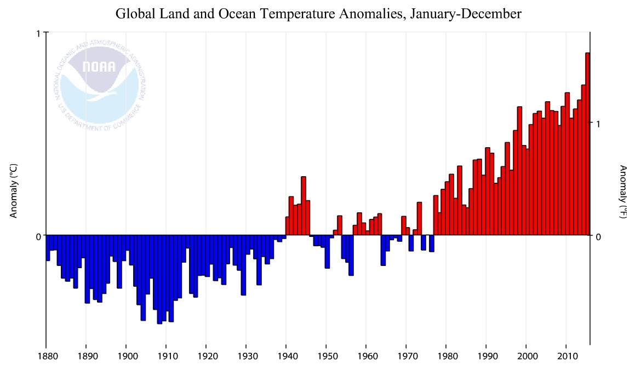

Slide 29
Some more stuff . . .
Pressure and pressure gradients
Cold/Warm fronts
Stationary and occluded fronts
Cyclones/Anti-cyclones
Coriolis effect
Polar and maritime fronts
Lightning
Thunderstorms
Tornadoes
Severe weather
El Niño/La Niña
Jet streams

