Slide 1
EOS/GEOG 230
Binary File Types
** download binary_class.ipynb from Week 3 of brightspace for code and data from this class **

Slide 2
Binary
Not Human readable!
can be opened in notepad++ or some other basic editor, but it presents as a bunch of garbage
  (although… there are binary editors: unleash the Hexinator)
In general, we really hope the fn extension is giving us the correct information
  Very hard to check
  But – there are binary editors!
(which reminds me… let’s see how to make the fn extension visible in windows)

Slide 3
Binary
*.bin or others
No particular format
This is just data written as binary
Faster than writing in byte format
  read(fn,mode=‘rb’) or write(fn,mode=‘wb’)
These are base python functions and are not associated with any library.
Try a simple file of bytes. (Part 1 of class code)
  Return to the ASCII table (next page)
Try a group of integers as integers (Part 2)
and as strings (Part 3)
  (hexinator on the results)
https://www.tutorialspoint.com/How-to-write-binary-data-to-a-file-using-Python

Slide 4
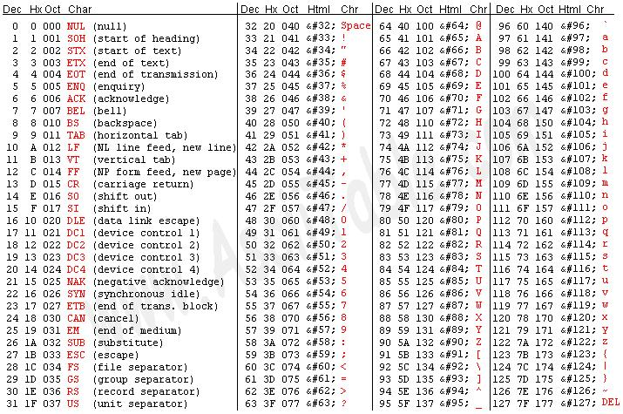

Slide 5
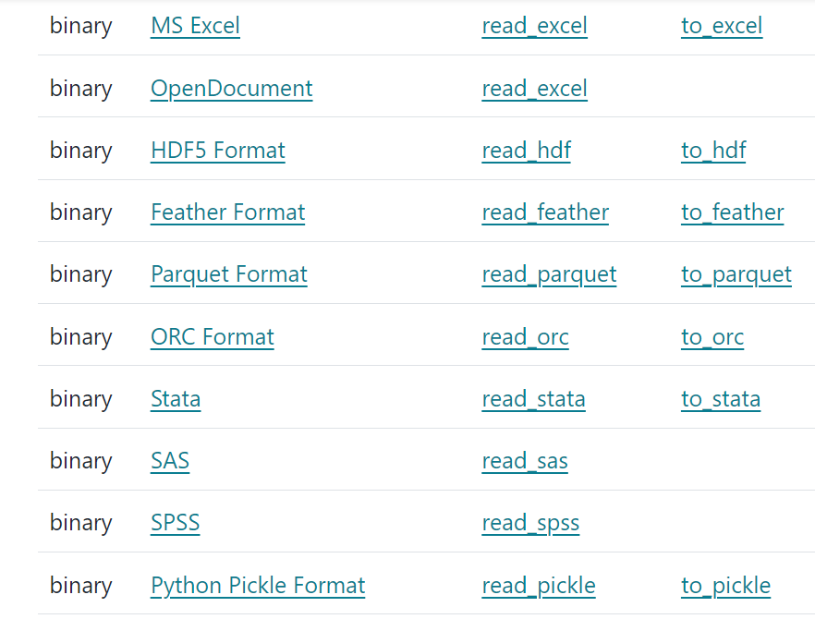
Binary
*. Lots!
Back to Pandas library readers: proprietary/commercial formats
Lots of them:
“hierarchical data format” – not commercial
“DataFrame binary serializer”
“DataFrame storage format”
https://pandas.pydata.org/docs/user_guide/io.html

Slide 6
Binary
*.hdf *.hdf4 *.hdf5
The self-describing gridded binary formats: Hierarchical Data Format
We will ignore commercial formats
  If you have data in that format, use the appropriate reader.
From the NASA site: “The Hierarchical Data Format (HDF) is a data model, file format and I/O library designed for storing, exchanging, managing and archiving complex data including scientific, engineering, and remote sensing data. The latest version of HDF, HDF5 allows users to read only the data that they need, not the whole file. Data producers can put images, tables, multidimensional arrays, etc into the same file.”
From wiki: “HDF is self-describing, allowing an application to interpret the structure and contents of a file with no outside information. One HDF file can hold a mix of related objects which can be accessed as a group or as individual objects. Users can create their own grouping structures called "vgroups." "

Slide 7
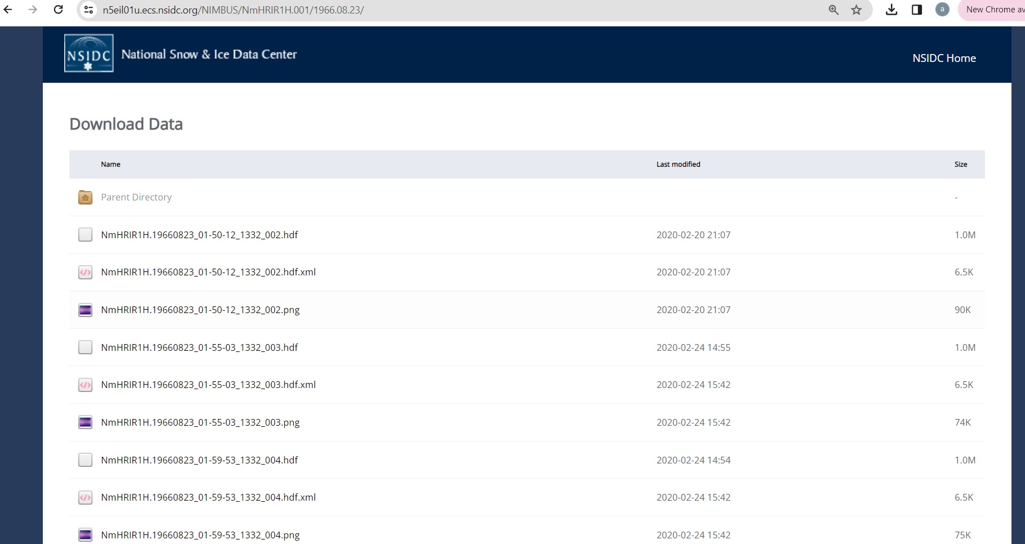
Binary
*.hdf *.hdf4 *.hdf5
I went looking for some data to demonstrate hdf5 and found this at NSIDC. We’ll work through reading this in.

Slide 8
Binary
*.nc
The self-describing gridded binary formats: Network Common Data Format
From wiki: “NetCDF (Network Common Data Form) is a set of software libraries and self-describing, machine-independent data formats that support the creation, access, and sharing of array-oriented scientific data. The project homepage[2] is hosted by the Unidata program at the University Corporation for Atmospheric Research (UCAR).“
  “It is commonly used in climatology, meteorology and oceanography applications (e.g., weather forecasting, climate change) and GIS applications”.
Multi-dimensional structures supported (5-d):
https://www.earthinversion.com/utilities/reading-NetCDF4-data-in-python/

Slide 9
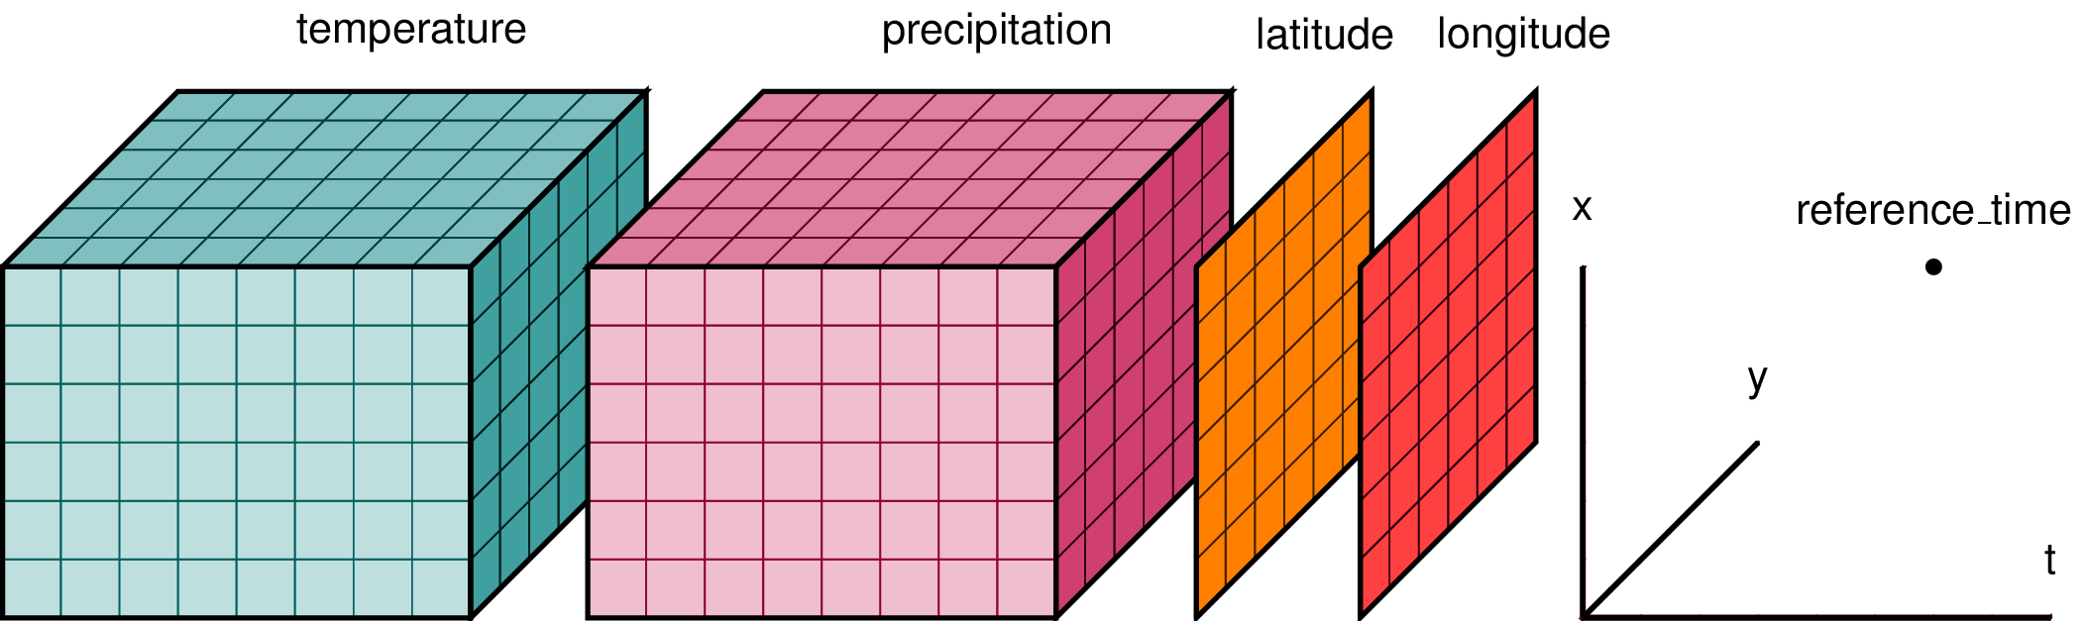
Binary
*.nc
The self-describing gridded binary formats: Network Common Data Format
https://www.guillaumedueymes.com/courses/tutorial_python_netcdf/1-netcdf_tutorial/

Slide 10
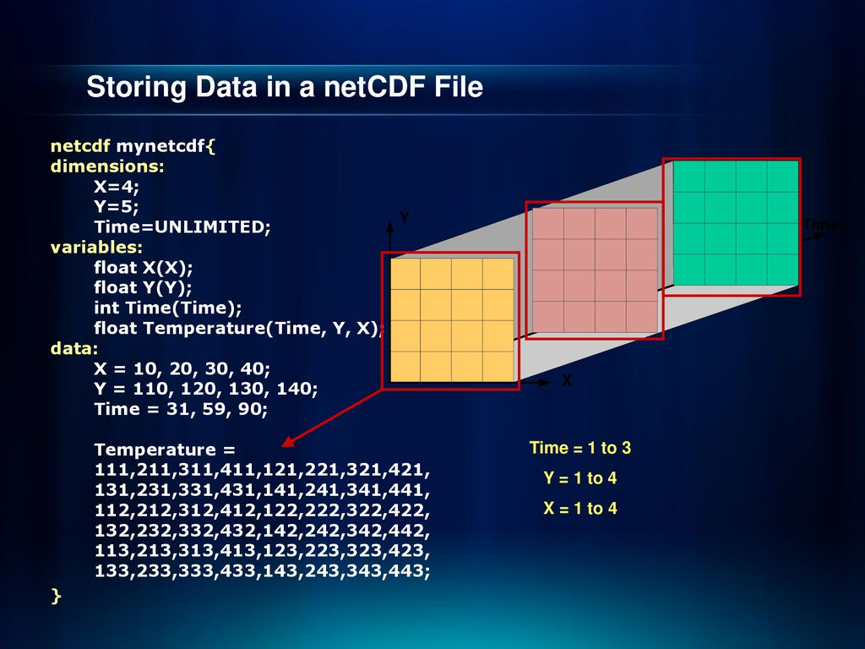
Binary
*.nc
The self-describing gridded binary formats: Network Common Data Format

Slide 11
Binary
*.grb *.grib2
The self-describing gridded binary formats: GRidded Binary
From wiki: “GRIB (GRIdded Binary or General Regularly-distributed Information in Binary form[1]) is a concise data format commonly used in meteorology to store historical and forecast weather data. It is standardized by the World Meteorological Organization's Commission for Basic Systems…“
Similar to netCDF, but fewer dimensions
No demo because I don’t want to install the extra packages ☹

