Slide 1
Impact of Gender & Education on Income in DS & ML
Samuel Atkins - October 2020

Slide 2
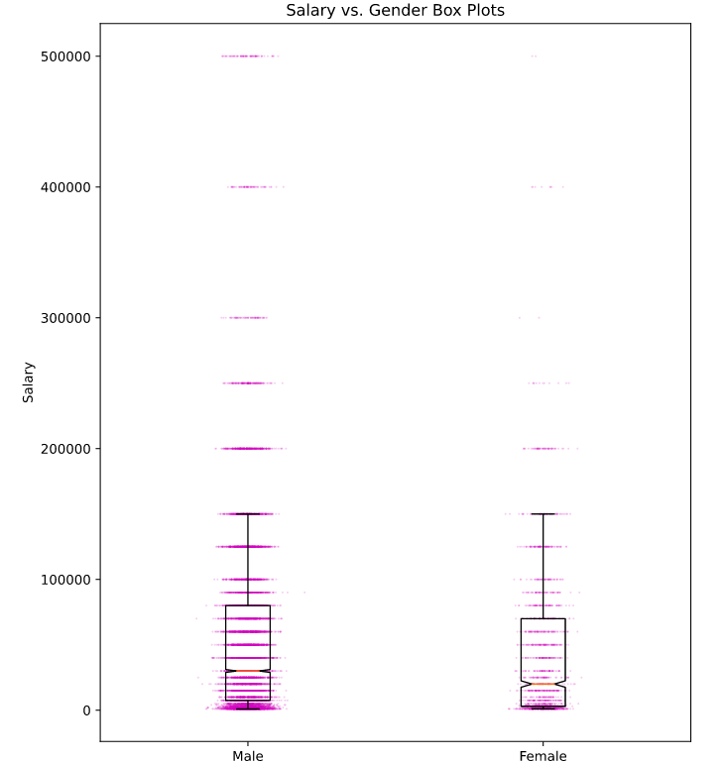
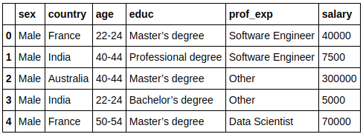
Exploratory Data Analysis
- Salary vs. Gender & Salary vs. Education Box Plots - Descriptive Statistics - Preliminary Data Analysis

Slide 3
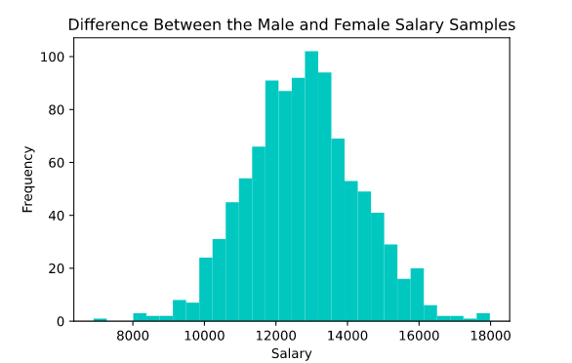
Comparing Male and Female Salaries in DS & ML
Two-Sample t-Test & Bootstrapping

Slide 4
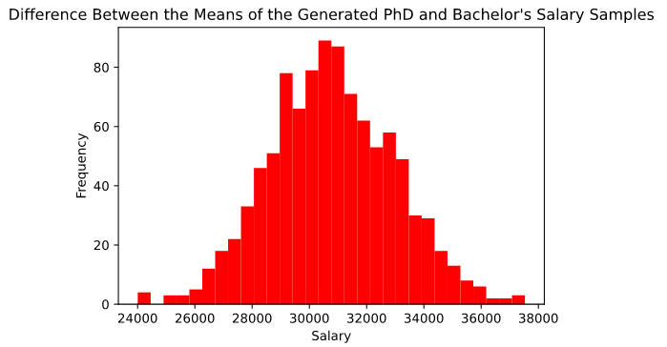
Impact of Education on Income
ANOVA, Bootstrapping, & Estimating the Difference Between the Means

Slide 5
Conclusion
?
Difference Between Salaries of Males and Females in DS & ML:
Males earn approximately $12,772.14 more on average
Average Salary Increases for Education Tiers Surpassing a Bachelor’s Degree:
Bachelor’s Degree to Master’s degree: $13,740.45 approximate pay increase
Bachelor’s Degree to PhD: $30,785.89 approximate pay increase

