Slide 1
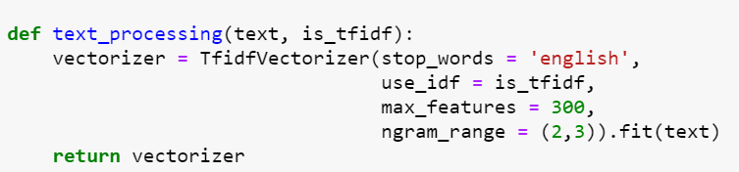
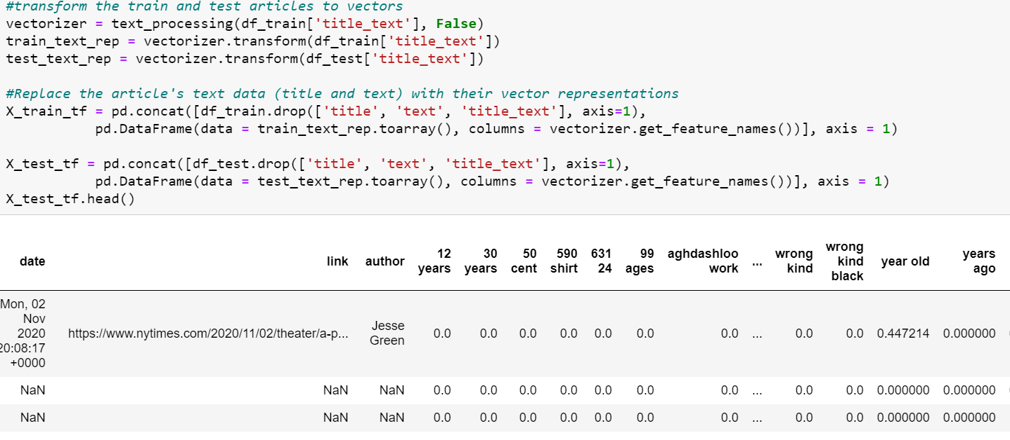

Advance text processing - TF
Notes:
Term frequency depends on the frequency of a word in the current article.
Use sklearn’s TfidfVectorizer to get the word representation of the data
Combined title and text of article as they are related
Each cell represents the frequency of the corresponding word in the article

Slide 2
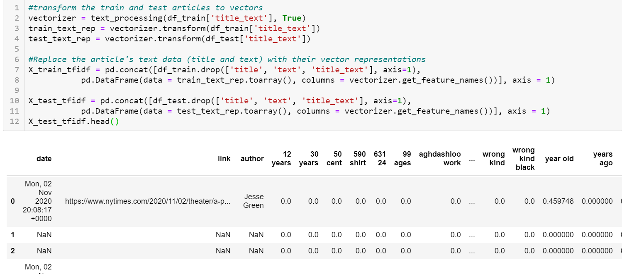
Advance text processing - TF-IDF
Notes:
Using TF is problematic because words that are frequent but not necessarily useful (e.g. the) will have a high score. TF-IDF, combines TF and IDF, which measures the how rare a word is across articles to solve the limitation.
Uses the same model as TF (TfidfVectorizer) with is_idf parameter set to true
If the features being represented are quite different, vectorize them separately

Slide 3
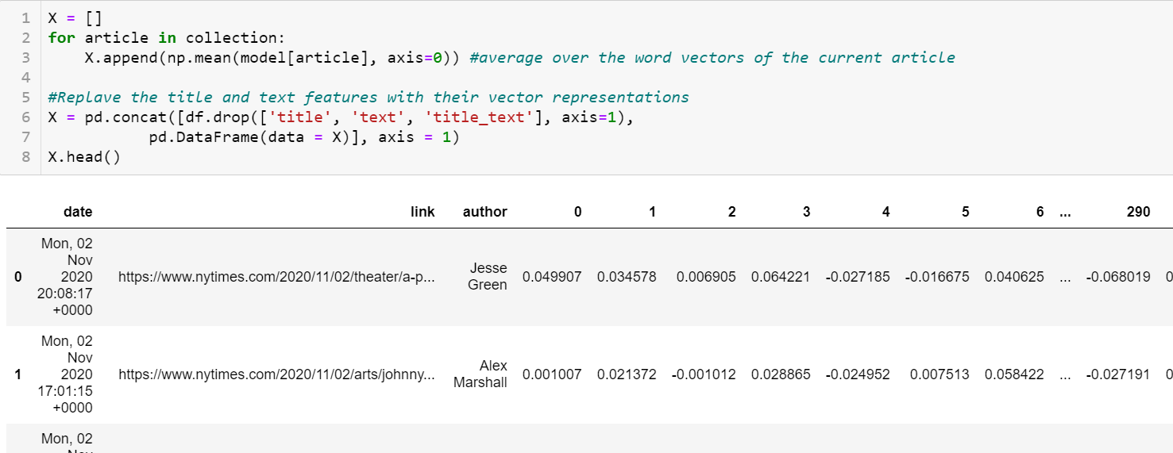
Word Embedding Techniques - Word2Vec
Notes:
Word embedding techniques represents each word as a vector, in such a way that the context of the word is captured by that representation. That is, vector representation of words that are used in similar ways (e.g. mother, and father) are closer in the vector space.
Some of the most popular word embedding techniques include: Word2Vec and GloVe. will discuss Word2Vec using a pre-trained model on Google news dataset (why? we don’t have enough data to train the model)
We get word embeddings for each article (300 by #of words in article)
To get the representation of article, average over word vectors of article

