Slide 1


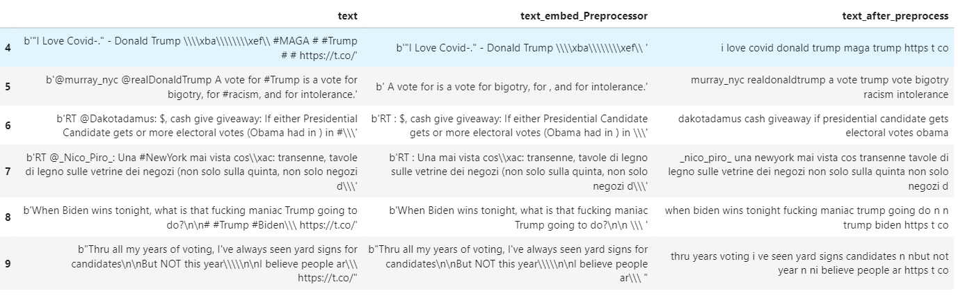
Basic text preprocessing on tweets from csv file
A tweet may contain:
URL’s https://
Mentions @
Hashtags #
Emojis
Smileys ☺ : )
Spefic words etc…
we can use a python library
tweet-preprocessor to clean tweet.
Remove URL
Remove Hashtag
Remove Emojis/convert Emojis to text
Then we can apply normal text
preprocessing like:
Lowercasing
Punctuation Removal
Replace extra white spaces
Stopwords removal
etc.
Notes:
After Using the Twitter API to download data and save those as a csv file,

Slide 2
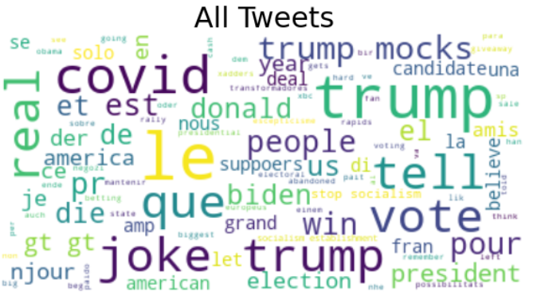
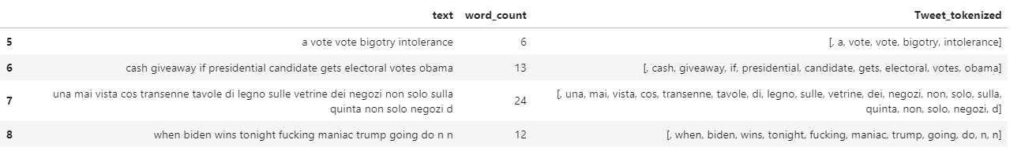
Basic feature extraction
Extract numerical features from text, namely:
tokenizing strings and giving an integer id for each possible token.
counting the occurrences of tokens in each document.
Could also count #word, #URL, #Hashtag, #Emoji in each string
normalizing and weighting with diminishing importance tokens that occur in the majority of samples

