Slide 1
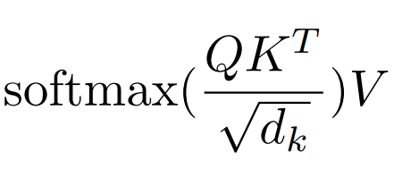
nn.Dropout
Y
nn.Linear
nn.ReLU
Square Feed-Forward
nn.Linear
nn.Linear
nn.LayerNorm
nn.LayerNorm
Multi-Head Attention +
Feedforward Block
x N
nn.Dropout
nn.Dropout(QK^{T})
nn.Linear
Position Embedding
Token Embedding
Attention
“K”
“Q”
“V”
Attention
Attention
X
nn.Linear
nn.Linear
nn.Linear
nn.LayerNorm

