Slide 1
XQuery Update
http://www.w3.org/TR/xquery-update-10/
Roger L. Costello
16 June 2010

Slide 2
Prerequisites
This tutorial assumes that you know
XQuery

Slide 3
XQuery vs XQuery Update
XQuery enables you to select nodes from XML documents, and then output new documents containing the nodes.
XML → XQuery → New Document
Conversely, XQuery Update enables you to change an XML document, in-place.
XML XQuery Update

Slide 4
Update Operations
Insert a node inside, before, or after a specified node.
Delete a node.
Replace a node by another node.
Rename a node

Slide 5
Usage
retrieve
XQuery
Processor
update
FitnessCenter.xml
FitnessCenter.xu

Slide 6
XQuery Update Processor: SAXON
SAXON is an XSLT processor, an XQuery processor, and an XQuery Update processor.
I created a DOS batch file to enable you to invoke the SAXON XQuery Update processor. In the examples folders you will find: run-saxon-1-arg.bat Here's how to use it:
run-saxon-1-arg FitnessCenter.xu

Slide 7
SAXON flags
You need to set these flags when invoking SAXON:
-update:on
-tree:linked
-backup:on (A backup of the file is made before it is updated.)
java -classpath %CLASSPATH% net.sf.saxon.Query -update:on -tree:linked -backup:on FitnessCenter.xu
Note: these flags are already set in run-saxon-1-arg.bat

Slide 8
Using Oxygen XML
Oxygen XML supports XQuery Update (because it is bundled with Saxon-EE)
To enable XQuery update:
  Select Options > Preferences (see next slide)

Slide 9
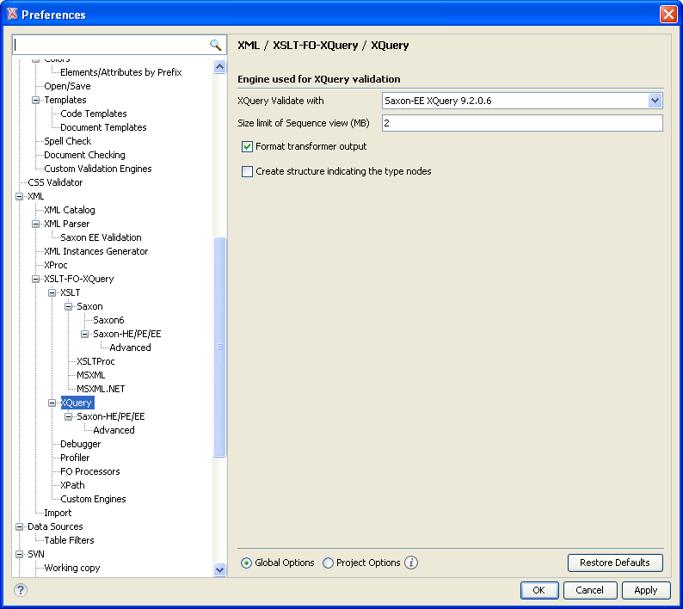
Set to this value

Slide 10
Using Oxygen XML
Select the wrench icon, Select Transformation Scenario (see next slide)

Slide 11
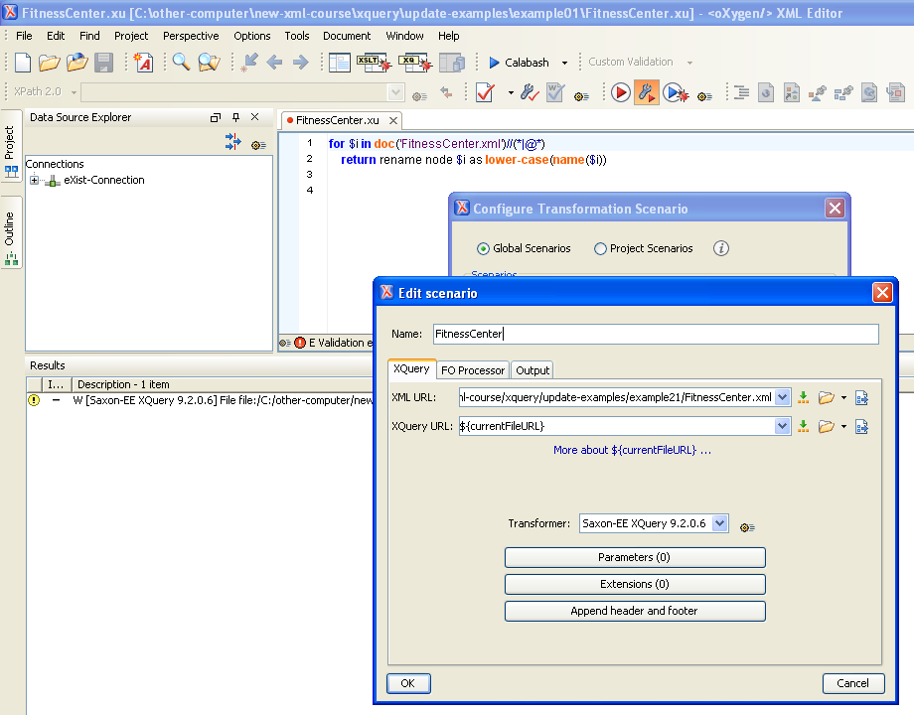
Select
this

Slide 12
Using Oxygen XML
You need to associate the .xu file extension to the XQuery editor. Go to Options > Preferences > File Types and add a new association there with xu as the extension and XQuery Editor as the editor. (See next slide)

Slide 13
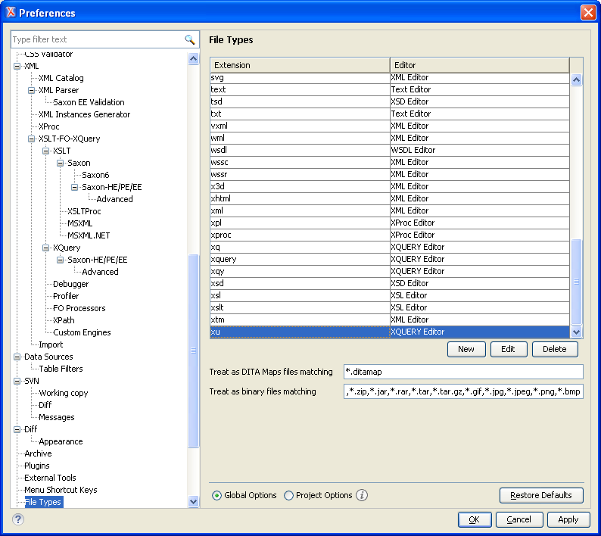
Associate the xu file extension
to XQuery Editor

Slide 14
Back up your XML files!
Oxygen XML doesn't create a backup of your XML files (in their next release they will).
So, before executing an update, backup your XML file!

Slide 15
rename

Slide 16
Example: rename element/attribute names to lower case
In XQuery.ppt you saw how to transform all element and attribute names to lower case.
See next slide →

Slide 17
<FitnessCenter>
<Member Level="platinum">
<Name>Jeff</Name>
<FavoriteColor>lightgrey</FavoriteColor>
</Member>
<Member Level="gold">
<Name>David</Name>
<FavoriteColor>lightblue</FavoriteColor>
</Member>
<Member Level="platinum">
<Name>Roger</Name>
<FavoriteColor>lightyellow</FavoriteColor>
</Member>
</FitnessCenter>
<fitnesscenter>
<member level="platinum">
<name>Jeff</name>
<favoritecolor>lightgrey</favoritecolor>
</member>
<member level="gold">
<name>David</name>
<favoritecolor>lightblue</favoritecolor>
</member>
<member level="platinum">
<name>Roger</name>
<favoritecolor>lightyellow</favoritecolor>
</member>
</fitnesscenter>
XQuery
Processor
declare namespace ex = "http://www.example.org";
declare function ex:identity-plus-lcase ($seq)
{
for $i in $seq
return
if ($i[self::*]) then
element {lower-case(name($i))}
{
for $j in $i/@*
return
attribute {lower-case(name($j))} {data($j)},
ex:identity-plus-lcase($i/child::node())
}
else
text {$i}
};
ex:identity-plus-lcase(doc('FitnessCenter.xml')/root()/*)

Slide 18
Solving the problem with XQuery Update
The problem is solved much more easily with XQuery Update.
Simply visit each element and attribute in the tree and rename it to lower case.
See next slide →

Slide 19
<FitnessCenter>
<Member Level="platinum">
<Name>Jeff</Name>
<FavoriteColor>lightgrey</FavoriteColor>
</Member>
<Member Level="gold">
<Name>David</Name>
<FavoriteColor>lightblue</FavoriteColor>
</Member>
<Member Level="platinum">
<Name>Roger</Name>
<FavoriteColor>lightyellow</FavoriteColor>
</Member>
</FitnessCenter>
XQuery
Processor
rename,
rename,
rename,
…
for $i in doc('FitnessCenter.xml')//(*|@*)
return rename node $i as lower-case(name($i))
see example01

Slide 20
Iterate over each element and attribute node
for $i in doc('FitnessCenter.xml')//(*|@*)
return rename node $i as lower-case(name($i))

Slide 21
for $i in doc('FitnessCenter.xml')//(*|@*)
return rename node $i as lower-case(name($i))
Rename the node to the same name, but lower case

Slide 22
Operate on N documents
On the next slide I show how to rename all the elements and attributes in two XML documents.

Slide 23
<FitnessCenter>
<Member Level="platinum">
<Name>Jeff</Name>
<FavoriteColor>lightgrey</FavoriteColor>
</Member>
<Member Level="gold">
<Name>David</Name>
<FavoriteColor>lightblue</FavoriteColor>
</Member>
<Member Level="platinum">
<Name>Roger</Name>
<FavoriteColor>lightyellow</FavoriteColor>
</Member>
</FitnessCenter>
XQuery
Processor
rename,
rename,
rename,
…
FitnessCenter1.xml
<FitnessCenter>
<Member Level="platinum">
<Name>Jeff</Name>
<FavoriteColor>lightgrey</FavoriteColor>
</Member>
<Member Level="gold">
<Name>David</Name>
<FavoriteColor>lightblue</FavoriteColor>
</Member>
<Member Level="platinum">
<Name>Roger</Name>
<FavoriteColor>lightyellow</FavoriteColor>
</Member>
</FitnessCenter>
See Next Slide
FitnessCenter2.xml

Slide 24
for $i in doc('FitnessCenter1.xml')//(*|@*) | doc('FitnessCenter2.xml')//(*|@*)
return rename node $i as lower-case(name($i))
see example01-a

Slide 25
Update all the XML files in a folder
The XPath 2.0 doc() function is used to select one file.
The XPath 2.0 collection() function is used to select a bunch of files.
Here's how to select all *.xml files in a subfolder called "dir":
collection('dir?select=*.xml;recurse=yes;on-error=ignore')

Slide 26
Rename all the elements and attributes in all *.xml files in the subfolder "files"
for $i in collection('dir?select=*.xml;recurse=yes;on-error=ignore')//(*|@*)
return rename node $i as lower-case(name($i))
see example01-b

Slide 27
Bug in SAXON
The previous slide is the correct way to solve the problem.
However, it won't work in SAXON 9.2.0.3
SAXON has a bug.
To fix the bug, append onto collection(…) this: /doc(document-uri(.))
for $i in collection('dir?select=*.xml;recurse=yes;on-error=ignore')/doc(document-uri(.))//(*|@*)
return rename node $i as lower-case(name($i))

Slide 28
Update Conflict
Suppose you rename a node to lower-case. Then you rename the same node to upper-case.
What will be the result? Answer: you will get an "update conflict" error:
Update conflict: two attempts to rename the same <FitnessCenter> element() node
see example01-c

Slide 29
rename node N as name-expr
N must identify a single element or attribute node.
name-expr must yield a value of type xsd:QName.

Slide 30
Namespace rename
Currently each node in FitnessCenter.xml is in no namespace. That is, the namespace URI for each node is ""
Rename each node to have the same local name, but the namespace URI is http://www.gym.com
rename
<FitnessCenter>
<FitnessCenter xmlns="http://www.gym.com">

Slide 31
Here's how to do it
for $i in doc('FitnessCenter.xml')//*
return rename node $i as QName('http://www.gym.com', local-name($i))
see example02

Slide 32
QName(namespace, prefix:local-name)
QName(namespace, local-name)
These are XPath 2.0 functions.
They return a value of type xsd:Qname
Example: QName('http://www.gym.com', 'FitnessCenter')
returns FitnessCenter in the gym namespace, with no
prefix
Example: QName('http://www.gym.com', 'gym:FitnessCenter')
returns gym:FitnessCenter, where the prefix is
associated to the gym namespace
see example02-a

Slide 33
for $i in doc('FitnessCenter.xml')//*
return rename node $i as QName('http://www.gym.com', local-name($i))
Rename the node to the same name, but in the gym namespace

Slide 34
Don't do this
for $i in doc('FitnessCenter.xml')//*
return rename node $i as QName('http://www.gym.com', name($i))
Here's the error message you will get:
New name conflicts with existing namespace binding

Slide 35
Explanation
The name() function returns both the namespace URI and the local name. (It just so happens the namespace URI is "")
The second argument of the QName() function cannot contain a namespace URI, only local name or a prefix + local name.

Slide 36
Rename the Level attribute to level
for $i in doc('FitnessCenter.xml')//Member
return rename node $i/@Level as 'level'
see example03

Slide 37
Rename FitnessCenter to HealthClub
rename node doc('FitnessCenter.xml')/FitnessCenter as 'HealthClub'
Do Lab1
see example04

Slide 38
delete

Slide 39
Delete all Level attributes
for $i in doc('FitnessCenter.xml')//Member
return delete node $i/@Level
see example05

Slide 40
Alternate Solution
delete nodes doc('FitnessCenter.xml')//@Level
see example06

Slide 41
delete node node or delete nodes node-sequence
If you want to delete one node, use
delete node
If you want to delete multiple nodes, use
delete nodes

Slide 42
<FitnessCenter>
<Member Level="platinum">
<Name>Jeff</Name>
<FavoriteColor>lightgrey</FavoriteColor>
</Member>
<Member Level="gold">
<Name>David</Name>
<FavoriteColor>lightblue</FavoriteColor>
</Member>
<Member Level="platinum">
<Name>Roger</Name>
<FavoriteColor>lightyellow</FavoriteColor>
</Member>
</FitnessCenter>
Delete this member
delete node doc('FitnessCenter.xml')//Member[child::Name eq 'Roger']
see example07

Slide 43
<FitnessCenter>
<Member Level="platinum">
<Name>Jeff</Name>
<FavoriteColor>lightgrey</FavoriteColor>
</Member>
<Member Level="gold">
<Name>David</Name>
<FavoriteColor>lightblue</FavoriteColor>
</Member>
<Member Level="platinum">
<Name>Roger</Name>
<FavoriteColor>lightyellow</FavoriteColor>
</Member>
</FitnessCenter>
Delete this text
delete node doc('FitnessCenter.xml')//Member[child::Name eq 'Roger']/Name/text()
see example08

Slide 44
Things you can delete
The last slides showed how you can delete:
attribute nodes
element nodes
text nodes

Slide 45
insert

Slide 46
<FitnessCenter>
<Member Level="platinum">
<Name>Jeff</Name>
<FavoriteColor>lightgrey</FavoriteColor>
</Member>
<Member Level="gold">
<Name>David</Name>
<FavoriteColor>lightblue</FavoriteColor>
</Member>
<Member Level="platinum">
<Name>Roger</Name>
<FavoriteColor>lightyellow</FavoriteColor>
</Member>
</FitnessCenter>
XQuery
Processor
insert @id,
insert @id,
insert @id
let $source := doc('FitnessCenter.xml')
for $i in 1 to count($source//Member)
return insert node attribute {'id'} {$i} into $source//Member[$i]
see example09

Slide 47
Insert an attribute into Member
<FitnessCenter>
<Member Level="platinum">
<Name>Jeff</Name>
<FavoriteColor>lightgrey</FavoriteColor>
</Member>
<Member Level="gold">
<Name>David</Name>
<FavoriteColor>lightblue</FavoriteColor>
</Member>
<Member Level="platinum">
<Name>Roger</Name>
<FavoriteColor>lightyellow</FavoriteColor>
</Member>
</FitnessCenter>
<FitnessCenter>
<Member Level="platinum" id="1">
<Name>Jeff</Name>
<FavoriteColor>lightgrey</FavoriteColor>
</Member>
<Member Level="gold" id="2">
<Name>David</Name>
<FavoriteColor>lightblue</FavoriteColor>
</Member>
<Member Level="platinum" id="3">
<Name>Roger</Name>
<FavoriteColor>lightyellow</FavoriteColor>
</Member>
</FitnessCenter>
Do Lab2

Slide 48
Places to insert
The last two slides showed how to insert an attribute into an element.
You can insert an element A into an element B at different places:
  first (A will become the first child of B)
  last (A will become the last child of B)
  before (A will become the first preceding sibling of B)
  after (A will become the first following sibling of B)

Slide 49
insert node A relative position B
insert node A as first into B
insert node A as last into B
insert node A before B
insert node A after B

Slide 50
Insert <id> as the
first child of Member
<FitnessCenter>
<Member Level="platinum">
<Name>Jeff</Name>
<FavoriteColor>lightgrey</FavoriteColor>
</Member>
<Member Level="gold">
<Name>David</Name>
<FavoriteColor>lightblue</FavoriteColor>
</Member>
<Member Level="platinum">
<Name>Roger</Name>
<FavoriteColor>lightyellow</FavoriteColor>
</Member>
</FitnessCenter>
<FitnessCenter>
<Member Level="platinum">
<id>1</id>
<Name>Jeff</Name>
<FavoriteColor>lightgrey</FavoriteColor>
</Member>
<Member Level="gold">
<id>2</id>
<Name>David</Name>
<FavoriteColor>lightblue</FavoriteColor>
</Member>
<Member Level="platinum">
<id>3</id>
<Name>Roger</Name>
<FavoriteColor>lightyellow</FavoriteColor>
</Member>
</FitnessCenter>
let $source := doc('FitnessCenter.xml')
for $i in 1 to count($source//Member)
return insert node element {'id'} {$i} as first into $source//Member[$i]
see example10

Slide 51
Insert <id> as the
last child of Member
<FitnessCenter>
<Member Level="platinum">
<Name>Jeff</Name>
<FavoriteColor>lightgrey</FavoriteColor>
</Member>
<Member Level="gold">
<Name>David</Name>
<FavoriteColor>lightblue</FavoriteColor>
</Member>
<Member Level="platinum">
<Name>Roger</Name>
<FavoriteColor>lightyellow</FavoriteColor>
</Member>
</FitnessCenter>
<FitnessCenter>
<Member Level="platinum">
<Name>Jeff</Name>
<FavoriteColor>lightgrey</FavoriteColor>
<id>1</id>
</Member>
<Member Level="gold">
<Name>David</Name>
<FavoriteColor>lightblue</FavoriteColor>
<id>2</id>
</Member>
<Member Level="platinum">
<Name>Roger</Name>
<FavoriteColor>lightyellow</FavoriteColor>
<id>3</id>
</Member>
</FitnessCenter>
let $source := doc('FitnessCenter.xml')
for $i in 1 to count($source//Member)
return insert node element {'id'} {$i} as last into $source//Member[$i]
see example11

Slide 52
Insert <Location>
before Member[1]
<FitnessCenter>
<Member Level="platinum">
<Name>Jeff</Name>
<FavoriteColor>lightgrey</FavoriteColor>
</Member>
<Member Level="gold">
<Name>David</Name>
<FavoriteColor>lightblue</FavoriteColor>
</Member>
<Member Level="platinum">
<Name>Roger</Name>
<FavoriteColor>lightyellow</FavoriteColor>
</Member>
</FitnessCenter>
<FitnessCenter>
<Location>
<Street>201 Boylston St.</Street>
<City>Boston</City>
<State>MA</State>
</Location>
<Member Level="platinum">
<Name>Jeff</Name>
<FavoriteColor>lightgrey</FavoriteColor>
</Member>
<Member Level="gold">
<Name>David</Name>
<FavoriteColor>lightblue</FavoriteColor>
</Member>
<Member Level="platinum">
<Name>Roger</Name>
<FavoriteColor>lightyellow</FavoriteColor>
</Member>
</FitnessCenter>

Slide 53
Insert <Location>
before Member[1]
let $source := doc('FitnessCenter.xml')
return insert node
<Location>
<Street>201 Boylston St.</Street>
<City>Boston</City>
<State>MA</State>
</Location>
before $source//Member[1]
see example12

Slide 54
Why "return"?
let $source := doc('FitnessCenter.xml')
return insert node
<Location>
<Street>201 Boylston St.</Street>
<City>Boston</City>
<State>MA</State>
</Location>
before $source//Member[1]
Why?

Slide 55
Here's why return is required
This is how FLWOR is defined:
(for expr | let expr)+ (where expr)? (order by expr)? return expr
optional
optional
Suppose you use "let"
required

Slide 56
Insert <Number-of-Members>
after the last Member
<FitnessCenter>
<Member Level="platinum">
<Name>Jeff</Name>
<FavoriteColor>lightgrey</FavoriteColor>
</Member>
<Member Level="gold">
<Name>David</Name>
<FavoriteColor>lightblue</FavoriteColor>
</Member>
<Member Level="platinum">
<Name>Roger</Name>
<FavoriteColor>lightyellow</FavoriteColor>
</Member>
</FitnessCenter>
<FitnessCenter>
<Member Level="platinum">
<Name>Jeff</Name>
<FavoriteColor>lightgrey</FavoriteColor>
</Member>
<Member Level="gold">
<Name>David</Name>
<FavoriteColor>lightblue</FavoriteColor>
</Member>
<Member Level="platinum">
<Name>Roger</Name>
<FavoriteColor>lightyellow</FavoriteColor>
</Member>
<Number-of-Members>3</Number-of-Members>
</FitnessCenter>
let $source := doc('FitnessCenter.xml')
return insert node
<Number-of-Members>{count($source//Member)}</Number-of-Members>
after $source//Member[last()]
see example13

Slide 57
insert nodes (i.e., sequence)
Thus far we inserted just one node. We used: insert node …
You can insert multiple nodes. Use:
insert nodes …
insert nodes X, Y, Z as first into B
insert nodes X, Y, Z as last into B
insert nodes X, Y, Z before B
insert nodes X, Y, Z after B

Slide 58
Insert node sequence
before Member[1]
<FitnessCenter>
<Member Level="platinum">
<Name>Jeff</Name>
<FavoriteColor>lightgrey</FavoriteColor>
</Member>
<Member Level="gold">
<Name>David</Name>
<FavoriteColor>lightblue</FavoriteColor>
</Member>
<Member Level="platinum">
<Name>Roger</Name>
<FavoriteColor>lightyellow</FavoriteColor>
</Member>
</FitnessCenter>
<FitnessCenter>
<Street>201 Boylston St.</Street>
<City>Boston</City>
<State>MA</State>
<Member Level="platinum">
<Name>Jeff</Name>
<FavoriteColor>lightgrey</FavoriteColor>
</Member>
<Member Level="gold">
<Name>David</Name>
<FavoriteColor>lightblue</FavoriteColor>
</Member>
<Member Level="platinum">
<Name>Roger</Name>
<FavoriteColor>lightyellow</FavoriteColor>
</Member>
</FitnessCenter>

Slide 59
let $source := doc('FitnessCenter.xml')
return
insert nodes
(
<Street>201 Boylston St.</Street>,
<City>Boston</City>,
<State>MA</State>
)
before $source//Member[1]
see example14

Slide 60
Sequences always in (…, …, …)
let $source := doc('FitnessCenter.xml')
return
insert nodes
(
<Street>201 Boylston St.</Street>,
<City>Boston</City>,
<State>MA</State>
)
before $source//Member[1]
Must put the node sequence in parentheses, and separate each item with a comma.

Slide 61
Insert 2 attributes into Member
<FitnessCenter>
<Member Level="platinum">
<Name>Jeff</Name>
<FavoriteColor>lightgrey</FavoriteColor>
</Member>
<Member Level="gold">
<Name>David</Name>
<FavoriteColor>lightblue</FavoriteColor>
</Member>
<Member Level="platinum">
<Name>Roger</Name>
<FavoriteColor>lightyellow</FavoriteColor>
</Member>
</FitnessCenter>
<FitnessCenter>
<Member Level="platinum" id="1" active="true">
<Name>Jeff</Name>
<FavoriteColor>lightgrey</FavoriteColor>
</Member>
<Member Level="gold" id="2" active="true">
<Name>David</Name>
<FavoriteColor>lightblue</FavoriteColor>
</Member>
<Member Level="platinum" id="3" active="true">
<Name>Roger</Name>
<FavoriteColor>lightyellow</FavoriteColor>
</Member>
</FitnessCenter>

Slide 62
let $source := doc('FitnessCenter.xml')
for $i in 1 to count($source//Member)
return
insert nodes
(
attribute {'id'} {$i},
attribute {'active'} {'true'}
)
into $source//Member[$i]
see example15

Slide 63
Delete @Level then insert it as the first child of Member
<FitnessCenter>
<Member Level="platinum">
<Name>Jeff</Name>
<FavoriteColor>lightgrey</FavoriteColor>
</Member>
<Member Level="gold">
<Name>David</Name>
<FavoriteColor>lightblue</FavoriteColor>
</Member>
<Member Level="platinum">
<Name>Roger</Name>
<FavoriteColor>lightyellow</FavoriteColor>
</Member>
</FitnessCenter>
<FitnessCenter>
<Member>
<Level>platinum</Level>
<Name>Jeff</Name>
<FavoriteColor>lightgrey</FavoriteColor>
</Member>
<Member>
<Level>gold</Level>
<Name>David</Name>
<FavoriteColor>lightblue</FavoriteColor>
</Member>
<Member>
<Level>platinum</Level>
<Name>Roger</Name>
<FavoriteColor>lightyellow</FavoriteColor>
</Member>
</FitnessCenter>

Slide 64
for $i in doc('FitnessCenter.xml')//Member
return
let $name := name($i/@Level)
let $value := data($i/@Level)
return
(
delete node $i/@Level,
insert node element {$name} {$value} as first into $i
)
Do Lab3
see example16

Slide 65
replace

Slide 66
Replace <msg/> with prose
<FitnessCenter>
<Member Level="platinum">
<Name>Jeff</Name>
<FavoriteColor>lightgrey</FavoriteColor>
<Remark><msg/></Remark>
</Member>
<Member Level="gold">
<Name>David</Name>
<FavoriteColor>lightblue</FavoriteColor>
<Remark><msg/></Remark>
</Member>
<Member Level="platinum">
<Name>Roger</Name>
<FavoriteColor>lightyellow</FavoriteColor>
<Remark><msg/></Remark>
</Member>
</FitnessCenter>
<FitnessCenter>
<Member Level="platinum">
<Name>Jeff</Name>
<FavoriteColor>lightgrey</FavoriteColor>
<Remark>Works at Hanscom AFB</Remark>
</Member>
<Member Level="gold">
<Name>David</Name>
<FavoriteColor>lightblue</FavoriteColor>
<Remark>Works in Bedford</Remark>
</Member>
<Member Level="platinum">
<Name>Roger</Name>
<FavoriteColor>lightyellow</FavoriteColor>
<Remark>Works in Hawaii</Remark>
</Member>
</FitnessCenter>

Slide 67
let $source := doc('FitnessCenter.xml')
return
(
replace node $source//Member[1]/Remark/msg with "Works at Hanscom AFB",
replace node $source//Member[2]/Remark/msg with "Works in Bedford",
replace node $source//Member[3]/Remark/msg with "Works in Hawaii"
)
see example17

Slide 68
Replace <Member> with its data
<FitnessCenter>
<Member level="platinum">
<Name>Jeff</Name>
<FavoriteColor>lightgrey</FavoriteColor>
</Member>
<Member level="gold">
<Name>David</Name>
<FavoriteColor>lightblue</FavoriteColor>
</Member>
<Member level="platinum">
<Name>Roger</Name>
<FavoriteColor>lightyellow</FavoriteColor>
</Member>
</FitnessCenter>
<FitnessCenter>
<MemberData>Jeff lightgrey</MemberData>
<MemberData>David lightblue</MemberData>
<MemberData>Roger lightyellow</MemberData>
</FitnessCenter>

Slide 69
let $source := doc('FitnessCenter.xml')
let $M1 := $source//Member[1]
let $M2 := $source//Member[2]
let $M3 := $source//Member[3]
return
(
replace node $M1 with
element {'MemberData'} {normalize-space(data($M1))},
replace node $M2 with
element {'MemberData'} {normalize-space(data($M2))},
replace node $M3 with
element {'MemberData'} {normalize-space(data($M3))}
)
see example18

Slide 70
Replace @level with @id, insert @level after <FavoriteColor>
<FitnessCenter>
<Member level="platinum">
<Name>Jeff</Name>
<FavoriteColor>lightgrey</FavoriteColor>
</Member>
<Member level="gold">
<Name>David</Name>
<FavoriteColor>lightblue</FavoriteColor>
</Member>
<Member level="platinum">
<Name>Roger</Name>
<FavoriteColor>lightyellow</FavoriteColor>
</Member>
</FitnessCenter>
<FitnessCenter>
<Member id="Jeff">
<FavoriteColor>lightgrey</FavoriteColor>
<Level level="platinum"/>
</Member>
<Member id="David">
<FavoriteColor>lightblue</FavoriteColor>
<Level level="gold"/>
</Member>
<Member id="Roger">
<FavoriteColor>lightyellow</FavoriteColor>
<Level level="platinum"/>
</Member>
</FitnessCenter>

Slide 71
let $source := doc('FitnessCenter.xml')
for $i in $source//Member return
(
replace node $i/@level with
attribute {'id'} {data($i/Name)},
delete node $i/Name,
insert node <Level>{$i/@level}</Level>
after $i/FavoriteColor
)
see example19

Slide 72
Any order is OK!
let $source := doc('FitnessCenter.xml')
for $i in $source//Member return
(
delete node $i/Name,
replace node $i/@level with
attribute {'id'} {data($i/Name)},
insert node <Level>{$i/@level}</Level>
after $i/FavoriteColor
)
delete Name, then use it
see example19-a

Slide 73
Why can I delete an element and then use its value?
Below is an XQuery Update that first deletes a <Name> element and then replaces @level with the value of <Name>. How can that be? How can I use <Name> after it's been deleted?
let $source := doc('FitnessCenter.xml')
for $i in $source//Member return
(
delete node $i/Name,
replace node $i/@level with
attribute {'id'} {data($i/Name)}
)

Slide 74
XQuery updates do not apply during execution. Instead the query will just return a pending update list (during its creation the <Name> element is still there) and will then apply all updates.
XQuery with Updates is a declarative language: "before"
and "after" are meaningless -- the updates are applied at the end
all together.

Slide 75
Accumulate Pending Updates
Updates are applied when execution of the whole expression completes.
Updates are accumulated into a "Pending Update List." At some point at the end of execution, Pending Updates are applied all at once, and the XML file is updated atomically.

Slide 76
Loop Forever?
let $source := doc('FitnessCenter.xml')
for $i in $source//Member/Name return
insert node <Name>{$i/text()}</Name>
after $i
The for-loop iterates over each <Name> element. Each iteration adds another <Name> element, i.e., it is a self-replicating loop. Will it ever stop?
see example19-b

Slide 77
The Loop Does Stop
Create the set of <Name> elements to be inserted.
Insert the <Name> elements.
Done.

Slide 78
Record each Member's BMI
(Body Mass Index)
<FitnessCenter>
<Member level="platinum">
<Name>Jeff</Name>
<FavoriteColor>lightgrey</FavoriteColor>
<BMI-Values>
<BMI date="2009-10-01">36</BMI>
<BMI date="2009-12-01">32</BMI>
</BMI-Values>
</Member>
<Member level="gold">
<Name>David</Name>
<FavoriteColor>lightblue</FavoriteColor>
<BMI-Values>
<BMI date="2010-01-04">25</BMI>
</BMI-Values>
</Member>
<Member level="platinum">
<Name>Roger</Name>
<FavoriteColor>lightyellow</FavoriteColor>
</Member>
</FitnessCenter>
<FitnessCenter>
<Member level="platinum">
<Name>Jeff</Name>
<FavoriteColor>lightgrey</FavoriteColor>
<BMI-Values>
<BMI date="2009-10-01">36</BMI>
<BMI date="2009-12-01">32</BMI>
</BMI-Values>
</Member>
<Member level="gold">
<Name>David</Name>
<FavoriteColor>lightblue</FavoriteColor>
<BMI-Values>
<BMI date="2010-01-04">25</BMI>
</BMI-Values>
</Member>
<Member level="platinum">
<Name>Roger</Name>
<FavoriteColor>lightyellow</FavoriteColor>
<BMI-Values>
<BMI date="2010-01-01">10</BMI>
</BMI-Values>
</Member>
</FitnessCenter>
Add a BMI record for Roger

Slide 79
declare namespace ex = "http://www.example.org";
declare variable $source := doc('FitnessCenter.xml');
declare updating function ex:insert-BMI ($person, $BMI)
{
if (empty($person/BMI-Values)) then
insert node <BMI-Values>{$BMI}</BMI-Values> as last into $person
else
insert node $BMI as last into $person/BMI-Values
};
ex:insert-BMI($source//Member[3], <BMI date='2010-01-01'>10</BMI>)
see example19-d

Slide 80
declare namespace ex = "http://www.example.org";
declare variable $source := doc('FitnessCenter.xml');
declare updating function ex:insert-BMI ($person, $BMI)
{
if (empty($person/BMI-Values)) then
insert node <BMI-Values>{$BMI}</BMI-Values> as last into $person
else
insert node $BMI as last into $person/BMI-Values
};
ex:insert-BMI($source//Member[3], <BMI date='2010-01-01'>10</BMI>)
If the body of a function contains an updating expression, then the function must be declared with the updating keyword. If you forget to add this, you will get this error:
The body of a non-updating function must be a non-updating expression.

Slide 81
declare namespace ex = "http://www.example.org";
declare variable $source := doc('FitnessCenter.xml');
declare updating function ex:insert-BMI ($person, $BMI)
{
if (empty($person/BMI-Values)) then
insert node <BMI-Values>{$BMI}</BMI-Values> as last into $person
else
insert node $BMI as last into $person/BMI-Values
};
ex:insert-BMI($source//Member[3], <BMI date='2010-01-01'>10</BMI>)
Notice that no return type is specified (e.g., as element()). An updating function returns no value and therefore is not allowed to declare a return type.

Slide 82
This Won't Work
declare namespace ex = "http://www.example.org";
declare variable $source := doc('FitnessCenter.xml');
declare updating function ex:insert-BMI ($person, $BMI)
{
if (empty($person/BMI-Values)) then
insert node <BMI-Values /> as last into $person
else (),
insert node $BMI as last into $person/BMI-Values
};
ex:insert-BMI($source//Member[3], <BMI date='2010-01-01'>10</BMI>)
see example19-c

Slide 83


Compare
declare updating function ex:insert-BMI ($person, $BMI)
{
if (empty($person/BMI-Values)) then
insert node <BMI-Values>{$BMI}</BMI-Values> as last into $person
else
insert node $BMI as last into $person/BMI-Values
};
declare updating function ex:insert-BMI ($person, $BMI)
{
if (empty($person/BMI-Values)) then
insert node <BMI-Values /> as last into $person
else (),
insert node $BMI as last into $person/BMI-Values
};

Slide 84
Can't Build on Previous Updates
declare updating function ex:insert-BMI ($person, $BMI)
{
if (empty($person/BMI-Values)) then
insert node <BMI-Values /> as last into $person
else (),
insert node $BMI as last into $person/BMI-Values
};
This insert statement is trying to insert <BMI> after
<BMI-Values> has been inserted. This is not allowed. The next slides explain why.

Slide 85
Declarative Programming
XQuery and XQuery Update are declarative programming languages.

Slide 86
Declarative Programming Requires a Different Mindset
First, distinguish between imperative and declarative programming:
Imperative: specify how to do it; prescriptive.
Declarative: specify what you want; descriptive.
Imperative programming is like a recipe: do this first, then that second, and so forth. Statement A must be executed before statement B.
In declarative programming "before" and "after" are meaningless. Statements can be executed in any order, even in parallel.
Below are two examples that illustrate--in a rather dramatic fashion--the differences between imperative and declarative programming.

Slide 87
EXAMPLE #1
Consider this XML document that contains the name and favorite color of members of a fitness center:
<FitnessCenter>
<Member id="1">
<Name>Jeff</Name>
<FavoriteColor>lightgrey</FavoriteColor>
</Member>
<Member id="2">
<Name>David</Name>
<FavoriteColor>lightblue</FavoriteColor>
</Member>
<Member id="3">
<Name>Roger</Name>
<FavoriteColor>lightyellow</FavoriteColor>
</Member>
</FitnessCenter>
Note that each member has an id attribute.
I want to change the document so that each member is identified by his name. I want to change this:
<Member id="1">
<Name>Jeff</Name>
<FavoriteColor>lightgrey</FavoriteColor>
</Member>
to this:
<Member id="Jeff">
<FavoriteColor>lightgrey</FavoriteColor>
</Member>

Slide 88
Here's some pseudo code that shows how to accomplish this:
For each <Member> element:
1. replace @id with the value of <Name>
2. delete <Name>
Some key things to note:
A. In my preamble I said "... pseudo code that shows how to ..." That's prescriptive.
B. There is a definite order of actions -- delete <Name> only after extracting its value.
This is all very imperative. Is declarative programming not useful for this application?
In fact declarative programming is well suited for this application. Let's recast the pseudo-code into the declarative mindset:
For each <Member> element:
The new document has the id attribute's value replaced
with what was previously the value of the <Name> element, and
the <Name> element no longer exists.
Here is a key thing to note:
The new pseudo-code is a description of the new document.
It is not a recipe for what actions to take.
Thus, in declarative programming it would be perfectly fine to "delete <Name>" first!
For each <Member> element:
1. delete <Name>
2. replace @id with the value of <Name>
In an imperative mindset, this would be nonsensical -- you cannot delete <Name> and then later use it. In a declarative mindset, it is perfectly fine - you are stating facts about the new document. Order is irrelevant.

Slide 89
EXAMPLE #2
Consider this new version of the fitness center, where some members have a record of their Body Mass Index (BMI):
<FitnessCenter>
<Member id="1">
<Name>Jeff</Name>
<FavoriteColor>lightgrey</FavoriteColor>
<BMI-Values>
<BMI date="2009-10-01">36</BMI>
<BMI date="2009-12-01">32</BMI>
</BMI-Values>
</Member>
<Member id="2">
<Name>David</Name>
<FavoriteColor>lightblue</FavoriteColor>
<BMI-Values>
<BMI date="2010-01-04">25</BMI>
</BMI-Values>
</Member>
<Member id="3">
<Name>Roger</Name>
<FavoriteColor>lightyellow</FavoriteColor>
</Member>
</FitnessCenter>
Note that each <BMI> element is nested within a <BMI-Values> element.
I want to insert this <BMI> element into the Roger member:
<BMI date='2010-01-01'>10</BMI>
The imperative approach would be to execute this sequence of actions:
1. If there is no <BMI-Values> element then add one.
2. Insert the new <BMI> element into the <BMI-Values> element.

Slide 90
That approach won't work for declarative programming. Express it declaratively and you can see why:
In the new document the <Member> will have a <BMI-Values>
element if it didn't already. The new <BMI> element
will be nested within the <BMI-Values> element.
Look at this <Member> element:
<Member level="platinum">
<Name>Roger</Name>
<FavoriteColor>lightyellow</FavoriteColor>
</Member>
How can we declare that in the new document the <BMI> element will be nested within the <BMI-Values> element, since there is no <BMI-Values> element? We can't.
The lesson learned in this second example is:
In declarative programming you cannot build
on top of previous actions.
The declarative approach to this example is:
The new document has nested within the <Member> element a
new <BMI-Values> element (and nested within it the new <BMI>
element), where the <Member> element previously had no
<BMI-Values> element. Where the <Member> element did previously
have a <BMI-Values> element, the new document has nested within
it the new <BMI> element.

Slide 91
XQuery and XQuery Update are declarative programming languages. Below I show how to express the above examples in the XQuery Update language.
EXAMPLE #1
let $source := doc('FitnessCenter.xml')
for $i in $source//Member return
(
delete node $i/Name,
replace node $i/@id with
attribute {'id'} {data($i/Name)}
)
EXAMPLE #2
declare namespace ex = "http://www.example.org";
declare variable $source := doc('FitnessCenter.xml');
declare updating function ex:insert-BMI ($person, $BMI)
{
if (empty($person/BMI-Values)) then
insert node <BMI-Values>{$BMI}</BMI-Values> as last into $person
else
insert node $BMI as last into $person/BMI-Values
};
ex:insert-BMI($source//Member[3], <BMI date='2010-01-01'>10</BMI>)

Slide 92
Declarative way of thinking
The three main constructs used in programming are:
- Loops
- Conditional
- Sequence
I have always thought of these constructs in terms of "Do this, then that." That is, I thought these are imperative constructs only. But now I understand that these are also declarative constructs.
Here's how to declaratively think about the constructs.

Slide 93
Ways of Thinking about Loops
Example Loop:
for $i in //Member return A, B, C
Imperative: loop through each <Member> element and do actions A, B, C.
Declarative: this A, B, C description applies to each <Member> element.

Slide 94
Ways of Thinking about Conditional Statements
Example Conditional:
if (empty(//Member[999])) then A else B
Imperative: if there is no 999th <Member> element then do action A, else do action B.
Declarative: this description A is for the case where the old document does not contain a 999th <Member> element. And this description B is for the case where the old document _does_ contain a 999th <Member> element.

Slide 95
Ways of Thinking about a Sequence of Statements
Example Sequence:
delete node $i/Name,
replace node $i/@id with
attribute {'id'} {data($i/Name)}
Imperative: delete the <Name> element, then replace the value of the id attribute with the value of the <Name> element. (Obviously, this is nonsensical in imperative programming.)
Declarative: in the new document there will be no <Name> element. In the new document the id attribute's value will be the value of the <Name> element in the old document.

Slide 96
To recap: declarative programming focuses on describing what you want in the new document, relative to what was in the old document. How a machine takes that declarative description and accomplishes it, is transparent.

Slide 97
replace node N with sequence
This will replace node N and all its descendants with sequence.

Slide 98
replace value of node N with
text sequence
This will replace the value of node N with text sequence.
If N is a leaf node then its value is replaced by text sequence.
If N is a non-leaf node then its subtree is replaced with text sequence.
Note: if text sequence is an element node, only the string value of the element node is used.

Slide 99
Can't replace a node's value with element(s)
<Author>Roger Costello</Author>
Replace the value of <Author>
with this element sequence:
<Given>Roger</Given>
<Surname>Costello</Surname>
<Author>
<Given>Roger</Given>
<Surname>Costello<</Surname>
</Author>

Slide 100
Replace the value of <Name> with concat('Mr. ', name)
<FitnessCenter>
<Member level="platinum">
<Name>Jeff</Name>
<FavoriteColor>lightgrey</FavoriteColor>
</Member>
<Member level="gold">
<Name>David</Name>
<FavoriteColor>lightblue</FavoriteColor>
</Member>
<Member level="platinum">
<Name>Roger</Name>
<FavoriteColor>lightyellow</FavoriteColor>
</Member>
</FitnessCenter>
<FitnessCenter>
<Member level="platinum">
<Name>Mr. Jeff</Name>
<FavoriteColor>lightgrey</FavoriteColor>
</Member>
<Member level="gold">
<Name>Mr. David</Name>
<FavoriteColor>lightblue</FavoriteColor>
</Member>
<Member level="platinum">
<Name>Mr. Roger</Name>
<FavoriteColor>lightyellow</FavoriteColor>
</Member>
</FitnessCenter>

Slide 101
let $source := doc('FitnessCenter.xml')
for $i in $source//Member return
replace value of node $i/Name with
concat('Mr. ', data($i/Name))
Do Lab4
see example20

Slide 102
transform

Slide 103
No change to the document
Thus far, all the update primitives change the XML document. They are Updating Expressions.
Transform does not. It operates on a copy of the nodes in the XML document and updates that copy. Transform is a Non-Updating Expression. The updated copy is then displayed on, say, your DOS window. This is useful for seeing what your updates would do, without committing yourself to doing them.

Slide 104
Transform Expression
copy $var1 := node1, $var2 := node2, $var3 := node3
modify update-expressions
return expression

Slide 105
Replace the value of <Name> with concat('Mr. ', name)
<FitnessCenter>
<Member level="platinum">
<Name>Jeff</Name>
<FavoriteColor>lightgrey</FavoriteColor>
</Member>
<Member level="gold">
<Name>David</Name>
<FavoriteColor>lightblue</FavoriteColor>
</Member>
<Member level="platinum">
<Name>Roger</Name>
<FavoriteColor>lightyellow</FavoriteColor>
</Member>
</FitnessCenter>
<FitnessCenter>
<Member level="platinum">
<Name>Mr. Jeff</Name>
<FavoriteColor>lightgrey</FavoriteColor>
</Member>
<Member level="gold">
<Name>Mr. David</Name>
<FavoriteColor>lightblue</FavoriteColor>
</Member>
<Member level="platinum">
<Name>Mr. Roger</Name>
<FavoriteColor>lightyellow</FavoriteColor>
</Member>
</FitnessCenter>

Slide 106
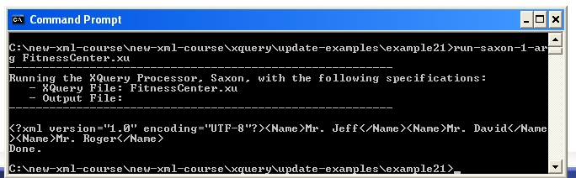
let $source := doc('FitnessCenter.xml')
for $i in $source//Member return
copy $n := $i/Name
modify
replace value of node $n with
concat('Mr. ', data($n))
return $n

Slide 107
let $source := doc('FitnessCenter.xml')
for $i in $source//Member return
copy $n := $i/Name
modify
replace value of node $n with
concat('Mr. ', data($n))
return $n
Make a copy of some nodes
The update primitives in here can only operate on the copied nodes
Do Lab5
see example21

