Slide 1







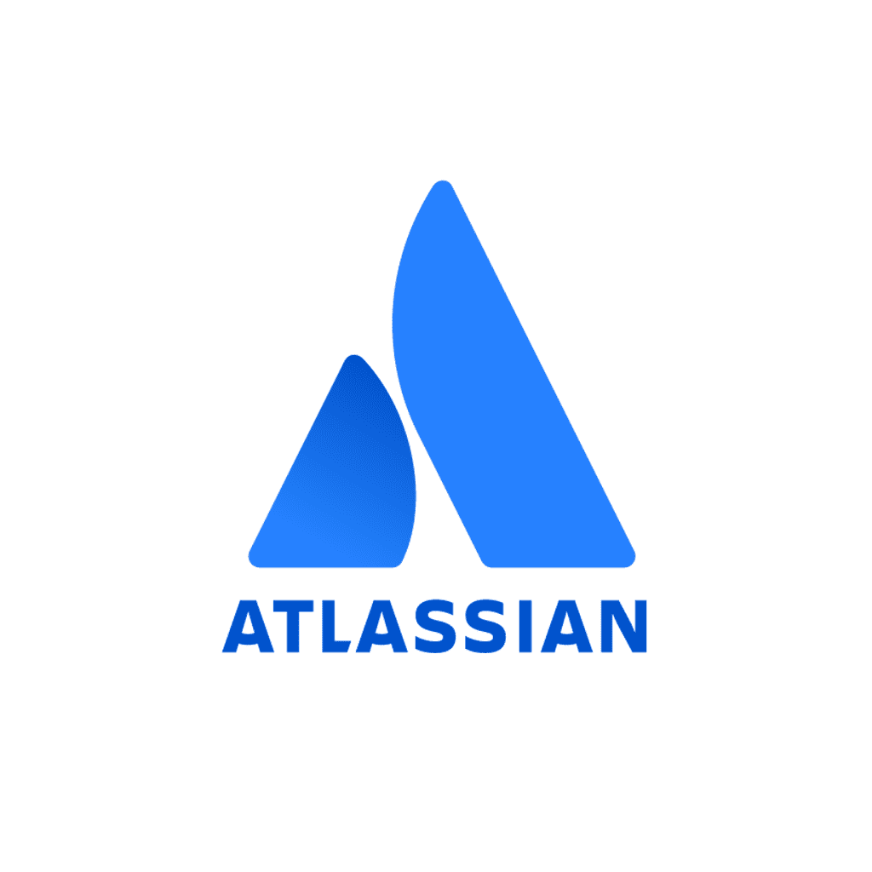



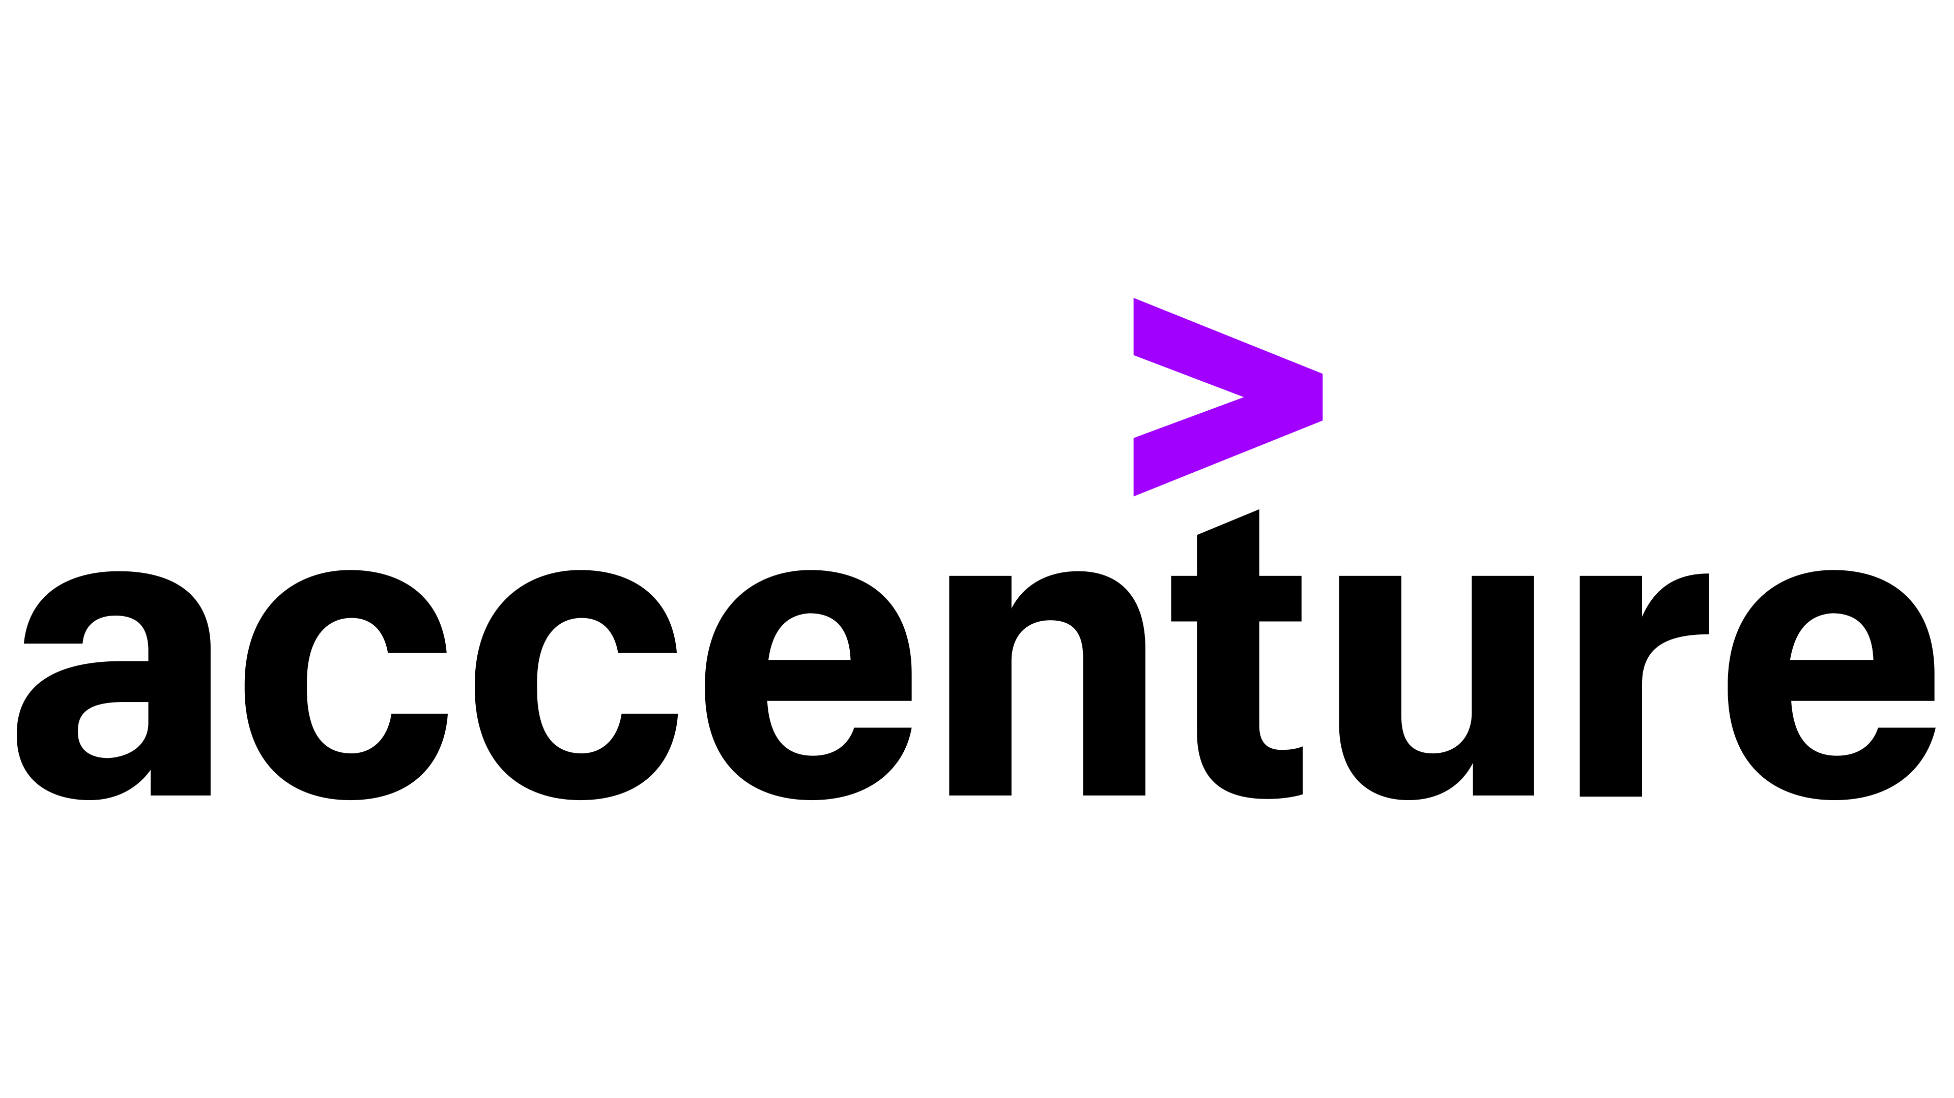
API-first! Contract-first! Make backend development great again!
a.k.a API-first and Contract-first development with Automatic, Agnostic, Fail-fast, API Contract Validation
In the current situation of increased remote working, having an common, easier to understand medium of communication such as an OpenAPI spec document is indispensable.
Things get exciting when this so-called document can serve as a contract, generate clients, servers, documentation, help you build APIs and validate them!
When this OpenAPI document can also:
- Put your developers, clients and client's developers first!
- Have Automatic, Fail-fast, API Contract Validation!
- Be Cross-Platform and Language Agnostic!
- Generate clients, servers, and documentation from OpenAPI specs in a plethora of languages!
- Simplify communication by means of a common document in YAML or JSON!
- Speed up development, prototyping, R&D, etc.!
- Reduce costs! Using contract tests in conjunction with (or as a replacement for) traditional end-to-end integration tests will be cheaper in the long run.
... things get even more interesting... Come at our talk and find out more!
About the speaker:
Currently:
https://github.com/atkuzmanov
https://www.linkedin.com/in/atkuzmanov/
https://twitter.com/atkuzmanov
https://linktr.ee/atkuzmanov https://atkuzmanov.wordpress.com/
Previously:

Slide 2
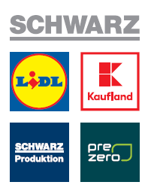

14,65
14,65
a.k.a API-first and Contract-first development with Automatic, Agnostic, Fail-fast, API Contract Validation
In the current situation of increased remote working, having an common, easier to understand medium of communication such as an OpenAPI spec document is indispensable.
Things get exciting when this so-called document can serve as a contract, generate clients, servers, documentation, help you build APIs and validate them!
When this OpenAPI document can also:
- Put your developers, clients and client's developers first!
- Have Automatic, Fail-fast, API Contract Validation!
- Be Cross-Platform and Language Agnostic!
- Generate clients, servers, and documentation from OpenAPI specs in a plethora of languages!
- Simplify communication by means of a common document in YAML or JSON!
- Speed up development, prototyping, R&D, etc.!
- Reduce costs! Using contract tests in conjunction with (or as a replacement for) traditional end-to-end integration tests will be cheaper in the long run.
... things get even more interesting... Come at our talk and find out more!
4,75
API-first!
Contract-first!
Make backend development great again!
About the speaker:
Currently:
https://github.com/atkuzmanov
https://www.linkedin.com/in/atkuzmanov/
https://twitter.com/atkuzmanov
https://linktr.ee/atkuzmanov https://atkuzmanov.wordpress.com/
Previously:
7,83

