Slide 1
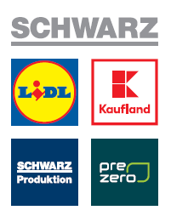


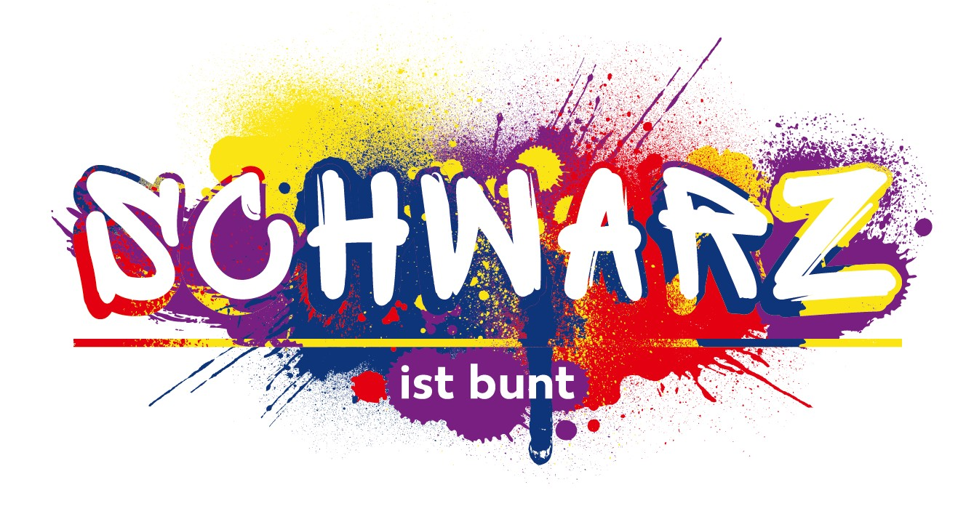




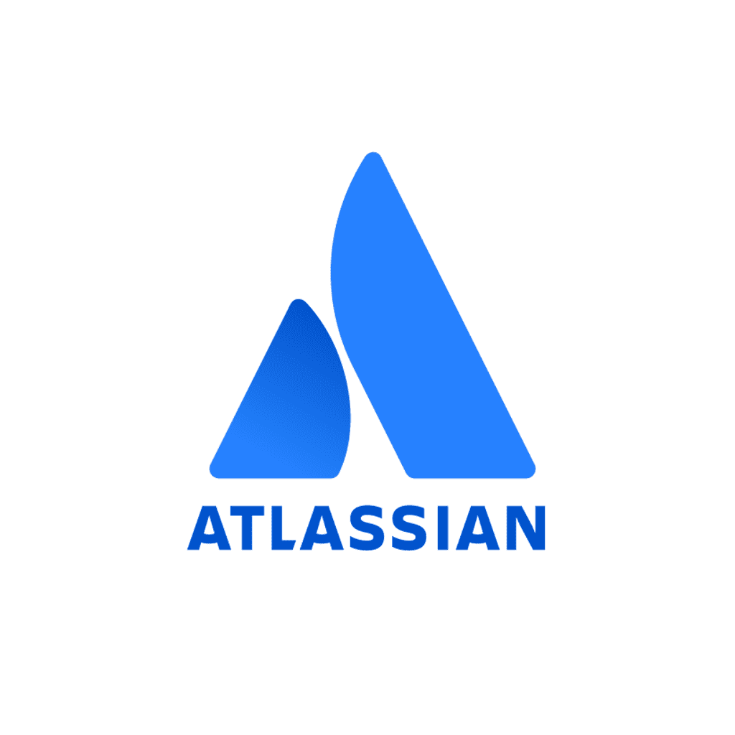


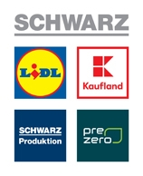



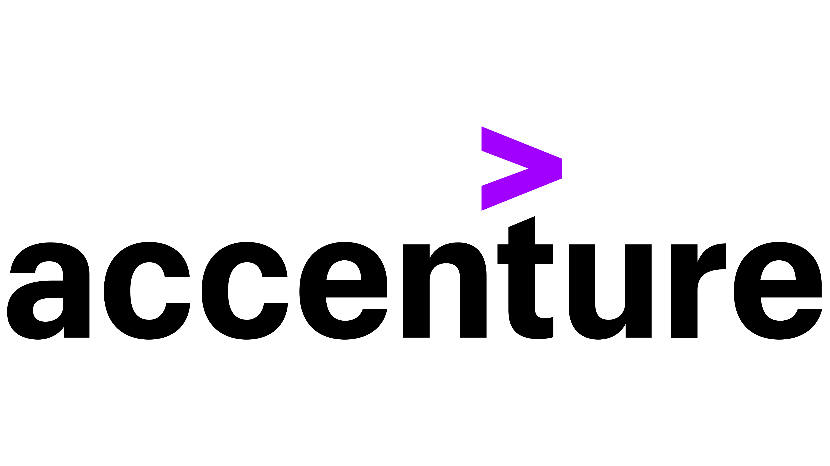
14,65
14,65
a.k.a API-first and Contract-first development with Automatic, Agnostic, Fail-fast, API Contract Validation
In the current situation of increased remote working, having a common, easier to understand medium of communication such as an OpenAPI spec document is indispensable.
Things get exciting when this so-called document can serve as a contract, generate clients, servers, documentation, help you build APIs and validate them!
When this OpenAPI document can also:
- Put your developers, clients and client's developers first!
- Have Automatic, Fail-fast, API Contract Validation!
- Be Cross-Platform and Language Agnostic!
- Generate clients, servers, and documentation from OpenAPI specs in a plethora of languages!
- Simplify communication by means of a common document in YAML or JSON!
- Speed up development, prototyping, R&D, etc.!
- Reduce costs! Using contract tests in conjunction with (or as a replacement for) traditional end-to-end integration tests will be cheaper in the long run.
... things get even more interesting... Come at our talk and find out more!
4,75
API-first!
Contract-first!
Make API development great again!
About the speaker:
Currently:
https://github.com/atkuzmanov
https://www.linkedin.com/in/atkuzmanov/
https://twitter.com/atkuzmanov
https://linktr.ee/atkuzmanov https://atkuzmanov.wordpress.com/
Previously:
7,83

