Slide 1

Better Living Via Automation
Introduction to RODBC & SQL

Slide 2
Realities of Working In Industry
Data Collection often organized around Processes
Order-to-cash, Procure-to-Pay, Inventory, BOM, etc..
Roles often focused on deep analysis of specific domain
Exploratory analysis
Modeling Building / Validation
Tracking / Change Management
The Good: data often aggregated, can do CSV download
Corporate data warehouse (ERP offshoot => dedicated box)
Departmental Systems (MS Access) / Web Platforms
The Bad: CSV generation often manual…
The Ugly: Weaving together a dozen views for a weekly update…
“Manager of Spinning Blue Circles”… grrr…
Is there a faster way?

Slide 3
RODBC
ODBC - Open Database Connectivity
Industry standard API for talking to databases
Supported by most major databases since ‘90’s
Database agnostic
Use SQL (also near standard) to make requests
Platform specific drivers handle implementation details
RODBC – library for tapping into this API

Slide 4
Why Use ODBC?
Data
Local machine
Database Server
Network
All R operations take place in local machine memory
Corporate data stores often contain hundreds of gigabytes to terabytes of information, exceeding capacity of desktops / laptops
ODBC enables one to pre-process / aggregate data on a remote server, sending the query results to the local machine (versus moving all the data first and then processing it locally, as long as the remote database supports the operations defined in an SQL statement passed to it

Slide 5
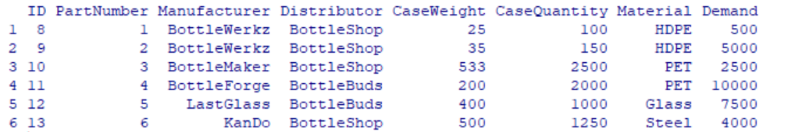
Scripting Database Access
install.packages("RODBC")
library("RODBC")
# connect to database. (Access specific issue: 32 bit vs. 64 bit drivers)
conn <- odbcConnectAccess2007("C:/Users/aioffers/Documents/R Meetup/rodbc/test.accdb")
# create SQL string, use to query database
sqlresult <- SQLQuery("Select * from parts")

Slide 6
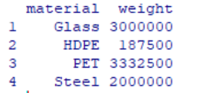
Some Basic SQL – Single Table
sqlresult <- sqlQuery(conn,
"Select material,
sum(demand*caseweight) as weight
from parts
group by material
order by sum(demand*caseweight) desc")
Specific field
Calculated Field
Table name
Aggregation
Sort order (Reverse)

Slide 7
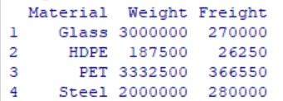
Some Basic SQL – Basic Join
sqlresult <- sqlQuery(conn,
" SELECT parts.Material, Sum([parts]![Demand]*[parts]![CaseWeight]) AS Weight, Sum(([parts]![Demand]*[parts]![CaseWeight])*[Freight]![FreightRate]) AS Freight
FROM Freight INNER JOIN parts ON Freight.Vendor = parts.Distributor
GROUP BY parts.Material;”)
Join Tables
Using Like
Fields

Slide 8
SQL – More Explorations…
Core statements:
Create (“Insert”)
Read (“Select”)
Update
Delete
Access Rights / Roles – Managed At Table Level
Analysts rarely have write access to production…. (and no, you don’t want it…)
If the query runs slow, look at the complexity of joins and # records
Window Functions – Oracle, SQL Server
Ranks, Ranges, Running Totals…
The nicer (Paid) databases have embedded statistical libraries
Push heavy calculations to the database server

Slide 9
Alternative Packages
You might want to mention something about security / credentials here
DBI
Odbc
RMySQL / RMariaDB
Roracle
RSQLite
(and many more…)
Generally takes an afternoon to solve for the connection details at a specific organization
Other Tips
Automate “data conversion”: use meta-data about query results to trigger conversions to appropriate R data types
Cron (and other schedulers)… can easily run at night…
Database writes - remember to commit..
Prototype / Explore in R, push SQL views to web-based reports or Shiny Apps…

