Slide 1
Debugging an R program: Monte Carlo Simulation of Bernoulli Trials
Len Greski March 25, 2021
Level: intermediate

Slide 2

Background
A user on Stackoverflow wanted to calculate coverage probabilities for sets of Bernoulli Trials at varying sample sizes and expected probability values.
Bernoulli Trial:
A random experiment with two possible outcomes where probability of success is the same every time the experiment is conducted
Monte Carlo Method:
A class of computational algorithms that rely on repeated random sampling to obtain numerical results
Coverage Probability:
Proportion of trials of sample size <n> within a confidence interval that contains the true value for the population 95% of the time (for a 95% confidence interval)
Wald Method:
The most commonly presented formula for calculating binomial confidence intervals, calculated as:
Reference: Sauro and Lewis, 2005

Slide 3
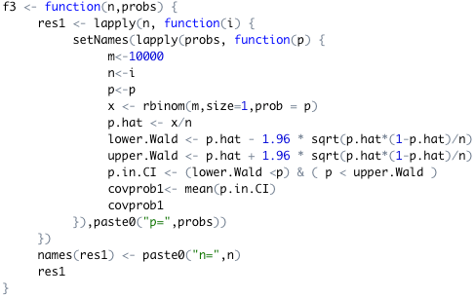
Original solution: runs, but inaccurate results

Slide 4
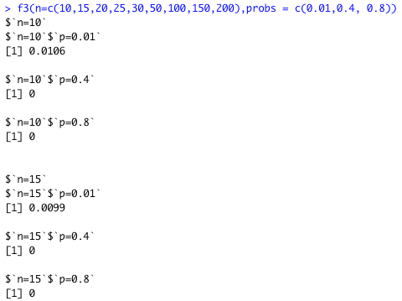
What’s wrong?
All results for expected probability values > 0.01 are zero when they should approach 0.95 as p approaches 0.5

Slide 5
The process
Determine what “fixed” looks like
Build a correct version for a subset of the problem
Isolate the problem in the original code
Refactor the code to eliminate the problem

Slide 6
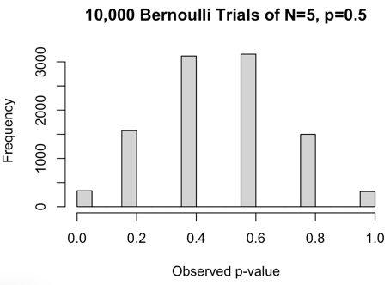
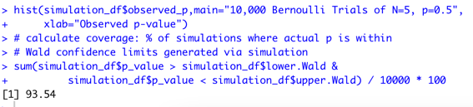
What ”fixed” looks like
A distribution that looks binomial
A coverage percentage close to 1 – alpha (rejection region) in confidence interval

Slide 7
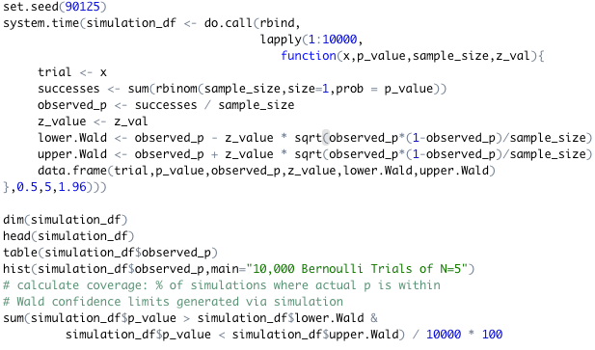
Understanding the problem
Refactoring to use data frames facilitates understanding Use of more descriptive variable names also facilitates understanding We’ll refactor for speed in a subsequent step
Notes:
Here we run 10,000 Bernoulli trials of sample size 5 with an expected probability of 0.5 and a 95% confidence interval. Note that this is going to execute relatively slowly because we are calling rbinom() 10,000 times and it is a slow function.

Slide 8
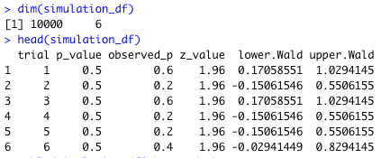
Inspecting intermediate results
Observed p is a proportion with values 0, 0.2, 0.4, 0.6, 0.8, 1.0
Confidence intervals vary by value of observed p

Slide 9
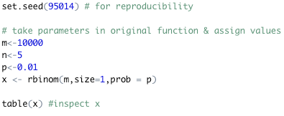



Isolating the problem
We deconstruct the nested apply() functions for a single set of input values and step through the code
The object x is a vector of 10,000 items, each of which is either 1 or 0
The p.hat calculation is also a vector when it should be a single number.
Therefore, all subsequent calculations are in error

Slide 10


An accurate p-value
For an expected p-value of 0.01, an observed p-value of 0.0087 is reasonable
However, this represents 10,000 Bernoulli trials of size 1, which is not what the original developer intended

Slide 11
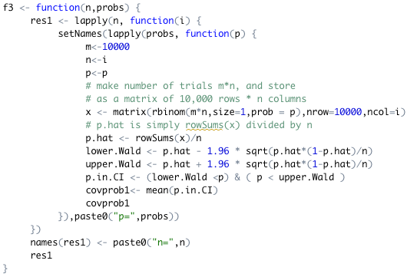
Refactoring to correct solution
Two simple changes
Expand x so each row is a trial of size n and cast result as a matrix() of size m * n
Use rowSums() to calculate p.hat and divide by n, which represents trial size
Resulting solution makes 1 call to rbinom() per iteration of lapply() instead of 10,000

Slide 12
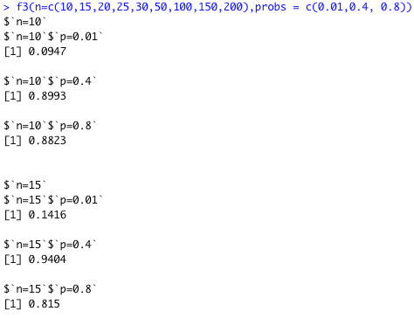
…and the results
The results conform to what we expect to see from a Monte Carlo Simulation of Bernoulli Trials:
Poor coverage at low sample size, extreme values of p
Coverage improves with sample size, values of p approaching 0.5

Slide 13
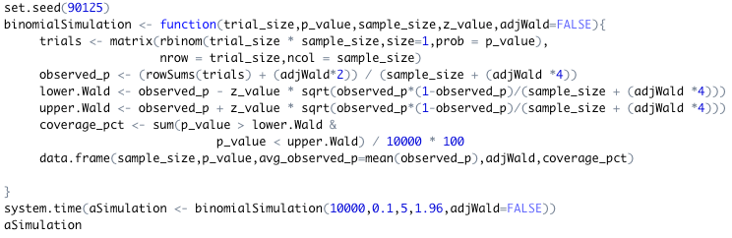

A more sophisticated solution
Use Boolean argument to calculate Adjusted Wald
confidence intervals
Reference: Sauro and Lewis, 2005

Slide 14
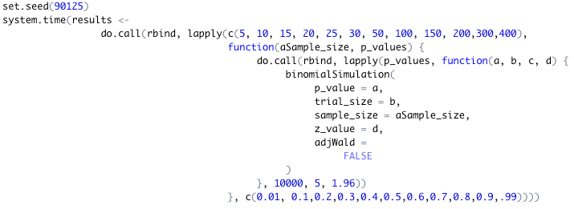

Run 132 Monte Carlo Simulations
12 sample sizes
11 p values
Yes, the 132 simulations ran in under 7 seconds

Slide 15
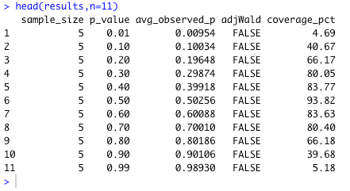
Results for sample_size = 5

Slide 16
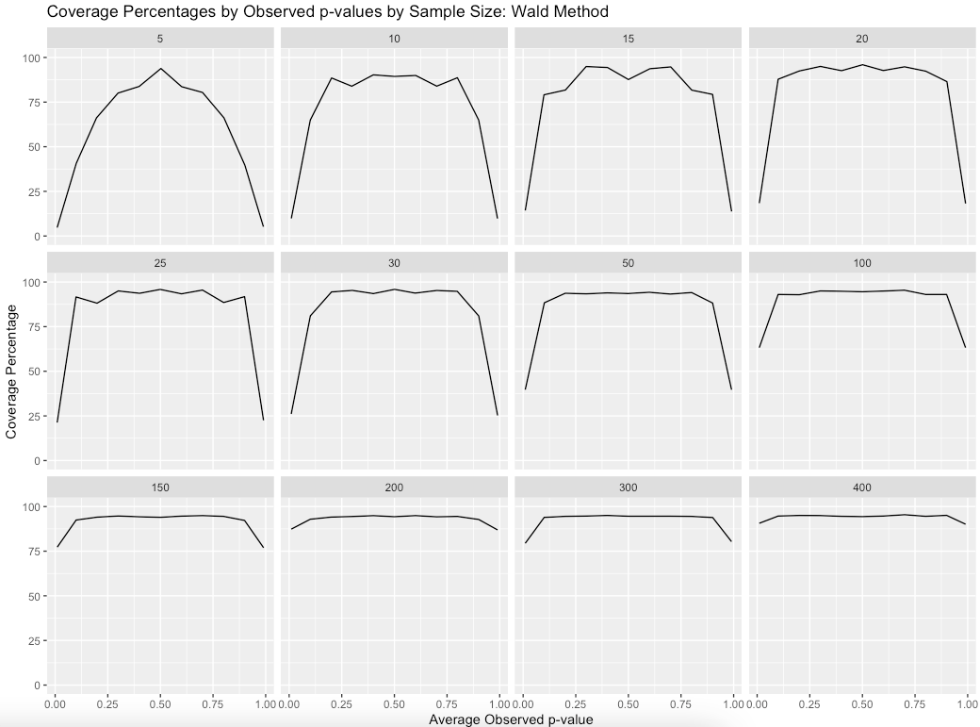

Slide 17
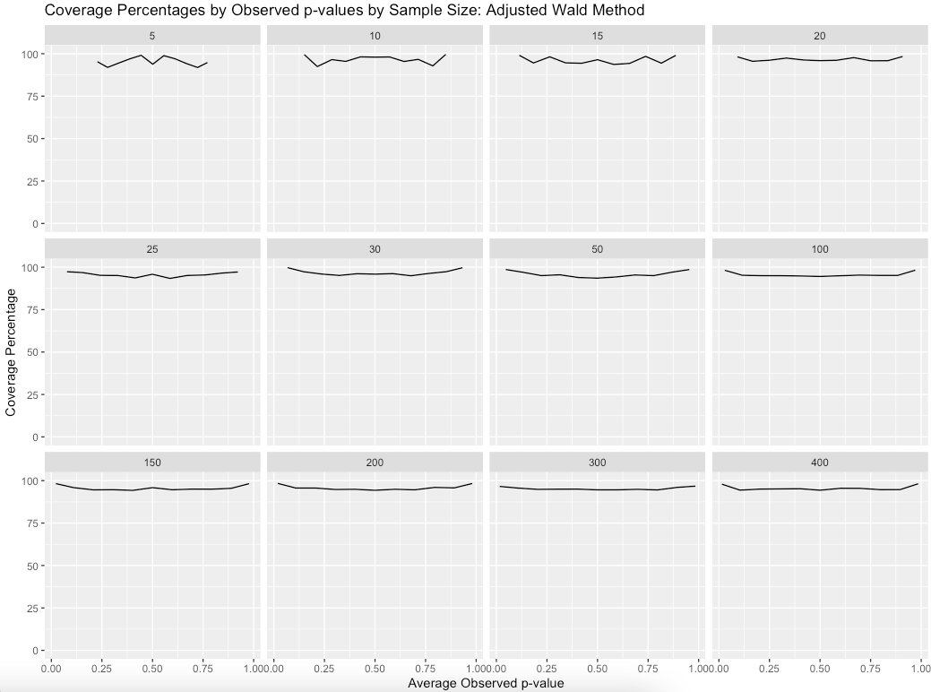
At small sample sizes, observed p has less variability, leading to higher coverage percentages

Slide 18
Q & A

Slide 19
References
Monte Carlo Simulation of Bernoulli Trials (blog article version of this presentation): http://bit.ly/2PicLJN
Coverage probability for confidence interval (Stackoverflow question): https://bit.ly/33l04lC
Estimating Completion Rates from Small Sample Sizes Using Binomial Confidence Intervals, Sauro & Lewis 2005: http://bit.ly/estimatingCoverageRates

Slide 20






About Len
Len Greski currently serves as Principal Consultant at LeadingAgile, the leader in helping large companies generate economic value through agile transformation. Len started his career at Information Resources Inc., developing statistical and AI models to predict consumer behavior. He learned R in 2015 when he needed a way to analyze the value of a software portfolio without spending $9,000 on a copy of SAS. Len has mentored hundreds
of thousands of students in the Johns Hopkins University Data Science Specialization on
Coursera, having served as a Community Mentor since 2015. Len has a top 5% ranking on Stackoverflow.com, where he primarily answers questions about R.
len@greskilabs.com
lgreski
atl-r-users/communications – repository where tonight’s code and presentation are stored
lgreski
Data Science Depot blog: https://lgreski.github.io/datasciencedepot/

